Slide 1
Process Management

Slide 2
Topics
Process concept
Process scheduling
Operations on processes
Inter-process communication

Slide 3
Process Concept
An operating system executes a variety of programs that run as a process.
Process – a program in execution
Process has multiple parts
The program code, also called text section
Current activity including program counter, processor registers

Slide 4
Stack containing temporary data
Function parameters, return addresses, local variables
Data section containing global variables
Heap containing memory dynamically allocated during run time
Program is passive entity stored on disk (executable file); process is active
Program becomes process when an executable file is loaded into memory

Slide 5
Execution of program started via GUI mouse clicks, command line entry of its name, etc.
One program can be several processes
Consider multiple users executing the same program

Slide 6
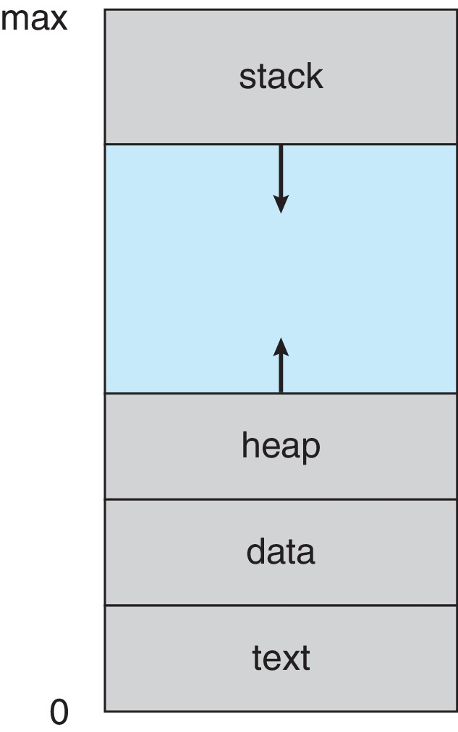
Process in Memory

Slide 7
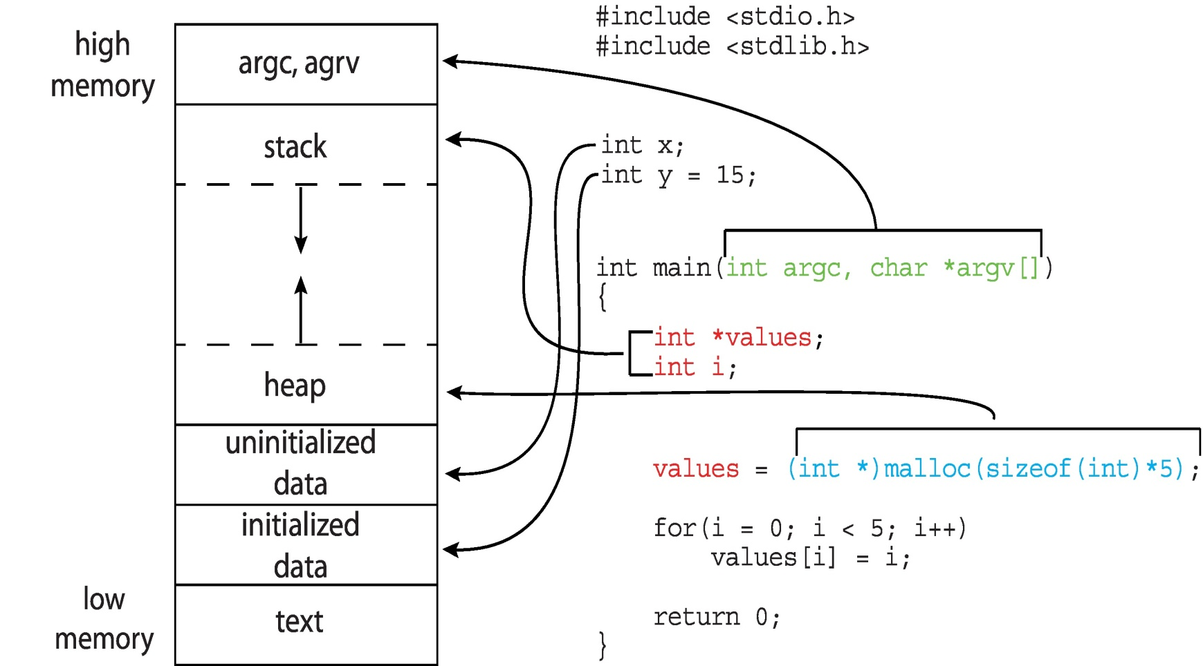
Memory Layout of a C program

Slide 8
Process state
As a process executes, it changes state
New: The process is being created
Running: Instructions are being executed
Waiting: The process is waiting for some event to occur
Ready: The process is waiting to be assigned to a processor
Terminated: The process has finished execution

Slide 9
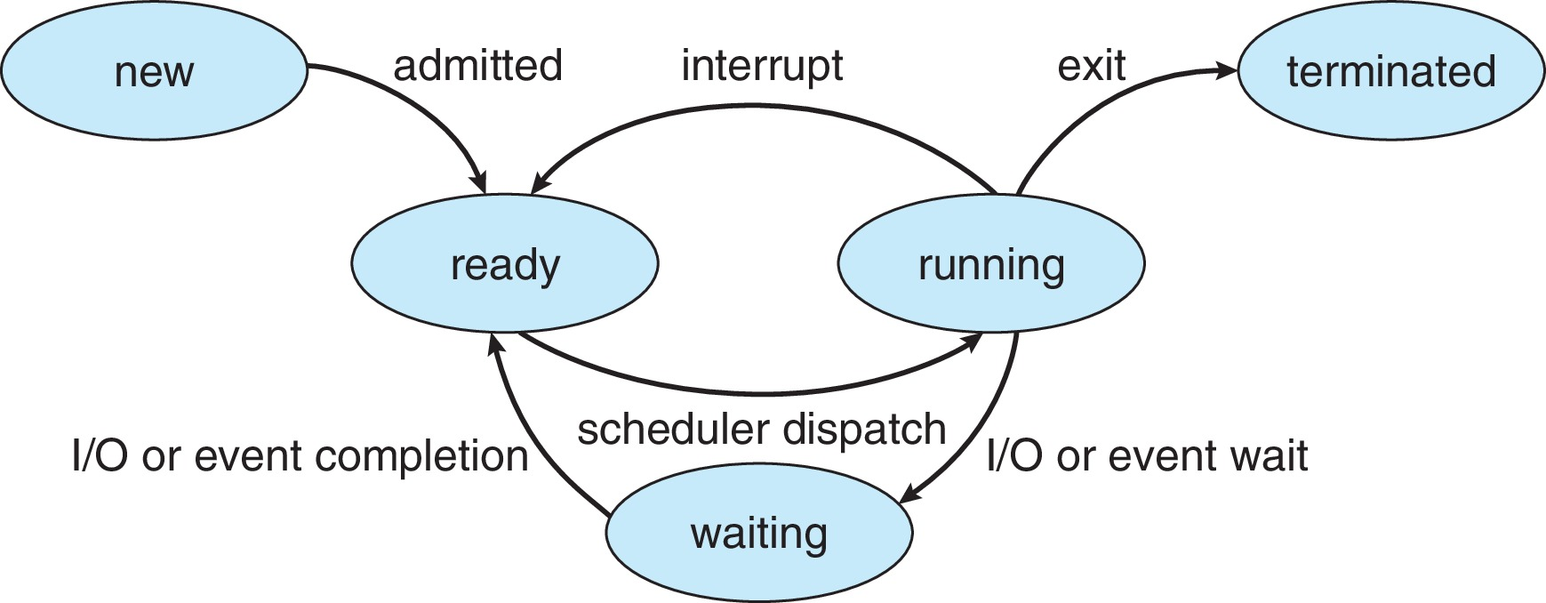
Diagram of Process State

Slide 10
Process Control Block
Each process is represented in the operating system by a process control block (PCB)
It also called a task control block.
It contains many pieces of information associated with a specific process, including these:
Process state: The state may be new, ready, running, waiting, halted, and so on
Program counter: The counter indicates the address of the next instruction to be executed for this process.

Slide 11
CPU registers: The registers vary in number and type, depending on the computer architecture. They include
accumulators, index registers, stack pointers, and general-purpose registers, plus any condition-code information.
CPU-scheduling information. This information includes a process priority, pointers to scheduling queues, and any other scheduling parameters.
Memory-management information. This information may include such items as the value of the base and limit registers and the page tables, or the segment tables, depending on the memory system used by the operating system

Slide 12
Accounting information: This information includes the amount of CPU and real time used, time limits, account numbers, job or process numbers, and so on
I/O status information. This information includes the list of I/O devices allocated to the process, a list of open files, and so on.
In brief, the PCB simply serves as the repository for all the data needed to start, or restart, a process, along with some accounting data

Slide 13
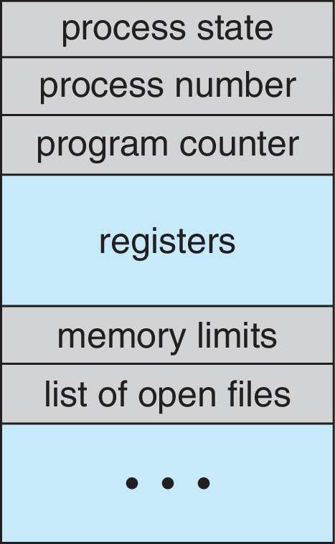
PCB

Slide 14
Threads
The process model discussed so far has implied that a process is a program that performs a single thread of execution
For example, when a process is running a word-processor program, a single thread of instructions is being executed
This single thread of control allows the process to perform only one task at a time
Thus, the user cannot simultaneously type in characters and run the spell checker.

Slide 15
Most modern operating systems have extended the process concept to allow a process to have multiple threads of execution and thus to perform more than one task at a time.
This feature is especially beneficial on multicore systems, where multiple threads can run in parallel.
A multithreaded word processor could, for example, assign one thread to manage user input while another thread runs the spellchecker.
On systems that support threads, the PCB is expanded to include information for each thread.

Slide 16
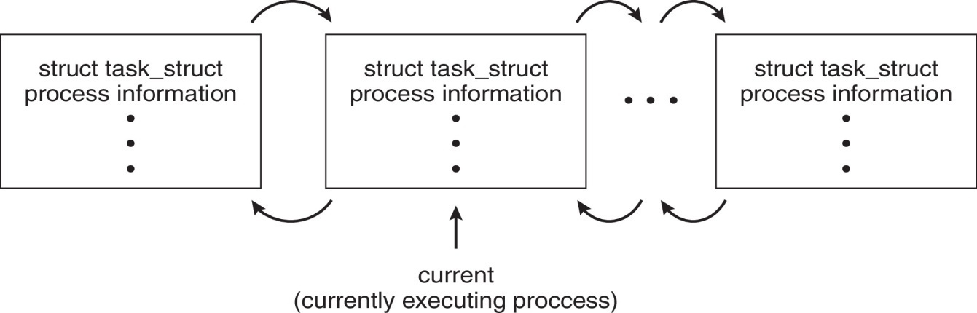
Process Representation in Linux
Represented by the C structure task_struct
pid t_pid; /* process identifier */ long state; /* state of the process */ struct sched entity se; /* scheduling information */ struct task_struct *parent; /* this process’s parent */ struct list_head children; /* this process’s children */ struct files_struct *files; /* list of open files */ struct mm_struct *mm; /* address space of this process */

Slide 17
The process control block in the Linux operating system is represented by the C structure task_struct
task_struct is found in the <include/linux/sched.h> include file in the kernel source-code directory.
This structure contains
state of the process
scheduling and memory-management information
list of open files
pointers to the process’s parent
a list of its children and siblings.

Slide 18
Process Scheduling
The objective of multiprogramming is to have some process running at all times so as to maximize CPU utilization.
The objective of time sharing is to switch a CPU core among processes so frequently that users can interact with each program while it is running.
To meet these objectives, the process scheduler selects an available process (possibly from a set of several available processes) for program execution on a core.

Slide 19
Each CPU core can run one process at a time
For a system with a single CPU core, there will never be more than one process running at a time
whereas a multicore system can run multiple processes at one time.
If there are more processes than cores, excess processes will have to wait until a core is free and can be rescheduled.
The number of processes currently in memory is known as the degree of multiprogramming.

Slide 20
Balancing the objectives of multiprogramming and time sharing also requires taking the general behaviour of a process into account.
In general, most processes can be described as either
I/O bound or CPU bound.
An I/O-bound process is one that spends more of its time doing I/O than it spends doing computations.
A CPU-bound process, in contrast, generates I/O requests infrequently, using more of its time doing computations

Slide 21
Scheduling Queues
Maintains scheduling queues of processes
Ready queue – set of all processes residing in main memory, ready and waiting to execute
Wait queues – set of processes waiting for an event (i.e., I/O)
Processes migrate among the various queues

Slide 22
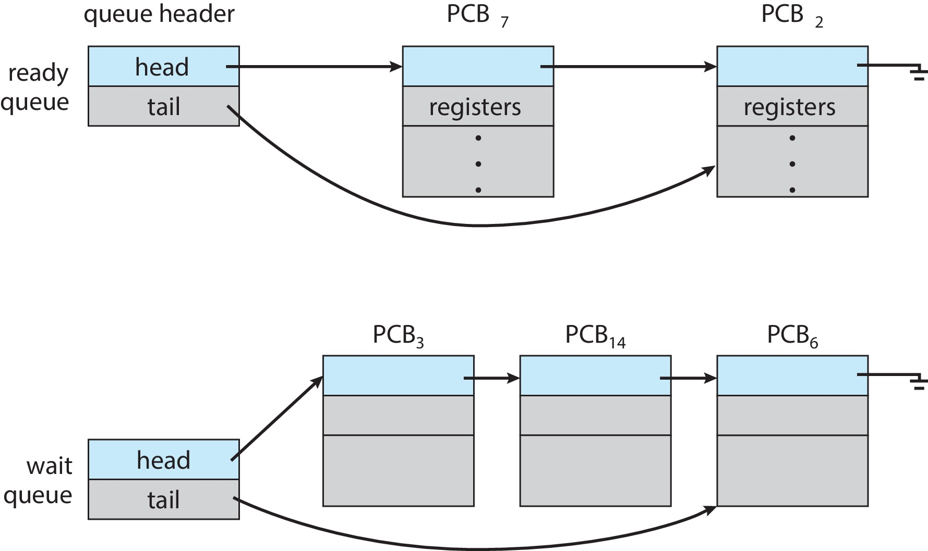
Ready and Wait Queues

Slide 23
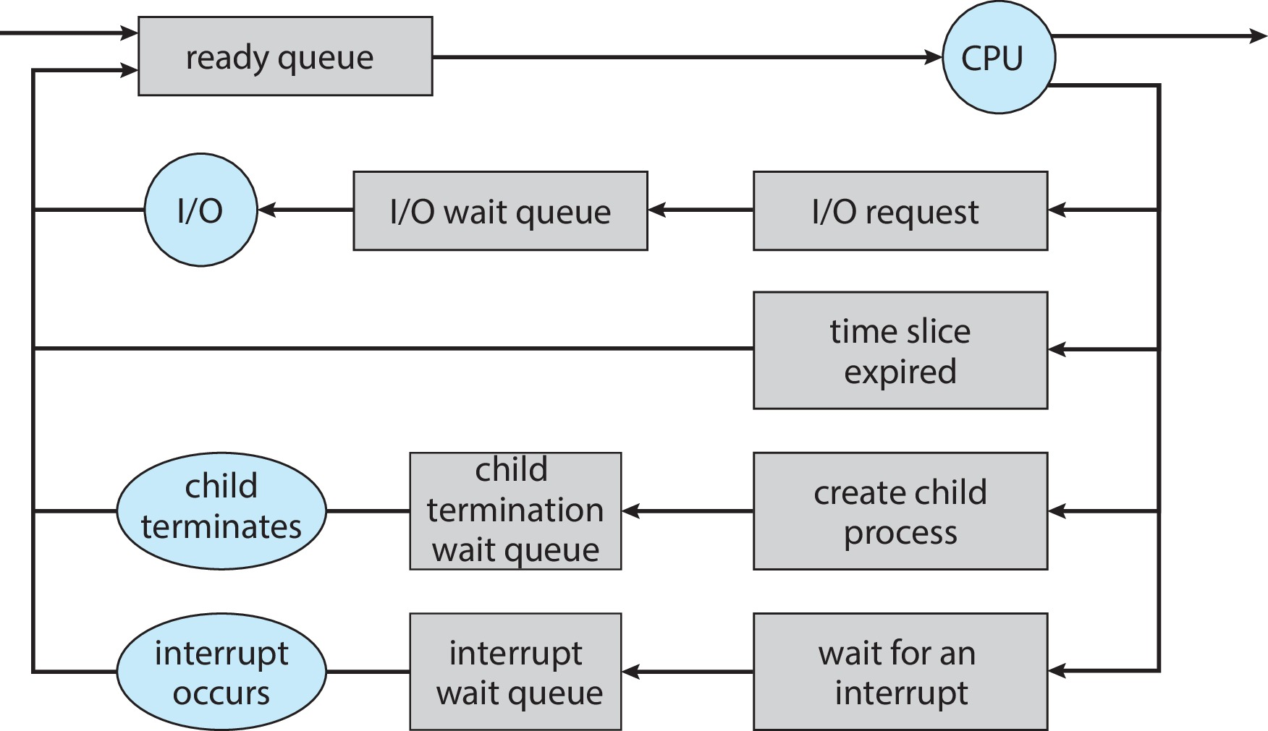
Representation of Process Scheduling

Slide 24
The circles represent the resources that serve the queues, and the arrows indicate the flow of processes in the system
A new process is initially put in the ready queue.
It waits there until it is selected for execution, or dispatched. Once the process is allocated a CPU core and is executing, one of several events could occur:
The process could issue an I/O request and then be placed in an I/O wait queue
The process could create a new child process and then be placed in a wait queue while it awaits the child’s termination

Slide 25
The process could be removed forcibly from the core, as a result of an interrupt
having its time slice expire and be put back in the ready queue.
A process continues this cycle until it terminates, at which time it is removed from all queues and has its PCB and resources deallocated.

Slide 26
CPU Scheduling
A process migrates among the ready queue and various wait queues throughout its lifetime
The role of the CPU scheduler is to select from among the processes that are in the ready queue and allocate a CPU core to one of them
The CPU scheduler must select a new process for the CPU frequently

Slide 27
The CPU scheduler executes at least once every 100 milliseconds, although typically much more frequently
Some operating systems have an intermediate form of scheduling known as swapping
Here key idea is that sometimes it can be advantageous to remove a process from memory and thus reduce the degree of multiprogramming
Later, the process can be reintroduced into memory and its execution can be continued where it left off

Slide 28
Context Switch
When CPU switches to another process, the system must save the state of the old process and load the saved state for the new process via a context switch
When an interrupt occurs, the system needs to save the current context of the process running on the CPU core so that it can restore that context when its processing is done, essentially suspending the process and then resuming it
Context of a process represented in the PCB

Slide 29
Context-switch time is pure overhead; the system does no useful work while switching
The more complex the OS and the PCB ➔ the longer the context switch
Highly dependent on hardware support
Some hardware provides multiple sets of registers per CPU
A typical speed is a several microseconds

Slide 30
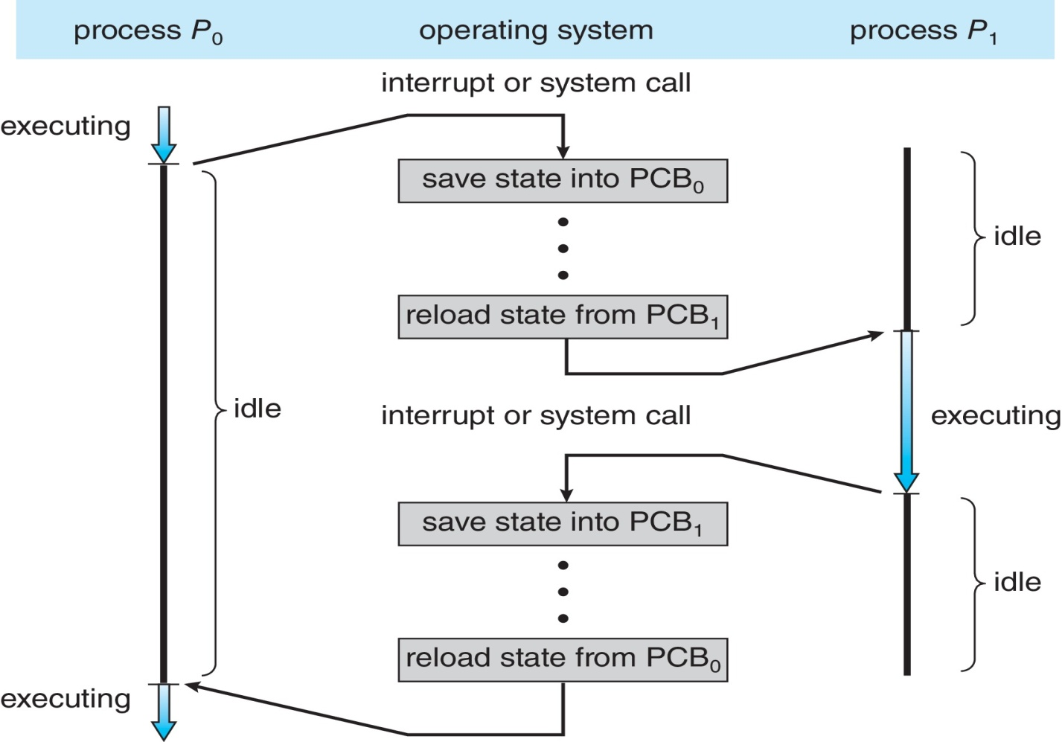
CPU Switch From Process to Process

Slide 31
Operations on Processes
Operating System must provide mechanisms for:
Process creation
Process termination

Slide 32
Process Creation
Parent process create children processes, which, in turn create other processes, forming a tree of processes
Most operating systems (including UNIX, Linux, and Windows) identify processes according to a unique process identifier (or pid), which is typically an integer number.
The pid provides a unique value for each process in the system, and it can be used as an index to access various attributes of a process within the kernel.

Slide 33
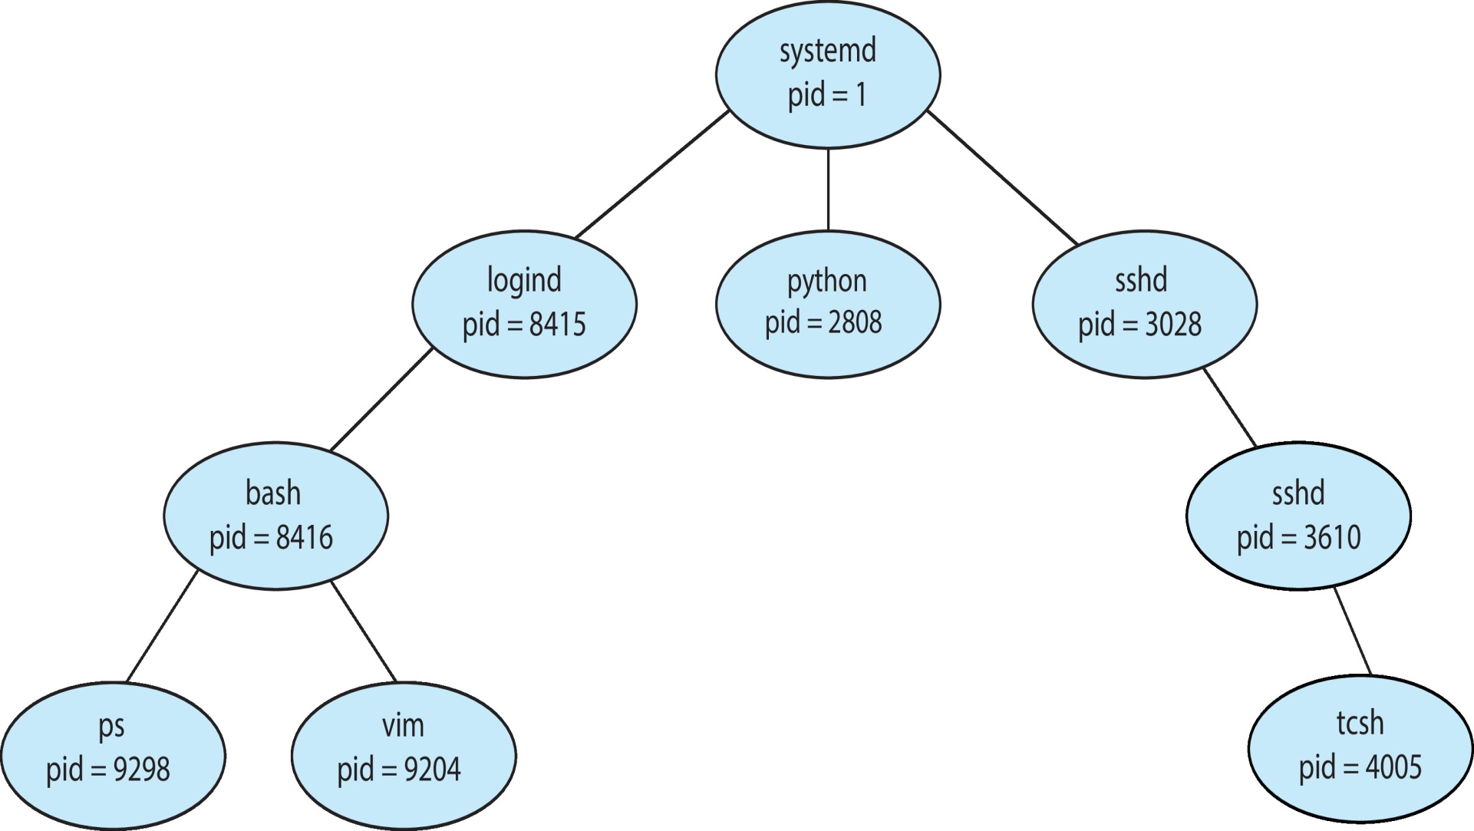
Tree of processes in Linux

Slide 34
Resource sharing options
Parent and children share all resources
Children share subset of parent’s resources
Parent and child share no resources
Execution options
Parent and children execute concurrently
Parent waits until children terminate
Address space
Child duplicate of parent
Child has a program loaded into it

Slide 35
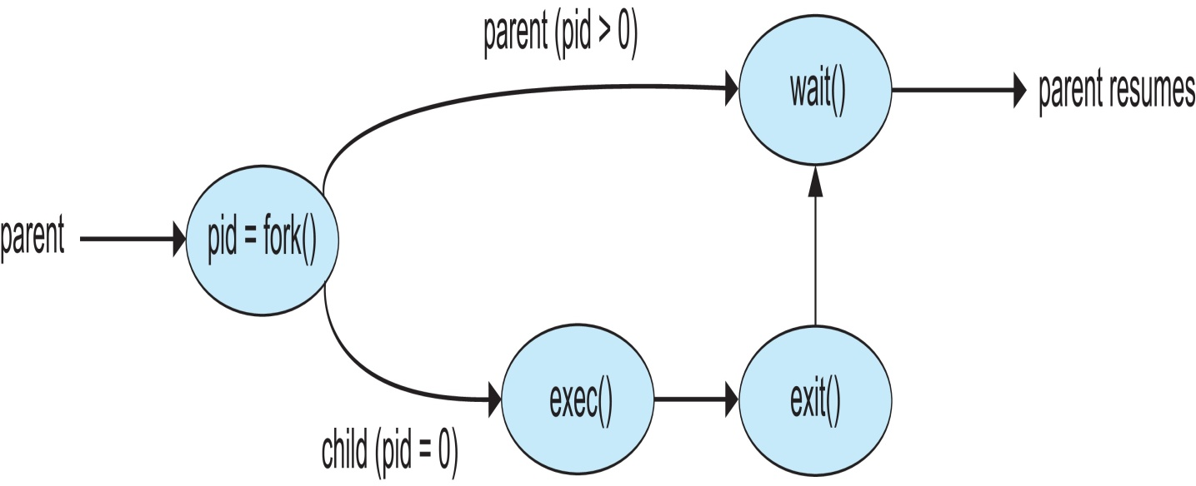
UNIX examples
fork() system call creates new process
exec() system call used after a fork() to replace the process’ memory space with a new program
Parent process calls wait()waiting for the child to terminate

Slide 36
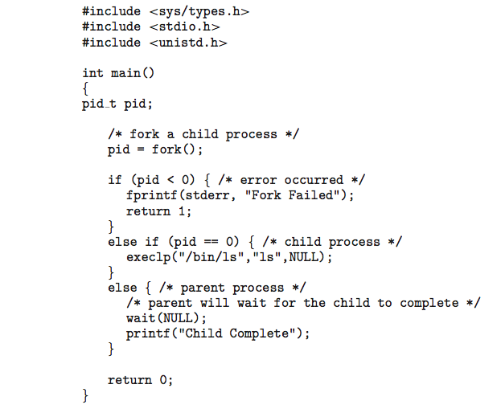
C Program Forking Separate Process

Slide 37
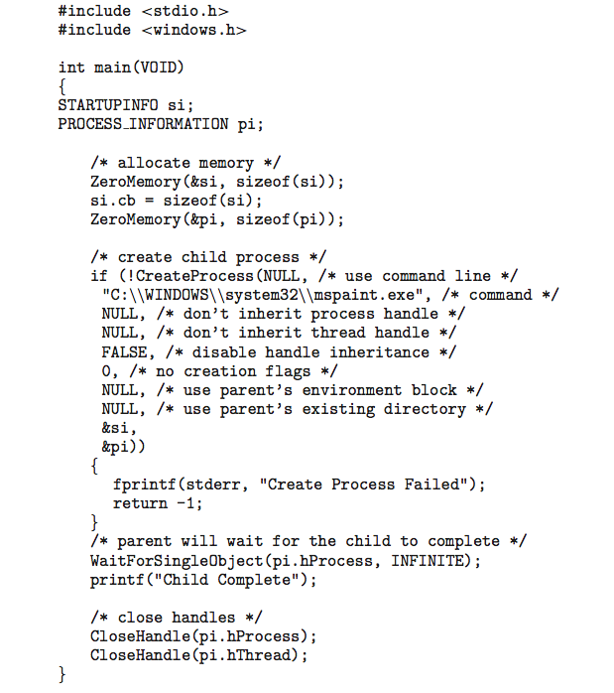
Creating a Separate Process via Windows API

Slide 38
Process Termination
Process executes last statement and then asks the operating system to delete it using the exit() system call.
Returns status data from child to parent (via wait() system call)
Process’ resources like physical and virtual memory, open files, I/O buffers are deallocated and reclaimed by the operating system
Parent may terminate the execution of children processes using the abort() system call. Some reasons for doing so:
Child has exceeded allocated resources
Task assigned to child is no longer required

Slide 39
The parent is exiting, and the operating systems does not allow a child to continue if its parent terminates
Some operating systems do not allow child to exists if its parent has terminated.
If a process terminates, then all its children must also be terminated.
cascading termination. All children, grandchildren, etc., are terminated.
The termination is initiated by the operating system.
A parent process may wait for the termination of a child process by using the wait() system call.

Slide 40
The call returns status information and the pid of the terminated process
pid = wait(&status);
A process that has terminated, but whose parent has not yet called wait(), is known as a zombie process.
All processes transition to this state when they terminate, but generally they exist as zombies only briefly.
Once the parent calls wait(), the process identifier of the zombie process and its entry in the process table are released

Slide 41
If parent terminated without invoking wait(), process is an orphan
Traditional UNIX systems addressed this scenario by assigning the init process as the new parent to orphan processes
The init process periodically invokes wait(),there by allowing the exit status of any orphaned process to be collected and releasing the orphan’s process identifier and process-table entry
Linux allows systemd or processes other than systemd to inherit orphan processes and manage their termination.

Slide 42
Android Process Importance Hierarchy
Mobile operating systems often have to terminate processes to reclaim system resources such as memory.
From most to least important:
Foreground process
Visible process
Service process
Background process
Empty process
Android will begin terminating processes that are least important

Slide 43
Inter Process Communication
Processes within a system may be independent or cooperating
A process is independent if it does not share data with any other processes executing in the system
A process is cooperating if it can affect or be affected by the other processes executing in the system.
Clearly, any process that shares data with other processes is a cooperating process.

Slide 44
There are several reasons for providing an environment that allows process cooperation:
Information sharing: Since several applications may be interested in the same piece of information (for instance, copying and pasting), we must provide an environment to allow concurrent access to such information
Computation speed up: If we want a particular task to run faster, we must break it into subtasks, each of which will be executing in parallel with the others
Modularity: We may want to construct the system in a modular fashion, dividing the system functions into separate processes or threads

Slide 45
Cooperating processes need inter process communication (IPC) mechanism
Two fundamental models of IPC are:
Shared memory
Message passing
Shared Memory
In the shared-memory model, a region of memory that is shared by the cooperating processes is established.
Processes can then exchange information by reading and writing data to the shared region

Slide 46
Shared memory can be faster than message passing, since message-passing systems are typically implemented using system calls and thus require the more time-consuming task of kernel intervention.
In shared-memory systems, system calls are required only to establish shared memory regions.
Once shared memory is established, all accesses are treated as routine memory accesses, and no assistance from the kernel is required

Slide 47
Message Passing
In the message-passing model, communication takes place by means of messages exchanged between the cooperating processes
Message passing is useful for exchanging smaller amounts of data, because no conflicts need be avoided.
Message passing is also easier to implement in a distributed system than shared memory

Slide 48
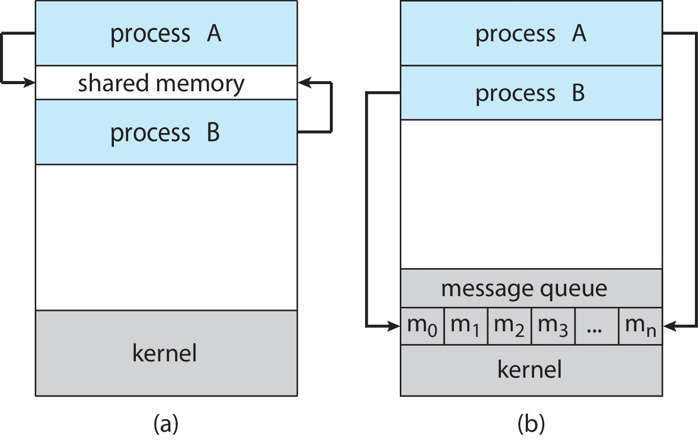
Communications Models
(a) Shared Memory (b) Message Passing

