Slide 1
Project Title
Predicting ticket prices for Big Mountain resort

Slide 2
Problem Identification
Big Mountain Resort, a ski resort located in Montana offers spectacular views of Glacier National Park and Flathead National Forest, with access to 105 trails. Every year about 350,000 people ski or snowboard at Big Mountain. This mountain can accommodate skiers and riders of all levels and abilities. Big Mountain Resort has recently installed an additional chair lift to help increase the distribution of visitors across the mountain which increased their operating costs by $1,540,000 this season. Management wants to monitor the ticket price either by cost cut and without having to reduce ticket prices or improve their offering so that they can increase their ticket prices even more.
The criteria for success is: Capitalizing on the facilities and adjusting ticket prices to reduce operating costs.
Constraints within Solution Space:
Not capitalizing their facilities
Basing their pricing on just the market average
Not reducing the ticket price and charging premium above the average price of resorts in its market segment.

Slide 3
Problem Identification
Stakeholders to provide key insight:
Jimmy Blackburn (Director of Operations),
Alesha Eisen(Database Manager),
Key data sources: The data is loaded in the metadata to guide in identifying the important columns needed to complete this project.
Specific user level access granted to a SQL database or an S3 bucket

Slide 4
Recommendation and key findings
The actual price for Big Mountain Resort is $81.0, but modelling suggests a ticket price of $97.85, which suggests there is still room to increase the ticket prices, given big mountains strong facilities offerings. But increasing ticket prices by $16.85 doesn’t seem suitable. Rather we can expect the ticket price to be increase by $5-$7 making the ticket price somewhere between $85-$87 would be a better choice and it will cover the cost of new chair lift and will be in market competition too.
The data focused only on ticket price for modelling ticket price. This could lead to lack of information from other factors, such as maintenance costs, staff expenses and some other notable factors. We had information on operating costs of the new chair lift, but some other information cost such as maintenance cost, food and beverages supply and/or staff expenses would be useful in modelling the ticket prices here.
Yes, Big Mountain's modelled ticket price is 97.85 which seems pretty high than its actual price which is 81.0. This could be due to whether big mountain is undervaluing its offerings or they are not focusing on features where customers want to pay more. To decide a profitable ticket price without losing market competitiveness we can discuss with stake holders and/or compare price with other big-league resorts. To make this model we can create an interactive dashboard for stakeholders or business leaders giving proper documentation where they can input and see the changes in features according to the trend.

Slide 5
Modeling results and analysis
Model Preprocessing with feature engineering:
We divided the data into 70/30 ratio of train and test splits to evaluate model performance.
We calculated coefficient of determination, mean absolute error, mean squared error from sklearn metrics.
We imputed missing values with median and mean.
Introducing pipeline for linear regression model which performs all the steps from replacing missing values, scaling the data to zero mean and unit variance and training a linear regression model.
We used a Random Forest Regressor as the final model after testing Linear Regression. Preprocessing included scaling, PCA for visualization, and mean imputation. The random forest model has a lower cross-validation mean absolute error by almost $1. It also exhibits less variability.

Slide 6
Modeling results and analysis
Algorithms used to build the model with evaluation metric:
Algorithm used to build the models was defining the pipelines which performs the following steps:
replace missing values with the median for each feature
scale the data to zero mean and unit variance
train a linear regression model/random forest regressor
The following models were trained, cross-validated, and evaluated using Mean Absolute Error (MAE) as the primary metric.

Slide 7
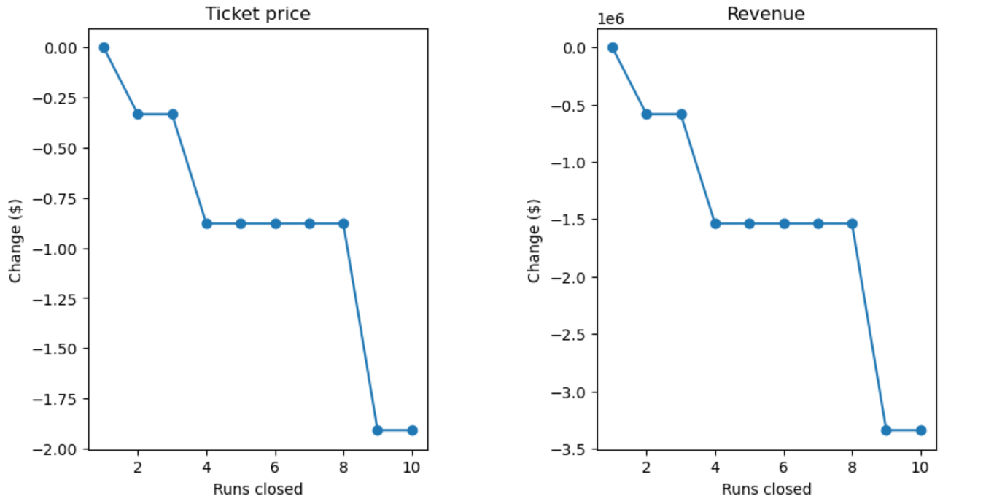
Modeling results and analysis

Slide 8
Modeling results and analysis
Winning model and scenario modelling:
Modelled Price for Big Mountain: $97.85, but the actual Price: $81.00. This significant gap suggests the resort is underpriced by ~$17, despite having superior facilities.
Big Mountain was reviewing some potential scenarios for either cost cuttings or increasing revenues which were:
Permanently closing down up to 10 of the least used runs. This doesn't impact any other resort statistics: According to the model, if they close more than one run this will reduce ticket price, which could mean a revenue loss.
Increase the vertical drop by adding a run to a point 150 feet lower down but requiring the installation of an additional chair lift to bring skiers back up, without additional snow making coverage: This scenario increases support for ticket price by $2.36. Over the season, this could be expected to amount to $4136364
Same as number 2, but adding 2 acres of snow making cover: This gives the same profit as given by scenario 2.
Increase the longest run by 0.2 mile to boast 3.5 miles length, requiring an additional snow making coverage of 4 acres: This scenario makes no difference in profit at all.

Slide 9
Summary and conclusion
Conclusion and Future scope of work
The data focused only on ticket price for modelling ticket price. This could lead to lack of information from other factors, such as maintenance costs, staff expenses and some other notable factors. We had information on operating costs of the new chair lift, but some other information cost such as maintenance cost, food and beverages supply and/or staff expenses would be useful in modelling the ticket prices here.
Yes, Big Mountain's modelled ticket price is 97.85 which seems pretty high than its actual price which is 81.0. This could be due to whether big mountain is undervaluing its offerings or they are not focusing on features where customers want to pay more. To decide a profitable ticket price without losing market competitiveness we can discuss with stake holders and/or compare price with other big-league resorts. To make this model we can create an interactive dashboard for stakeholders or business leaders giving proper documentation where they can input and see the changes in features according to the trend.

