Slide 1
Table of Contents
Introduction
Raw Materials for cement production
Main steps in cement production
Portland Cement Process
Cement Industry in Nepal

Slide 2
Introduction
Cement is an extremely fine material having adhesive and cohesive properties which provides a binding medium for the discrete ingredients. It is a binder, a substance used for construction that sets, hardens, and adheres to other materials to bind them together. They are not very water-soluble and so are quite durable in water and safe from chemical attacks. Cement mixed with fine aggregate produces mortar for masonry, or with sand and gravel, produces concrete.

Slide 3
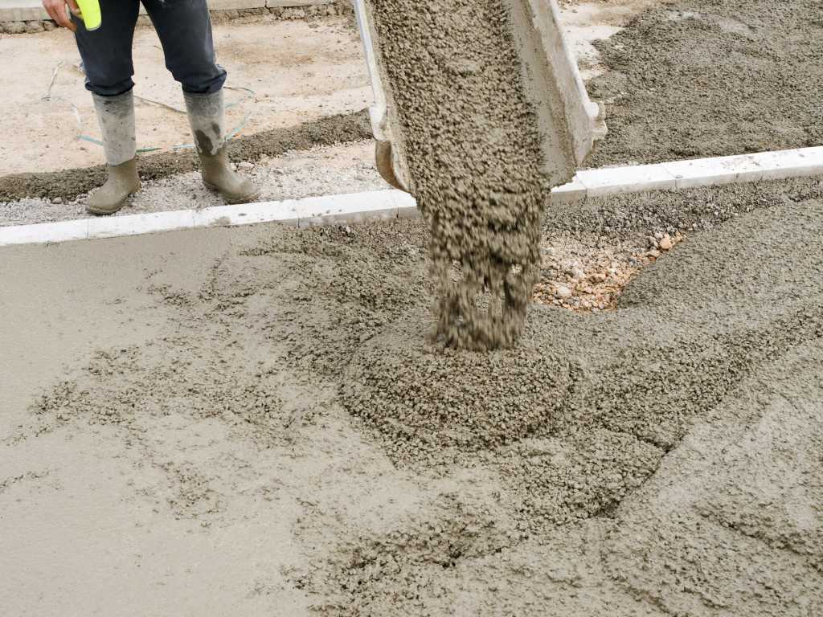
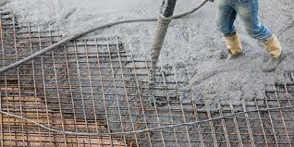
Terms and their Definitions :
Mortar : It is the combination of cement , fine sand , water and lime used for binding bricks or stones together during construction.
Concrete: Concrete is the most widely used material in existence and is behind only water as the planet’s most-consumed resource. It is capable of bonding constructional materials like sand, stones, bricks, buildings, blocks and many more. The principal constituents of cement are the compounds of calcium, aluminium and silicon. Cement containing calcium is called calcareous whereas containing aluminium and silicon is called argillaceous. Cement has a unique property of setting and hardening of calcareous and argillaceous material underwater by virtue of certain chemical reactions.
Reinforced Concrete (RCC) : It is concrete in which steel reinforcements is added so that both materials act together to withstand high stresses.

Slide 4
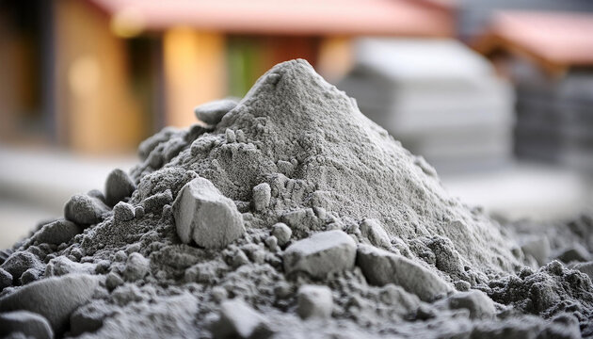
Uses of Cement:
In making concrete for buildings , bridges , dams and roads
In preparing mortar for joining bricks and stones .
For plastering and flooring of walls and surfaces.
In water-proofing works and repair of cracks

Slide 5
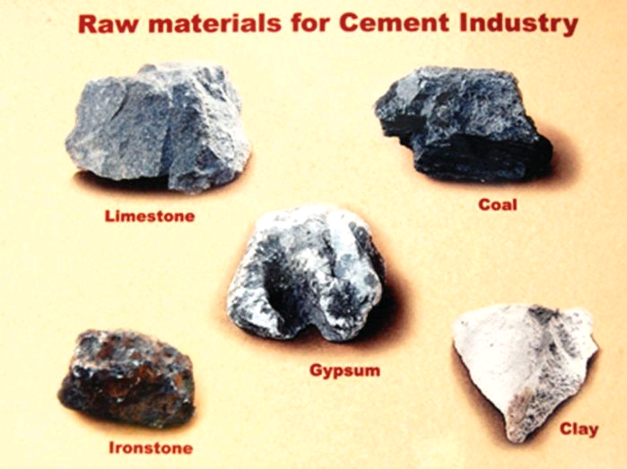
Raw materials for cement production
Basic raw materials to manufacture cement are :
Calcerous materials : These materials supply lime . For eg : limestone , chalk , clay/marl , cement rock etc . [Contributes 85% if clinkers]
Argillaceaus materials : These supply silica (SiO₂) , aluminates(Al₂O₃) and iron oxides (Fe₂O₃). For eg: clay , shale , ashes etc . [Contibutes <15% of clinker]
Gypsum(CaSO₄.2H₂O) : It regulates the setting time of cement and is especially used for resulting receiving water content . It doesnt contribute in the clinker formation.

Slide 6
Major limestone depositing area in Nepal
Okhre(Makwanpur)
Chovar(Kathmandu)
Bhattedada(Lalitpur)
Nirapani and SupaKhola (Arghakhanchi)
Galtar(Udayapur)
Diyarigad(Baitadi)

Slide 7
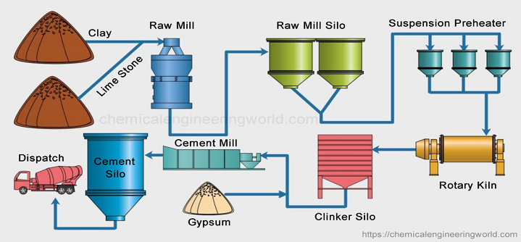
Main Steps in Cement Production

Slide 8
Crushing: The raw materials are extracted from quarries by blasting, drilling or ripening using heavy machinery. The raw materials are then crushed in a rotating cylindrical ball or tube mill. The ores are crushed first to 6 inches and reduced them by a secondary crusher or hammer mill to 3 inches.
Grinding: : The crushed ore is mixed either in dry or wet ways is then grounded and then made homogeneous by means of compressed gas in a grinding mill. The resulting material is known as slurry having 35-40 % water.
Heating: Slurry is then introduced in a rotary with the help of a conveyor. The rotary kiln consists of a large cylinder, 8 to 10 feet in diameter and a height of 300-500 feet. It is made of steel and lined with firebricks. In a rotary kiln, the slurry is passed through different zones of temperature. The whole process in the kiln is completed in 2 to 3 hours.

Slide 9
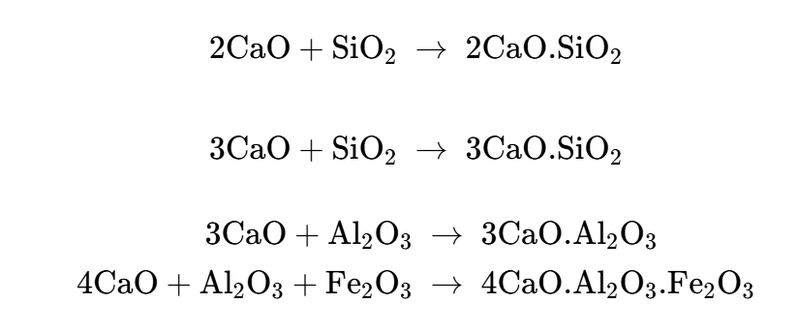
Different Temperature Zones
Preheating zone: In this zone, the temperature is kept to 500°C and usually the moisture is removed and clay is broken into silica, aluminium oxide and iron oxide.
Decomposition zone: Temperature is raised to 800°C. In this zone, limestone decomposes into quick lime and CO₂.
CaCO₃ -----> CaO + CO₂
iii. Burning zone: n this zone, the temperature is maintained up to 1500°C and the oxide formed in the above zone combines and forms respective silicate, aluminate and ferrite.
iv. Cooling zone: This is the last stage where the whole assembly is cooled up to 150-200°C.

Slide 10
4. Final Grinding: The product which is obtained from the rotary kiln is called clinker. It is usually in the form of a greenish-black or grey-coloured solid. It is then air-cooled and the required amount of gypsum is mixed with the clinker to slow down the setting of cement so that cement is adequately hardened.
4. Packaging and Shipping: Cement is conveyed from grinding mills to silos (large storage tanks) where it is packed in 20-40 kg bags. Most of the product is shipped in bulk quantities by trucks, trains or ships, and only a small amount is packed for customers who need small quantities.

Slide 11
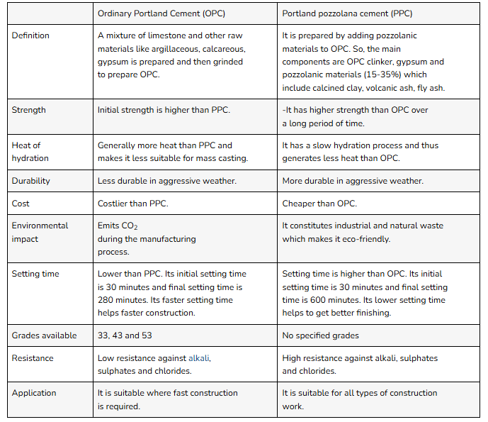
Types of Cement (OPC and PPC)

Slide 12
OPC 33 Grade:
  This grade develops a minimum compressive strength of 33 MPa (33 MN/m²) after 28 days. It gains strength slowly and is mainly used for simple construction works such as plastering, masonry, flooring, and non-reinforced structures.
OPC 43 Grade:
  OPC 43 grade attains a minimum compressive strength of 43 MPa after 28 days. It provides moderate early strength and is commonly used in general reinforced concrete works, including residential buildings, beams, slabs, and columns.
OPC 53 Grade:
  OPC 53 grade achieves a minimum compressive strength of 53 MPa after 28 days. It gains high early strength, making it suitable for heavy construction works, high-rise buildings, bridges, and pre-stressed concrete structures. However, it requires careful curing to avoid cracks due to higher heat of hydration.

Slide 13
White Cement:
  White cement is produced from raw materials free from iron oxide, giving it a white color. It has properties similar to OPC and is mainly used for decorative works, architectural finishes, tiles, and ornamental structures.
High Alumina Cement:
  High alumina cement is manufactured from bauxite and limestone and contains a high percentage of alumina. It develops very high early strength, resists high temperatures, and is used in refractory works and chemical plants.
Hydraulic Cement:
  Hydraulic cement is the type of cement that sets and hardens in the presence of water. It gains strength even under water and is widely used in dams, bridges, and underwater constructions.
Non-Hydraulic Cement:
  Non-hydraulic cement hardens only in the presence of air and does not set under water. It is mainly used in dry conditions and for plastering and decorative works.

Slide 14
Portland Cement Process
Manufacturing of portland Cement involves the following steps :
Quarrying of raw materials : Raw materials are extracted from quarries by blasting or by ripping using heavy machinery.
Crushing : Limestones produced are then crushed with the help of crushers installed at the mine site and crushed .
Grinding,blending and homogenization: Crushed quarried limestone is grounded as necessary to provide a fine material which is then blended with corrective ingredients like clay/shale , silica and iron ore in required ratio and mix homogenously to produce clinker .
Pyro processing : The blended material is then heated at high temperature up to 1300 - 1450ºC in a rotatory kiln to produce a clinker
Cooling, storing, and final grinding: Clinker is cooled, stored, mixed with additives (e.g., gypsum, pozzolanic materials), and finally ground to produce fine cement ready for use.

Slide 15
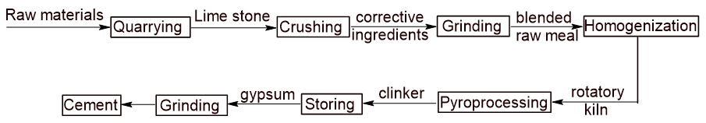

Slide 16
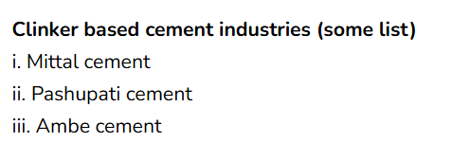
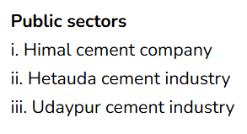
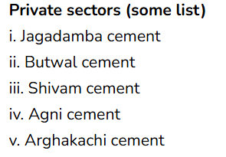
Cement Industry in Nepal
Cement was used first in Nepal during the 1950s and its supply was diversed in 1965. Himal cement company was the first cement plant established in 1975 had a production rate of 160 tons a day but it was later shut down in 2002. After this, the Hetauda cement industry and Udaypur cement industry limited were established. Nepal’s domestic cement production has been growing steadily over the past few years as the demand for cement continues to rise. Nepali cement producers are producing OPC, PPC of which OPC is widely used by consumers. Hongshi-Shivam Cement Private Limited, a Nepal-China joint venture company has started cement production in 2018. It is the largest cement factory in Nepal with a daily production capacity of 6000 tons. According to the department of industries, 27 mini, medium and large scale cement industries and more than 17 mini and mini clinker based cement industries have been registered in Nepal. Some cement industries established in the public and private sectors are mentioned below:

Slide 17
Challanges during cement production in Nepal
Poor adequate infrastructures such as roads , housing construction and multiple layer of taxation charged by local , provincial and federal government.
Frequent power crisis (lack of electricity & fuel sources)
Unable to provide proper quality of cement and its’ export in the market supply.
Lack of raw materials and supplementary cementitious materials and frequent change in policies.
Lack of modern technology and an equally skilled workforce in the country.
Lack of maintainance to account for environmental pollution .

Slide 18
Strategies to cope with the challanges
Government should invest a lot in infrastructure development in roads , housing construction & expansion of corporate production facilities.
Manufacturing blended cements (PPC) by diluting portland cement clinker with other constituents.
Replacing fossil fuels to cost effective renewable energy sources like solar and hydroelectricity.
By the application of alternative raw materials that minimizes CO₂ emission and reduce energy consumption

Slide 19
Before starting a new cement plant , the following aspects should be considered :
Cement Manufacturing process
Cement plant equipment
Cost-benefits of cement plant

