Slide 1
Backend Implementation of Email System
Presentation
Sunil Karki

Slide 2
1. Overview
Purpose:
Effectively handle large number of email request & send mail.
Have reliable and scalable system to handle high traffic.
Functionality:
Persistent storage
Fault Tolerance
Query mails.

Slide 3
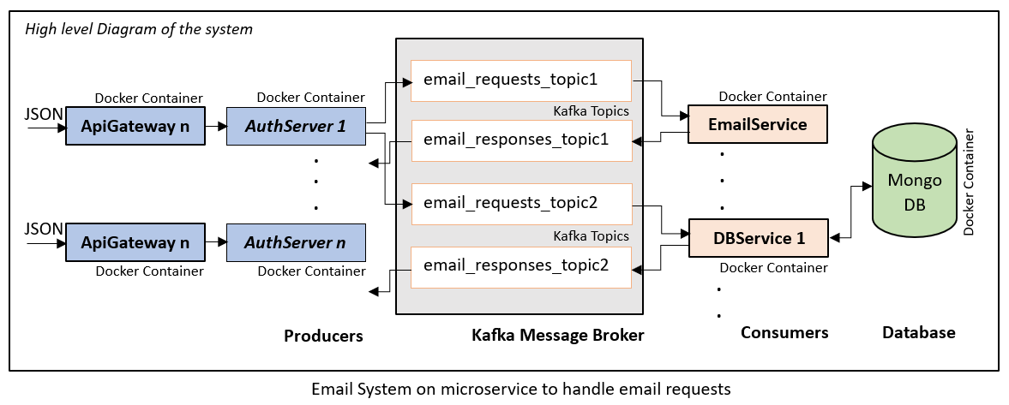
2. System Architecture

Slide 4
2. System Architecture
ApiGateway
Entry point for all incoming mail requests.
Request handling, authentication and rate limiting.
Producer that creates events for Kafka cluster.

Slide 5
2. System Architecture
EmailService
Consumer that consumes events from the kafka cluster.
Processes email request to send mail and the template chosen.
Stores the email generated in the database (MongoDB)
DBService
Also a consumer that consumes events from the kafka cluster.
Queries email sent based on the time range provided or email address or both.

Slide 6
2. System Architecture
Kafka Integration
Decouples producers & consumers, allowing them to operate independently and asynchronously.
Ensures reliable email delivery as messages(events) are stored in disk.
Makes the services scalable & also allows load balancing.

Slide 7
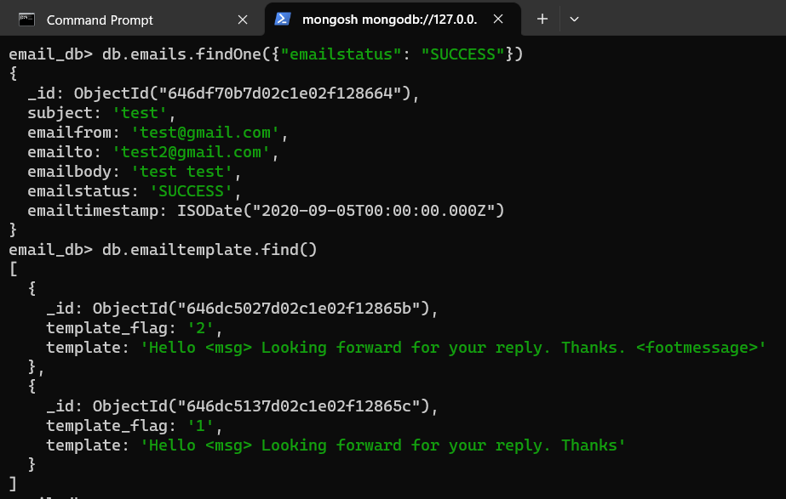
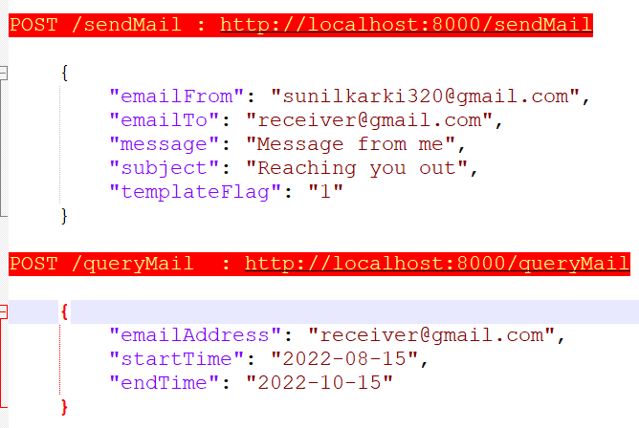
Examples
EndPoint
DB collections

Slide 8
3. Conclusion
Kafka for reliability and streaming events.
Services in docker container.
Docker/Kubernetes for automated scaling and auto recovery.
Organize & schedule each service across fleet of servers.

Slide 9
4. Demo

Slide 10
Thank You

