Slide 1
My digital garden
User manual

Slide 2
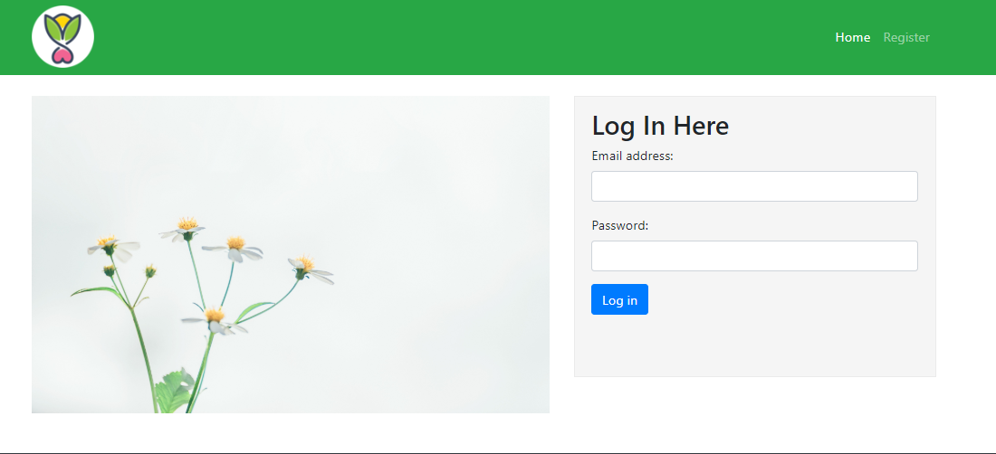
Introduction
My Digital Garden is a website on which a user can add plants that he planted in his garden with its picture and details. A user can also make a group of plants with similar features.

Slide 3
Navigation Flow of MY DIGITAL GARDEN
HOME PAGE: THIS IS THE MAIN PAGE OF THE WEBSITE SHOWING A WELCOMING MESSAGE AND PLANTS ANG GROUPS MADE BY A USER.
MY PLANTS: THIS PAGE CONTAINS THE LIST OF VARIOUS PLANTS ADDED BY A USER WITH ITS DESCRIPTION.
MY GROUPS:IT INCLUDES DIFFERENT GROUPS OF PLANTS WITH THEIR PICTURE AND DETAIL.
LOGOUT:THE USER CAN EXIT FROM ITS PROFILE BY CLICKING ON LOG OUT.

Slide 4
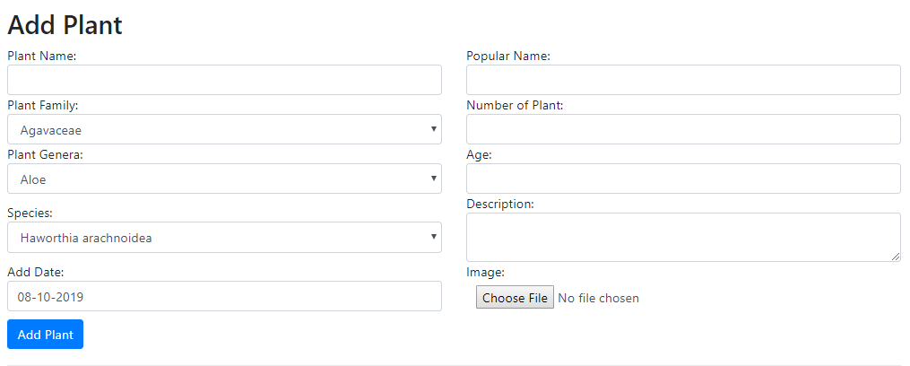
FORMS
There are four forms on MY DIGITAL GARDEN website.
ADD PLANT FORM

Slide 5
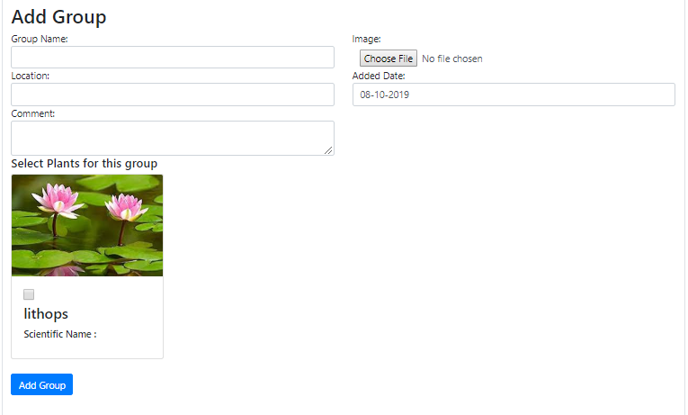
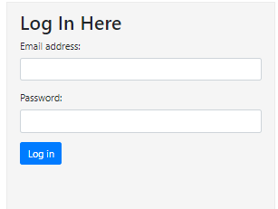
FORMS
ADD GROUP FORM
LOGIN FORM

Slide 6
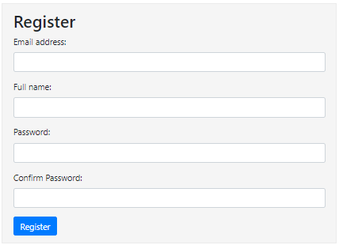
REGISTER FORM

Slide 7
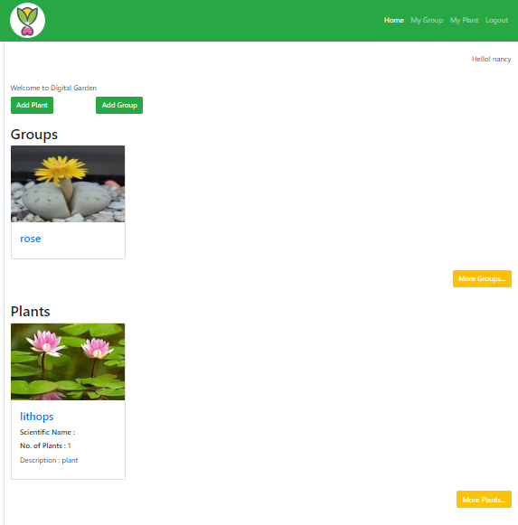
HOME PAGE
THIS IS THE HOME PAGE OF MY DIGITAL GARDEN.
THERE ARE 4 LINKS ON IT: HOME, MY PLANTS, MY GROUPS, LOG OUT.
There is a logo on the top left corner of the page.

Slide 8
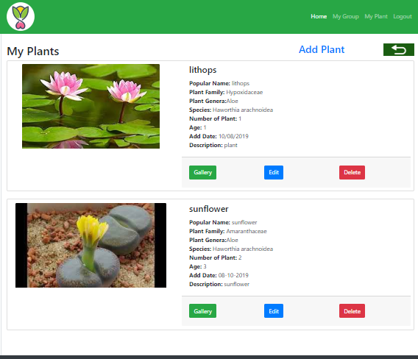
My plants page
This page contains a list of plants added by a user.

Slide 9
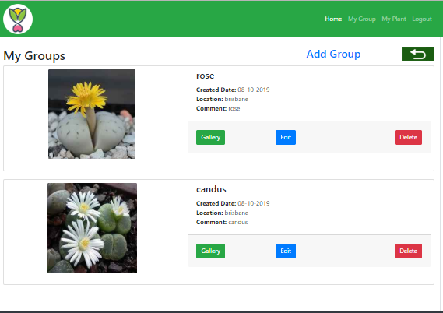
My groups page
This page contains a list of groups having number of plants in it.

Slide 10


