Slide 1
Wide Area Network(WAN)

Slide 2
Contents :-
Introduction to WAN.
Routing.
Congestion control.
WAN Technologies.
DQDB(Distributed Queue Dual Bus)

Slide 3
Introduction to WAN
A WAN is a data communications network that covers a relatively broad geographic area and that often uses transmission facilities provided by common carriers, such as telephone companies. WAN technologies generally function at the lower three layers of the OSI reference model: the physical layer, the data link layer, and the network layer.

Slide 4
Routing
Routing is the act of moving information across an inter-network from a source to a destination. Along the way, at least one intermediate node typically is encountered. It’s also referred to as the process of choosing a path over which to send the packets

Slide 5
Congestion Control
Congestion -
A state occurring in network layer when the message traffic is so heavy that it slows down network response time.
Effects of Congestion
- As delay increases, performance decreases.
-If delay increases, retransmission occurs, making situation worse.

Slide 6
Congestion Control
Methods for Congestion Control-
-Open loop
-Retransmission policy
-Acknowledgment policy
-Discard policy
-Admission policy

Slide 7
Congestion control
-Closed loop
-Back pressure
-Choke pack
-Implicit signaling
-Explicit signaling

Slide 8
Congestion control Algorithms
Leaky Bucket
Token Bucket

Slide 9
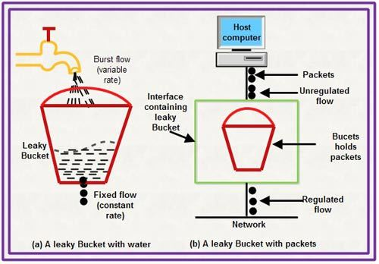
Leaky Bucket

Slide 10
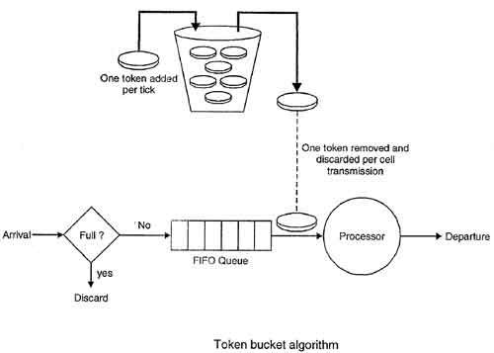
Token Bucket

Slide 11
WAN Technologies
Methods of data forwarding
-Circuit switching
-Packet Switching
-Cell Switching
Leased Lines
-Leased lines are one of the older WAN options. Imagine we have a LAN in New York and another LAN in Miami. Somehow, we need to connect these two networks. A leased line is a point-to-point link that we exclusively use, often offered by a phone company.

Slide 12
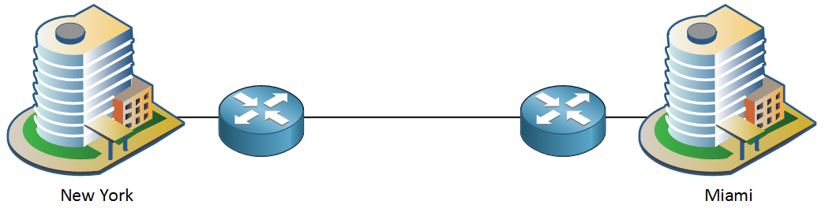
WAN Technologies

Slide 13
WAN Technologies
Frame-relay
-Frame-relay is also an older WAN technology that was an alternative to leased lines. Frame-relay offers point-to-point and point-to-multipoint circuits with a shared network, which is cheaper than a dedicated line.
DSL
-DSL (Digital Subscriber Line) became a very popular option for high-speed Internet access since it uses the analog phone cables that pretty much every home or building has. The speed that you get depends on the distance between your home and the phone company.

Slide 14
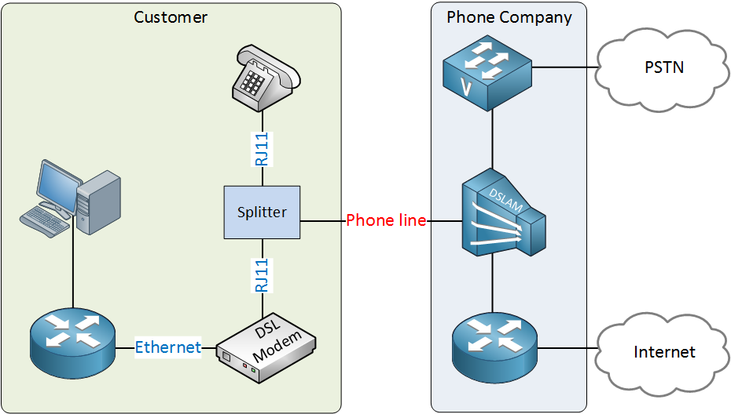

Slide 15
Ethernet
X.25 packet-switching networks
Fiber Distributed Data Interface

Slide 16
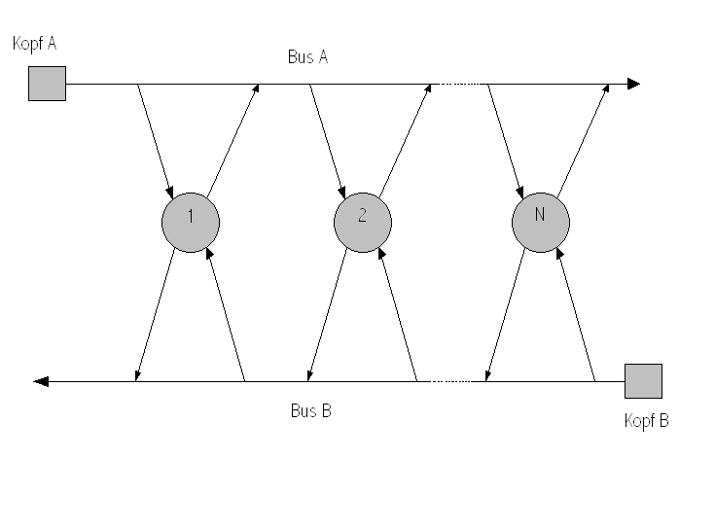
DQDB(Distributed Queue Double Bus)

