Slide 1
Embedded System
and
Programming

Slide 2
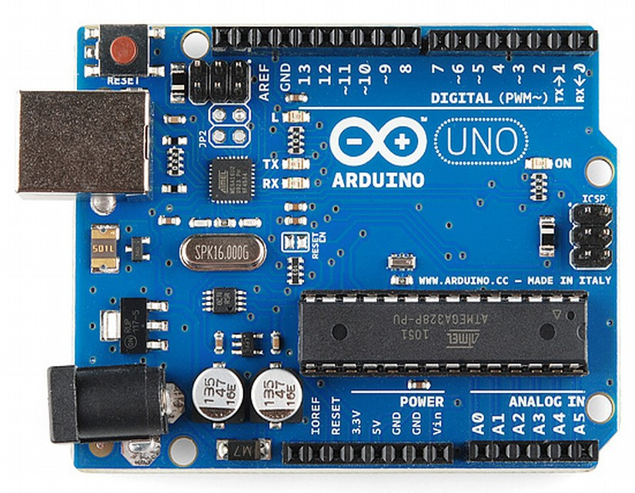
Arduino Board

Slide 3
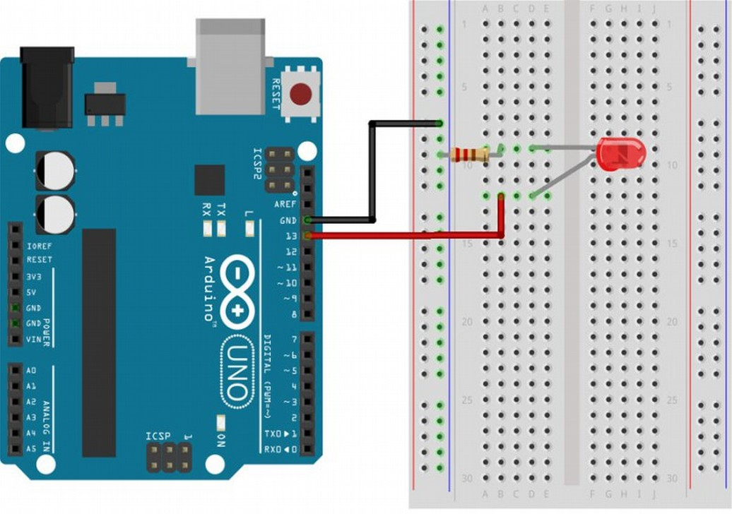

Slide 4
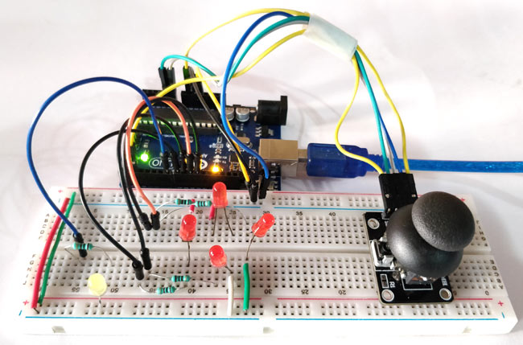
JoyStick with Arduino

Slide 5
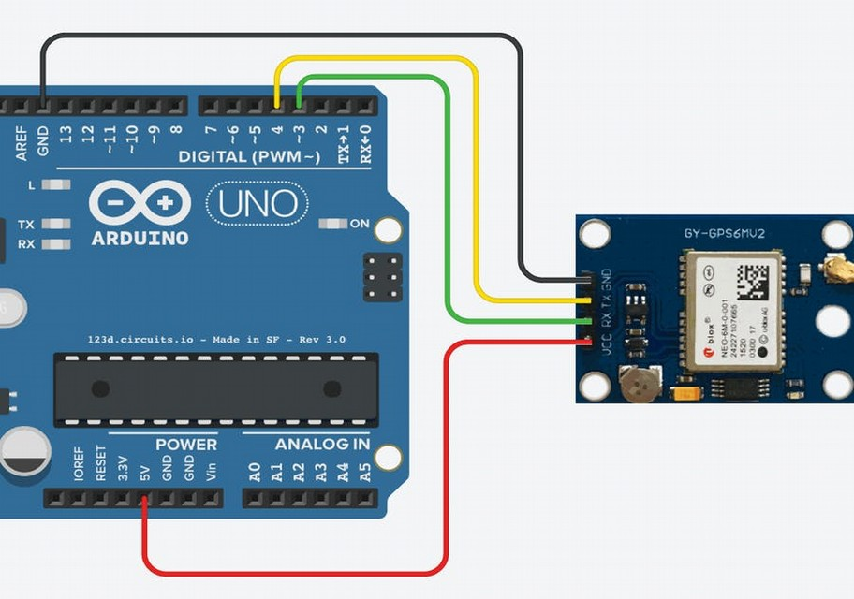
Arduino with GPS

Slide 6
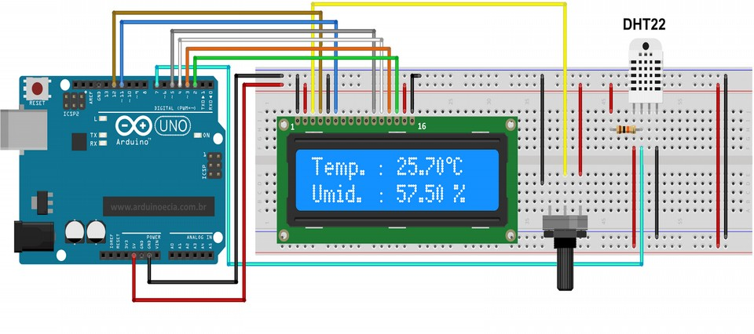
Arduino with LCD and Temperature Sensor

Slide 7
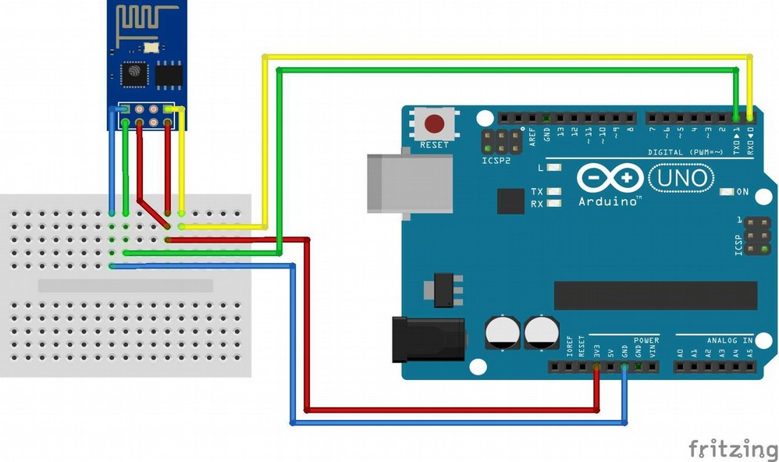
Arduino with WiFi

Slide 8
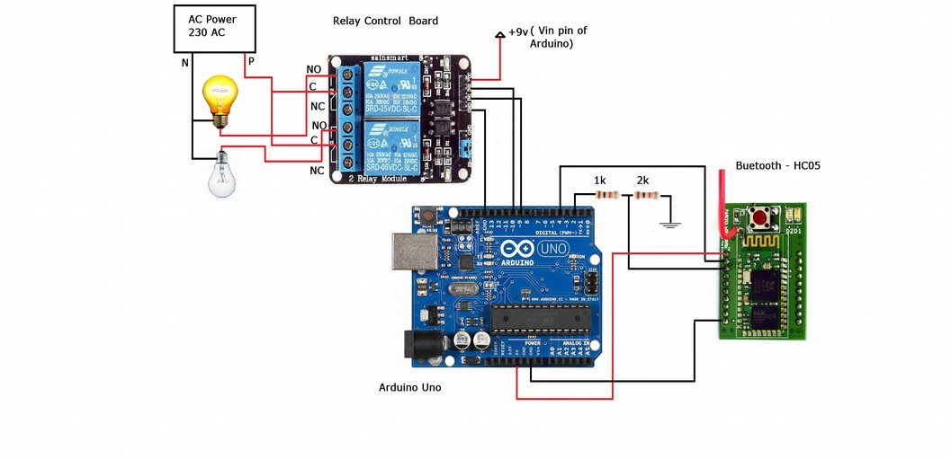
Home Automation with Arduino

Slide 9
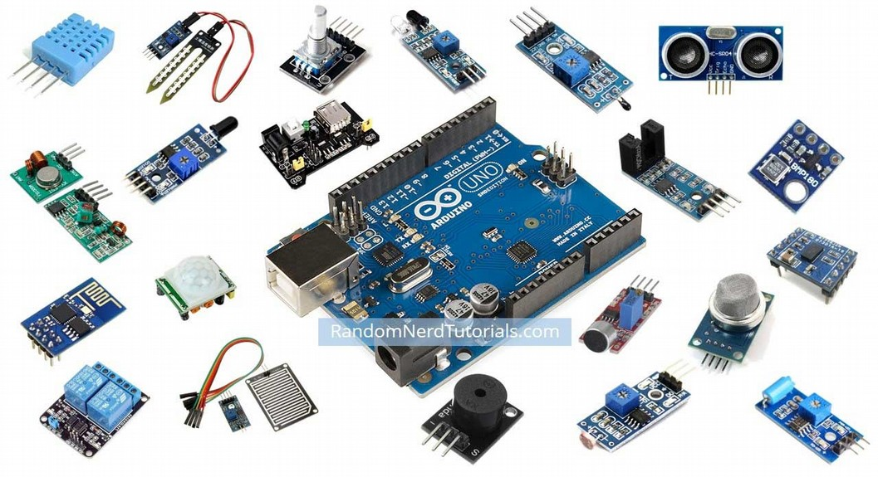
Sensors

