Slide 1
UNIX emulation in MACH
Sunil Kumar
15-CSE-2830

Slide 2
What is Mach?
Mach
Transparent multiprocessing – Avoiding issues in BSD.
Protected message passing – Better than Unix message messaging.
“extensible” Microkernel
Multiple levels of operating system
Other O/S’s implemented as “applications”
Basis for NeXT O/S, Mac X O/S, OSF/1

Slide 3
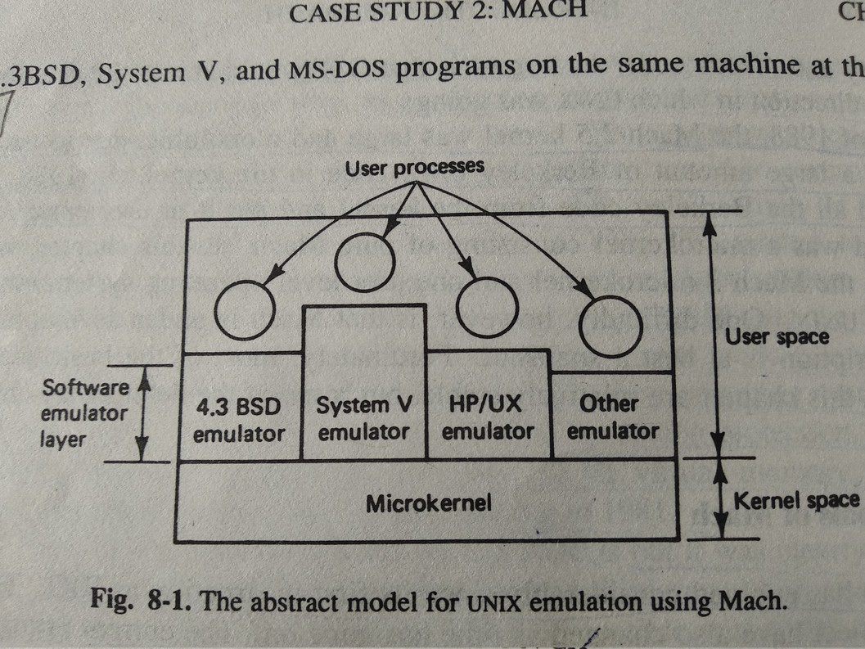
MACH MicroKernal

Slide 4
The Kernel manages five principal abstractions
Processes
Threads
Memory Objects
Ports
Messages

Slide 5
Primary Goals of MACH
Providing a base for building other operating systems (e.g. UNIX).
Supporting large sparse address spaces.
Allowing transparent access to .network resources.
Exploiting parallelism in both the system and the applications.
Making Mach portable to a larger collection of machines.

Slide 6
UNIX Emulation
Implementation of UNIX emulation on Mach consists of two pieces, the UNIX server and a system call emulation library. When the system starts up, the UNIX server instructs the kernel to catch all system call traps and vector them to addresses inside the emulation library of the UNIX process making the system call. System call made by a UNIX process will result in control passing temporally to the kernel and immediately thereafter passing to its emulation library. At the moment is given to the emulator_library, all the machine registers have the values they had at the time of trap. This method of bouncing off the kernel back into user space is sometimes trampoline mechanism.

Slide 7
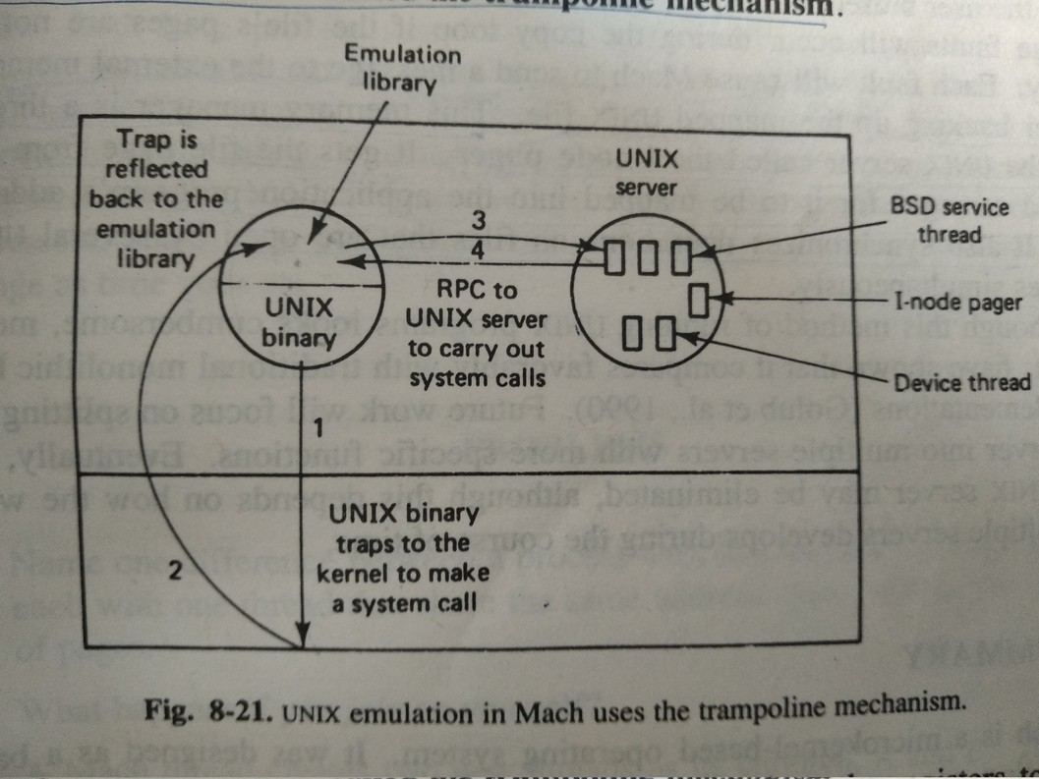
UNIX Emulation

Slide 8
Thanks

