Slide 1
UNIX emulation in MACH
Sunil Kumar
15-CSE-2830

Slide 2
What is Mach?
Mach
Transparent multiprocessing – Avoiding issues in BSD.
Protected message passing – Better than Unix message messaging.
“extensible” Microkernel
Multiple levels of operating system
Other O/S’s implemented as “applications”
Basis for NeXT O/S, Mac X O/S, OSF/1

Slide 3
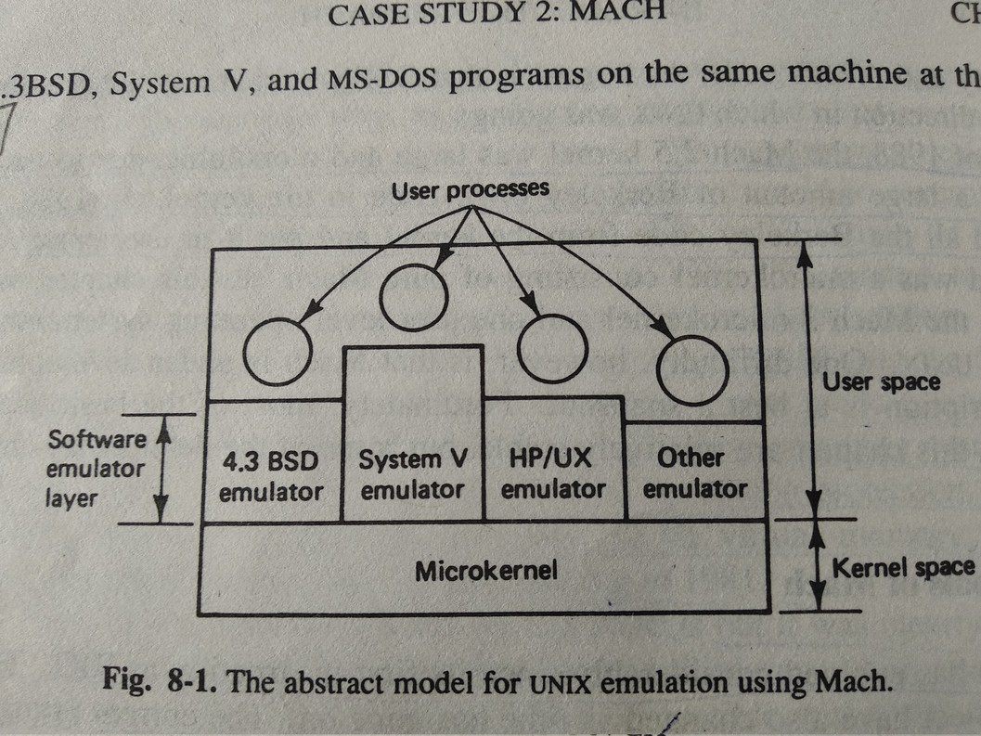
MACH MicroKernal

Slide 4
The Kernel manages five principal abstractions
Processes
Threads
Memory Objects
Ports
Messages

Slide 5
Primary Goals of MACH
Providing a base for building other operating systems (e.g. UNIX).
Supporting large sparse address spaces.
Allowing transparent access to .network resources.
Exploiting parallelism in both the system and the applications.
Making Mach portable to a larger collection of machines.

Slide 6
Interprocess Communication
Mach’s overriding principle is to be a “simple, extensible kernel, concentrating on communications facilities.”
Universal communications mechanism between all objects in the system
Location-independence, automatic addressing
Isolation between objects because all messages pass through the kernel
Secured communications via port rights
A capability to communicate on a particular port (many senders, 1 receiver)‏
A transferable right
Rights must be transferred via IPC so the kernel can track the transfer

Slide 7
Interprocess Communication: Ports and Port Sets
Ports
Implemented as a protected bounded queue in the kernel
Has a unique global name
System Calls
Allocate a new port in task, give the task all access rights
Deallocate task’s access rights to a port
Get port status
Create backup port to inherit the receive right when the existing port is deallocated
Port Sets
A grouping of ports in the same task
Used for using a single thread as an incoming queue processor (e.g. Unix select or poll system calls)‏
A port may be a member of one set at a time

Slide 8
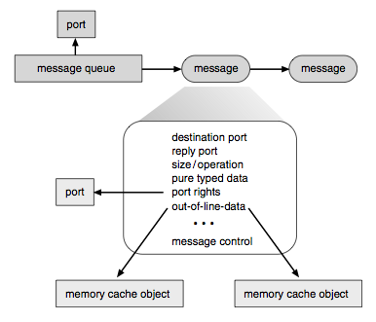
Interprocess Communication: Messages
Header + one or more typed data objects
Header contains destination port name, reply port name, message length
In-line message data contains simple types, port rights
Out-of-line data: pointers
Via virtual-memory management
Uses copy-on-write
Sparse virtual memory

Slide 9
Interprocess Communication: Location Independence and Transparency
NetMsgServer
User-level daemon that forwards messages between hosts
Used when receiver port is not on the kernel’s computer
Provides primitive network-wide name service
Network protocol independent interface allows many implementations
Mach 3.0 IPC for NORMA multiprocessor systems
Directly in the kernel rather than in user space
Supports the formation of one single system across smaller systems

Slide 10
Interprocess Communication: Synchronization Using IPC
IPC-based Synchronization
Port used as synchronization variable since
Receive message = wait
Send message = signal
Only works natively for threads within a single task because one receiver task is allowed on a single port
Or via a daemon process that sends/receives messages between tasks

Slide 11
UNIX Emulation
Implementation of UNIX emulation on Mach consists of two pieces, the UNIX server and a system call emulation library. When the system starts up, the UNIX server instructs the kernel to catch all system call traps and vector them to addresses inside the emulation library of the UNIX process making the system call. System call made by a UNIX process will result in control passing temporally to the kernel and immediately thereafter passing to its emulation library. At the moment is given to the emulator_library, all the machine registers have the values they had at the time of trap. This method of bouncing off the kernel back into user space is sometimes trampoline mechanism.

Slide 12
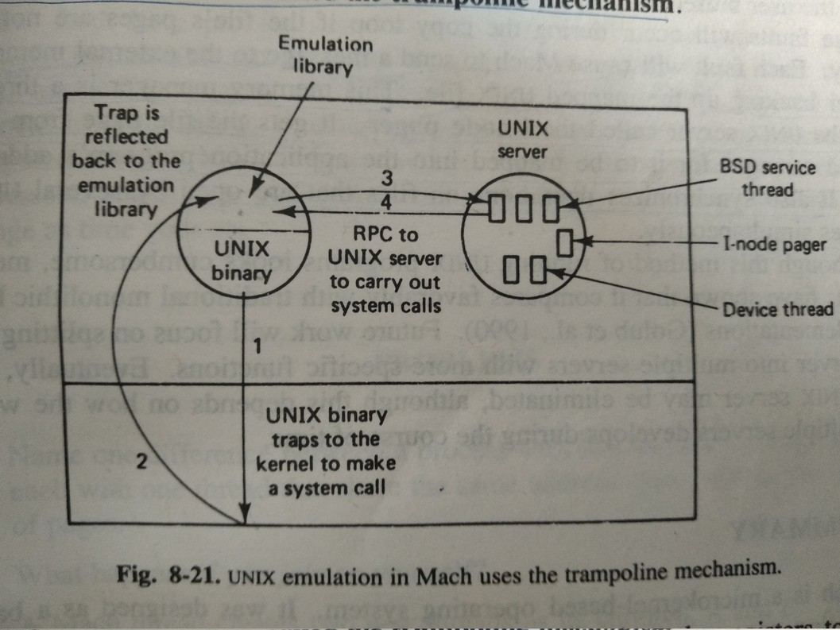
UNIX Emulation

Slide 13
Thanks

