Slide 1

CO₂ Distribution
Presenter: Sunil Laudari
University of Alabama in Huntsville (UAH)
Source: https://www.globalcarbonproject.org/carbonbudget/index.htm
Source: Friedlingstein et al. (2021)
Notes:
The source is provided down below and I used particularly global carbon cycle data which is in the format of xls. With multiple sheets.

Slide 2
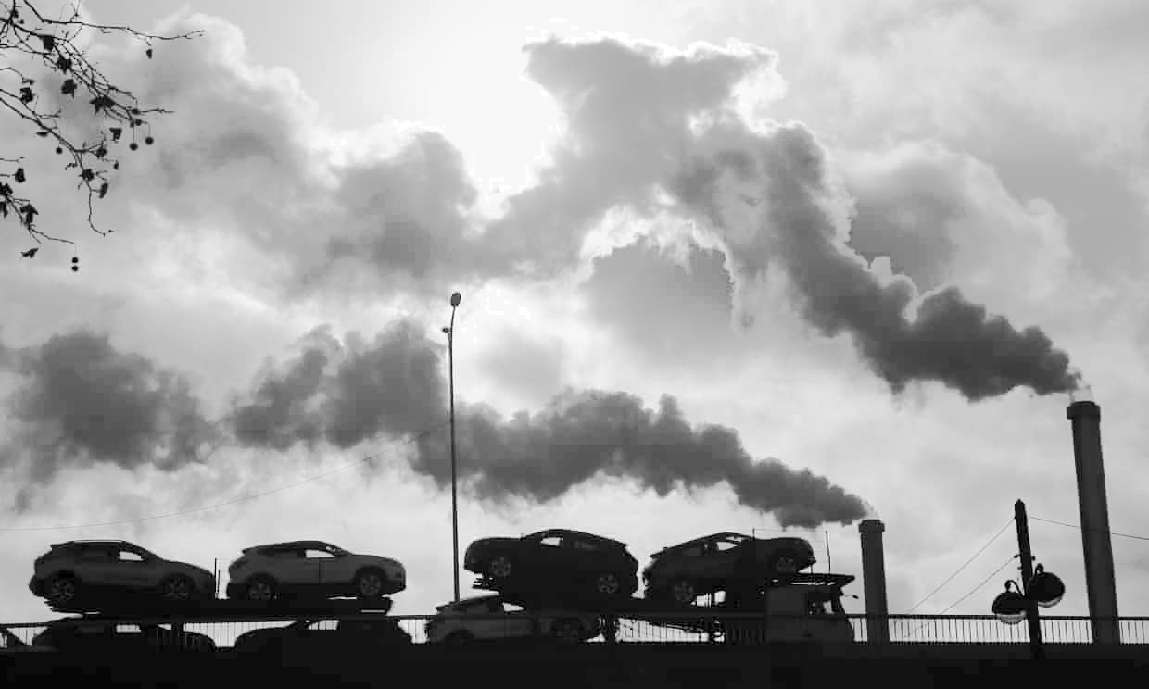
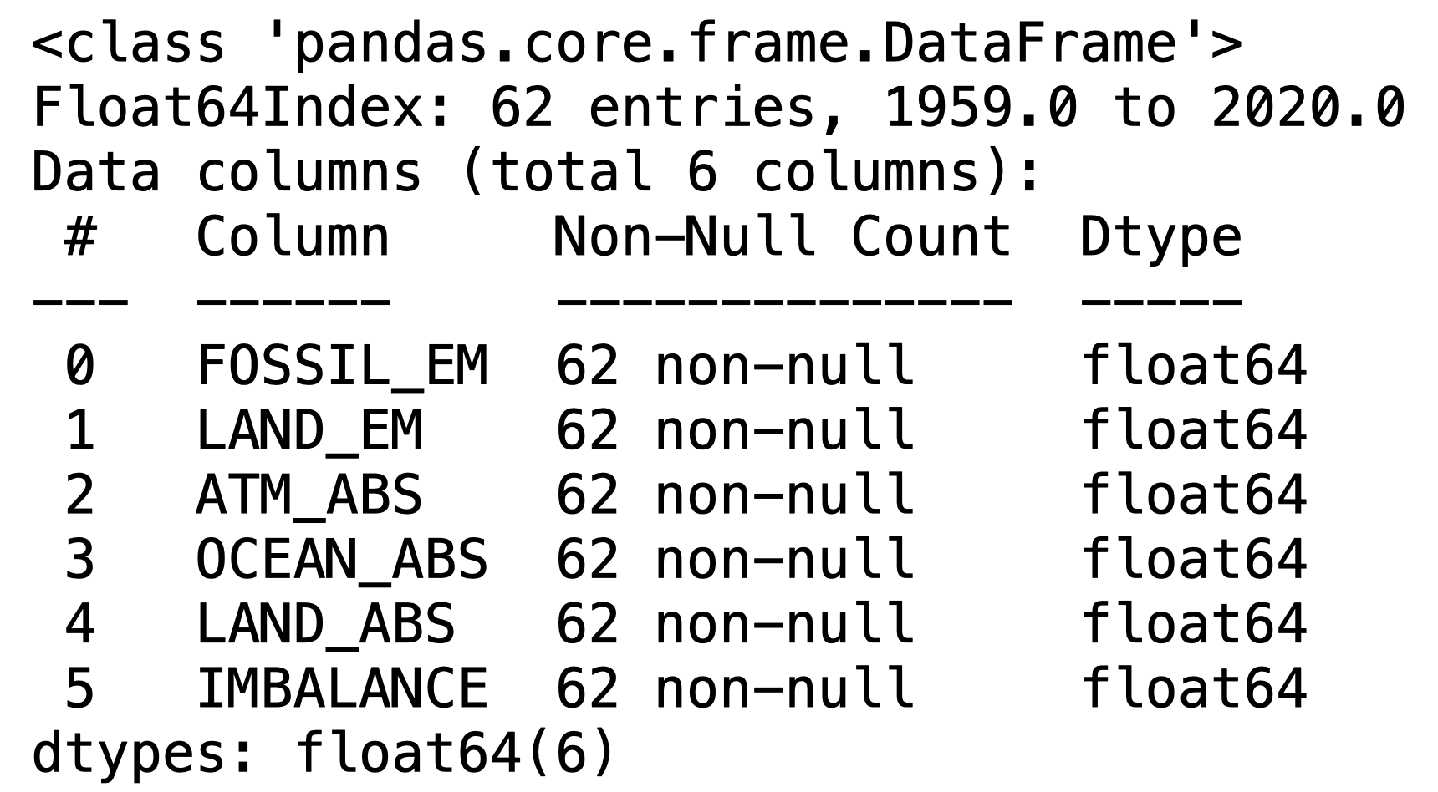
Background
Fossil emission: based on energy statistics and cement production data; physical drivers of recent climate change
Land Emissions: land-use change mainly from deforestation
Atmospheric sink: annual changes in atmospheric concentration
Ocean sink: estimated from global ocean biogeochemistry
Terrestrial sink: estimated with dynamic global vegetation models
CO₂ Components
Importance
Accurate assessment of CO₂ emissions and their redistribution in the environment is critical to understand the global carbon cycle
Raise awareness about the greenhouse gas like CO₂ in the environment
Guides climate policies, and project future climate change.
e.g. COP26 climate conference
Notes:
The project is important in the sense that it is currently the most discussed topic among politicians and world leaders like in Climate change conference (COP26) held in Glashgow. Leaders have agreed to minimize the emission of CO2

Slide 3
Results
Highlights of the plot
Implemented Python libraries like matplotlib, NumPy, pandas as well as scikit-learn for data visualization and analysis
Fig. shows all 5 components of carbon cycle with year in the x-axis
The fossil emission is shown with a 1𝝈 uncertainty which shows linear trend.
There is clearly over emission trend as seen by the fossil emission.
Fossil emission remains the principal component
ATM emission can be modeled using Fourier Sine function
Lower panel shows “Imbalance” defined as the total emission – total absorption/sink.
Notes:
I extensively used python libraries in my work. Figure on the left shows the plot of 5 major carbon cycle components wrt YEAR. The fossil emission can be modeled with regression plot.
It is the most dominant component of the cycle which is due to emissions from man made. Deforestation which is alnd_em seems more cyclic. In my opinion it can be modeled using Fourier Sine or Cosine function. The other three absorbtion components is not dominant which creates unbalance in the carbon distribution.
The lower panel shows the imbalance due to difference in emission and absorption.

Slide 4
Results
Highlights of the plot
Top Fig. shows the box plots of 5 components with median, quartiles and extreme values.
Again, fossil emission component is the dominant one
CO₂ absorption from the atmosphere, ocean and land should be increased to compensate the fossil emission
Bottom Fig. shows scatter plot of Fossil emission wrt ATM absorption
Clearly a linear trend is seen
The best fit is plotted using linear regression.
Notes:
I extensively used python libraries in my work. Figure on the left shows the plot of 5 major carbon cycle components wrt YEAR. The fossil emission can be modeled with regression plot.
It is the most dominant component of the cycle which is due to emissions from man made. Deforestation which is alnd_em seems more cyclic. In my opinion it can be modeled using Fourier Sine or Cosine function. The other three absorbtion components is not dominant which creates unbalance in the carbon distribution.
The lower panel shows the imbalance due to difference in emission and absorption.

Slide 5
Thank You
Source: Friedlingstein et al. (2021)

