Slide 1
Banking App
Secure authentication and login
The top priority of any banking application is its security since there is a great amount of sensitive data being processed. Hence, one of the most important features of a banking app is secure login and high-level authentication.
In general, a banking application usually requires a password from a user in order to log in but you can also add biometric authentication. Note though that even biometric authentication can be bypassed by hackers. So in order to enhance the security, you can do the following:
Store all passwords and PINs either encrypted or hashed. Also, it is highly recommended not to store them in the source code but on a server instead.
For biometric authentication, store PINs in the verified storage of a specific platform (either Keychain for iOS or Keystore for Android).
Add SMS confirmation to the log-in.
Limit the number of login attempts.
Always make sure to start a new session every time.

Slide 2
Account management
The main idea behind a banking app is to enable users to manage their accounts from any place and any time – hence, it is essential to provide efficient account management.
A user’s account is usually the core of a banking app and its management includes the following options:
Display of all active and inactive accounts;
Balance check;
Display of transaction history;
Funds transfer;
Saved payments and “quick payments”;
Display of available transactions.
Of course, this is not the whole list and there may be many more functions available. Just remember that the main idea is to let a user fully control their bank account from an app without the need to contact bank representatives for assistance.

Slide 3
Solve this problem by Azure
Azure Kubernetes Service
Azure monitor
‘Azure Load balancer
Azure firewall
Key vault
Azure Active directory with MFA authentication
Azure Devops for automating CI/CD
Terraform for infrastructure provisioning
Azure Container Registry (ACR )
Microsoft database

Slide 4
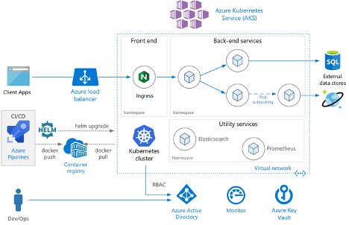
Solution Architecture

