Slide 1

Extensions Land
Extended Attack Surface
“Everything Published, Talked and/or discussed in this conference is solely based on my personal point of view, does not represent my current, or past employer”
https://sqrx.com/polymorphic-extensions

Slide 2
Next 40 Mins !
Structure
Why adversaries target browser extensions ?
Types of Harmful Extension
Distribution
Demo - Content.JS
Permissions
Demo - Infiltration and Exfiltration
Demo - ClickJacking
Why Malicious Extensions Are Difficult to Detect?
Extension Hunting - defender , CQL
Analysis Tools
Mitigation
Q & A

Slide 3
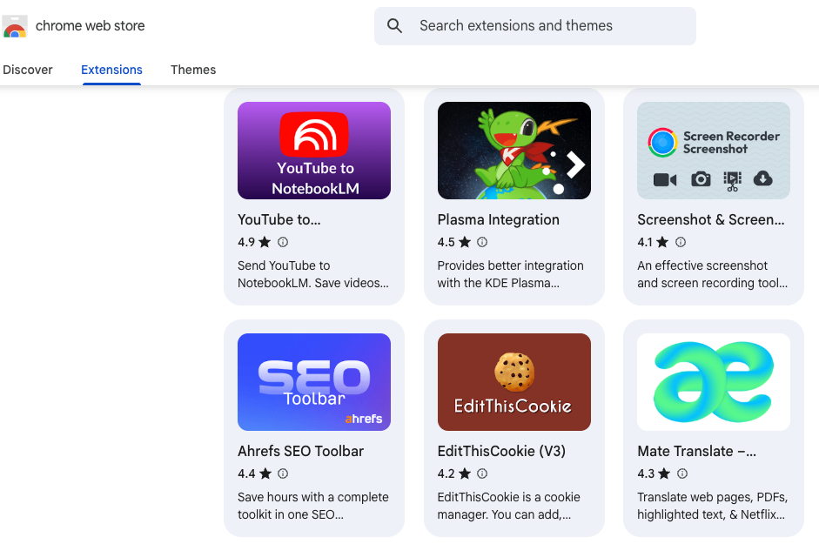
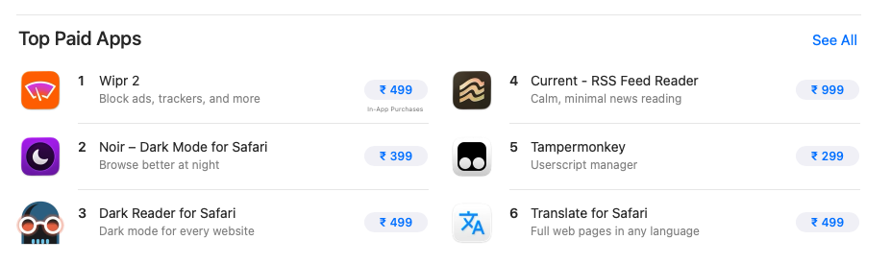
What are extensions
Small applications that enhance the capabilities of web browsers and improve the user experience
﻿﻿Adds new features
﻿﻿Modify web content
﻿﻿Automate tasks

Slide 4
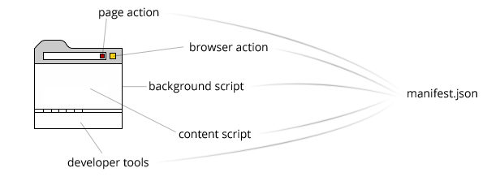
Extension Structure
Manifest: Center file contains metadata like name, version, permission and pointers to below file types, it controls everything in extension.
Sidebar: A panel displayed at the left of the browser window, next to the web page.
Popup: A dialog displayed when the user clicks on a toolbar button or address bar button
Options page: page shown when user accesses add-on preferences in browser's native add-ons manager.
Web Resources: Images, JS, CSS accessible by web pages
Notes:
Think of manifest.json as the instruction manual of the Chrome extension.
Pop up page: Think of it as the user interface of the extension.
Icons and Resources: These are the visual and supporting files used by the extension
Option pages: Think of it as the Settings page of the extension.
Web Resources: Think of them as resources that the extension makes available to specific web pages.
Manifest → Popup → Resources → Options → Web Access “Manifest controls the extension, Popup interacts with the user, Resources support it, Options configure it, and Web-accessible resources allow controlled access from web pages.”

Slide 5
Content Scripts: Extensions “Frontend”
Injected into web pages, reads DOM & form inputs
Loaded inside “matching” sites and either "js" or "css" are required.
Runs in a special VM context (its own vars and private-world)
BackGround Scripts: Extensions “Backend”
Scripts that respond to browser events and Run once in a special Dedicated Process.
Access to more API’s
Persistent background scripts (MV2) runs continuously in the background from the moment the browser starts or the extension is loaded until the browser is closed or the extension is disabled
Non-persistent background scripts (MV3) background scripts are strictly non-persistent by design, Here event-driven modules used which spin-up background script when required or shutdown when idle.
Notes:
Background Page. It contains the basic logic of the extension. The main feature of a background page is that it runs and does some work in the background when the browser is started and keeps it in memory as a background process during a session.
Content Scripts. These are JavaScript files or code that run not in a separate background process but in the context of the web page. Content scripts use the Chrome API in a limited way. They are isolated and cannot use functions and variables which are declared, for example, on the background page.

Slide 6
Why adversaries target browser extensions
Browser extensions first became mainstream in the early 2000s with their adoption by Firefox , Chromium and 2025 saw noticeable surge in malicious extensions uploaded to browser marketplaces.
Implicit trust: User trust their browser and its marketplace
Manipulable Code: extensions are JS code that adversaries can use to Exfiltrate cookies, Execute remote code or hijack searches
Lenient Updates: security review for updates is often less stringent than for initial submission
Automatic Deployment: Default auto-updating rapidly deploys malicious code to a massive user base
Organizational blind spot: Organizations lack effective management and visibility into extension activity
Developer Monetization: Developer who legitimately created and maintained an extension might unknowingly sell the extension to buyers with malicious intentions.
Cross Platform works on any desktop/OS.
Notes:
https://www.aikido.dev/blog/browser-extension-security https://github.blog/security/vulnerability-research/attacking-browser-extensions/

Slide 7
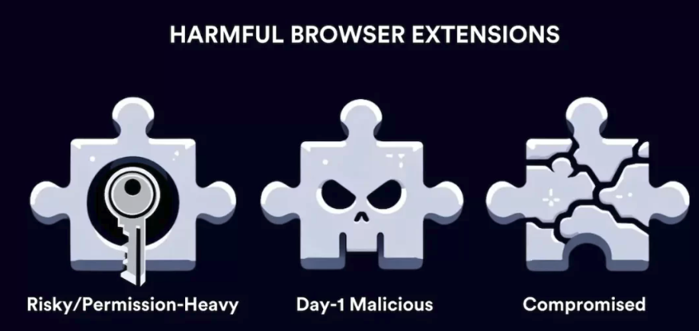
Types of harmful web extensions
Browser extensions come in various forms and sizes. To put things simply, we can categorize these extensions into three main subtypes
Initially malicious extension: An extension that was created by an adversary from scratch for a malicious purpose.
Compromised extension: An initially legitimate extension that became owned by an adversary after directly purchasing the extension or compromising the extension’s developer account .
Risky extension: A legitimate extension that has excessive permissions
Notes:
https://spin.ai/blog/beyond-add-ons-elevating-browser-governance-against-malicious-and-risky-extensions/#types-of-harmful-browser-extensions
https://attack.mitre.org/techniques/T1176/

Slide 8
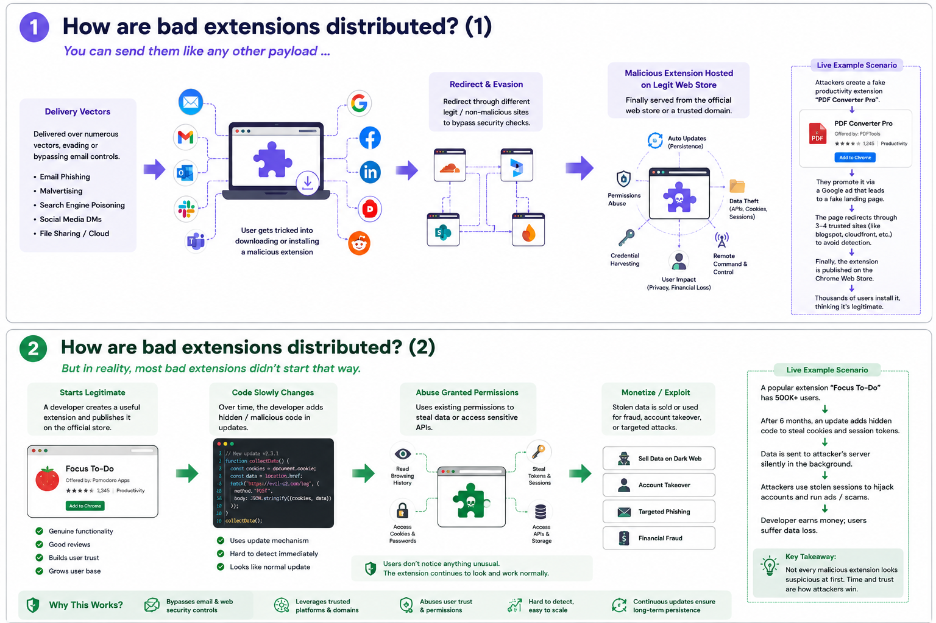

Slide 9
Demo - Content.JS MV2

Slide 10
Manifest V2: Why Extensions Had a Larger Security Risk
Persistent background page: runs continuously with full DOM/window access which is always-on code and risk
Blocking webRequest API: can inspect and modify every network request in real time which is powerful and favorite for traffic hijacking
Remote code allowed: can fetch and execute JavaScript at runtime, bypassing store review entirely, harder to control and review
Cookies without permission (Firefox): extensions can send authenticated requests to arbitrary domains even without host_permissions
Minimal CSP enforcement: extension pages are greater exposed to script injection
“MV2 treats the extension as fully trusted, high-privilege runtime code one compromise has a large blast radius”

Slide 11
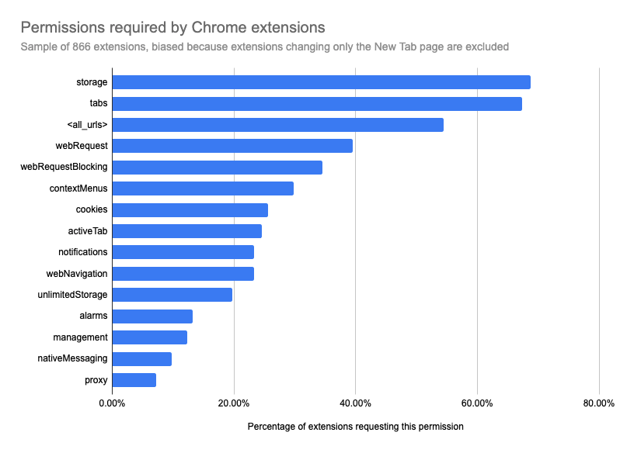
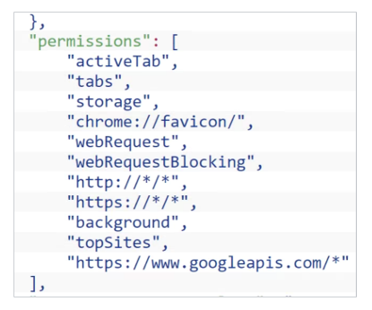
Extension Permissions
Developers have to declare all required things in manifest.json
set of rules that dictate what actions an extension is allowed to perform within your browser
Permissions are usually the cornerstone of extension-based cyberattacks.
https://www.debugbear.com/blog/counting-chrome-extensions

Slide 12
Permission set | Direct Session Hijack | Credential Theft
Content Scripts (ISOLATED) | OAuth Access Token, refresh token, Json web token (JWT) | Session cookie, OAuth Code
WebRequest + Host permission | Session cookie, OAuth Refresh token | Session token, OAuth Code, API key
debugger | Session cookie, OAuth Access and Refresh token, JWT | Tokens: App Auth (JS), Stored, websocket
Proxy | Session cookie, OAuth Access and Refresh token, JWT | Session token, API key
Devtools_Page | Session cookie, OAuth Access token, JWT | API key, OAuth Code, Tokens: App Auth (JS), Stored
Chrome: https://support.google.com/chrome/a/answer/9897812
Firefox: https://support.mozilla.org/en-US/kb/permission-request-messages-firefox-extensions
Safari: https://developer.apple.com/documentation/safariservices/managing-safari-web-extension-permissions

Slide 13
Demo Attack Surface - Infiltration and Exfiltration

Slide 14
Manifest V3: How Security Is Improved
Non-persistent service worker: background logic sleeps when idle, shrinking the always-on exposure window
declarativeNetRequest: static, pre-declared rules evaluated by the browser itself where the extension never directly inspect raw traffic raw request/response
No remote code execution: all logic must included in the reviewed extension package which reduces the dynamic payload loophole/abuse.
Stricter default CSP: inline scripts, eval() are blocked by default which reduces script injection risk
Explicit host_permissions : Chromium extensions must explicitly declare which sites they can act on before sending cookies or requests
Store review can still miss malicious logic.
Permission creep, DOM/clickjacking attacks, and browser specific differences such as Firefox's continued MV2 support can still create risk.
MV3 reduces the attack surface but it does not make browser extensions automatically safe.

Slide 15
Demo MV3 - ClickJacking
Marek Toth, DEF CON 33 (Aug 2025) – 11 password-manager extensions tested, ~40M installs affected
Inject: the extension drops its UI (autofill dropdown, login prompt) straight into the page’s DOM – not an isolated iframe
Bait: attacker page renders a decoy (e.g. a “cookie consent” banner) and calls focus() on a hidden input to trigger the extension’s autofill UI
Hide: script sets the injected UI to opacity:0 (or overlays it) – pointer-events still reach it, so it stays fully clickable
Redirect the click: victim clicks the visible decoy – the click actually lands on the invisible extension element and autofill fires into an attacker-controlled form
Exfiltrate: page reads the now-filled hidden form and ships it to an attacker server – credentials, card data, personal info
Why it matters: one click, pure CSS/DOM manipulation, no elevated permission, webRequest, or host_permission required, and it works identically on MV2 and MV3

Slide 16
Why Malicious Extensions Are Difficult to Detect
Huge Ecosystem: Thousands of extensions make manual security review difficult and time-consuming.
Bypassing web store code analysis checks by dynamically loading malicious content.
Malicious Extensions Can Persist: Lag of weeks or months for Harmful extensions to being identified and removed from stores.
Broad Permissions: Extensions can request access to websites, browsing data, cookies, and other sensitive information.
Legitimate-Looking Behavior: Malicious extensions can appear normal and provide useful functionality to avoid suspicion.
Constantly Changing Threats: Extensions can be updated after installation, potentially introducing malicious code later.
Even when removed , Extension are aften re-skinned and re-uploaded and process starts again

Slide 17
Suspicious Extension Hunting
1) Defender Collects the Extensions related Logs under table: DeviceTvmBrowserExtensions
Create an datatable with know Malicious Extension ID with Threat Intels to create the Correlation query
2) We can also use “Falcon Exposure Management module” in Falcon EDR under Event: InstalledBrowserExtension
Refer: https://www.byteray.com/cql-hub/malicious-chrome-extension-freevpn-one-detection
3) Hunt Idea:
Newly Installed Browser Extension on High-Value Device
Extension with Sensitive Permissions or Broad Host Access
4) Block using GPO policy and intune.
let MaliciousExtensions = datatable (MaliciousExtensionId:string, ThreatType:string, Source:string) [ "abcdefghijklmnopabcdefghijklmnop", "Credential Theft", "Koi DEX", "12345678901234567890123456789012", "Data Theft", "Internal TI"]; DeviceTvmBrowserExtensions | extend ExtensionIdLower = tolower(ExtensionId) | join kind=inner MaliciousExtensions on $left.ExtensionIdLower == $right.MaliciousExtensionId | join kind=leftouter ( DeviceInfo | project DeviceId, DeviceName) on DeviceId | project DeviceName, DeviceId, ExtensionName, ExtensionVersion, WatchlistExtensionName, ExtensionId | order by DeviceName asc

Slide 18
Online Scanning TII’s
Threat Intel Platform | Inputs | URL
Extension Security | Extension ID Store URL | https://extensionsecurity.io/
KOI DEX | Extension ID or name | https://dex.koi.security/
Extension checker | Extension ID, Store URL Code analysis | https://app.extensionchecker.org/
They cover Important checks like Permissions, Host/website access, code & obfuscation in code ,
External/Malicious Domain and share the Risk score along with Verdict
Open source offline analysis
Tool | Inputs | URL
Ext Analysis | .crx - .xpi - .zip | https://github.com/Tuhinshubhra/ExtAnalysis
crx-analyzer | Extension ID and store name | https://github.com/rileydakota/crx-analyzer

Slide 19
Mitigations
Download Safely: Use only official browser extension stores.
Keep extensions updated: Avoid extensions that are outdated or no longer maintained.
Review Privacy: Check the privacy policy and developer website before installing.
Research First: Look at ratings, reviews, downloads, and developer reputation.
Check Permissions: Install only extensions requesting permissions relevant to their purpose.
Use Security Tools: Keep antivirus/anti-malware protection enabled.
Stay Alert: Avoid extensions offering suspicious or “too good to be true” features.
Regularly Clean Up: Regularly remove unused/suspicious extensions and monitor installed extensions.
Limit the number of installed extensions: To reduce the attack surface and limit potential vulnerabilities, users should install only essential browser extensions.
“treat every browser extension like third-party code with production access , because that’s exactly what it is”

Slide 20
Reference
https://sqrx.com/polymorphic-extensions
https://www.aikido.dev/blog/browser-extension-security
https://github.blog/security/vulnerability-research/attacking-browser-extensions/
https://spin.ai/blog/beyond-add-ons-elevating-browser-governance-against-malicious-and-risky-extensions/
https://attack.mitre.org/techniques/T1176/
https://developer.mozilla.org/en-US/docs/Mozilla/Add-ons/WebExtensions/Anatomy_of_a_WebExtension
https://seraphicsecurity.com/resources/blog/malicious-browser-extensions-are-on-the-rise/
https://marektoth.com/blog/dom-based-extension-clickjacking/#browser-extension-clickjacking

Slide 21
…Any questions or Feedback….

Slide 22
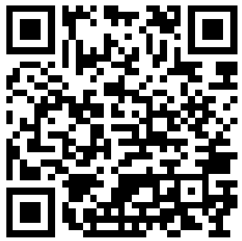
Whoami$
Sunil Kumar BV
Sr Security Engineer

