Slide 1

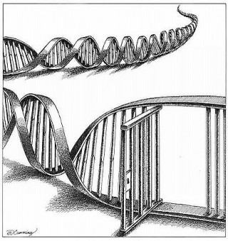

Forensic DNA Databases
Jeremy Gruber

Slide 2
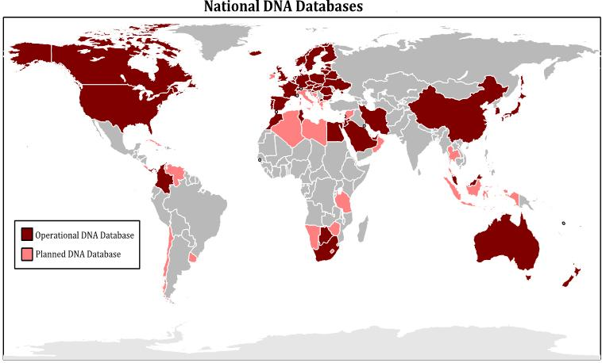
60 countries worldwide operate national DNA databases
34 countries plan to set up new DNA databases
A number of countries are in the process of expanding their databases
d

Slide 3
Growing International Cooperation
Concerned with terrorism, illegal immigration and “global crime” law enforcement and government officials are engaged in efforts to link national DNA databases
United Kingdom: Through data-sharing agreements established through the European Union (such as the PRUM DNA Search Network) and other international institutions, DNA data is shared across borders with little oversight.
United States: The National Institute of Justice’s International Center promotes information sharing among similar Institutes worldwide.
INTERPOL: Interpol’s DNA Gateway and G8/Interpol Search Request Network now contains profiles shared by 49 countries.
Advisory groups have been formed in Europe and elsewhere to improve harmonization of forensic DNA methods (such as the ISO Standards for DNA Database Exchange)
Plans to develop a ‘Google search’ type system for sharing data across national boundaries.

Slide 4
With New Technologies Come New Powers
Technology can be used justly and democratically or it can be used unjustly or undemocratically
Preserving the balance between the legitimate needs of law enforcement and the security of citizens with human rights

Slide 5

DNA testing was initially introduced into criminal justice systems as a method of developing supplemental evidence to be used in convicting violent felony offenders or freeing the innocent on a case by case basis.
Most people are unlikely to commit serious crimes for which DNA evidence might be relevant.
The creators of New York's database recognized this point when they noted in a 1992 report that it would be limited to "murderers and sexual offenders because DNA evidence is more likely to be uncovered in homicides and sexual attacks than in other crimes."

Slide 6
This has changed dramatically, with DNA collection by law enforcement now routinely being used for a multiplicity of purposes that pose significant privacy and civil rights concerns to every citizen.
A growing trend towards the permanent retention of DNA from innocent people in forensic DNA databanks.
Trolling for suspects using DNA dragnets.
Searching for partial matches between crime scene evidence and DNA banks to obtain a list of possible relatives for DNA analysis (“familial searching”).
Constructing probabilistic phenotypic profiles of a perpetrator from DNA collected at a crime scene.
Surreptitiously collecting and searching DNA left behind on items such as cigarette butts and coffee cups.
The creation of local “offline” forensic DNA databases.

Slide 7
What do Police Do When They Take Your DNA
Biological Sample: Blood, Hair, Saliva, Semen, Tissue etc.
From the Sample Lab Techs Can Extract DNA
There are Standard Sites on Multiple Chromosomes which are used to obtain a “profile” of the person from their DNA
United States uses 13 sites located on several of our 23 chromosomes; each site is called a locus
Police compare DNA profile from crime scene with a suspect

Slide 8
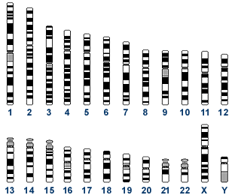
13 CODIS Core STR Loci with Chromosomal Positions-Hypervariable Sites
TPOX
D3S1358
TH01
D8S1179
D5S818
VWA
FGA
D7S820
CSF1PO
AMEL
D13S317
D16S539
D18S51
D21S11
AMEL

Slide 9
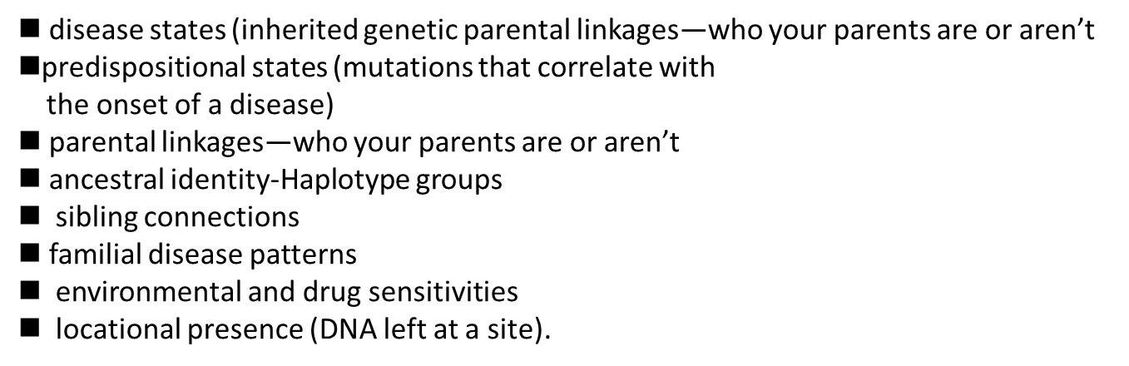
What our DNA Can Reveal
DNA is far different from other methods of identification such as fingerprints. It is a window into an individual's medical history as well as that of his or her entire family.

Slide 10
Common Features of DNA Database Authorizing Legislation
1) Entry criteria (arrest, conviction, type of crime)
2) Sample collection
3) Removal criteria
4) Sample retention
5) Database access

Slide 11
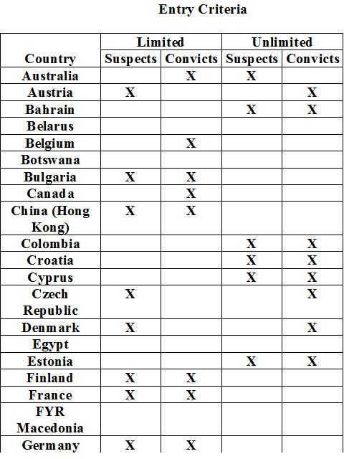
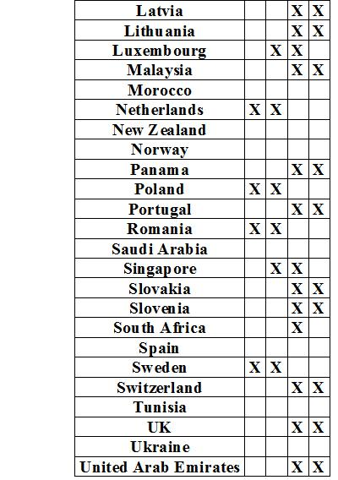

Slide 12
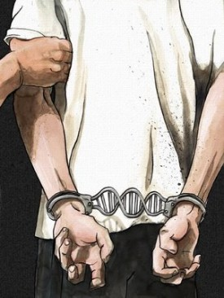
Draft India DNA Profiling Bill
Issues of Concern

Slide 13
Preamble (§ 1)
“[DNA analysis] makes it possible to determine whether the source of origin of one body substance is identical to that of another, and further to establish the biological relationship, if any, between two individuals, living or dead without any doubt.”
(ignores false matches, cross-contamination, laboratory error etc)

Slide 14
Steven Myer
Ohio man who was indicted for burglary based solely on DNA evidence. He spent seven months in jail before being released after subsequent retesting proved it was not his DNA sample.

Slide 15
DNA EVIDENCE: Officials admit error, dismiss case
Las Vegas Review Journal
Houston's Troubled DNA Crime Lab Faces Growing Scrutiny
New York Times
Errors prompt states to watch over crime labs
USA TODAY
Murder, rape charges dropped due to botched DNA evidence
Star-Ledger
SFPD Concealed DNA Sample Switch at Crime Lab
San Francisco Weekly

Slide 16
Definitions (§ 2)
A number of the Bill’s definitions are overbroad, further expanding the scope of its later provisions.
For example:
“Crime scene index” is defined to include “DNA profiles from forensic material found . . . on or within the body of any person, on anything, or at any place, associated with the commission of a specified offence.” Id., § 2(1)(vii) et seq. A “specified offence” is defined as any of a number of more serious crimes, “or any other offence specified in the Schedule [to the Bill].” The so-called “Schedule,” tucked neatly on page 34 of the Bill’s 35 pages, lists a hodge-podge of various crimes from rape, to “offences relating to dowry,” defamation, and “unnatural offenses.”
Taken together, the government is empowered to conduct genetic testing on almost anyone in any way connected with even minor infractions of the criminal law.
Furthermore, the crucial term “suspect” is defined as anyone “suspected of having committed an offence.” Id., § 2(1)(xxxvi). By intentionally leaving out the qualifier “specified,” the drafters’ intent is plain: to sweep within the Bill’s breadth all persons suspected of any crime whatsoever.

Slide 17
DNA Profiling Board (§§3 to 13)
An independent Board with rigorous oversight of lab quality and forensic procedures is important.
The DNA Profiling Board responsible for administering and overseeing the Indian DNA database. §3 et seq. Among its several enumerated powers, the Board is charged with “recommend[ing] privacy protection statutes, regulations and practices relating to access to, or use of stored DNA samples or DNA analyses,” as well as “mak[ing] specific recommendations to . . . ensure the appropriate use and dissemination of DNA information [and] take any other necessary steps require to be taken to protect privacy.” §13(1)(xv) to (xvi).
This provision is in lieu of any substantive principle limiting the scope of the legislation, which the bill otherwise lacks. This is a significant omission. As expressed in the preamble, the stated purpose of the Bill is “to enhance protection of people in the society and [the] administration of justice.” §1. Taken alone, this expresses only the government’s interest in the legislation, suggesting an ambiguously wide scope for its provisions.
Moreover the membership of the Board makes no provisions for the inclusion of members representing defense lawyers or anyone with a background in privacy or biomedical ethics

Slide 18
Board Approval of Laboratories (§§14 to 18)
Sections 14 to 18 provide for the approval by the DNA Profiling Board of DNA laboratories that will process and analyze genetic material for eventual inclusion on the DNA database. Under §14, all laboratories must be approved in writing prior to processing or analyzing any genetic material. However, a conflicting provision appears in the next section, §15(2), which permits DNA laboratories in existence at the time the legislation is enacted to process or analyze DNA samples immediately, without first obtaining approval.
.
The potential for abuse and error that this conflict of provisions would be best addressed in keeping with the rule articulated in §14, i.e. correcting the language of §15(2) that allows for laboratories to be “grandfathered” into the system.
Standards, Obligations of DNA Laboratory (§§19 to 28)
Chapter V, which concerns the obligations of and the standards to be observed by approved DNA laboratories, lacks adequate administrative provisions. For example, §22 requires that labs ensure “adequate security” to minimize contamination without providing for accountability in the event of contamination. Similarly, §28 provides for audits of DNA laboratories only, withholding from similar scrutiny of the DNA Profiling Board itself.

Slide 19
National DNA Database (§§33 to 37)
The national database is envisioned to comprise several sub-databases, each to contain the genetic information of a subset of persons/samples, namely: (1) unidentified crime scene samples, (2) samples taken from suspects, (3) samples taken from persons convicted or currently subject to prosecution for “subject offences,” (4) samples associated with missing persons, (5) samples taken from unidentified bodies, (6) samples taken from “volunteers,” and finally (7) samples taken for reasons “as may be specified by regulations. Id., § 33(4) et seq.
Subcategories (1) through (6) improperly create a vast database of genetic data well beyond traditional forensic use, subsection Furthermore (7) appears on its face to be a “catch all” provision, leaving one only to guess at the circumstances under which its specificities may be promulgated. Id.

Slide 20
National DNA Database (§§33 to 37)
Sample retention
A close reading of § 33(6) strongly suggests that the agency conducting the forensic analyses and populating the DNA database shall retain the DNA samples thereafter. This section reads in relevant part:
The DNA Data Bank shall contain . . . the following information, namely: (i) in the case of a profile in the offenders index, the identity of the person from whose body substance or body substances the profile was derived, and (ii) in case of all other profiles, the case reference number of the investigation associated with the body substance or body substances from which the profile was derived. Id., § 33(6).

Slide 21
Confidentiality, Access to DNA Profiles, Samples, and Records (§§ 38-44)
In all three of its subsections it purports to govern access to “the information” contained in the database, not “the DNA profiles” contained in the database. Id., § 38(1) et seq. Subsection 2 employs even broader language, covering “the information in the offenders’ index pertaining to a convict.” Id. Taken at face value, this provision of the Bill suggests that any and all sort of “information . . . pertaining to a convict” that might be derived from his or her DNA can be stored on the database.
§§ 39 and 40 purport to confer upon the police direct access to all of the information contained in the national DNA database. While administratively expedient, this arrangement opens up the possibility for misuse. A more prudent system would place the Board (or some administrative subordinate portion thereof) between the police and the content of the DNA database, with the latter having to make specific and particular requests to the former.
§ 41 permits the Data Bank Manager to grant access to the database to “any person or class of persons that the Data Bank Manager considers appropriate.” This is a sweeping provision. It vests in one individual the ability to permit almost anyone access to the DNA database—without administrative review or oversight of any kind.

Slide 22
Confidentiality, Access to DNA Profiles, Samples, and Records (§§ 38-44)
§ 44 Post-Conviction DNA Testing
Any individual undergoing a sentence of imprisonment or death pursuant
to conviction for an offence, may apply to the court which convicted him
for an order of DNA testing of specific evidence and the court may order
DNA testing of specific evidence if the specific evidence to be tested is in
the possession of the Government and has been subjected to a chain of
custody and retained under conditions sufficient to ensure that such
evidence has not been substituted, contaminated, tampered with,
replaced, or altered in any respect to the proposed DNA testing and the
court is satisfied that : (List of Nine Additional Criteria)
High barriers and absolute discretion make such testing highly unlikely

Slide 23
Omissions
No private cause of action for the unlawful collection of DNA, or for the unlawful storage of private information on the national DNA database.
No right to review one’s personal data contained on the database.

Slide 24
Best Practices Analysis: Collection of DNA
With Consent only for specific investigation (eg volunteer, victim) | No Provision
Without consent for crimes where DNA is relevant only | No Provision
Court Order Required? | No Provision
Professional req. for sample taker, location of collection? | No Provision
Quality assurance procedures for crime scene collection | Regulated at discretion of DNA Profiling Board

Slide 25
Best Practices Analysis: Analysis of DNA
Should take place only in laboratories with quality assurance | Regulated at discretion of DNA Profiling Board
Laboratories should be independent of police | Regulated at discretion of DNA Profiling Board
Profiling standards must be sufficient to minimise false matches | Regulated at discretion of DNA Profiling Board

Slide 26
Best Practices Analysis: Storage of DNA/linked data
Data from convicted persons should be separate from others e.g. missing persons’ databases | Unclear
Access to databases and samples must be restricted and there must be an independent and transparent system of governance | Regulated at discretion of DNA Profiling Board
Personal identification information should not be sent with samples to laboratories | Regulated at discretion of DNA Profiling Board
Any transfer of data e.g. from police station to lab or database, must be secure | Regulated at discretion of DNA Profiling Board

Slide 27
Best Practices Analysis: Uses of samples and data
Research uses should be restricted to anonymized verification of database performance | No Provision
Identification of a person is not an acceptable use | Unclear
Familial Searching should have specified practices and procedures | No Provision

Slide 28
Best Practices Analysis: Destruction of DNA and Linked DNA
DNA samples should be destroyed once the DNA profiles needed for identification purposes have been obtained (allowing for quality assurance) | DNA samples retained indefinitely
Automatic removal for DNA/linked data of innocent persons | No Provision
Minor crimes should not be included | Minor crimes are included
If minor crimes are included there should be retention limits | No provision
Appeals process against DNA retention | No provision

Slide 29
Best Practices Analysis: Use in court
Individuals must have a right to have a second sample taken from them and reanalyzed as a check | No Provision
Individuals must have a right to obtain re-analysis of crime scene forensic evidence in the event of appeal | High bar and discretion
Expert evidence and statistics must not misrepresent the role and value of the DNA evidence in relation to the crime | No provision

Slide 30
Best Practices Analysis: Other
Impact on vulnerable persons must be considered | No Provision
Potential for racial/ethnic/class bias must be considered In US African Americans are 13% of population but make up 40% of CODIS | No provision

Slide 31



The Forensic Genetics Policy Initiative seeks to achieve a direct impact on the human rights standards
adopted for DNA databases across the world.
Our aims are to:
Build global civil society’s capacities to engage in the policy-making processes on the development of national and international DNA databases and cross-border sharing of forensic information
Protect human rights by setting international standards for DNA databases
For more information, please visit our website at:
www.dnapolicyinitiative.org
FGPI is a collaboration of the following organizations:

