Slide 1
The UK DNA database and the European Court of Human Rights; Lessons India can learn from UK mistakes
Dr Helen Wallace
Director
GeneWatch UK
Email: helen.wallace@genewatch.org
Website: www.genewatch.org

Slide 2
Forensic DNA in the UK
Sir Alec Jeffreys discovered DNA fingerprinting and pioneered its use
The UK set up the first DNA database in the world in 1995
DNA has played a very important role in criminal investigations: helping to convict criminals and acquit innocent people
Having a DNA database was popular
But a major expansion of the UK DNA database from 2000 was controversial for technical and ethical reasons

Slide 3
UK National DNA Database
Set up in 1995 (the first in the world)
Contains DNA profiles from more than 5.7 million people (9% of UK population)
March 2009: 350,033 crime scene DNA profiles
During 2008/09, one or more subject profiles were matched with 40,687 crime scene profiles.
Matches are not convictions. About a quarter of matches lead to a conviction.

Slide 4
UK DNA database expansion
Police and Criminal Evidence Act 1994
Criminal Justice and Police Act 2001 (May 2001): allowed retention of innocent people’s DNA records (to age 100)
Criminal Justice Act 2003: move to collection on arrest (all recordable offences)
2008: European Court ruled UK retention regime unlawful (breach of privacy)
Protection of Freedoms Act adopted in May 2012 (this will remove about 1 million records from the database).

Slide 5
European Convention on Human Rights: Article 8
Everyone has the right to respect for his private and family life, his home and his correspondence.
There shall be no interference by a public authority with the exercise of this right except such as is in accordance with the law and is necessary in a democratic society in the interests of national security, public safety or the economic well-being of the country, for the prevention of disorder or crime, for the protection of health or morals, or for the protection of the rights and freedoms of others.

Slide 6
In conclusion, the Court finds that the blanket and indiscriminate nature of the powers of retention of the fingerprints, cellular samples and DNA profiles of persons suspected but not convicted of offences, as applied in the case of the present applicants, fails to strike a fair balance between the competing public and private interests and that the respondent State has overstepped any acceptable margin of appreciation in this regard. (S & Marper v UK 2008)

Slide 7
Accordingly, the retention at issue constitutes a disproportionate interference with the applicants' right to respect for private life and cannot be regarded as necessary in a democratic society. (S. and Marper v UK, 2008)

Slide 8
Problems with the UK DNA database expansion
Expanding the UK DNA database did not help to solve more crimes
Making DNA databases bigger also increases the risk of miscarriages of justice due to false matches or errors
Collecting DNA routinely or arrest and keeping all records indefinitely caused a loss of public trust in policing and a decision against the UK government by the European Court

Slide 9
DNA detections
Matches between crime scene DNA profiles and stored individuals DNA profiles are a poor measure of success
In the UK many matches are now with innocent people (including victims or their relatives) not the perpetrator
DNA detections: are cases which go to court in which there is a DNA match
About half DNA detections lead to a conviction (may vary with crime type)
All 3 types of matches are included

Slide 10
3 types of DNA matches
DNA matches with known suspects (don’t need a DNA database);
DNA matches with stored crime scene profiles (only need crime scene DNA profiles to be stored);
DNA matches with stored individuals’ profiles can sometimes identify an unexpected suspect (a ‘cold hit’): but corroborating evidence is needed to show this individual committed the crime

Slide 11
0.37% of crimes were detected using DNA in 2008/09. Mostly volume crimes.
GeneWatch estimate: only about 11% of these involved ‘cold hits’ with stored individuals’ DNA profiles. Most of these will involve matches with DNA profiles from repeat offenders.
89% involved known suspects (no need for a database) or matches with stored crime scene DNA profiles.
0.98% of total DNA detections were for rape, and 0.4% were for homicide.

Slide 12
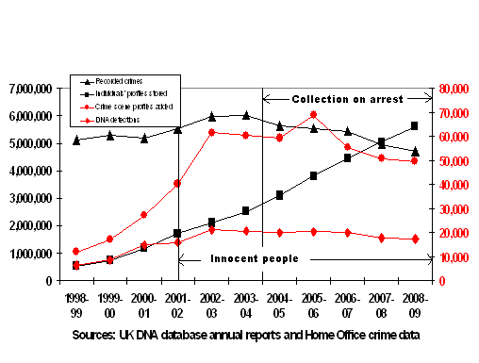
DNA detections have not increased as the DNA database expanded

Slide 13
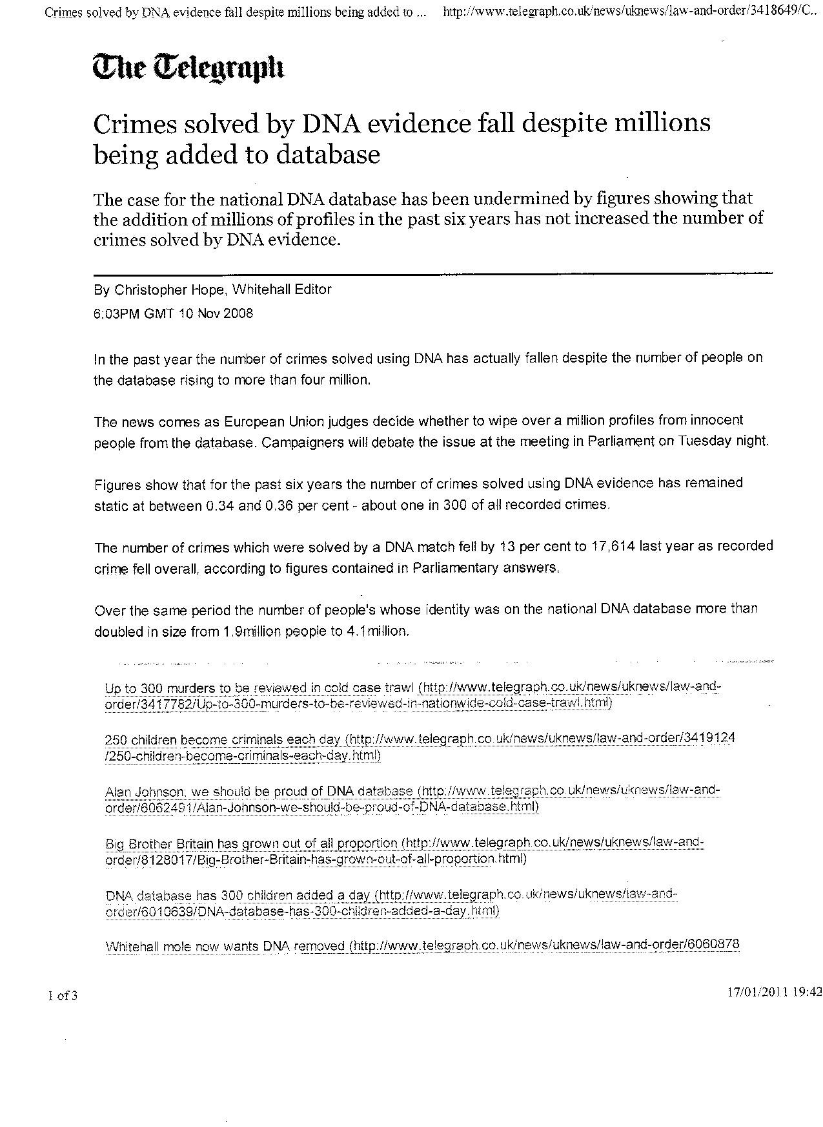

Slide 14
Cost effectiveness?
Record number of DNA samples taken but crimes solved with them are down. The Times, 22nd October 2009. A record number of DNA samples are on the national database yet the number of crimes solved using them has fallen by a fifth, according to an official report published yesterday. At the same time the cost of running the system has more than doubled to over £4 million.
Adding one DNA profile to the database costs £30-40. Storing one sample costs £1 per year. (Excludes police costs).

Slide 15
Importance of crime scene investigation
Success is driven by the number of crime scene DNA profiles loaded to the database.
If there is no DNA collected from the crime scene, a DNA database will not solve it.
Careful crime scene analysis is critical to maintaining a clear, uncontaminated chain of evidence (thorough, fast, documented, trusted).
There are real limits to how many crimes can be solved using DNA (DNA is collected from less than 1% of crime scenes).

Slide 16
Failures to take suspects’ DNA
Serial rapist Delroy Grant (the Night Stalker) 2011: Police focus on mass DNA screenings of black men with motorbikes. Wrong DNA predictions about Windward Islands origin. Identified but never interviewed in connection with a burglary linked to the attacks. Eliminated as a suspect because another Delroy Grant was on the DNA database. Ultimately caught when police abandoned their focus on DNA. http://www.telegraph.co.uk/news/uknews/crime/8397585/Night-Stalker-police-blunders-delayed-arrest-of-Delroy-Grant.html
.

Slide 17
Keeping individuals’ DNA records helps to solve more crimes only if they commit future crimes for which DNA evidence is relevant
Collection of DNA clearly makes sense if a person is a suspect for a crime from which DNA evidence is available.
‘Speculative searches’ against past crime scene DNA profiles stored on a database could lead to further matches (but there could also be false matches).
Retaining an individual’s DNA profile on a DNA database allows them to be treated as a suspect for any future crime, as new crime scene DNA profiles are loaded.

Slide 18
DNA is not foolproof
The expected number of false matches is proportional to the number of comparisons that are made
Chance of a false match with a partial (degraded) crime scene profile or with relatives is higher
Errors can occur in labs: quality assurance is critical
There can be an innocent explanation for DNA at a crime scene
An unexpected DNA match can reverse the burden of proof: an individual may be required to prove they did not commit a crime

Slide 19
EU Prüm Decisions (‘birthday problem’)
The expected number of false matches = number of comparisons x match probability
False DNA profile matches are expected to occur routinely by chance when the EU Prüm Decisions come into force (sharing of matches in EU).
This requires match sharing based on only 6 loci
Dutch Forensic Science predicts 9,460 false matches (20 with full SGM-plus DNA profiles) a year for a DNA database containing 4 million people’s profiles (less than UK database)
There are plans for a new EU-wide profiling system to try to address this.
The discriminatory power of existing DNA profiling systems may not be sufficient for large populations (if inclusion criteria are wide): especially if family size is large

Slide 20
Access to DNA samples and profiles can allow unethical abuses
Tracking of citizens and their families, including non-paternity, if access is gained
Categorisation based on genetics or other data (names, ethnicity, arrest records)
Discrimination based on categorisation of individuals as ‘risky’ (e.g. UK citizens refused US visas because of an arrest)
Private genetic data (e.g. health data) can be obtained if stored samples are re-analysed

Slide 21
Who is on the UK DNA Database?
March 2010: an estimated 1,083,207 innocent people (up to 100,000 aged ten to 17).
About a million people arrested as children.
Many more people not convicted by a court (given police cautions, reprimands or warnings)
DNA of 37% of black men held by police. The Guardian. 5th January 2006.
Three in four young black men on the DNA Database. The Telegraph. 5th November 2006.

Slide 22

November 24, 2009
From schoolboy squabble to DNA database in one easy step - if you're black
Fiona Hamilton, London Correspondent
A missing Pokémon set was a big deal to a young boy in the Nineties. The cards were treasured and traded, and children who could not join in the swapping huddles would feel left out.
So when Tresfaye Smith’s friend mislaid his set, he was more than upset. His father accused 12-year-old Tresfaye of stealing the cards — and called the police.

Slide 23
People on the DNA database
A grandmother arrested for failing to return a football kicked into her garden. The Daily Mail. 5th October 2006.
A ten-year-old victim of bullying who had a false accusation made against her. The Evening Standard. 11th September 2009.
A 14-year-old girl arrested for allegedly pinging another girl's bra. The Daily Mail. 28th July 2006.
A 13-year-old who hit a police car with a snowball. New Statesman. 25th April 2005.
A computer technician wrongly accused of being a terrorist. The Register. 17th September 2007.
TV executive Janet Street-Porter. The Independent. 31st July 2008.
Comedian Mark Thomas. The Guardian. 19th March 2009.
(At least) three innocent members of parliament

Slide 24
Three linked databases plus samples (currently kept to age 100)
DNA samples. Taken using a mouth swab at the police station. One is analysed and one stored in the lab, with personal data.
DNA database record. Includes name, ethnic appearance, DNA profile. Linked to sample with bar code. Linked to PNC with Arrest Summons Number.
Police National Computer records (PNC). Computer records containing details of individual and their arrest.
Fingerprints (computer database IDENT1)

Slide 25
People’s concerns include
  the personal nature of their DNA;
  being treated like a criminal (unfairness);
  the growth of a ‘Big Brother’ state and potential misuse of data by government (tracking individuals or groups of people or their families);
  potential loss of data or misuse of data (including by corrupt police officers, commercial providers or infiltrators);
  the implications of having a ‘criminal’ record for the rest of their life (including implications for employment, visas or treatment by the police);
  the possibility of being falsely accused of a crime.

Slide 26
Issues of trust in policing
Police 'arrest innocent youths for their DNA', officer claims. The Telegraph. 4th June 2009.
Public concerns about lack of independence of the DNA database. Citizens’ Inquiry 2008:
DNA database scandal is damaging UK race relations says expert. The Voice, 17th August 2009.
Body in charge of UK policing policy is now an £18m-a-year brand charging the public £70 for a 60p criminal records check. Daily Mail, 15th February 2009.

Slide 27
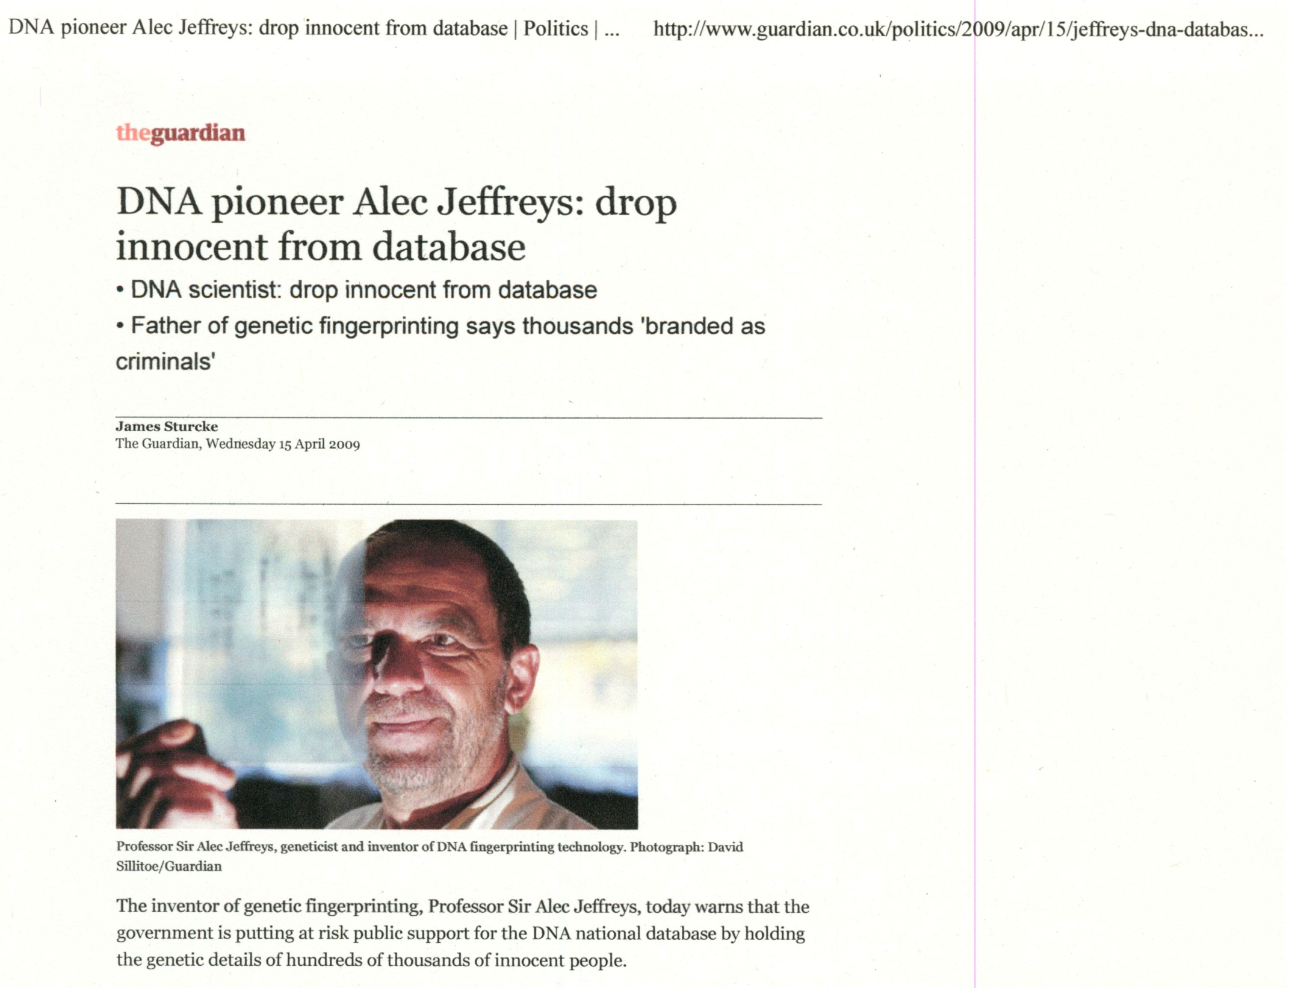

Slide 28
Protection of Freedoms Act
Biological samples will be destroyed within 6 months (instead of keeping for 100 years).
Innocent people’s DNA profiles will be automatically removed from the DNA database (most immediately, some can be kept for 3 to 5 years)
Fingerprints also will be removed.
Only a barcode, not identifying details, will be sent to labs with the samples for analysis
Police policy will change so innocent people’s Police National Computer records and photographs are also deleted

Slide 29
Retaining all DNA records
…led to loss of trust as people questioned why others should have access to their DNA and other data.
...did not help to solve more crimes. Benefits tail off rapidly and problems increase as DNA databases expand. Better and faster crime scene analysis, plus following leads to identify known suspects (and take DNA and fingerprints from them when relevant), is much more effective (and cost-effective) than “widening the net”.

Slide 30
India’s DNA proposals (1)
Collection policy is very unclear: when is consent needed? No judicial oversight.
Includes a wide (expandable) list of crimes and also civil cases, missing persons (and their relatives) and volunteers
Does include a removals process but for DNA profiles only: relies on court informing the database managers
Samples and other data may be retained, process may be unreliable, what about cases that do not go to court?

Slide 31
India’s DNA proposals (2)
Unclear what DNA profiling system will be used and whether it has sufficient statistical power (how big will the database be?) Populations: India 1,170m; US 313m; EU 502m.
Existing labs may carry on without QA
Will corroborating evidence be required in court? Will a confirmatory sample be taken from defendants?
Is the proposed system cost-effective?

Slide 32
India’s DNA proposals (3)
What other data will be retained in order to identify an individual when there is a match? Could this be misused e.g. to refuse visas, jobs?
How will state-level DNA databases be managed and controlled? Will they keep DNA samples indefinitely? Will these be used for controversial research?
What is the present situation in States and what is the legal basis for collection, storage and use of DNA and other data?

Slide 33
Conclusions
Use of DNA can help solve crimes, but putting more people on a database may not help to solve more crimes.
DNA databases can breach privacy of citizens: this can be justified during an investigation but not always afterwards.
DNA evidence is not foolproof: more comparisons mean more false matches
Safeguards and high technical standards are essential to prevent abuses and miscarriages of justice.

