Slide 1
PERSONAL INFORMATION
NAME: SUNIL ALDO S A
BRANCH: MCA
SEMESTER: II
SEC: 2
SUBJECT: MINI PROJECT
REGISTER NO: 142224621057

Slide 2
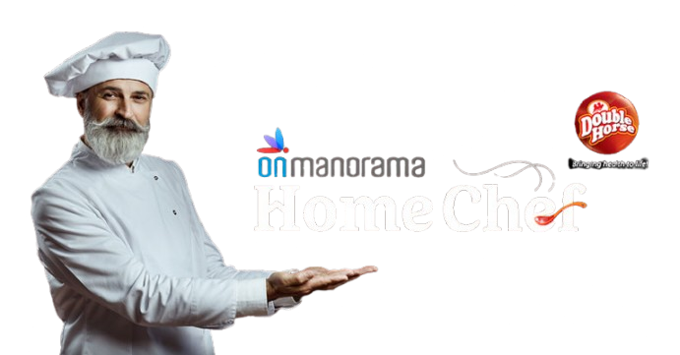

HOMECHEF
Instant Access to Home-Cooked Meals
Analysis and Development of a Personalized Home Chef Platform: A Design on User Preferences and Recommendation Algorithms

Slide 3
ABSTRACT
Many students and working professionals staying in PGs and rented houses struggle with daily cooking due to busy schedules and limited cooking resources. This project aims to develop a web-based food service platform that connects users with cooks who can either cook at the user's place, provide takeaway meals from their own place, or be hired for special events. The system will have three user roles: Admin, Cooks, and Users. The platform will allow users to register, book services, and cooks can manage orders and availability. The admin will oversee the entire system, ensuring smooth operation.
This paper explores the design and implementation of a home chef platform aimed at connecting home cooks with students and working professionals staying in PGs and rented houses. It investigates user preferences, personalization techniques, and recommendation algorithms to enhance the user experience. The study also addresses the challenges in meal planning, ingredient sourcing, and dietary customization. a web-based food service platform that connects users with cooks who can either cook at the user's place, provide takeaway meals from their own place, or be hired for special events. Experimental results demonstrate the effectiveness of machine learning-based recommendations and user satisfaction rates.

Slide 4
PROBLEM STATEMENT
Lack of Time for Cooking
Busy schedules leave little time for preparing home-cooked meals, leading individuals to rely on unhealthy fast food options, which may not meet nutritional needs.
Difficulty in Finding Reliable Cooks
Finding trustworthy and skilled cooks who can cook at the user’s home or provide takeaway services is time-consuming and uncertain.
Unhealthy Eating Habits
Due to limited access to affordable, nutritious food options, people often resort to unhealthy meals, which can negatively impact health in the long term.
Challenges in Organizing Special Events
users often lack a dedicated platform to hire cooks for special events or occasional meal needs.

Slide 5
SOFTWARE REQUIREMENTS
Frontend:
HTML, CSS, JavaScript
Backend:
PHP (or Node.js)
MySQL (Database Management System)
Server & Hosting:
Apache/XAMPP for local development
Cloud hosting (if deployed, e.g., AWS, Firebase, or any shared hosting)
Machine Learning Model
Recommendation Algorithm:
Collaborative Filtering
Content-Based Filtering
Hybrid Approach

Slide 6
HARDWARE REQUIREMENTS
Operating System:
Windows, Linux, or macOS (for development and deployment).
Processor:
Intel Core i3 or higher / AMD Ryzen 3 or higher.
RAM:
Minimum 8GB (Recommended: 16GB for better performance).
Storage:
Minimum 256GB SSD (Recommended: 500GB SSD or higher).
Internet Connection: Required for online hosting, API integration, and remote database access.

Slide 7
LITERATURE SURVEY
Online Food Delivery Systems
Growth of Online Food Services: Online food delivery platforms such as UberEats, Zomato, and Swiggy have seen explosive growth in recent years, revolutionizing the way people access meals.
According to a study by Rahman et al.(2020), the online food delivery market in India alone is expected to reach $16.1 billion by 2023, driven by factors like urbanization, changing lifestyle and the convenience of ordering food online.

Slide 8
LITERATURE SURVEY
Existing Home Chef Platforms
Uber Eats, Swiggy, Zomato – professional vs home-based services
Impact of COVID-19 on home-cooked meal demand
Recommendation Systems in Food Platforms
Content-based filtering vs collaborative filtering
Deep learning and natural language processing (NLP) in recipe recommendations

Slide 9
SDG Applied
1. SDG 2: Zero Hunger – Ensures access to affordable and home-cooked food for students and employees.
2. SDG 3: Good Health & Well-being – Promotes healthy eating by providing nutritious home-cooked meals.
3. SDG 8: Decent Work & Economic Growth – Creates job opportunities for cooks, empowering small-scale workers.
4. SDG 11: Sustainable Cities & Communities – Encourages community-driven solutions to urban food challenges.

Slide 10
Future Enhancement
Results and Discussion
Performance Evaluation
Accuracy of Recipe Recommendations
User Satisfaction Survey
Impact on User Engagement
Frequency of Platform Usage
User Retention Rate
Integration with smart kitchen devices

Slide 11
THANK YOU

