Slide 1
Replication Overview Types of Replication Types of Subscriptions Snapshot Replication Overview Transactional Replication Overview Merge Replication Overview Replication Agents Overview How to configure the Replication Troubleshooting Replication Replication using PerfMon

Slide 2
Replication Overview Replication is a set of technologies for copying and distributing data and database objects from one database to another and then synchronizing between databases to maintain consistency. Basically we need 3 servers to configure the replication process. 1. Publisher 2. Distributor 3. Subscriber Publisher, Distributor & Subscribers - Server/Instance name Publication, Articles & Subscriptions - Items.

Slide 3
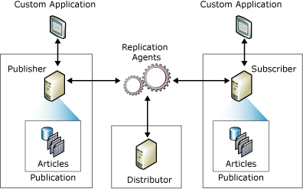

Slide 4
Publisher
The Publisher is a database instance that makes data available to other locations through replication. The Publisher can have one or more publications, each defining a logically related set of objects and data to replicate.
Distributor
The Distributor is a database instance that acts as a store for replication specific data associated with one or more Publishers. Each Publisher is associated with a single database (known as a distribution database) at the Distributor.
The distribution database stores replication status data, metadata about the publication, and, in some cases, acts as a queue for data moving from the Publisher to the Subscribers.
In many cases, a single database server instance acts as both the Publisher and the Distributor. This is known as a local Distributor. When the Publisher and the Distributor are configured on separate database server instances, the Distributor is known as a remote Distributor.

Slide 5
Subscribers
A Subscriber is a database instance that receives replicated data. A Subscriber can receive data from multiple Publishers and publications.
Publication
A publication is a collection of one or more articles from one database.
Subscription
A subscription is a request for a copy of a publication to be delivered to a Subscriber. The subscription defines what publication will be received, where, and when. There are two types of subscriptions.
push and pull.
Article
An article identifies a database object that is included in a publication. A publication can contain different types of articles, including tables, views, stored procedures, and other objects. When tables are published as articles, filters can be used to restrict the columns and rows of the data sent to Subscribers.

Slide 6
Types of Subscriptions
Subscription Method
Push | Pull
You have a relatively small no of subscribers | You have a large No of subscribers
You are replicating over the LAN or WAN, but it does not work well over the internet | You are replicating over the unreliable links or internet. Here the subscribers are autonomous(i.e.) they will determine when they wish to receive the data

Slide 7
Types of Replication
There are 4 types of Replication.
Snapshot Replication
Transactional Replication
Transactional Publication with Updating Subscriber
Merge Replication

Slide 8
Snapshot Replication Overview
Snapshot replication distributes data exactly as it appears at a specific moment in time and does not monitor for updates to the data. When synchronization occurs, the entire snapshot is generated and sent to Subscribers.
Here data changes are not tracked, each time a snapshot applied it completely overrides the existing data.
The Snapshot Agent & Distribution Agent will run when the data generated every time.
Copies the data from the published table at the publisher and writes the data to the snapshot folder. It is generated as a set of BCP files (Bulk Copy Program).

Slide 9
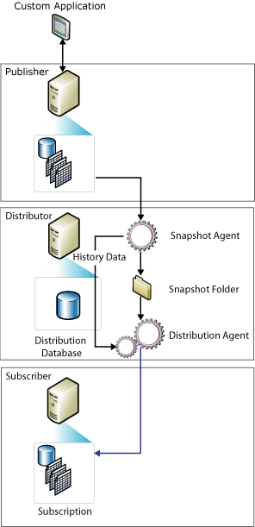
The Distribution agent reads the location of the snapshot files and applies the schema and commands to the subscription database and synchronization commands from both tables.

Slide 10
Transactional Replication Overview
Transactional replication typically starts with a snapshot of the publication database objects and data.
As soon as the initial snapshot is taken, subsequent data changes and schema modifications made at the Publisher are usually delivered to the Subscriber.
Incremental changes made at the Publisher flow to Subscribers according to the schedule of the Distribution Agent .
The application requires low latency between the time changes are made at the Publisher and the changes arrive at the Subscriber.

Slide 11
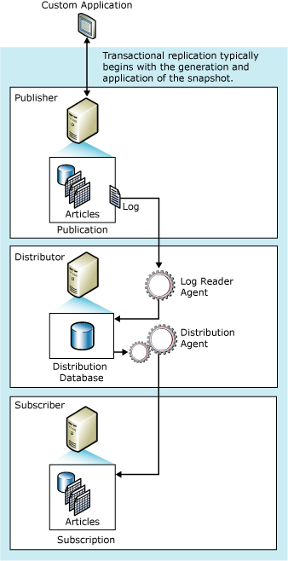
The Log Reader Agent monitors the transaction log of each database configured for transactional replication and copies the transactions marked for replication from the transaction log into the distribution database
When executing, the Log Reader Agent first reads the publication transaction log and identifies any INSERT, UPDATE, and DELETE statements, or other modifications made to the data in transactions that have been marked for replication
The Log Reader Agent calls sp_repldone to mark where replication was last completed.
The agent moves transactions from the distribution database to the Subscriber.

Slide 12
Transactional Publication with Updating Subscriber
It supports updates at Subscribers end through updatable subscriptions method. The following are the two types of updatable subscriptions:
Immediate updating. The Publisher and Subscriber must be connected to update data at the Subscriber.
Queued updating The Publisher and Subscriber do not have to be connected to update data at the Subscriber. Updates can be made while the Subscriber or Publisher is offline.
Updating subscriptions are supported for Subscribers running Microsoft SQL Server 2000 SP3 and later .

Slide 13
Peer to Peer Replication
Peer-to-peer transactional replication is designed for applications that might read or modify the data at any of the databases participating in replication.
Peer-to-peer replication is available only in SQL Server 2005 Enterprise Edition.
Configuring a peer-to-peer replication topology is very similar to configuring a series of standard transactional publications and subscriptions.
How to enable the publication for peer-to-peer replication.
In the Publication Properties - <Publication> dialog box, on the Subscription Options page, select a value of True for the property Allow peer-to-peer subscriptions.

Slide 14
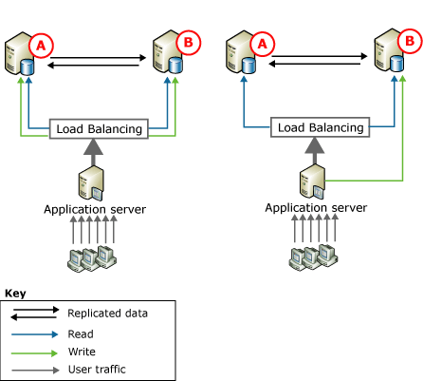
On the left, updates are partitioned between the two servers; if the database contained a product catalog, you could, for example, have a custom application direct updates to node "A" for product names beginning with A-M, and direct updates to node "B" for product names beginning with N-Z. Updates are then replicated to the other node.
On the right, all updates are directed to node "B". From there, updates are replicated to node "A". If "B" is offline (for example, for maintenance), the application server can direct all activity to "A". When "B" is back online, updates can flow to it, and the application server can move all updates back to "B" or keep directing them to "A".
Benefits of using this Replication
Improved read performance, because reads are spread out over two servers. Higher availability if maintenance is required or in case of failure at one node.

Slide 15
Merge Replication
Merge replication, like transactional replication, typically starts with a snapshot of the publication database objects and data.
Subsequent data changes and schema modifications made at the Publisher and Subscribers are tracked with triggers.
The Subscriber synchronizes with the Publisher when connected to the network and exchanges all rows between the Publisher and Subscriber since the last time synchronization occurred.
Multiple Subscribers might update the same data at various times.
Conflicts might occur and, when they do, you need the ability to detect and resolve them.

Slide 16
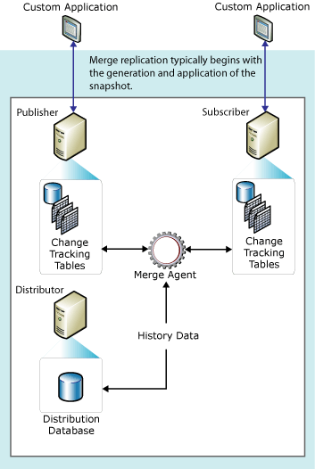
Merge replication is implemented by the SQL Server Snapshot Agent and Merge Agent.
The Snapshot Agent creates a snapshot for each partition of data.
The Merge Agent applies the initial snapshots to the Subscribers. It also merges incremental data changes that occurred at the Publisher or Subscribers after the initial snapshot was created, and detects and resolves any conflicts according to rules you configure.

Slide 17
Replication Agent Overview
Snapshot Agent: The Snapshot Agent is typically used with all types of replication. It prepares schema and initial data files of published tables and other objects, stores the snapshot files, and records information about synchronization in the distribution database.
Log Reader Agent: The Log Reader Agent is used with transactional replication. It moves transactions marked for replication from the transaction log on the Publisher to the distribution database.
Queue Reader Agent: The Queue Reader Agent is used with transactional replication with the queued updating option. The agent runs at the Distributor and moves changes made at the Subscriber back to the Publisher.
Distribution Agent: The Distribution Agent is used with snapshot and transactional replication. It applies the initial snapshot to the Subscriber and moves transactions held in the distribution database to Subscribers.
Merge Agent: The Merge Agent is used with merge replication. It applies the initial snapshot to the Subscriber and moves and reconciles incremental data changes that occur. Each merge subscription has its own Merge Agent that connects to both the Publisher and the Subscriber and updates both.
By default, the Merge Agent uploads changes from the Subscriber to the Publisher and then downloads changes from the Publisher to the Subscriber.

Slide 18
How to Trouble Shoot
Issue 1
Security is the common cause of replication failure.
To fix this problem the owner of the Job should be either a standard SQL Server Login Acc or a local system acc
To check the windows the working directory called \\drive\mssql\repldata folder. It is an administrative share It means that only Administrator can access it
If the account by the SQL Srv Agent is not an administrator on the domain, replication will fail.
All of the SQL Srv Agent services in all of the servers involved in Replication should use the same domain account, if not Distribution server will fail.

Slide 19
How to Trouble Shoot
Issue 2
For example, if your distribution is working fine, but none of your subscriber are not getting any new data, the Problem is Log Reader Agent.
To fix this problem make sure that SS Agent services on dis & Pub using the same domain.
Verify that the transaction log for the dis db is not full. If it is full the Log reader will not able to write changes to the Dis db.

Slide 20
How to Trouble Shoot
Issue 3
If some of the Subscribers receiving data, but others are not.
Then the problem is in the distribution process.
To fix this make sure the subscription server is online.
Make sure the sub db is online, becoz it should not be marked as shutdown, readonly, single user or restricted user as such.
Check the distributor & subscriber server using the same domain account for their SS Agent services.

Slide 21
How to Trouble Shoot
Issue 4
If one of your subscribers goes down.
It will show some error like, your sub will be out of synch with the publisher.
Here SQL Server is always keeping track of where it left off.
So, If sub goes down, just bring it online and it will start replicating again with the next schedule.
If it is down for more than 24 hours, you should create a new snapshot for it, so that it is completely restored.

Slide 22
How to Trouble Shoot
Issue 5
If your distribution goes down.
If it fails the replication halts altogether totally.
Just bring it back online and it starts functioning again.
Within 24 hours, the dis srv having a fail-safe mechanism that keeps it from replicating old transactions to subscribers.
If it is more than 24 hrs, all the transactions in the dis DB is timed out.
If this happens, just create a new snapshot for all of your subscribers and you will be up & replicating again.

Slide 23
Replication Tables
Using Distribution Database.
If you want to check the Publication & Articles
Use MsPublications & MSArticles tables
If you want to see all the agent
Select * from msdistribution_agents
If you want to see the complete information of all agents.
Use msdistribution_history table
If you want to see the subscriber details.
Use Mssubscriber_info & Mssubscriptions tables
If you want to see the errors that occur during replication & synchronization.
Use Msrepl_errors & Mssync_status

Slide 24
Using PerfMon
Using Performance Monitor
SQL Server: Replication Agents – Monitor the status of all replication agents.
Replication Dist – It monitor the No. of Transaction transferred/sec.
Replication Logreader – It monitor the status of Log reader agent.
Replication Merge Agent – It monitor the No of conflicts/Sec.
Replication Snapshot – It monitor the No of trans/sec.

Slide 25
Links Referred.
http://msdn.microsoft.com/en-us/library/ms152567(v=SQL.90).aspx
http://msdn.microsoft.com/en-us/library/ms152762(v=SQL.90).aspx
http://msdn.microsoft.com/en-us/library/ms152501(v=SQL.90).aspx
http://msdn.microsoft.com/en-us/library/ms152531(v=SQL.90).aspx

Slide 26
Thank U ☺

