Slide 1
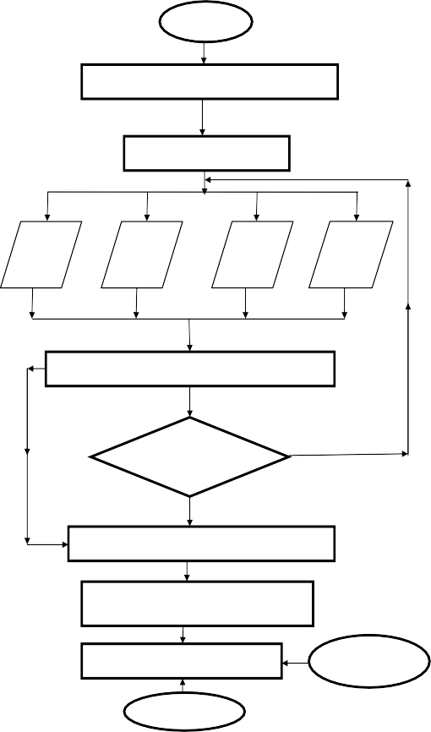
START
INITIALIZE HARDWARE MODULE
POWER UP HARDWARE
DHT11
SENSOR
IR
SENSOR
MQ9
SENSOR
HC-SR04
SENSOR
ESP32 (WROOM32)
EXCEED THE
CONDITION
NO
YES
DISPLAY THE MEASURE VALUES ON LCD
SENSOR VALUES UPDATED
TO WEB PAGE USING BLYNK IOT
LED ON
IF ABNORMALITY HAPPENS
BUZZER ON
STOP

