Slide 1

The Movies: Prediction of user ratings
Notes:
Template version: 11/20/2012, for PowerPoint 2007 & 2010

Slide 2
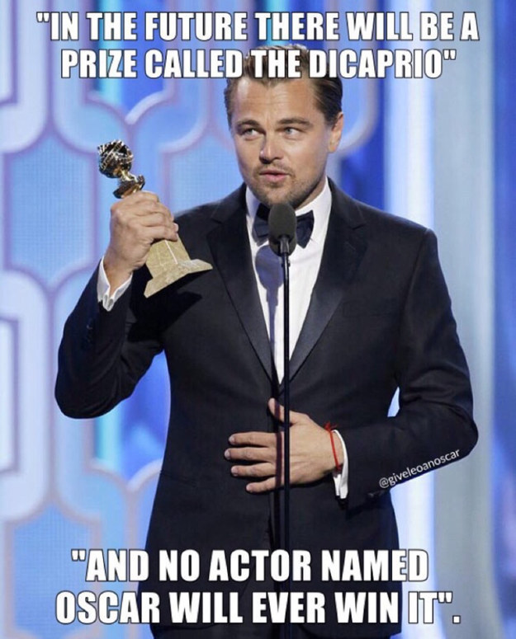
Many of our producers desperately deserve recognition. We can help them; with Data!

Slide 3
Goals
Goal: Predict user rating
Initial question: Can we predict how much people will like a movie based only on information we had before movie release?
Type of model: Linear Regression (sk-learn)
Target variable: User score
Inputs: Production budget, run time, widest release, director
Beyond the initial question listed above, we explored a variety of different models to predict user score
Inputs: Metascore
If we only know much critics liked the movie, could we predict how much users will like the movie?
Inputs: Metascore, domestic gross
Will adding one more variable improve the model?
Inputs: All continuous variables + director
How well can we predict user score if we just dump most of the variables in?

Slide 4
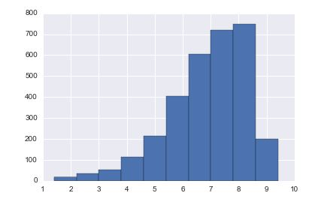
Distribution of User Scores
Frequency
User Score

Slide 5
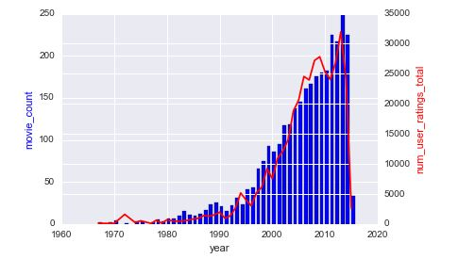
Number of Movies vs User Ratings

Slide 6
By looking at the pairwise correlation we were able to see which variables may be significant

Slide 7
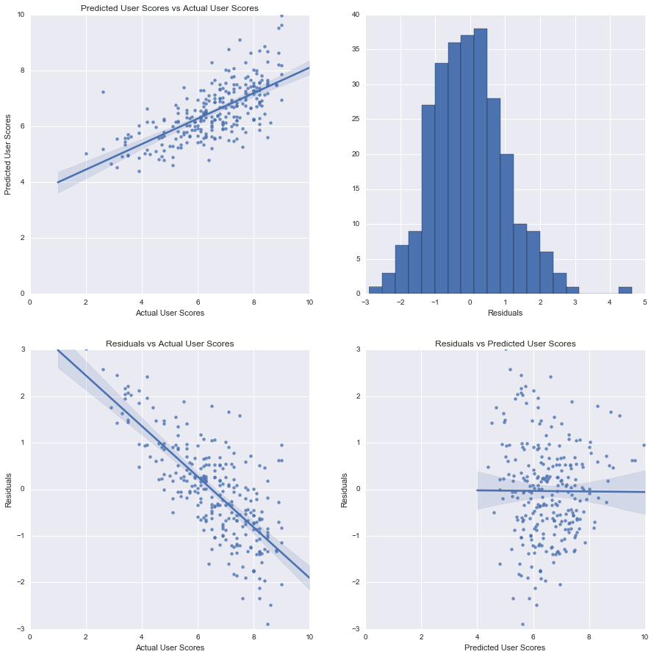
While the most comprehensive model appeared to have the best predictive ability, plots show variability

Slide 8
Results
Takeaways
Given information we would have before movie release, it’s very difficult to predict how much people will like the movie
Metascore (critic ratings) alone is quite powerful in predicting user score
Dumping [almost] all predictors into a model provided the best performance on the test set
Next steps
Explore more complex, non-linear models
More sophisticated feature generation & selection
Variable transformations
Monotonic and non-monotonic transformations
Code categorical variables differently
Handle missing variables differently
Inputs | R^2 | Adj-R^2 | MSE
Pre-release model | 0.158 | 0.121 | 1.506
Based only on critic ratings | 0.389 | 0.389 | 1.154
Critic ratings + gross | 0.376 | 0.375 | 1.293
All continuous + director | 0.442 | 0.402 | 1.174
All continuous + director + genre | 0.458 | 0.404 | 1.140

