Slide 1

Library Management System
Group Member
Abinash Phuel (985241)
Amit Timalsina (985282)
Sunil Chaudhary (985177)

Slide 2
1.0 Introduction
System helps to solve the library problems like checkout, members, book record, record search.
Librarian : Checkout books for members
Admin : Adds new books, adds new member.
Both : Can use all of the functions
LMS is simple and user friendly software

Slide 3
2.0 Problem Statement
Usually keeping book record in excel sheet or any other method is very slow and lest accurate
Current running software also cannot maintain record more securely and very slow performance.
LMS Follow the MVC Pattern which is safe and faster then others.

Slide 4
3.0 Our AIM
Admin : Can add Member and Book
Librarian : can check out easily
Make fast service in Library
Can generate very basic reports.

Slide 5
3.0 Our AIM
Admin : Can add Member and Book
Librarian : can check out easily
Make fast service in Library
Can generate very basic reports.

Slide 6
4.0 Requirement Analysis
Login : authorization for admin and librarian.
Administrator
Book and Book Copy: Add book and its copy, also Author details.
Member: Add new Member
Librarian
Checkout Entry : Check out book for member
Checkout Record : display records to the table.

Slide 7
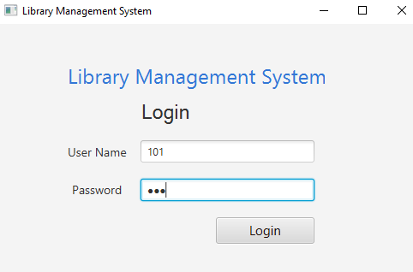

5.0 Project Overview
Login and Logout : Checks UserId and Password, authorization(Admin,librarian,Both)

Slide 8
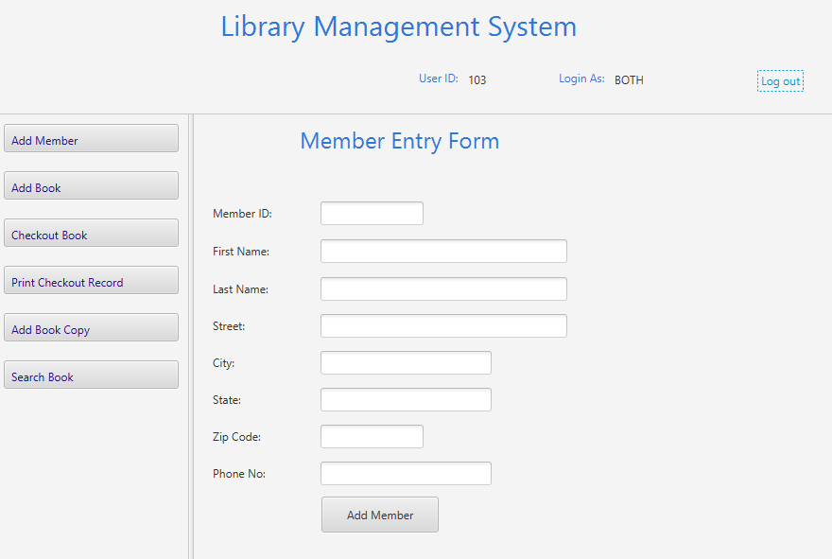
5.1 Main Page
All forms are redirects from this form.
Main form display on this basis of authorization.
Both

Slide 9
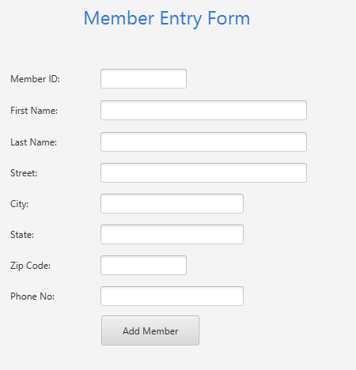
5.2 Member Panel
Can add members

Slide 10
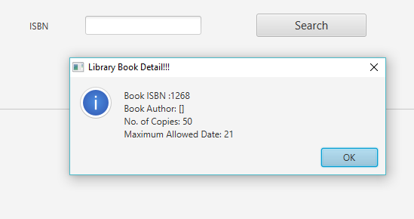
5.3 Add Book, Copy and Author
Also perform Search Book Operation.

Slide 11
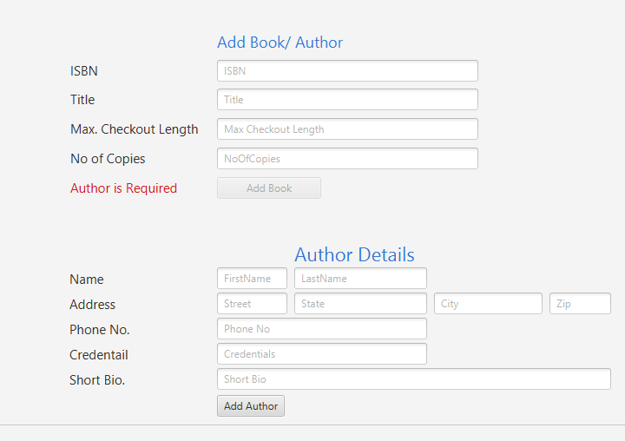
5.3.1 Book and Author

Slide 12
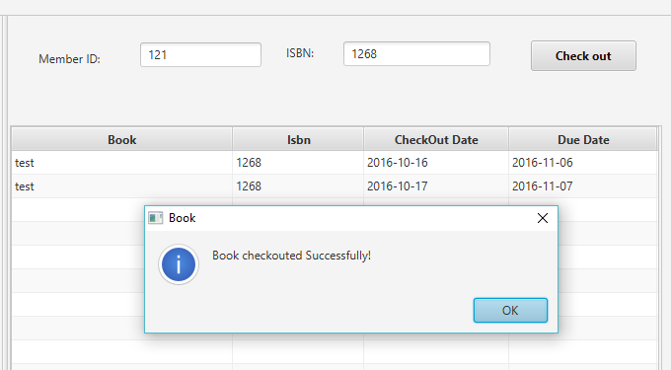
5.3.2 Checkout Entry and Record
Record of book and member.

Slide 13
6.0 Features Expansion
Check in Record system
Over Due Record
Book Location Tracker

Slide 14
7.0 Conclusion
LMS is user friendly, faster and very accurate software tool.
Suitable to use small and big library
Risk Reduction
Check the availability of book and copies
Issue book easily

Slide 15

Demo
Thank you

