Slide 1

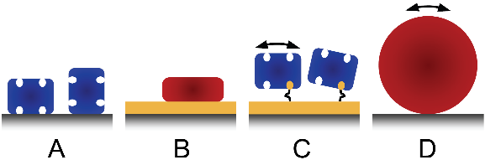
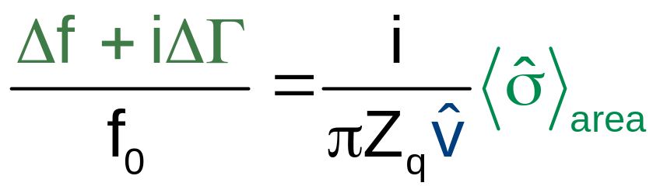
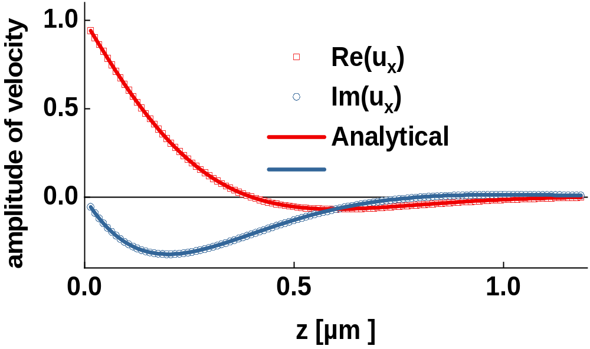

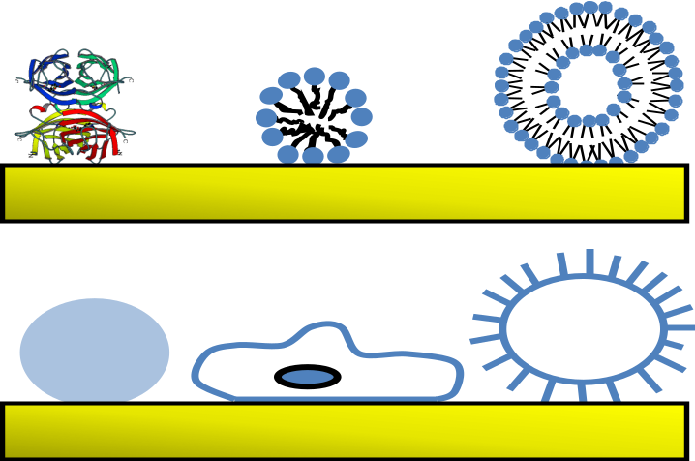
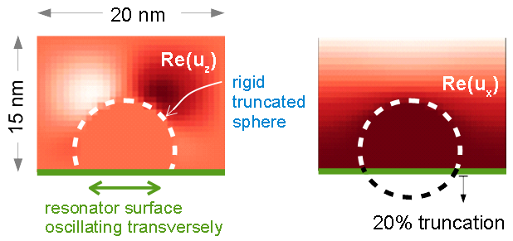
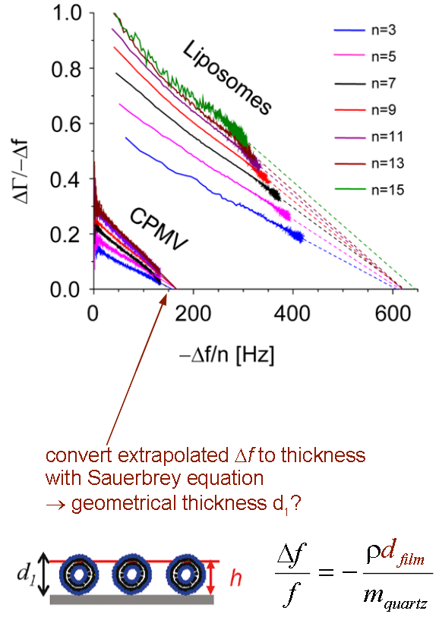
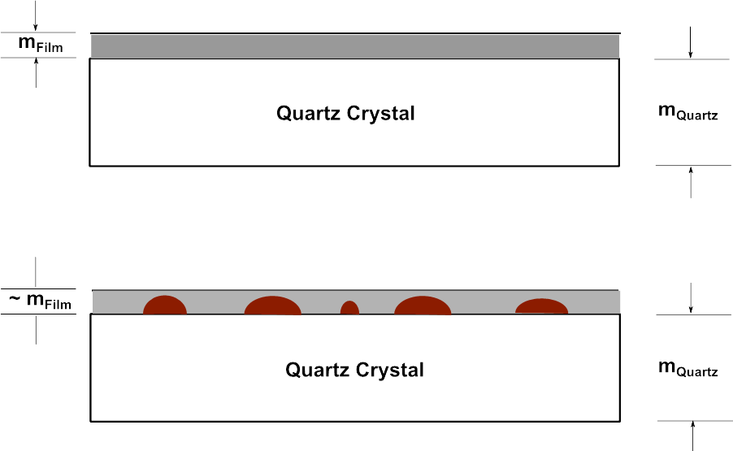
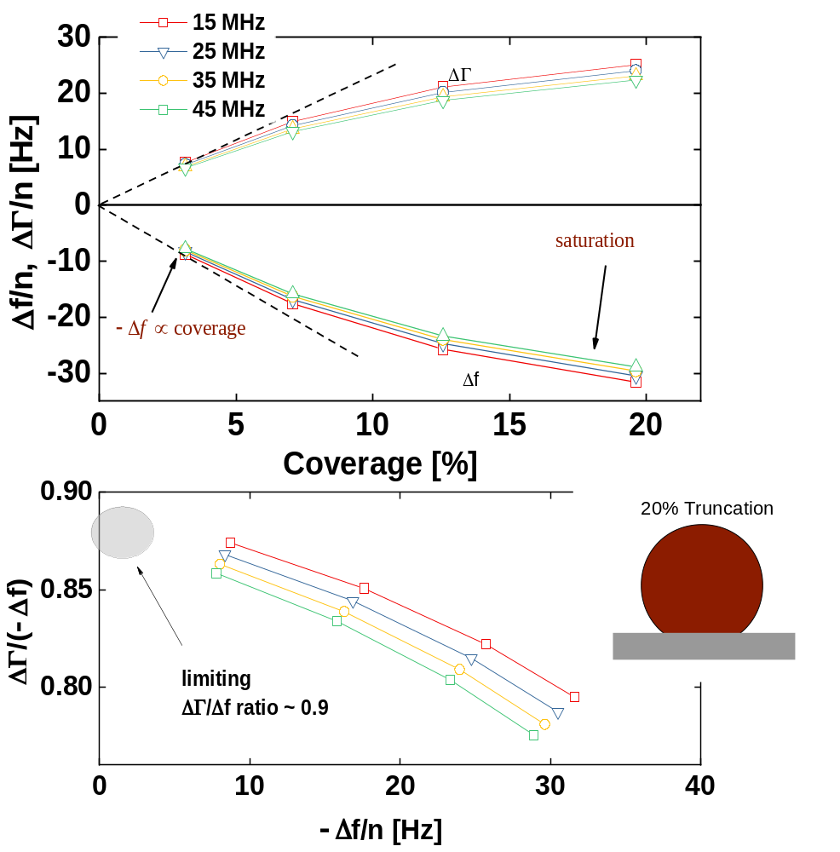
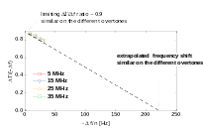
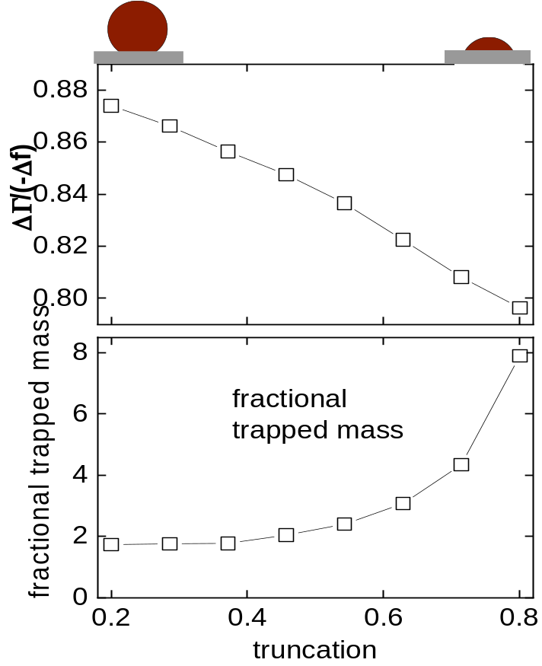
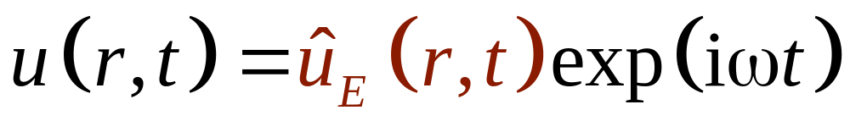
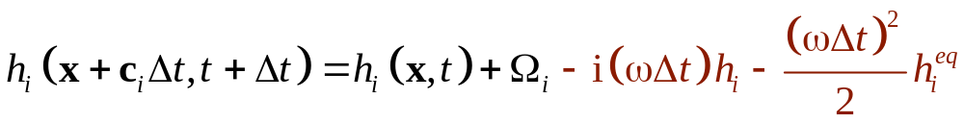
Towards the Prediction of the Frequency Shift of Acoustic Sensors using the Frequency-Domain Lattice Boltzmann Method
Sunil Gopalakrishna, Gunther Brenner, Diethelm Johannsmann
Clausthal University of Technology sunil.gopalakrishna@tu-clausthal.de
Background:
Quartz Crystal Microbalance (QCM)
Conclusions
FD-LBM algorithm implemented
− Δf scales as coverage at low coverage, as expected
− Δf saturates at high coverage, as expected
ΔΓ−Δf-plots
− small truncation: limiting value of ΔΓ/(−Δf) ~ 1
decreases with increasing truncation
− Extrapolation scheme does not work
Effects of clustering as expected
The quartz crystal microbalance (QCM) is not only a film-thickness monitor, but also a surface analytical tool in a wider sense.
The analysis rests on shifts of frequency and bandwidth (Δf and ΔΓ) on a number of different overtones (n).
Structured samples: Δf and ΔΓ cannot be predicted from the sample’s geometry and viscoelasticity ⇒ numerical methods required
(here: Lattice Boltzmann Method, LBM)
LBM model connects to Δf and ΔΓ via the
small-load-approximation.
U
~
I
~
quartz plate
f = f
res
:
large amplitude of motion
electrodes
⇒ large current
8
unloaded
6
loaded
Γ
conductance G [mS]
4
Δ
f
2
Γ
0
frequency
Validation
Bare liquid (“2nd Stokes problem”):
Velocity profile reproduced
Calculated Δf and ΔΓ within 1% of analytical result
Δf_{theo} = −716.78, ΔΓ_{theo} = 716.78
Δf_{simul} = − 716.32 , ΔΓ_{simul} = 716.71
Flow fields as expected
For hemispheres, Δf is in the range,
which is expected form the Sauerbrey
approximation
Key to the model is the area-averaged complex amplitude of the shear stress at the resonator surface , which may be obtained from computational fluid dynamics.
Research Goals
Create a numerical model, which predicts
Δf and ΔΓ from the geometry and the viscoelastic
parameters for structured samples.
Reproduce “ΔΓ−Δf-plots”:
Experimentalists doing adsorption
experiments do not know the coverage.
They plot ΔΓ/(−Δf) versus −Δf (“ΔΓ−Δf-plots”).
These plots need interpretation
Test ΔΓ/(−Δf) extrapolation hypothesis
Low coverage limit:
Calculate trapped mass of liquid
→ reliable conversion from –Δf/n to coverage
Tellechea, E., Johannsmann, D., Steinmetz, N. F., Richter, R. P., & Reviakine, I.
(2009). Langmuir, 25(9), 5177-5184.
Dependence of Δf and ΔΓ on coverage
At low coverage there is little hydrodynamic
interaction between spheres.
−Δf (“apparent mass”) scales as coverage.
The comparison between apparent mass and
true mass yields the “fractional trapped liquid”
At low coverage, the limiting ΔΓ/(−Δf) is close to unity. It decreases with truncation
At high coverage, there is saturation because
the liquid in-between particles moves together
with the particles.
The ΔΓ/(−Δf) extrapolation hypothesis is not supported
Frequency-Domain
Lattice Boltzmann Method (FD-LBM)
A modification of the standard Lattice-Boltzmann Method (LBM)
The modification comprises two steps:
Non-linear terms are omitted throughout (second or higher-order velocities)
The FD-LBM simulation computes the complex amplitude u_{E}(r,t) of an oscillatory flow field
In terms of efficiency, FD-LBM and standard LBM are comparable.
Streaming and relaxation are iterated until the steady state is reached.
(“ringing-in”)
The bounce-back step, that accounts for the boundary conditions, is part of the streaming step.
The collision step is
with h_{i} = f_{i} – f_{i,rest} a background-subtracted population and ω the frequency of
oscillation and Ω is the BGK collision operator.
- Shi, Y.; Sader, J. E., Physical Review E 2010, 81, (3), 036706
- Johannsmann, D., & Brenner, G. Analytical Chemistry 87.14 (2015): 7476-7484.
Current goals and future work
Introducing viscoelastic properties for the samples on the QCM.
OpenMP parallelization has been implemented but, MPI implementation is still in progress.
Performance measurement is to be conducted as well.
Acknowledgments
The work was funded by the Deutsche Forschungsgemeinschaft (DFG)
under Jo 278/20-1 324062370

