Slide 1
Product Quality Metrics

Slide 2
Software Quality Metrics
Three kinds of Software Quality Metrics
Product Metrics - describe the characteristics of product. Its related to operation and maintenance of software
size, complexity, design features, performance, and quality level
Process Metrics - used for improving software development/maintenance process
effectiveness of defect removal, pattern of testing defect arrival, and response time of fixes
Project Metrics - describe the project characteristics and execution
number of developers, cost, schedule, productivity, etc.
fairly straight forward

Slide 3
A Good Manager Measures
process
process metrics
project metrics
measurement
product metrics
product
What do we
use as a
basis?
• size?
• function?

Slide 4
Software Quality Metrics
Product Metrics
Mean Time to Failure (MTTF)
Defect Density
Problems per User Month (PUM)
Customer Satisfaction
Process Project Metrics
Defect density during machine testing
Defect arrival patterns during machine testing
Phased-based defect removal
Defect removal effectiveness

Slide 5
Software product quality metrics
Some terminology:
Error - a human mistake that results in incorrect (or incomplete) software
faulty requirement, design flaw, coding error
Fault (a.k.a. defect) - a condition within the system that causes a unit of the system to not function properly
GPF, Abend, crash, lock-up, dead-lock, error message, etc.
Failure - required function (I.e. the goal) cannot be performed
An error results in a fault which may cause one or more failures.

Slide 6
Software product quality metrics
The quality of a product:
the “totality of characteristics that bear on its ability
to satisfy stated or implied needs”.
Metrics of the external quality attributes
producer’s perspective: “conformance to requirements”
customer’s perspective: “fitness for use” - customer’s expectations

Slide 7
Product quality metrics
Software quality consist of two levels:
Intrinsic product quality
Customer satisfaction
Levels:
Mean time to failure
Defect density
Customer problems
Customer satisfaction

Slide 8
Intrinsic product quality metrics:
Reliability: number of hours the software can run before a failure
Defect density (rate):
number of defects contained in software, relative to its size.
Customer oriented metrics:
Customer problems
Customer satisfaction

Slide 9
3.1.1. Reliability
Software Reliability:
The probability that a program will perform its specified function,
for a stated time period, under specified conditions.
Usually estimated during system tests, using statistical tests, based on the software usage profile
Reliability metrics:
MTBF (Mean Time Between Failures)
MTTF (Mean Time To Failure)

Slide 10
Mean Time Between Failure (MTBF)
MTBF is useful in safety-critical applications (e.g. avionics, air traffic control, weapons, etc)
The US government mandates that new air traffic control systems must not be unavailable for more than 30 seconds per year

Slide 11
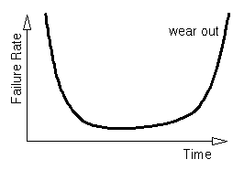
MTBF (Mean Time Between Failures):
the expected time between two successive failures of a system
expressed in hours
a key reliability metric for systems that can be repaired or restored
(repairable systems)
applicable when several system failures are expected.
For a hardware product, MTBF decreases with the its age.

Slide 12
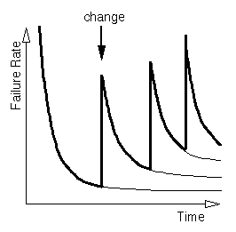
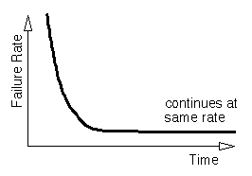
For a software product, MTBF it’s not a function of time!
It depends on the debugging quality.

Slide 13
MTTF (Mean Time To Failure):
the expected time to failure of a system
in reliability engineering → metric for non-repairable systems
non-repairable systems can fail only once; example, a satellite is not repairable.
Mean Time To Repair (MTTR): average time to restore a system after a failure
When there are no delays in repair: MTBF = MTTF + MTTR
Software products are repairable systems!
Reliability models neglect the time needed to restore the system after a failure.
with MTTR =0 → MTBF = MTTF
Availability = MTTF / MTBF = MTTF / (MTTF + MTTR)

Slide 14
3.1.2. Defect rate (density)
Number of defects per KLOC or per Number of Function Point, in a given time unit
Example:
“The latent defect rate for this product, during next four years, is 2.0 defects per KLOC”.
Crude metric: a defect may involve one or more lines of code
Lines Of Code
Different counting tools
Defect rate metric has to be completed with the counting method for LOC!
Not recommended to compare defect rates of two products written in different languages

Slide 15
Defect Density
Defect Density Example
Product is one year old, and is 10 KLOC
Unique causes of observed failures = 50
Current Defect Density = 50/10K x 1K = 5 defects per KLOC per year
After second year
Unique causes of observed failures = 75
Current Defect Density = 75 / 10K x 1K = 7.5 defects per KLOC per 2year or 3.75 per KLOC per year

Slide 16
Defect rate for subsequent versions (releases) of a software product:
Example:
LOC: instruction statements (executable + data definitions – not comments).
Size metrics:
Shipped Source Instructions (SSI)
New and Changed Source Instructions (CSI)
SSI (current release) = SSI (previous release)
+ CSI (for the current version)
- deleted code
- changed code (to avoid double count in both SSI and CSI)

Slide 17
Defects after the release of a product:
field defects – found by the customer (reported problems that required bug fixing)
internal defects – found internally
Post release defect rate metrics:
Total defects per KSSI
Field defects per KSSI
Release – origin defects (field + internal) per KCSI
Released – origin field defects per KCSI
Defect rate using number of Function Points:
If defects per unit of function is low, then the software should have better quality
even though the defects per KLOC value could be higher –
when the functions were implemented by fewer lines of code.

Slide 18
Customer Perspective
Another way to measure size is Function Point.
Function can be defined as a collection of executable statements that performs a certain task, together with declarations of the formal parameter and local variables manipulated by those statements.
Function point has gaining acceptance in application development in terms of both productivity and quality.

Slide 19
Customer Problem Metrics
In addition to valid defects, other issues are viewed as ‘problems’ by customers:
Usability
Unclear documentation/information
Missing documentation/information
Duplicate problems (counted as invalid)
User errors (traps)

Slide 20
Function Point Analysis (FPA)
Low and high weighting factors are used to account for complexity
External inputs, low = 3, high = 6
External outputs, low = 4, high = 7
Logical internal files, low = 7, high = 15
External interface files, low = 5, high = 10
External inquiries, low = 3, high = 6
Function Count (FC) is then calculated
FC = sum of each component

Slide 21
Function Point Analysis (FPA) 14 system characteristics are then accessed for impact on scale of 0 to 5
1. Data communications
2. Distributed functions
3. Performance
4. Heavily used configuration
5. Transaction rate
6. On-line data entry
7. End-user efficiency
8. On-line update
9. Complex processing
10. Reusability
11. Installation ease
12. Operational ease
13. Multiple sites
14. Facilitation of change

Slide 22
Function Point Analysis (FPA)
Value Adjustment Factor (VAF) then calculated (a.k.a Processing Complexity Adjustment)
VAF = 0.65 + (0.01 x C)
where C the sum of all the complexity ratings
Then Function Points (FP) are calculated
FP = FC x VAF
The resulting value is the function point rating for the software. This number can also be used to convert to a LOC rating for comparison reasons.

Slide 23
Customer Problem Metrics
Problem per user month (PUM) example:
Total defects = 75, Licenses = 50, Months = 6
PUM = 75 / (50 x 6) = .25 problems/user month
PUM is usually calculated for each month after a software release, and averaged for the year.
Note - PUM counts a defect multiple times, depending on how pervasive it is (I.e. mainstream function defects are costly)
No of license-months=No of install license of the software x No of the month in the calculation period.
Ways to lower PUM:
Improve the development process to reduce defects
Reduce non-defect-oriented problems (better documentation, usability, etc.)
Increase the number of licenses (?!)

Slide 24
Customer Satisfaction
PUM and Defect Rate are not true measurements of customer satisfaction, but they do contribute.
Timing, availability, company image, services, and (customized) customer solutions also contribute.
Customer satisfaction is usually measured using the five point (Likert scale), via a customer survey
1. - Very dissatisfied
2. - Dissatisfied
3. - Neutral
4. - Satisfied
5. - Very satisfied

Slide 25
Customer Satisfaction
Common metrics for Customer Satisfaction:
Percent of very satisfied customers=100%
Percent of satisfied customers =75%(very satisfied and satisfied)
Neutral = 50%
Percent of dissatisfied customers =25%(dissatisfied and very dissatisfied)
Percent of non-satisfied=0% (neutral, dissatisfied, and very dissatisfied)
Scope of three quality metrics (defects, customer problems, customer satisfaction).

Slide 26
2.Process Quality Metrics

Slide 27
It plays an important role.
Tracking defect arrival during formal machine testing for some organizations.
Well established software metrics programs cover various parameters in each phase of the development cycle.

Slide 28
Defect Density During Machine Testing
Machine Testing - testing after code is integrated into the system library (I.e. integration testing, function testing, system testing, regression testing)
Commonly held beliefs:
There is a positive correlation between defect rates found during testing and the number of defects injected during development.
There is a positive correlation between the defect rates found during testing and the defect rate once product is released.
Counter argument: Better testing will uncover more defects (I.e. maybe the code is just being tested better)

Slide 29
Defect Density During Machine Testing
Release quality:
If defect rate during testing is the same or lower than previous release then:
If current release testing is worse then:
testing needs to be improved (inconclusive about quality)
Else if release testing is the same (or better):
the quality is better than previous release
If defect rate during testing is higher than previous release then:
If testing process was improved then:
the quality is the same or better then previous release
Else if testing process was not improved then:
the quality is worse than previous release (more defects)

Slide 30
Defect Density During Machine Testing
Scenario 1: Defect rate during testing is the same or lower than previous release.
Reasoning: Does the testing for the current release deteriorate?
No
Yes
Quality Prospect
is positive
You need to
perform more
testing

Slide 31
Defect Density During Machine Testing
Scenario 2: Defect rate is substantially higher than that of the previous release
Reasoning: Did we plan for and actually improve testing effectiveness?
Yes
No
Quality Prospect
is positive
Quality prospect negative. Perform more testing.

Slide 32
Defect Arrival Pattern During Testing
Overall defect density during testing is a summary indicator
However, the pattern of defect arrivals gives more information
Even with the same overall defect rate during test, arrival patterns can be different

Slide 33
Defect Arrival Rate During Machine Testing
Defect arrival rate provides more information to supplement the defect density metric
This metric is a view of the patterns and time between defects.
Different arrival patterns (can) indicate different quality levels in the software.
Objective - to see declining and stabilizing arrival rates over time
Supports the idea of “shake-out” testing where you attempt to find all the highest level bugs first so that additional testing is not impacted.

Slide 34
Two Different Arrival Patterns

Slide 35
Defect Arrival Rate During Machine Testing
Three different metrics for arrival rate:
Raw defect (includes duplicates, and invalids) arrivals during testing phase per some time interval (day, week, month, etc).
Valid defect arrivals during testing phase per some time interval
Defect backlog over time. This is a measure of workload which could adversely affect quality.

Slide 36
Phased-Based Defect Removal Pattern
An extension of defect density metric.
Defects are tracked at all (inspection/test) phases of development cycle (design reviews, code reviews, unit test, integration test, function test, and system test).
This metric can be correlated to inspection coverage, and test coverage metrics.
Helps to identify the overall defect removal ability of the development process.

Slide 37
Phase-Based Defect Removal Pattern
The earlier defects are found, the cheaper they are to fix
This metric helps you monitor when your defects are being found

Slide 38
Phase-Based Defect Removal Pattern Example
Project A
Most defects found before testing
Ideal situation
Project B
Most defects found during testing
More expensive to fix
Should be corrected

Slide 39
Defect Removal Effectiveness
Defect Removal Effectiveness (DRE):
DRE = (Defects removed in the phase / defects latent (hidden) in product) x 100%
Where the latent defects can be calculated as the sum of all defects found in later phases, and the field (this is a constantly changing number)

Slide 40
Defect Removal Effectiveness
Example - Defects per phase:
HLD (I0) review I0 = 5
(found= 5, latent=4, total=9), DRE=(5/9x100%)=55%
LLD (I1) review I0 = 3, I1 = 4
(found = 4, latent=6, total=10), DRE=(4/10x100%)=40%
Code inspection (I2) I0 = 1, I1 = 1, I2 = 10
(found = 10, latent=6, total=16), DRE=(6/16x100%)=38%
Unit Test (UT) I0 = 0, I1 = 1, I2 = 5, UT = 3
(found = 3, latent=1, total=4), DRE = (3/4x100%) = 75%
Component Test (CT) I0 = 0, I1 = 0, I2 = 1, UT = 1, CT = 3
(found = 3, latent=1, total=4), DRE=(3/4x100%)= 75%
System Test (ST) I0 = 0, I1 = 0, I2 = 0, UT = 0, CT = 1, ST = 2
(found = 2, latent=1, total=3), DRE = (2/3x100%) = 67%
Field = 2 I0 = 0, I1 = 0, I2 = 0, UT = 0, CT = 0, ST = 1

Slide 41
Defect Removal Effectiveness
Example - Defects per phase:
HLD (I0) review I0 = 5
(found= 5, latent=4, total=9), DRE=(5/9x100%)=55%
LLD (I1) review I0 = 3, I1 = 4
(found = 4, latent=6, total=10), DRE=(4/10x100%)=40%
Code inspection (I2) I0 = 1, I1 = 1, I2 = 10
(found = 10, latent=6, total=16), DRE=(10/16x100%)=62.5%
Unit Test (UT) I0 = 0, I1 = 1, I2 = 5, UT = 3
(found = 3, latent=1, total=4), DRE = (3/4x100%) = 75%
Component Test (CT) I0 = 0, I1 = 0, I2 = 1, UT = 1, CT = 3
(found = 3, latent=1, total=4), DRE=(3/4x100%)= 75%
System Test (ST) I0 = 0, I1 = 0, I2 = 0, UT = 0, CT = 1, ST = 2
(found = 2, latent=1, total=3), DRE = (2/3x100%) = 67%
Field = 2 I0 = 0, I1 = 0, I2 = 0, UT = 0, CT = 0, ST = 1
Found
Latent

Slide 42
Other useful process metrics
Fix response time
Average time to fix a defect
Percent delinquent fixes
Fixes which exceed the recommended fix time according to their severity level
Fix quality
Percentage of fixes which turn out to be defective

Slide 43
3.Metrics for Software Maintenance
Development of a software product complete and released to the market , it enter the maintenance phase.
No of defects and problem is identified by development process before maintenance.
In maintenance phase fix the problem as soon as possible and with excellent fix quality.
Still not able to improve defect rate , can improve the customer satisfaction to a large extent.

Slide 44
Fix Backlog
Fix backlog is a workload statement for software maintenance.
It is related to both the rate of defect arrivals and the rate at which fixes for reported problems become available.
It is a simple count of reported problems that remain at the end of each time period (week, month, etc.)

Slide 45
Backlog Management Index (BMI)
BMI = (Number of problems closed during the month <divided by> Number of problem arrivals during the month) x 100%.
If BMI is larger than 100, it means the backlog is reduced.
If BMI is less than 100, then the backlog is increased.

Slide 46
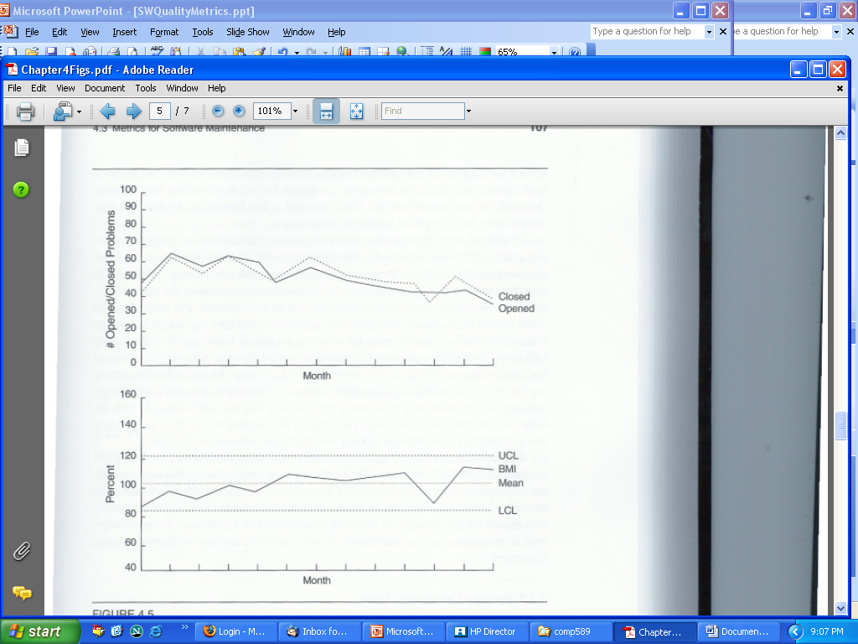
Opened Problems, Closed Problems, and Backlog Management Index by Month

Slide 47
Fix Response Time and Fix Responsiveness
The fix response time metric is usually calculated as:
Mean time of all problems from open to closed
Metric may be used for different defect severity levels.
Fix response time relates to customer satisfaction.
But meeting agreed-to fix time is more than just achieving a short fix time.
A possible metric is the percentage of delivered fixes meeting committed dates to customers.

Slide 48
Percent Delinquent Fixes
The mean response time metric is a central tendency measure.
A more sensitive metric is the percentage of delinquent fixes (for each fix, if the turnaround time greatly exceeds the required response time, it is classified as delinquent).
Percent delinquent fixes = (Number of fixes that exceeded the response time criteria by severity level <divided by> Number of fixes delivered in a specified time) x 100%

Slide 49
Percent Delinquent Fixes (Cont’d)
This is not a real-time metric because it is for closed problems only.
For a real-time metric we must factor in problems that are still open.
We can use the following metric
Real-Time Delinquency Index = 100 x Delinquent / (Backlog + Arrivals)

Slide 50
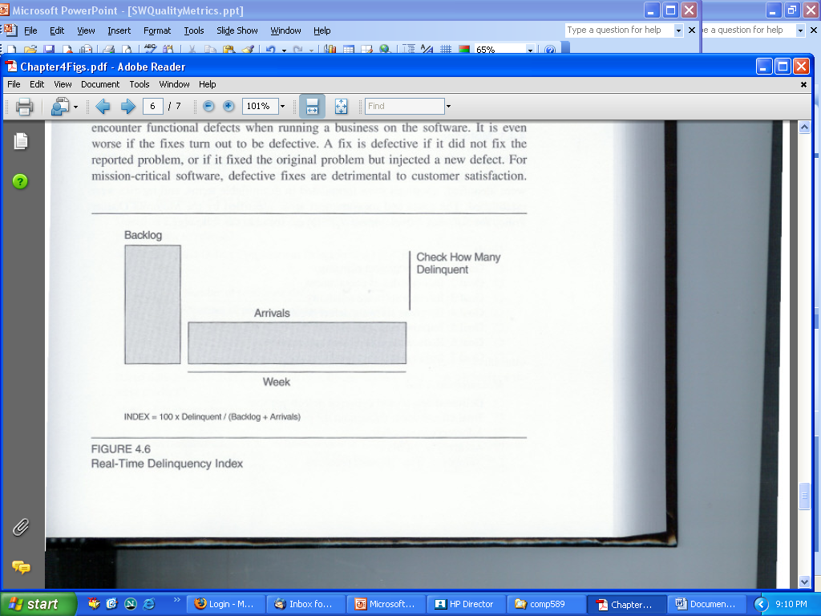
Real-Time Delinquency Index

Slide 51
Fix Quality
The number of defective fixes is another quality metric for maintenance.
The metric of percent defective fixes is simply the percentage of all fixes in a time interval that are defective.
Recording both the time the defective fix was discovered and the time the fix was made to be able to calculate the latent period of the defective fix.

