Slide 1
Hospital Records Data Analysis Data Visualization Jajimoggala Sunil-160123737109 Faculty: Dr. RamaKrishna Department of Information Technology Chaitanya Bharathi Institute of Technology

Slide 2
ABSTARCT
This project looks at hospital data from 2021 to 2024. We used tools like Python, Pandas, and Matplotlib to study the data. We checked how old the patients were, how long they stayed, and how much they were billed. We found patterns and trends to help hospitals plan better. This analysis helps hospitals understand their services and improve them for the future.

Slide 3
Data Analysis & Models
We found the age of patients and how long they stayed
We calculated average, highest, and lowest bill amounts
We checked how many patients came each month
We looked for unusual data like very high bills
We grouped data by gender, age, and date for trends

Slide 4
Tools and Libraries Used
Python: Used for coding
Pandas: Helps to read and work with data
NumPy: Helps with math and numbers
Matplotlib : Used to make graphs
Power point: Used to make this presentation
Kaggle:for Hospital DataSet

Slide 5
Visuals and Graphs
Bar Chart: Average bill for each age group
Pie Chart: Number of male vs female patients
Line Graph: Number of patients each month
Box Plot: Shows bills with very high or low values

Slide 6
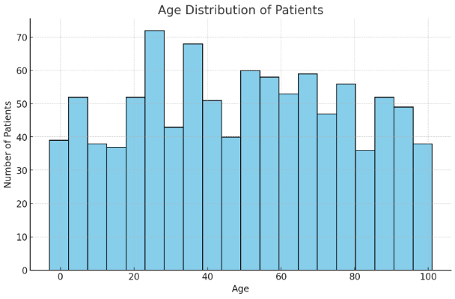
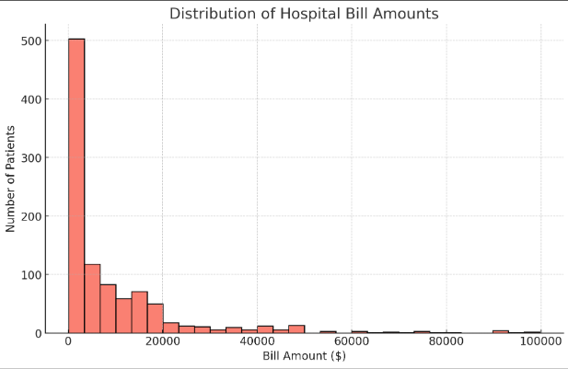
RESULTS

Slide 7
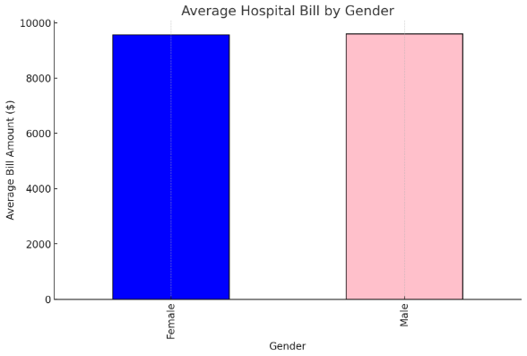
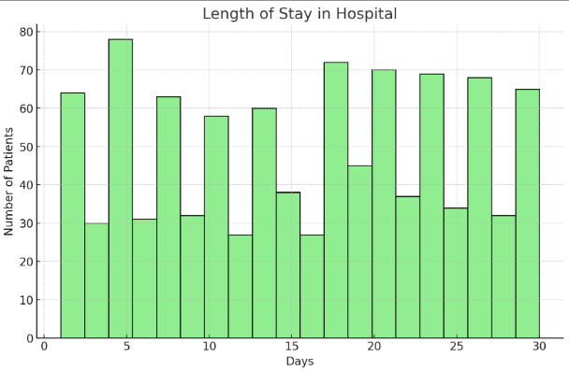
RESULTS

Slide 8
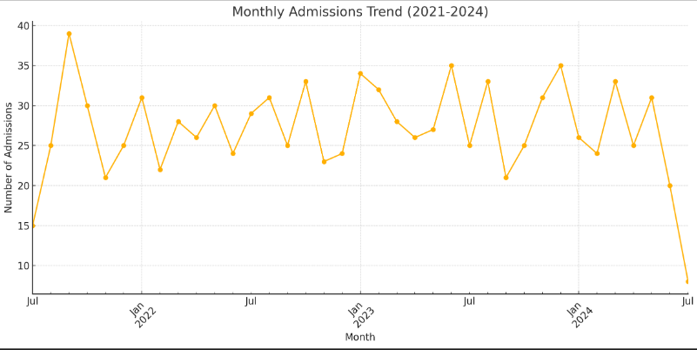
RESULTS

Slide 9
Summary & Conclusion
We studied real hospital data from 4 years.
Found useful patterns about patients and billing.
Used Python and graphs to show results.
The findings can help hospitals plan better.
This is a good start for future projects like prediction models.

Slide 11
References
pandas.pydata.org
numpy.org
matplotlib.org
Hospital Dataset (Kaggle)

Slide 12
Thank You
JAJIMOGGALA SUNIL
160123737109
Information Technology

