Slide 1

SAMAJ App
From Paper Lists to a Single Digital Record
Maheshwari Samaj • Project Lifecycle Presentation

Slide 2
Problems with Paper / Excel Lists
❌ Wrong addresses – once printed, never updated
❌ Painful data updates – changing one phone number means hunting through multiple pages/sheets.
❌ Mismatched data – different copies have different info
❌ No easy way to search for a member or family
❌ Communication gap – no quick way to reach all members
❌ Lost records – papers get damaged, files get corrupted
❌ Marathi spelling errors in manual entries
❌ No family connections visible (who is related to whom)
❌ Duplicate entries across different registers

Slide 3
Before (Old Paper/Excel)

Slide 4
How SAMAJ App Solves These Problems
✅ One single record – update once, visible everywhere
✅ Instant search – find any member by name, area, or mobile
✅ Always correct – members can update their own details
✅ Auto Marathi spelling – type in English, get correct Marathi
✅ Family tree – see all family connections visually
✅ WhatsApp messages – reach the whole community in one click
✅ Safe & backed up – data stored securely in the cloud
✅ No duplicates – system detects repeated entries
✅ Access from anywhere – phone, tablet, or computer

Slide 5
Before (Paper/Excel) → After (SAMAJ App)
❌ Address wrong for years
→
✅ Member updates own address anytime
❌ Phone number change = chaos
→
✅ One edit updates everywhere instantly
❌ 5 different lists with different data
→
✅ Single source of truth for all
❌ Search = flip through 100 pages
→
✅ Type a name → find in 1 second
❌ Communication = phone tree / postal
→
✅ WhatsApp message to all in one click
❌ Marathi spelling mistakes
→
✅ Auto-correct English to Marathi
❌ No idea who is related to whom
→
✅ Visual family tree for every family

Slide 6
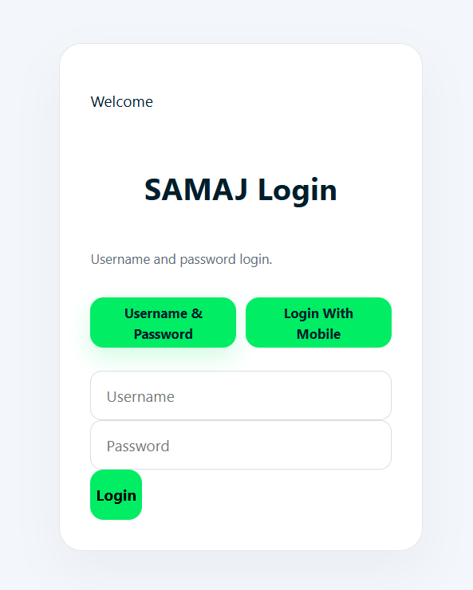
Phase 1: Initiation – Why We Started This
• Goal: Replace paper registers with a single digital system
that the whole Samaj can use
• Problems we wanted to solve:
– Outdated address/phone lists causing delivery failures
– Hours wasted updating records manually
– No way to quickly contact all members
– Marathi spelling inconsistencies
– No visibility of family relationships
• What we promised to deliver:
– Online registration form (English + Marathi)
– Searchable member directory
– Family tree for every household
– WhatsApp-based communication tool
– Self-registration so members can join themselves
📷 Screenshot: Login Page (Simple mobile OTP login for community members)

Slide 7
Phase 2: Planning – How We Organized the Work
• We broke the project into clear parts:
1. Registration Form
– Collect family details in English & Marathi
2. Member Directory
– Search and browse all members easily
3. Family Tree
– Show who belongs to which family visually
4. Communication (WhatsApp)
– Send announcements to all members at once
5. Self-Registration
– Let members register themselves from home
6. Reports & ID Cards
– Generate address lists, PDF cards

Slide 8
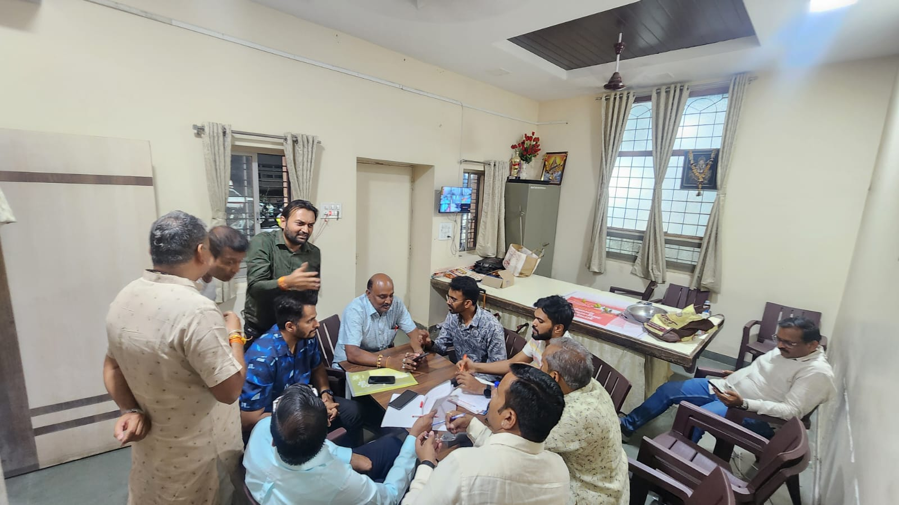
Phase 2: Planning – How We Organized the Work

Slide 9
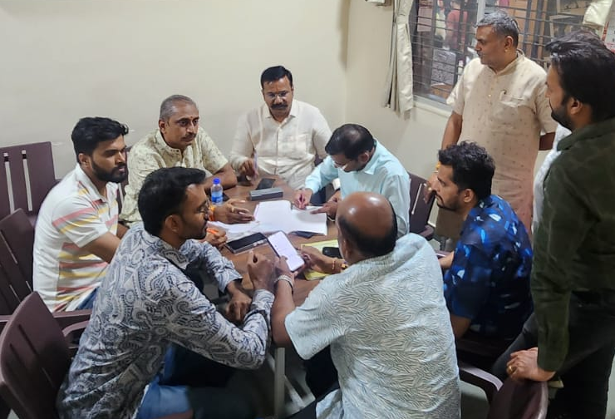
Phase 2: Planning – How We Organized the Work

Slide 10
Phase 3: Execution – Building the App
• What was built and delivered:
✓ Registration system with automatic Marathi translation
– Type 'Washim' → get 'वाशिम' automatically
✓ Member Directory – search by name, area, mobile
– Find anyone in the community in seconds
✓ Family Tree – visual map of family connections
– See parents, children, siblings at a glance
✓ WhatsApp Campaigns – send messages to everyone
– Festival wishes, meeting notices, event updates
✓ Self-Registration – members join from their phone
– Admin reviews and approves new entries
✓ ID Cards & Reports – downloadable PDF cards

Slide 11
Phase 3: Execution – App Screens
📷 Screenshot: Family Tree (Visual family map)
📷 Screenshot: Campaign Manager (Send WhatsApp to all)
📷 Screenshot: Self-Registration (Members join from phone)
📷 Screenshot: Reports & Data (Address lists, exports)

Slide 12

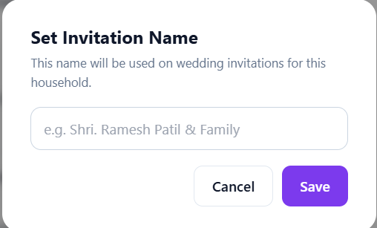
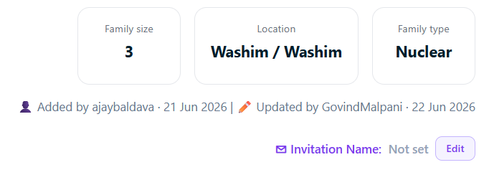
Phase 4: Data Collection & Control
• How we keep data accurate and up-to-date:
📋 Operator activity tracking
– We can see who registered how many families
🔍 Duplicate detection
– System warns if a member is entered twice
✏️ Self-correction by members
– Members update their own address/phone
– Admin approves changes before they go live
📊 Message delivery reports
– See which WhatsApp messages were delivered/read
🛡️ Data safety
– Cloud backup – no risk of lost papers or crashed computers
– Only authorized people can make changes

Slide 13
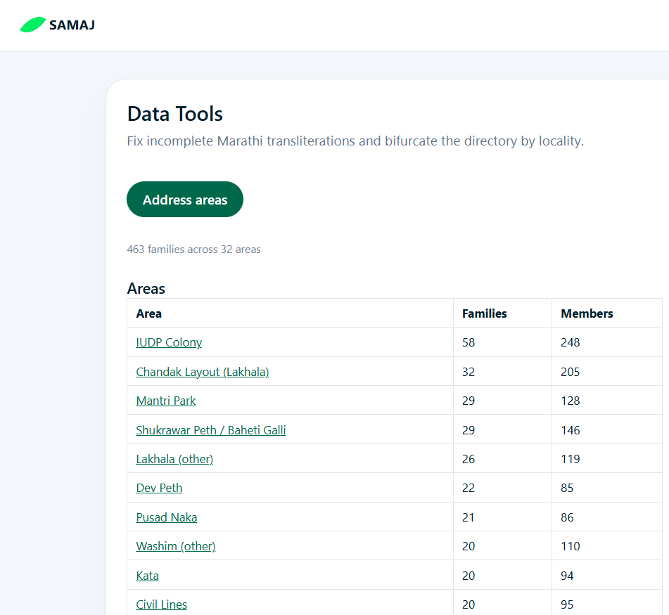
Phase 5: Final – What the Community Gets
• Delivered to the community:
📱 Working app accessible from any device
📖 Complete member directory with search
🌳 Family tree for every household
💬 WhatsApp communication channel
📝 Self-registration for new members
🪪 Downloadable List(PDF)
📊 Address and area-wise reports
• Handover & Training:
– Operators trained on data entry
– Admins trained on approvals & campaigns
– Members guided on self-registration
• Ongoing maintenance & future additions

Slide 14
Future Benefits for Our Community
🌳 Preserve family history – visual family tree for generations
🎯 Accurate records – no more wrong addresses or phone numbers
⚡ Instant updates – change once, updated everywhere
🔍 Find anyone – search by name, village, area in seconds
💬 Better communication – WhatsApp notices reach everyone
📱 Access from anywhere – no need to visit office for info
🤝 Member self-service – register, update, view from home
📈 Growth-ready – as community grows, system scales with it
🔒 Safe data – no lost papers, no corrupted files, cloud backup

Slide 15
For Live App Demo Visit samaj.fly.dev
For More Details Contact – Govind Malpani 7249333373
Sumit Chandak 9922412445

Slide 16
धन्यवाद!
Thank You
For More Details Contact – Govind Malpani 7249333373
Sumit Chandak 9922412445

