Slide 1
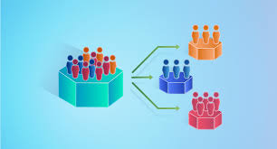
Customer Segmentation Analysis and Deployment

Slide 2
Introduction
Customer segmentation helps businesses target different groups effectively.
The aim is to identify customer clusters based on their behaviour , preferences & demographic attributes.(like : Age, Income, Education, Marital Status, Purchases, etc…)
Project Overview
Use machine learning to segment customers.
Visualize clusters using PCA-reduced dimensions.
Deploy a real-time prediction tool using streamlit.

Slide 3
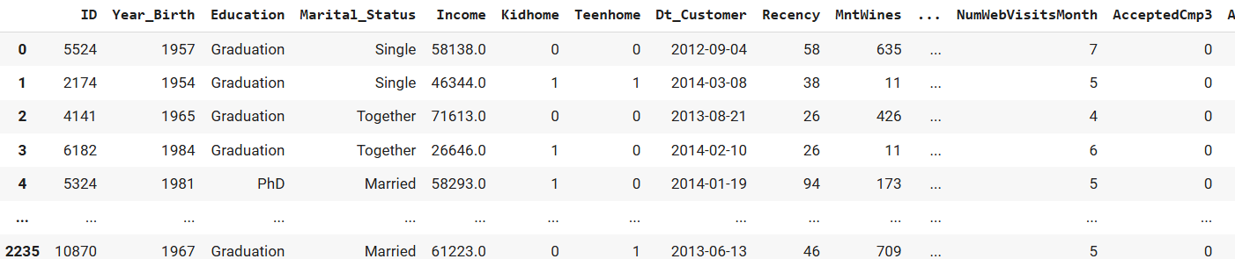
Dataset Overview
Dataset Size: 2240 rows, 29 columns
Key Features:
Numerical - Income, Recency, Wines, Fruits, Meat, Fish, etc.
Categorical: MaritalStatus , Education.
Data Quality:
Missing values in Income (in 24 rows).
0 duplicate rows.

Slide 4
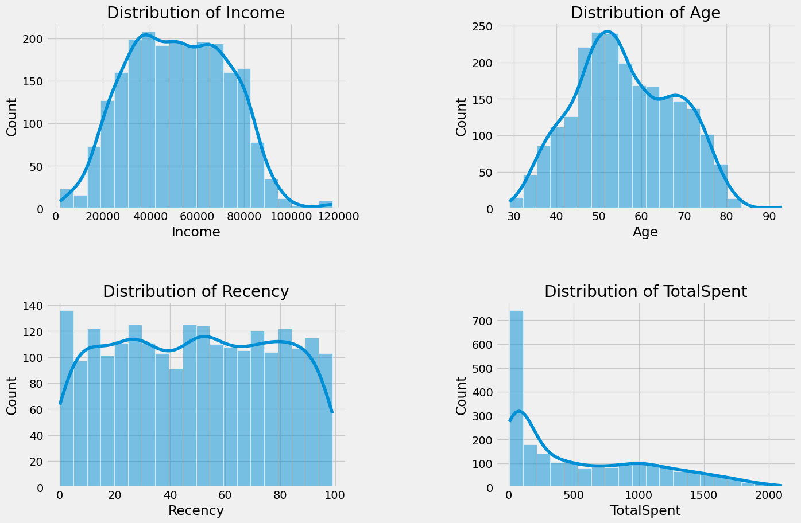
Exploratory Data Analysis (EDA)
Income : Most of there Income ranges from 30K to 80K
Age Distribution : Age spans from 30 to 90 years, with an average age of 50 to 60 years.
Recency : The days since the last purchase range from 0 to 100 days.
Total Spent : The average spending is approximately $550.

Slide 5
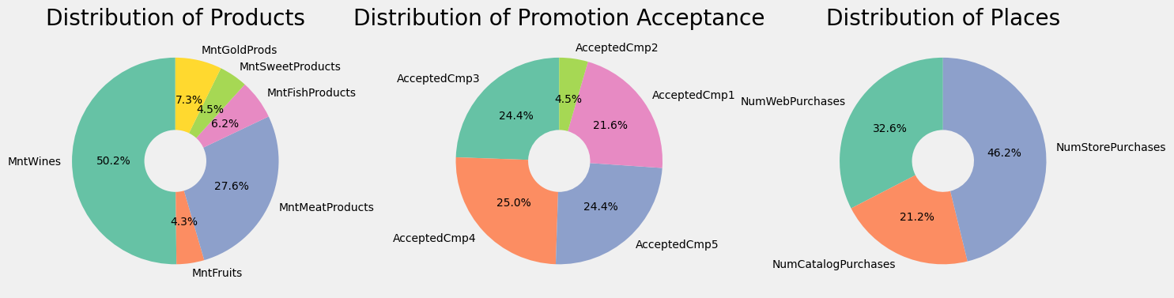
Distribution of products : MntWines has high distribution with 50.2%
Acceptance : The acceptance levels 4 and 5 show significant distribution.
Places : store purchases exhibit the highest distribution, reaching 46.3%.

Slide 6
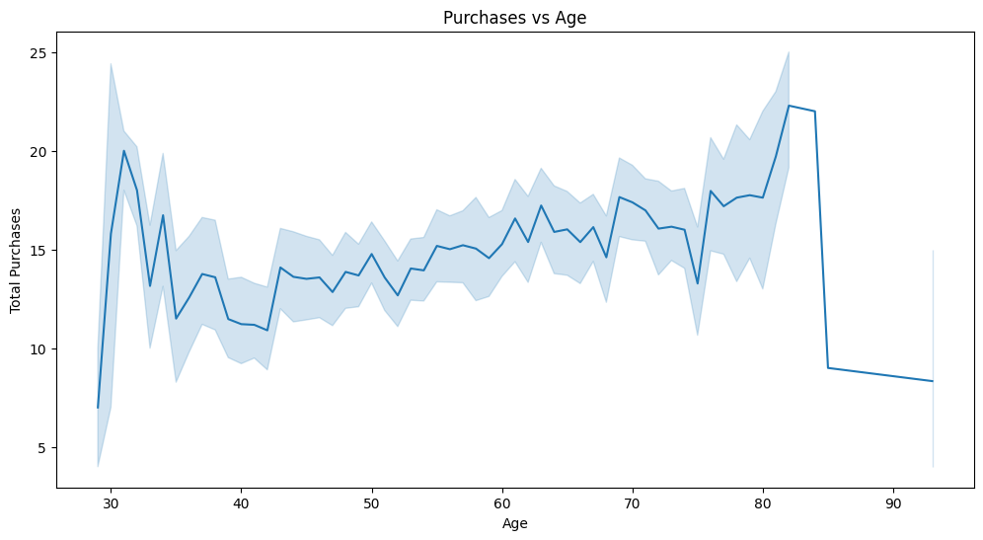
Key Insights
- EDA reveals key insights into customer behavior based on age, income, education, and kids.
- Offers can be personalized for segments.
- Example: Married, 40-50, likely to buy Wines/Meat with a store discount.
- Customer Personas enable targeted marketing.
- Example Persona: Single Graduate, Age 20-30.

Slide 7
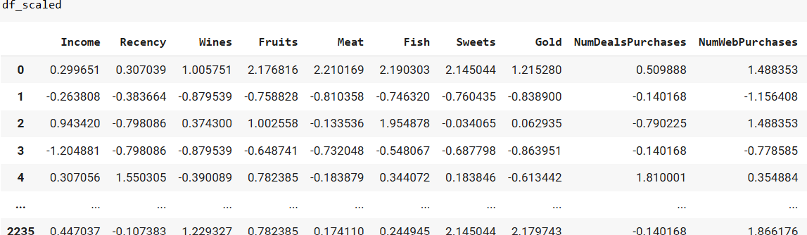
Feature Engineering:
Categorical Encoding: (one-hot encoding).
EducationLevel= {'Undergraduate': 0, 'Graduate': 1, "Postgraduate": 2}
LivingStatus = {'Solo': 0, 'Partnered': 1}
Feature scaling :
Used StandardScaler to normalize numerical features
Like : Income , Recency, Total Spent , Total Purchases, etc..
PCA : Reduced dimensionality using PCA for visualization and efficiency. After feature reduction we have 14 features in the data

Slide 8
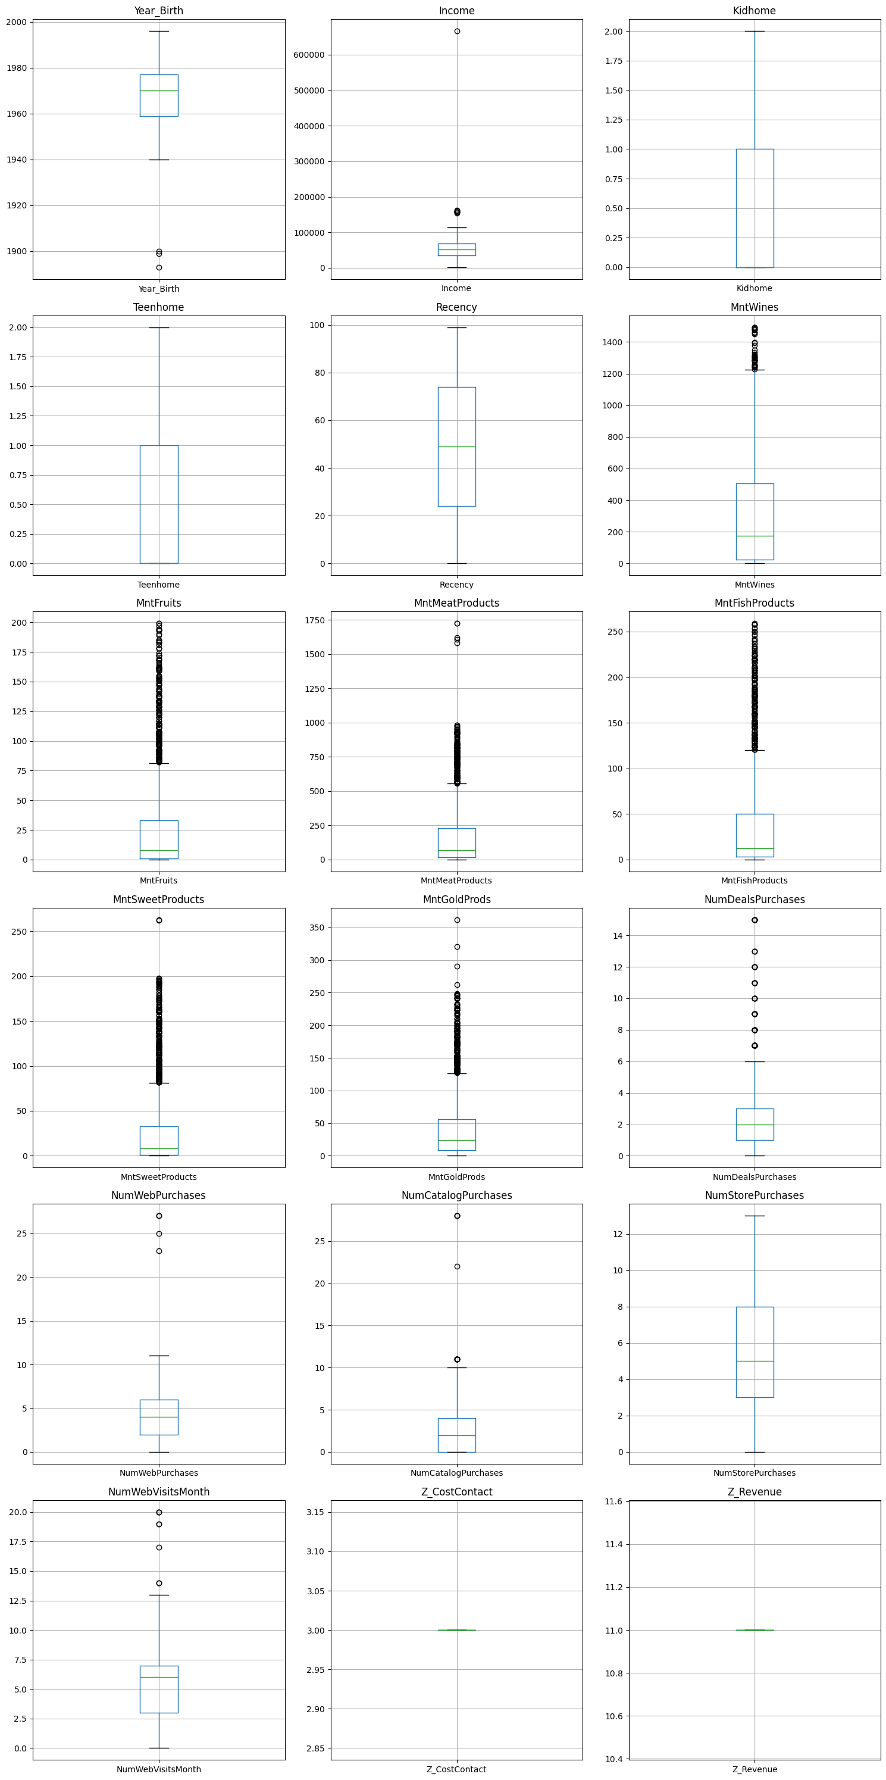
Box plot :

Slide 9
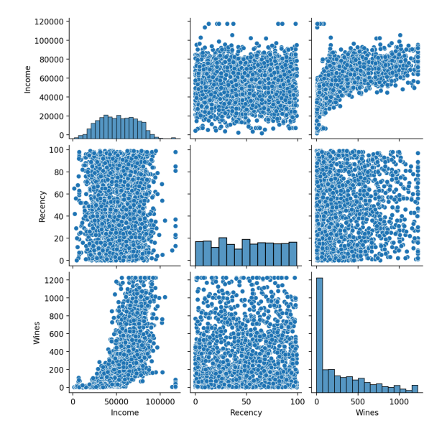
Pairplot of Selected Features :
In Income , Recency & Wines

Slide 10
Model Building :
Clustering Techniques: (Tested for)
KMeans (2 clusters, 3 clusters).
DBSCAN for noise and density-based clustering.
Hierarchical clustering for relationship-based grouping.
Evaluation Metric: Silhouette Score.
KMeans: Divides data into clusters based on feature similarity, tested with 2 and 3 clusters.
Description: Partitions data by minimizing distance to centroids.
Why Used: Groups similar data points and finds natural patterns.

Slide 11
DBSCAN: Density-based clustering that identifies clusters based on spatial density, useful for varying shapes and noise.
Description: Groups points by density, marking noise as outliers.
Why Used: Detects irregular clusters and removes noise.
Agglomerative Clustering: Hierarchical method that merges clusters iteratively based on similarity.
Description: Groups points by progressively combining smaller clusters.
Why Used: Ideal for hierarchical data, works well without pre-set cluster numbers..
Silhouette Score: Measures cluster quality by comparing point similarity within clusters to other clusters.
Description: Evaluates the compactness and separation of clusters.
Why Used: Quantitatively assesses cluster separation and performance.

Slide 12
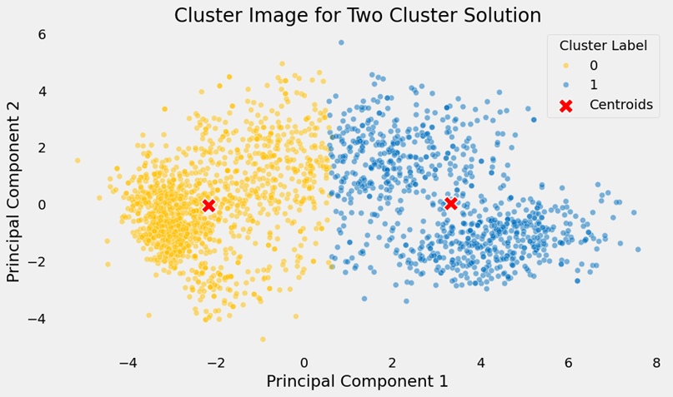
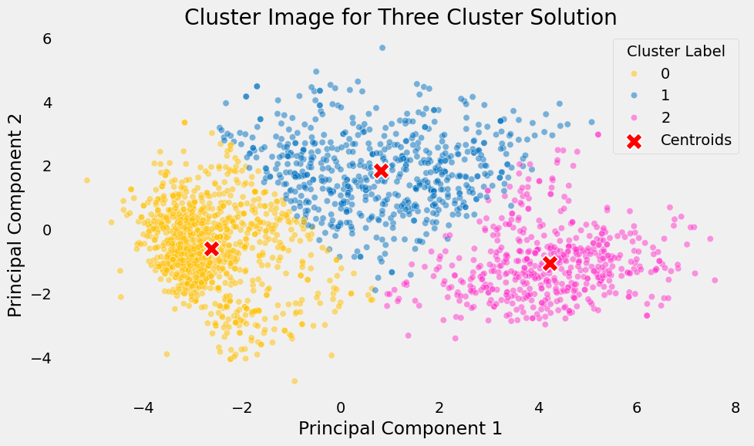
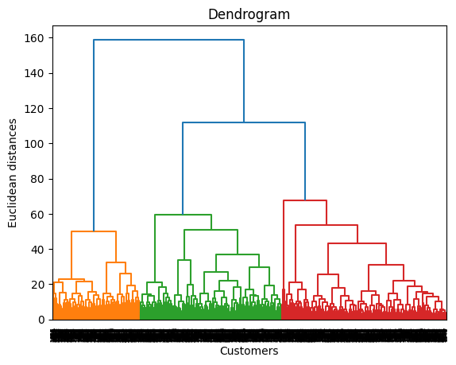
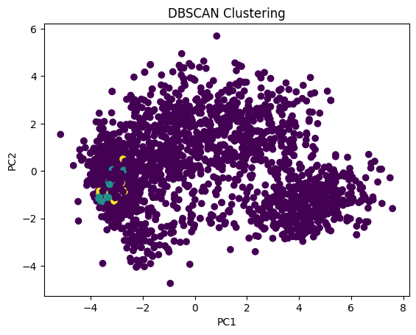

Slide 13
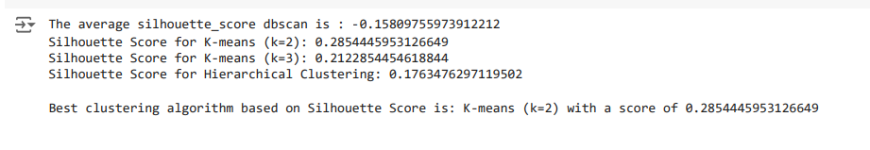
Model Performance :
Silhouette Scores:
- KMeans (2 clusters): [0.2854]
- KMeans (3 clusters): [0.2122]
- DBSCAN: [-0.1580]
- Hierarchical Clustering: [0.1763]
Best Model: Best clustering algorithm based on Silhouette Score is: K-means (k=2) with a score of 0.2854
KMeans with 2 clusters offers the best segmentation.

Slide 14
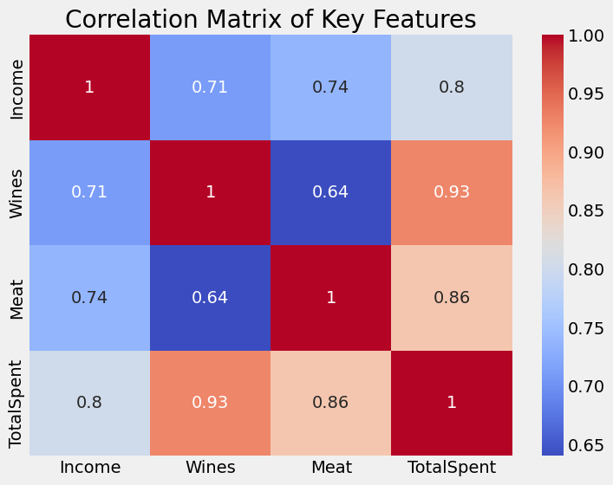
Feature Importance :
Key drivers of segmentation:
- Income, Wines, Meat, and Recency.
• Insights:
- Spending habits and recency strongly influence cluster membership.

Slide 15
Key Insights from Clustering:
For strong separation, the 2-cluster solution is ideal (silhouette scores). KMeans (2 clusters):
Cluster 1: High-income frequent buyers with a preference for premium products like wines and meats.
Cluster 2: Low-to-moderate-income buyers with occasional or balanced spending habits.
For detailed insights, the 3-cluster solution (elbow method) better differentiates customer behaviors.
KMeans (3 clusters):
• Cluster 1: High-income frequent buyers of wines and meats.
• Cluster 2: Low-income, occasional buyers.
• Cluster 3: Moderate-income with balanced spending patterns.

Slide 16
Deployment (via Streamlit) :
Deployment : Deployment involves releasing software to a production environment, making it accessible to users and systems. It ensures proper setup for functionality, backups, or updates.
Features:
User input interface for real-time segmentation.
Option to upload datasets for clustering visualizations.
Interactive visualizations:
PCA-based clustering, correlation heatmaps, and feature distributions.
Benefits:
Scalability and ease of use for business stakeholders.

Slide 17
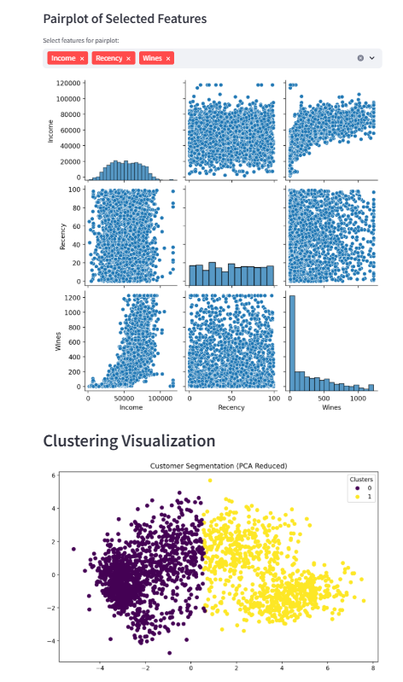
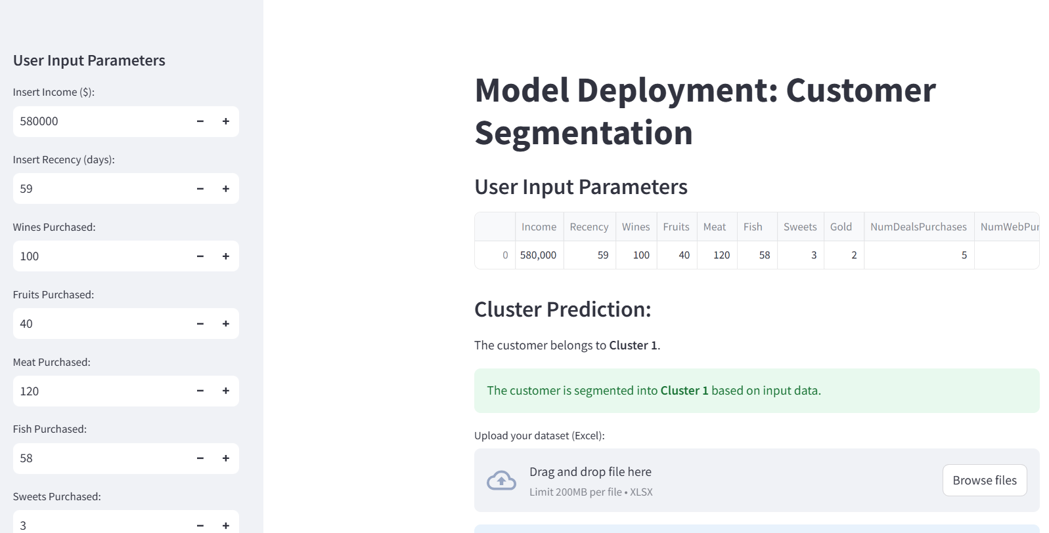

Slide 18
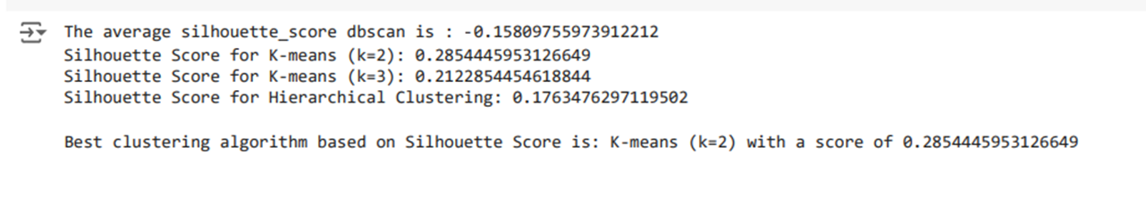
Evaluation of Results:
Model evaluation using PCA-reduced visualizations.
Clusters clearly separable in PCA space for the best-performing model.
KMeans with 2 clusters offers the best segmentation.

Slide 19

Conclusion
Successfully segmented customers into actionable groups.
Provided insights for targeted marketing strategies.
Delivered a scalable, interactive solution using Streamlit.

