Slide 1
photoshop
BY 1602-20-737-126 K.ASISH
1602-20-737-131 GANESH REDDY
1602-20-737-176 SUNIL

Slide 2
ACTORS WITH USE CASES
USER
Upload image
Save edited image
Remove background
Add filter
Rotating image
Black and white
Cropping image
Add frame
Blur the image
Merging images

Slide 3
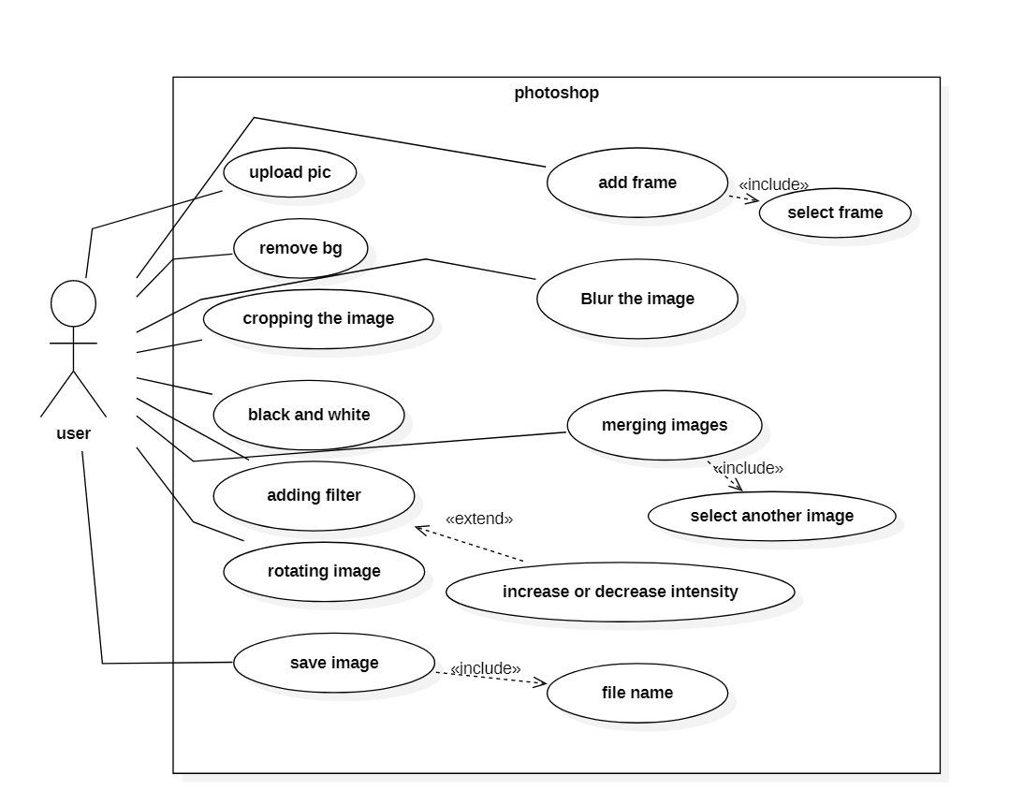
Use Case Diagram:

Slide 4
Use Case Descriptions:
Use Case-1:
Name : Add Frame
Actors : User
Description : Allows user to add frame to the picture
Pre-Conditions : Picture upload
Post-Conditions : Save or Discard
Main Flow:
User | System
1. Chooses Add Frame option.
 | 2. Adds frame to the picture, display
3. Enters save or discard.
 | 4. Works according to the user’s choice.

Slide 5
Use Case-2:
Name : remove background
Actors : User
Description : Allows user to remove background from the picture
Pre-Conditions : Picture upload
Post-Conditions : Save or Discard
Main Flow:
User | System
1. Chooses remove background option.
 | 2. Removes the background of the picture and display
3. Enters save or discard.
 | 4. Works according to the user’s choice.

Slide 6
Use case -3:
Name : cropping the image
Actors : User
Description : Allows user to crop the picture
Pre-Conditions : Picture upload
Post-Conditions : Save or Discard
Main Flow:
User | System
1. Chooses crop image option.
 | 2. Crops the picture and display
3. Enters save or discard.
 | 4. Works according to the user’s choice.

Slide 7
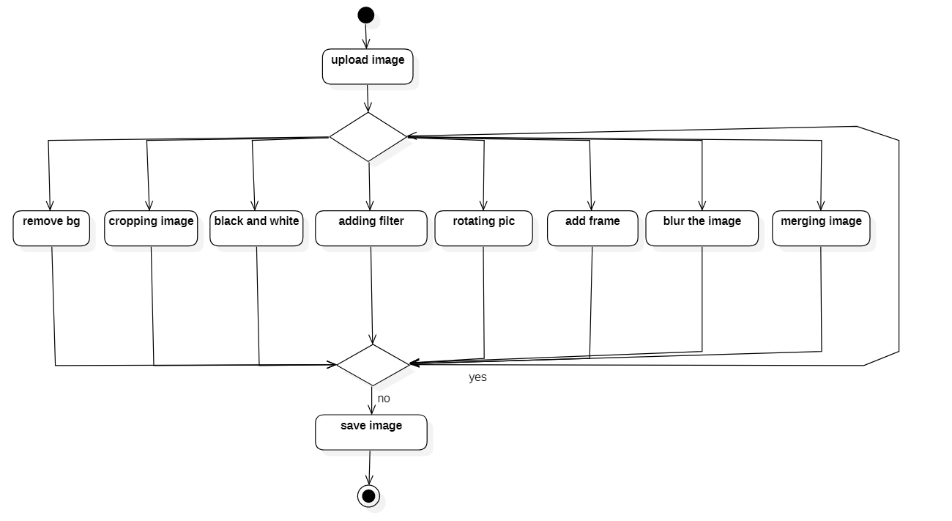
Activity Diagram:

Slide 8
THANK YOU ☺

