Slide 1

Insurance Expense Prediction Project
Exploring Predictive Analytics in Insurance

Slide 2
Introduction
Rising healthcare costs make insurance expense prediction crucial for insurers and individuals.
Understanding key factors like age, lifestyle, and health can help tailor insurance plans and manage risks.
Project Objective
Predict the insurance expenses of individuals based on various personal and health-related factors.
Understand key drivers of high medical costs to inform stakeholders.
Build a robust machine learning model for accurate expense prediction

Slide 3
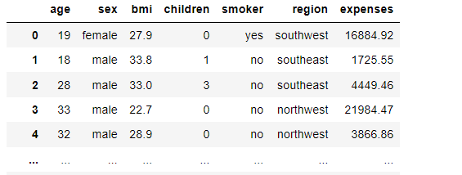
Dataset Overview
Dataset Size: 1337 records, 7 features.
Features:
Numerical: age, bmi, children, expenses.
Categorical: sex, smoker, region.
Data Quality:
No missing values.
1 duplicate removed.
Purpose of Features: expenses as the target variable, others as predictors.

Slide 4
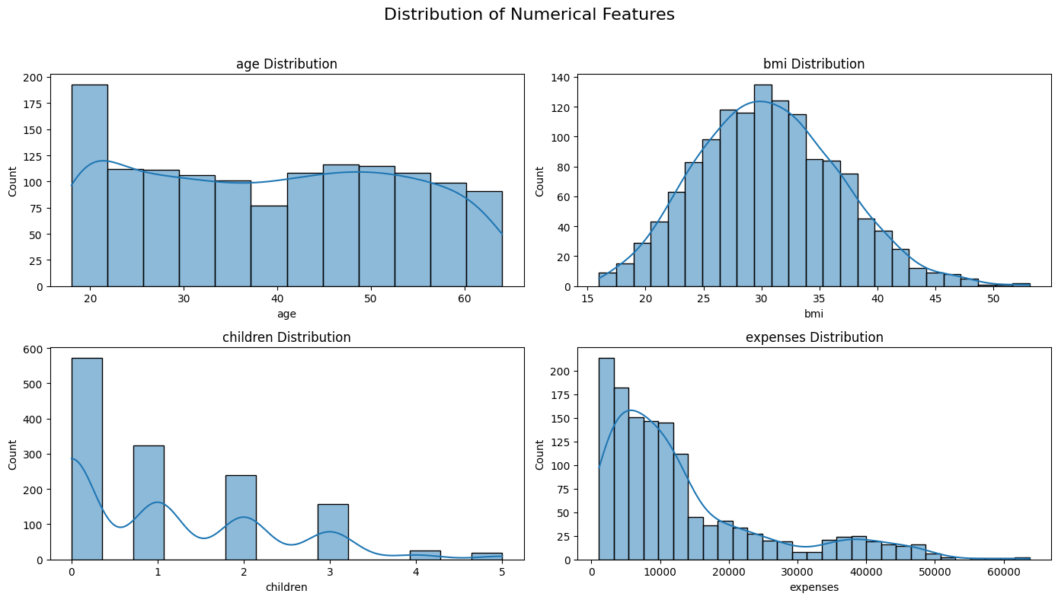
Exploratory Data Analysis (EDA)
Age Distribution: Most individuals are between 30-50 years.
BMI: Skewed towards 30, indicating overweight individuals.
Smoker Status: Smokers are fewer (20%), but their expenses are significantly higher.
Regional Distribution: Slightly higher concentration in the Southeast.

Slide 5
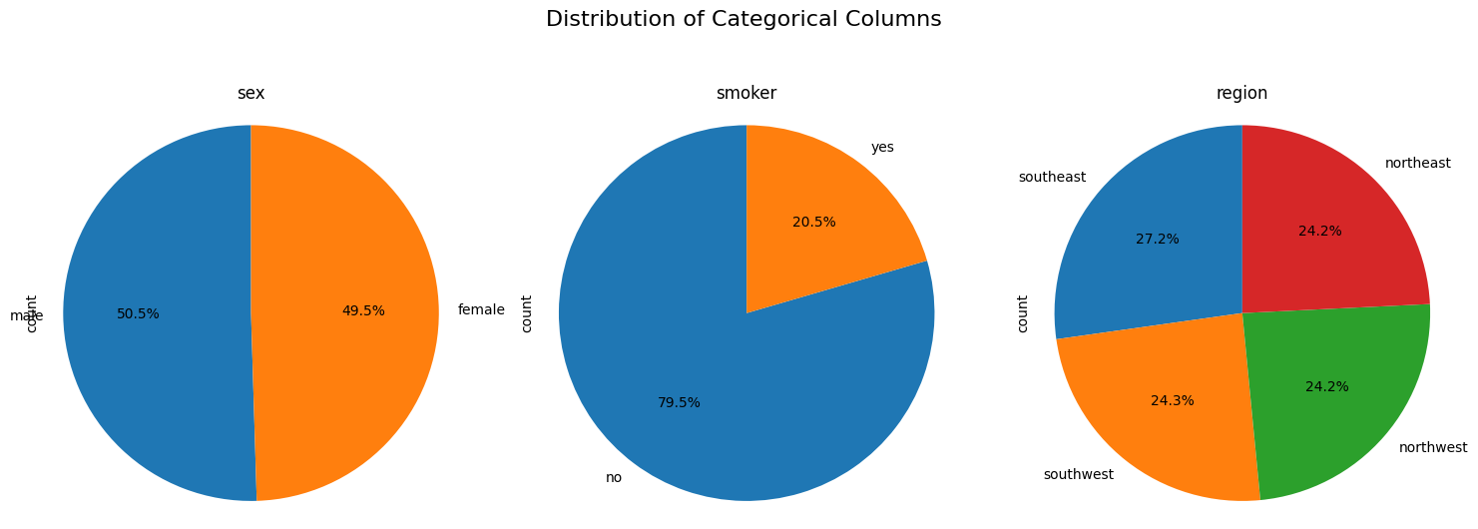
Sex: There’s a roughly equal distribution of males (50.4%) and females (49.6%).
Smoker: Non-smokers constitute about 79.5% of the dataset, indicating smoking is relatively less common.
Region: The dataset is well-distributed across four regions (Southeast, Southwest, Northwest, Northeast), with a slight edge for Southeast (27%).

Slide 6
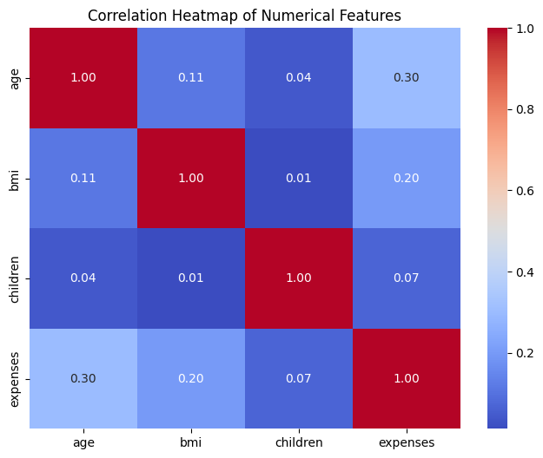
Key Insights
Smoking increases insurance expenses drastically.
BMI positively correlates with costs, especially for smokers.
Expenses across regions are mostly similar, but Southeast shows outliers.
Age has a moderate correlation with expenses.

Slide 7
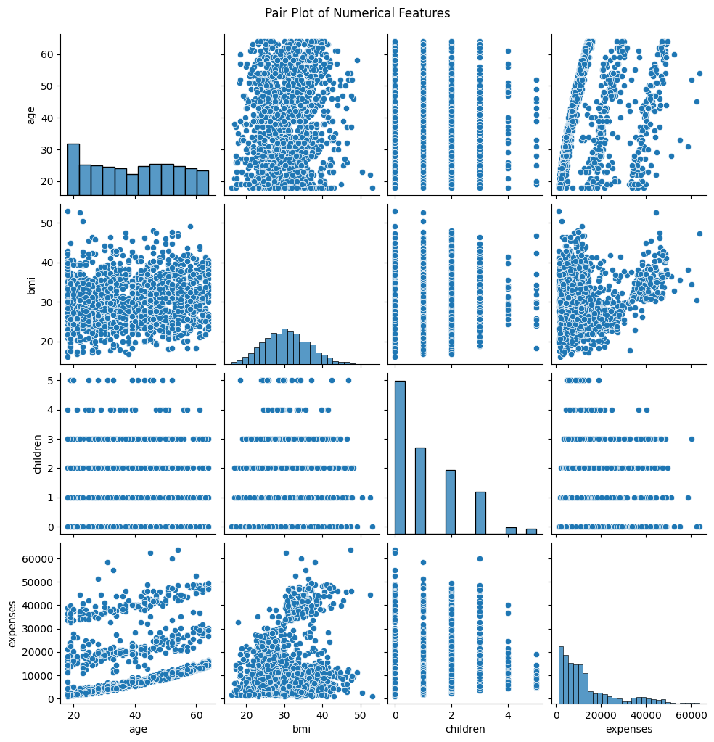
Feature Engineering
Categorical Encoding:
sex: Male (1), Female (0).
smoker: Yes (1), No (0).
region: Southwest (0), Southeast (1), etc.
Scaling:
Used MinMaxScaler to normalize numerical features: age, bmi, children, expenses.

Slide 8
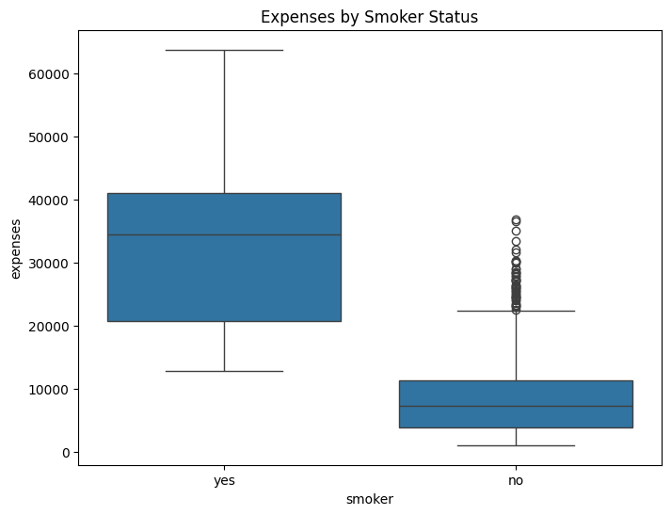
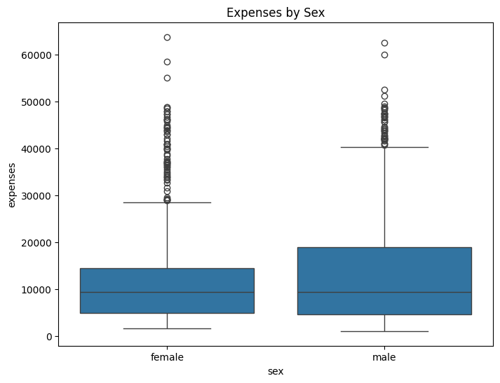
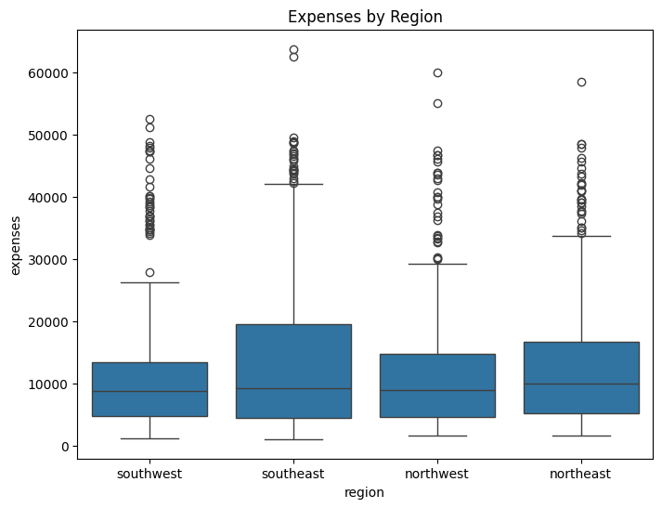
BOX PLOT

Slide 9
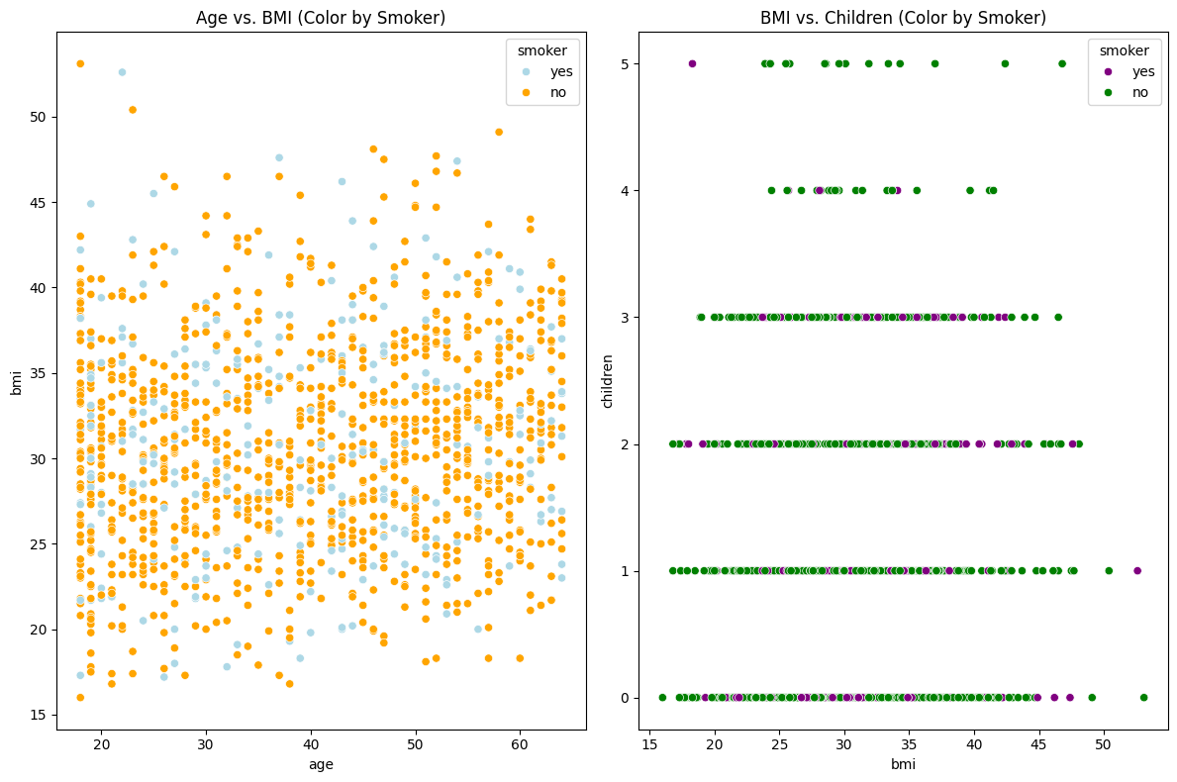
SCATTER PLOT
Age vs. BMI: Smokers appear distributed across all age and BMI levels, but those with high BMI and age likely face higher health costs.
BMI vs. Children: No significant trend is observed here between BMI and the number of children, but smokers are again evenly distributed.

Slide 10
Model Building
Goal: Compare multiple models to identify the best-performing one.
Algorithms Tested:
Linear Regression, Ridge, Lasso.
Decision Tree, Random Forest, Gradient Boosting.
Evaluation Metrics: R², RMSE, MAE
Multiple Linear Regression
Description: A simple, interpretable model that establishes a linear relationship between the independent variables (age, BMI, etc.) and the target variable (expenses).
Why Used: To serve as a baseline model and understand the overall linear trends in the data.
Lasso Regression
Description: A variation of linear regression that adds a penalty term (L1 regularization) to reduce the coefficients of less important features to zero, effectively performing feature selection.
Why Used: To identify the most significant predictors and reduce model complexity.

Slide 11
Ridge Regression
Description: Another variation of linear regression that uses L2 regularization to shrink the coefficients, preventing overfitting.
Why Used: To handle multicollinearity and improve the stability of the predictions.
Decision Tree Regressor
Description: A non-linear model that splits the data into subsets based on feature thresholds, creating a tree-like structure for predictions.
Why Used: To capture non-linear relationships and interactions between features.
Random Forest Regressor
Description: An ensemble of multiple decision trees, where each tree is trained on a random subset of data and features, and the final prediction is an average of all trees.
Why Used: For better generalization and to reduce overfitting, leveraging the power of ensemble learning.
Gradient Boosting Regressor
Description: An advanced ensemble technique that builds models sequentially, where each model tries to correct the errors of its predecessor.
Why Used: To achieve high accuracy by focusing on the most difficult-to-predict cases, making it ideal for complex datasets.

Slide 12
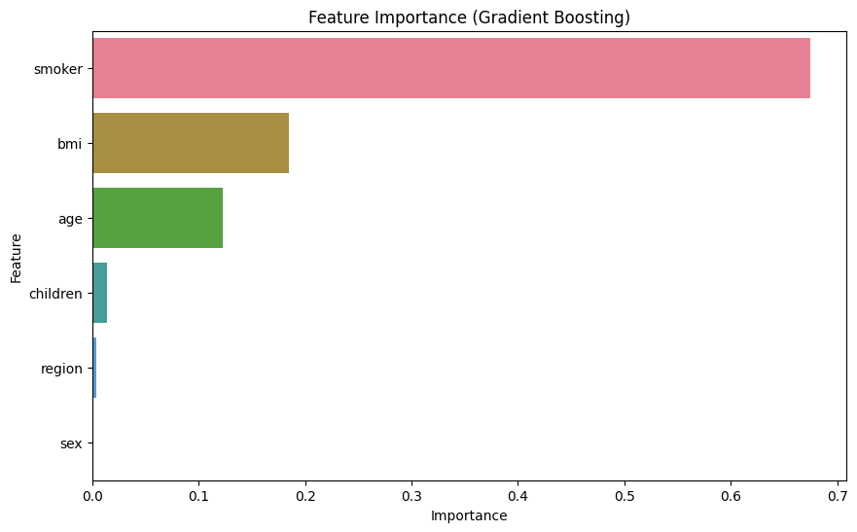
Feature Importance
Top Predictors:
Smoker: ~60% importance.
BMI: ~21% importance.
Age: ~13% importance.
Observations:
Smoking status overwhelmingly influences expenses.
BMI plays a significant role in predicting high costs.

Slide 13
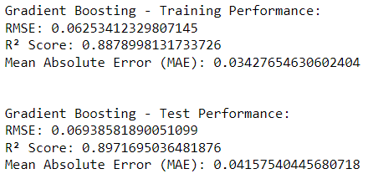
Model Performance: Gradient Boosting
Best Model: Gradient Boosting Regressor.
Performance Metrics:
Training Set:
RMSE: 0.0625, R²: 0.887.
Test Set:
RMSE: 0.069, R²: 0.897.
Gradient Boosting demonstrated the best balance of accuracy and generalizability.

Slide 14
Deployment
Deployment: Software deployment is the process of making software available to be used on a system by users and other programs. You might deploy software to create a backup copy of the software, to move the software to another system, or to create another SMP/E-serviceable copy for installing service or other products.
Model Cross Validation:
Multiple Linear Regression - Cross-Validation Results:
CV RMSE: 0.0968916523642255 ± 0.0030152572750911035
CV R²: 0.7471451303546595 ± 0.02386334876865286
CV MAE: 0.0669856727559874 ± 0.0013526176356703074
Ridge Regression - Cross-Validation Results:
CV RMSE: 0.09689142254683966 ± 0.003005055479166734
CV R²: 0.7471506892397795 ± 0.02379714650516752
CV MAE: 0.06697104731087726 ± 0.0013505347430204696
Lasso Regression - Cross-Validation Results:
CV RMSE: 0.19317109816111672 ± 0.00591860853524051
CV R²: -0.0006880878090343767 ± 0.0004958002934509569
CV MAE: 0.14516664327035148 ± 0.005449740078737539

Slide 15
Deployment
Model Cross Validation:
Decision Tree - Cross-Validation Results:
CV RMSE: 0.10170122401980963 ± 0.006236353555026247
CV R²: 0.72013447931547 ± 0.04317646715207966
CV MAE: 0.04779507453921631 ± 0.0048925824966465515
Random Forest - Cross-Validation Results:
CV RMSE: 0.07773062074988187 ± 0.005816806208662395
CV R²: 0.8354548638320229 ± 0.03445292426102999
CV MAE: 0.04280391442869018 ± 0.0026150486992233056
Gradient Boosting - Cross-Validation Results:
CV RMSE: 0.07284476513829156 ± 0.006003496331822506
CV R²: 0.8553027752546276 ± 0.03175940906781627
CV MAE: 0.039942556999553895 ± 0.0027562059417064245

Slide 16
Challenges Faced?
We faced the challenges regarding to set up the pipeline for the deployment.
We faced the challenges to determine the best accuracy for the model building.
We faced the challenges to visualize the model building to represent the box plot and Histogram
How did you overcome?
We used the platform to deploy the code and used the data from the given dataset to get the predicted output.
We resolved the accuracy of the model with the help of training and testing dataset by using the 6 different algoritms .
We used the outliers concept to resolve the boxplot visualisation.

Slide 17
Thank you

