Slide 1
SENTIMENTAL ANALYSIS FOR PRODUCT FEEDBACK REVIEW
D.Kiran 1602-20-737-139
K. Sunil 1602-20-737-176

Slide 2
Abstract
Online reviews, while valuable, lack non-verbal cues like facial expressions and vocal tones. Video reviews offer facial expressions and gestures, while audio captures vocal tones, enriching sentiment analysis. The proposed method integrates video and audio analysis for a comprehensive approach in the field of sentimental analysis. Utilizing facial recognition and deep learning, it extracts emotional cues from video and audio data. Through this fusion, the aim is to achieve a more accurate and brief assessment of reviewer sentiment towards products.

Slide 3
Problem Statement
Develop a feedback system that introduces a systematic approach to sentiment analysis in product reviews, leveraging both video and audio modalities to extract accurate sentiment relating to products. Incorporating the Haar cascade algorithm for video analysis and the BERT model for audio processing, our study aims to integrate these modalities to provide a comprehensive understanding of reviewer sentiment.

Slide 4
Literature survey
[1] In the study titled “Sentiment analysis on images using convolutional neural networks based Inception-V3 transfer learning approach” by Gaurav Meenaa, Krishna Kumar Mohbeya, Sunil Kumar introduces a CNN-based Inception-v3 architecture is employed for emotion detection and classification. The datasets contain are used in this process. The findings are also compared with various well-known machine learning approaches, and the results obtained by the suggested model are superior. The foundation of this research is a set of pre-trained deep CNN models and a method called transfer learning. This research aims to determine which of the Inception-V3 pre-trained deep CNN models is most suitable for image-based sentiment analysis.
[2] In their study titled "Sentiment Analysis for Video on Demand Application User Satisfaction with Long Short Term Memory Model," Gina Khayatun Nufus, Mustafid Mustafid, and Rahmat introduce a methodology that combines Word2vec and Long Short-Term Memory (LSTM) models. They apply this approach to perform aspect-level sentiment classification in reviews of video-on-demand applications. By integrating Word2vec embeddings with LSTM architecture, they improve the modeling of sequential data, leading to more accurate sentiment classification. It shows the robustness of SVM for highly skewed datasets. Which has been one of our main motivations to lean towards the use of SVM for cyberbullying classification.

Slide 5
Literature survey(cont..)
[3] In research by Dorca Manuel-Ilie, Pitic Antoniu Gabriel, and Crețulescu Radu George "Sentiment Analysis Using BERT Model," utilize the BERT model to develop a robust sentiment analysis method. Their approach involves annotating topics and emotions, tailoring neural network structures, and conducting thorough evaluations to enhance sentiment analysis accuracy across various datasets.

Slide 6
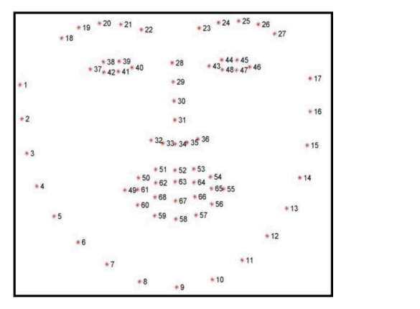
Proposed Solution
Video-based Emotion Detection:
Utilizing computer vision techniques to analyze facial expressions from video inputs. Detecting and recognizing key facial features (eyes, nose, mouth) to infer emotional states. Classifying emotions into predefined categories (e.g., Negative, Positive, Neutral). The images from dataset are in the form of gray scale .From the gray scale images the model identifies the face and locates the facial landmarks as cited in the paper [1].We use this pre-trained model to identify two more classes “Extremely negative - Anger “ and “Extremely positive - Surprise “ .

Slide 7
Audio-based Sentiment Analysis:
Implementing speech-to-text conversion to transcribe spoken feedback into textual format. The speech-to-text is done by google API module . The text is then stored in a .txt file .Then we apply Natural Language Processing (NLP) model BERT to analyze sentiment from the transcribed text. Categorizing sentiment into labels such as Extreme Positive, Positive, Negative, Extreme Negative, Neutral.
Combined Analysis:
Integrating video and audio analysis to derive comprehensive sentiment insights. Synthesizing results from both modalities to provide a better understanding of user feedback. We use a weighted sentiment values for both video and audio modalities.

Slide 8
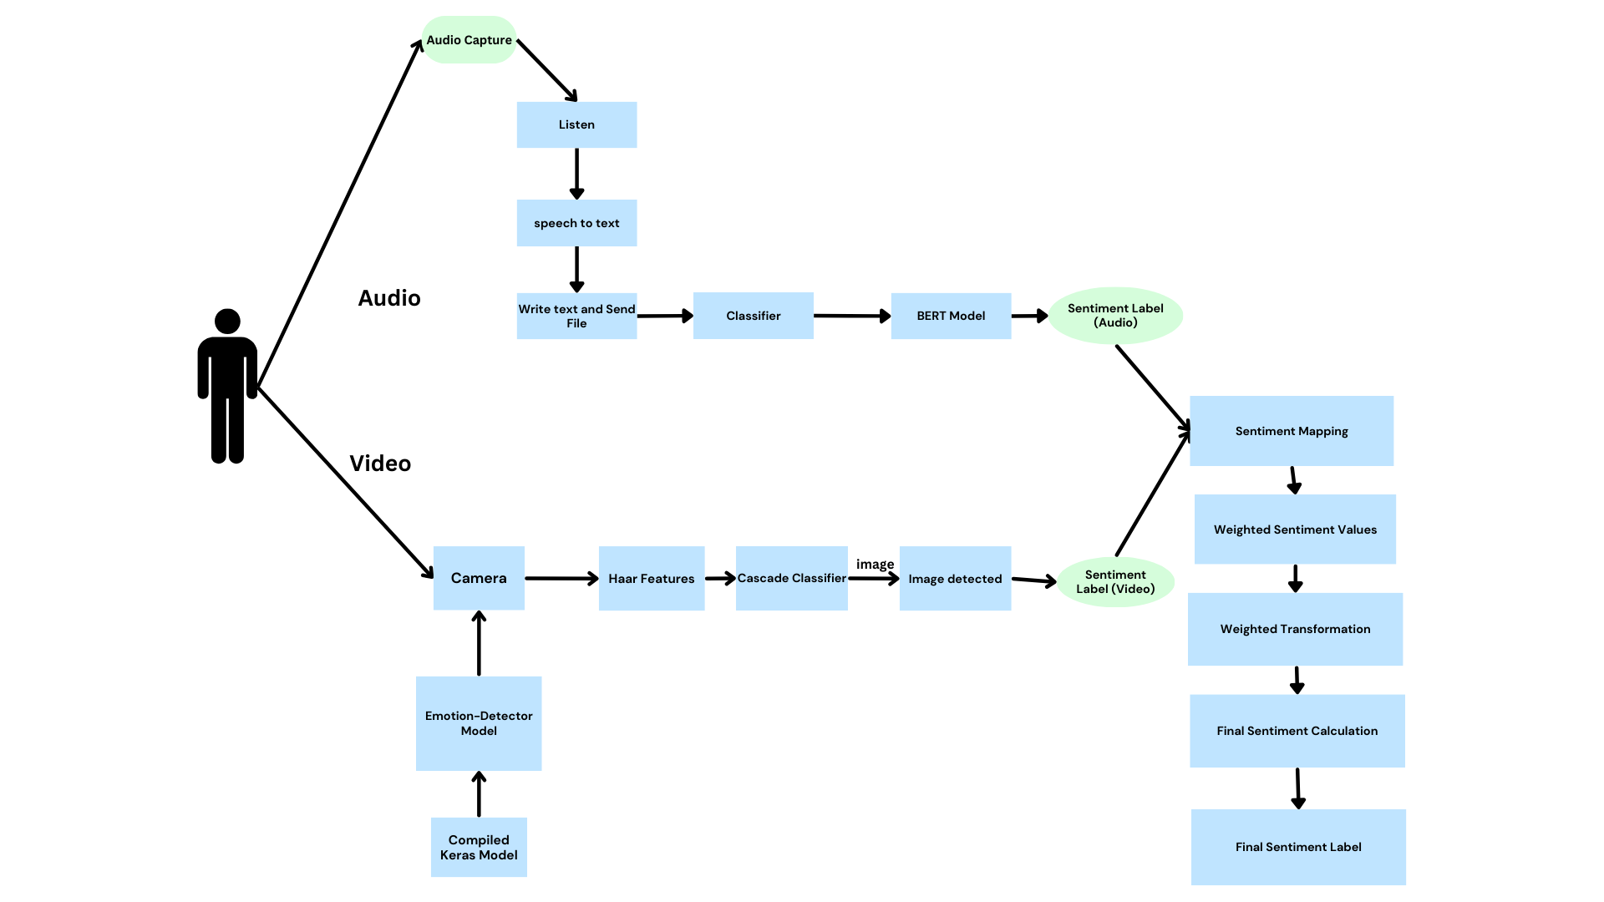
Block Diagram
The project workflow is divided into mainly three stages:
Firstly, sentiment analysis on video. For this module a Pre-trained MobileNet is used and developed further for two more classes. Before model compilation in keras the layer functions : Globalavgpooling and Dense are used.
The Haar cascade algorithm comes into picture for extracting the features in ROI(Region of Interest). This accomplishes the video sentiment
Secondly the audio signal are converted into text using google API and then pre-defined BERT model is used to classify the textual sentiment. This accomplishes the audio sentiment.

Slide 9
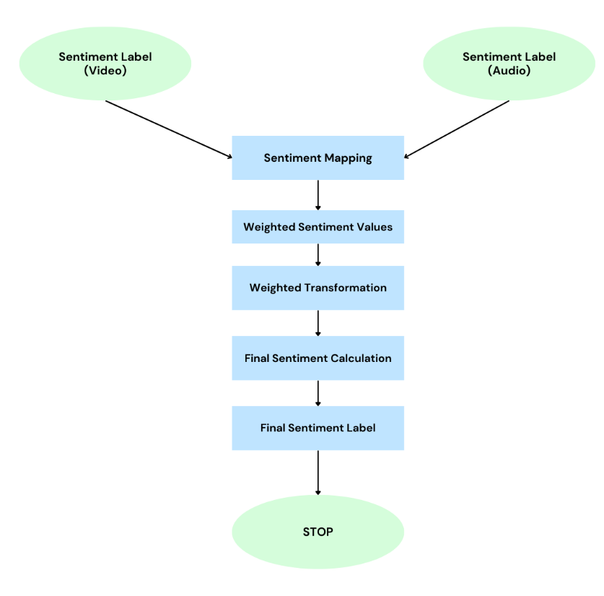
Block Diagram(cont..)
Lastly, The sentimental values are mapped into 5 numerical values ranging from 0-4 describing “extremely negative “, “Negative”, “Neutral”, “Positive” and “Extremely positive”.

Slide 10
Dataset
Dataset available in Kaggle at https://www.kaggle.com/competitions/challenges-in-representation-learning-facial-expression-recognition-challenge/data
In the dataset we have two columns emotion and pixels.
The dataset columns are inter-relates the pixels and emotions which are classified as 0-angry , 1-disgust , 2-fear, 3-happy , 4- sad , 5-surprise and 6-neutral. The pre-trained model uses happy, neutral and sad we used 0-angry and 5-surprise for extremely negative and extremely positive as an upgrade to the classes.

Slide 11
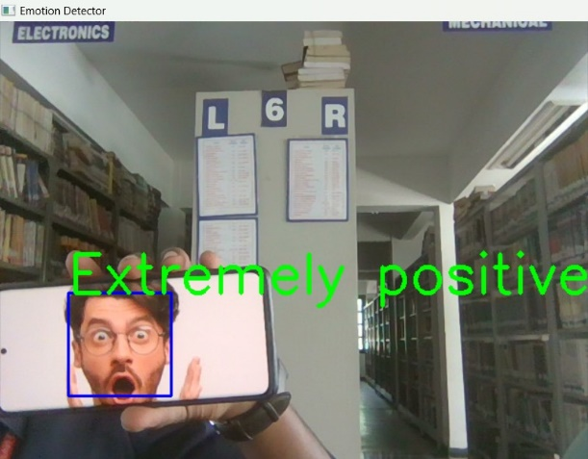
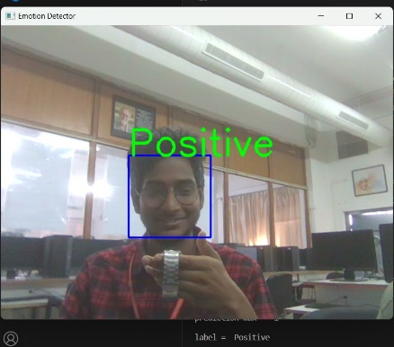
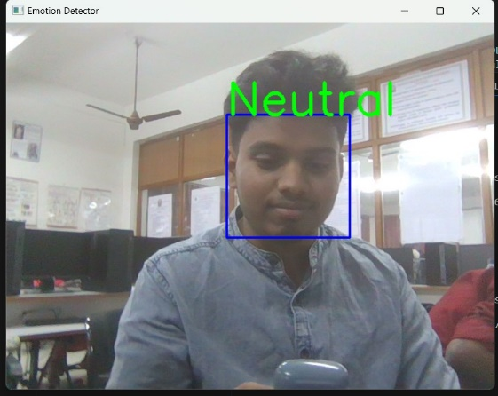
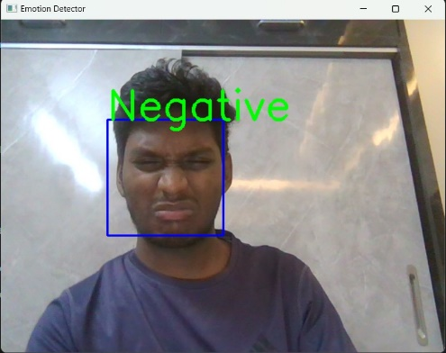
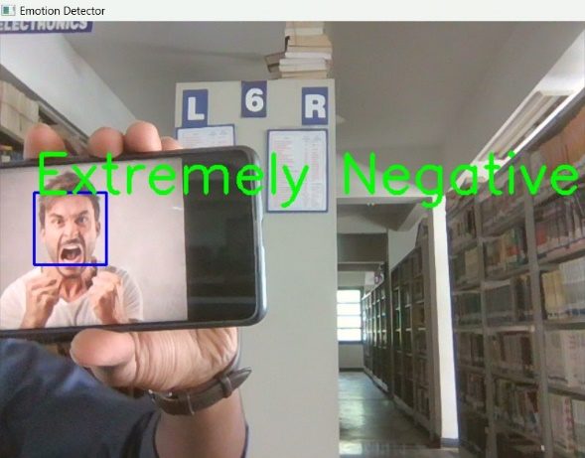
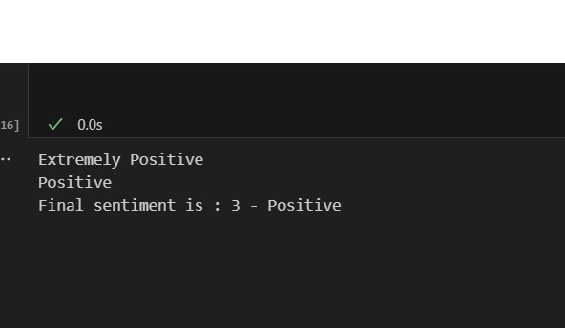
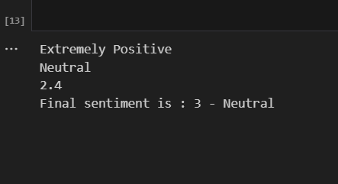
Output

Slide 12
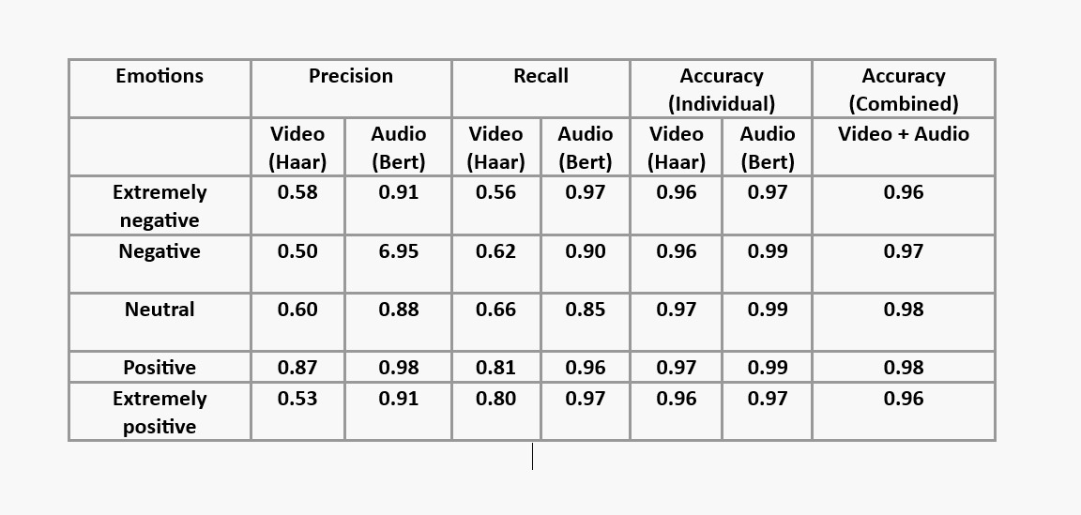
Analysis

Slide 13
Conclusion and Future Scope
The integration of traditional video-based sentiment analysis with Haar cascade for facial emotion detection and audio-based sentiment analysis using the BERT model offers a comprehensive approach to emotion recognition.
This integration combines visual and auditory cues, compensating for individual limitations and enhancing accuracy in emotion detection tasks, making it valuable for product feedback review systems. Future directions include exploring advanced fusion techniques for better integration, optimizing models for subtle expressions and group sentiment analysis, developing multimodal datasets and considering multi-lingual datasets for broader language coverage.

Slide 14
THANK YOU

