Slide 1
Ideas to prototype in Alpha
With rational on why to test these ideas

Slide 2
Learn from the research and experience of other service teams and avoid repeating work that’s already been done.
Help users get a better user experience by using tired and tested GDS patterns

Slide 3
Learn from the research and experience of other service teams and avoid repeating work that’s already been done.
Help users get a better user experience by using tired and tested GDS patterns

Slide 4
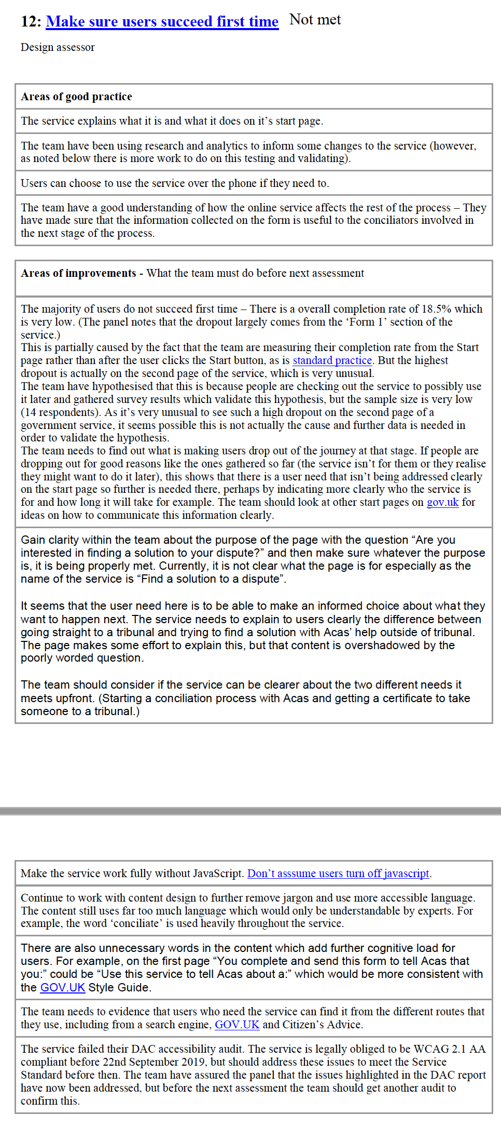
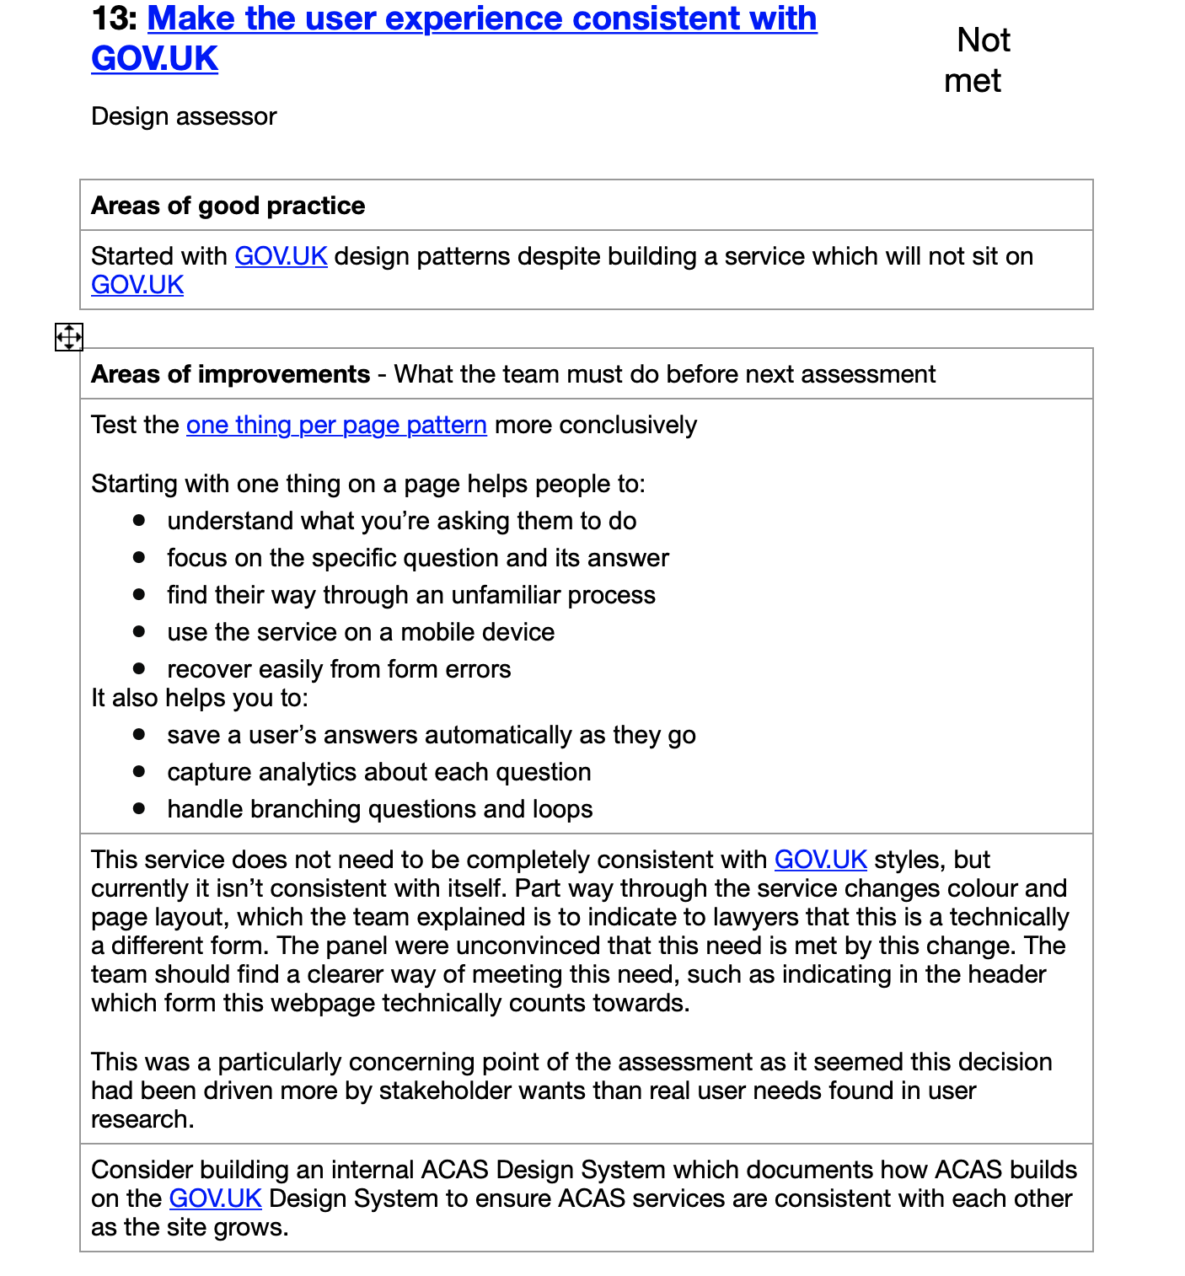

Slide 5
GDS pattern lets users review and undo mistakes more efficiently. Better presentation and usability as users can make a change to answer without have to having go back through all the pages in the form.
Help users to check answers with better check my answers page

Slide 6
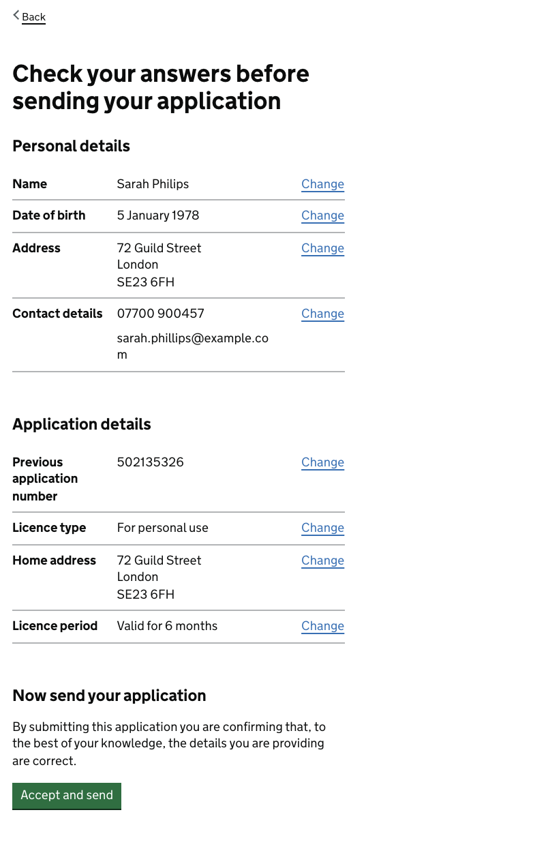

Slide 7
By using the GDS task list pattern we will using tried and pattern, which tells users which section in the form is completed, which is under progress and which section still needs to completed.
Help users to understand all the tasks they need to complete by using GDS task list pattern

Slide 8
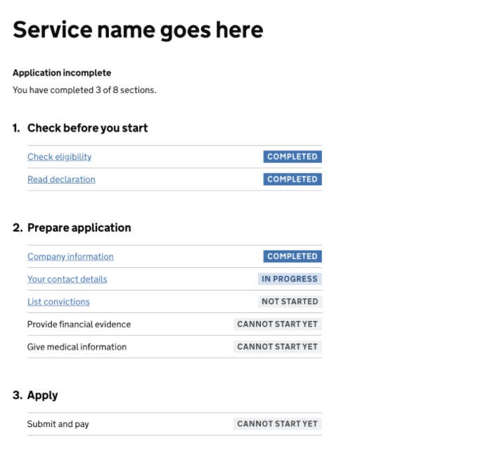

Slide 9
By using GDS patterns for error handling.e will using tried and pattern, which tells users which section in the form is completed, which is under progress and which section still needs to completed.
Help users to correct mistakes by using GDS patterns for error handling

Slide 10
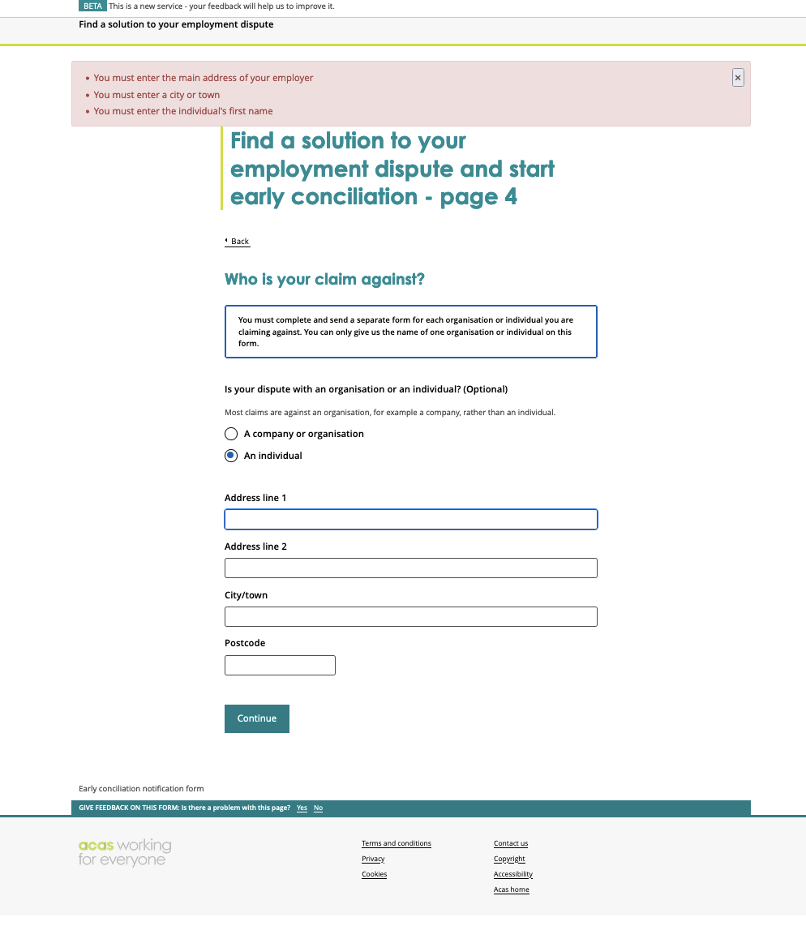
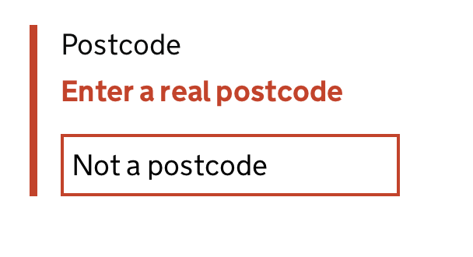


Slide 11
By using the business name and address lookup, we can save the time that users would need to find and enter employer’s correct legal name and address. We could also reduce potential errors that could happen when user enter employer name and address.
Help users save time and reduce mistakes by offering business name and address lookup

Slide 12

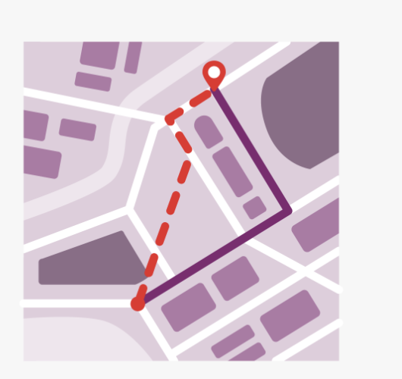

Slide 13
By using as dashboard we help users lets a user know where they are in the conciliation process and avoid too many phones calls from 'needy' (maybe unrepresented) customers that are anxious.
Help users to stay informed about the case status with a dashboard

Slide 14
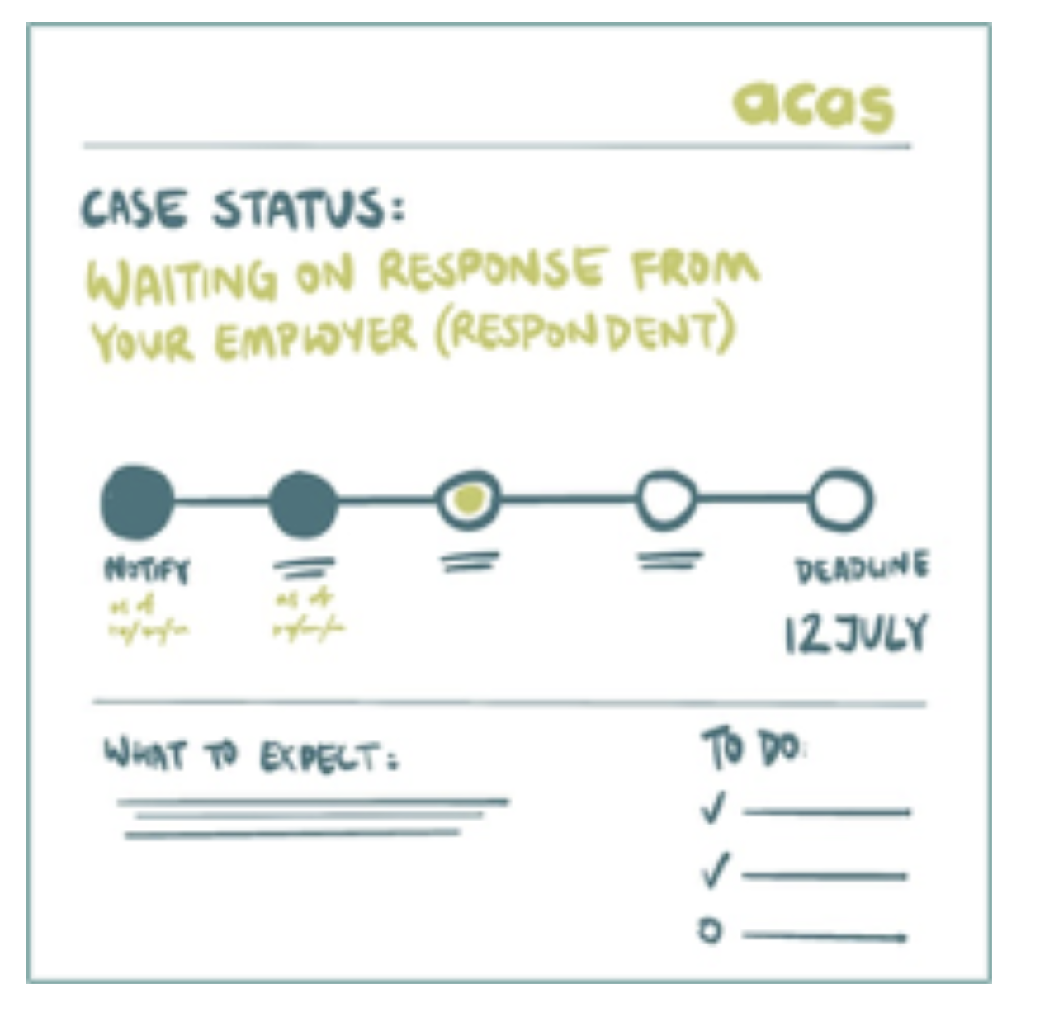

Slide 15
Consider using start page with step by step navigation to give users visibility of all the steps in the process so they know what to expect.
Please watch GDS video on how this pattern has been used across government to improve user experience, save time and money.
https://www.youtube.com/watch?v=I5gP62TX8aQ
Help users to get visibility of all the steps in the process so they know what to expect.

Slide 16
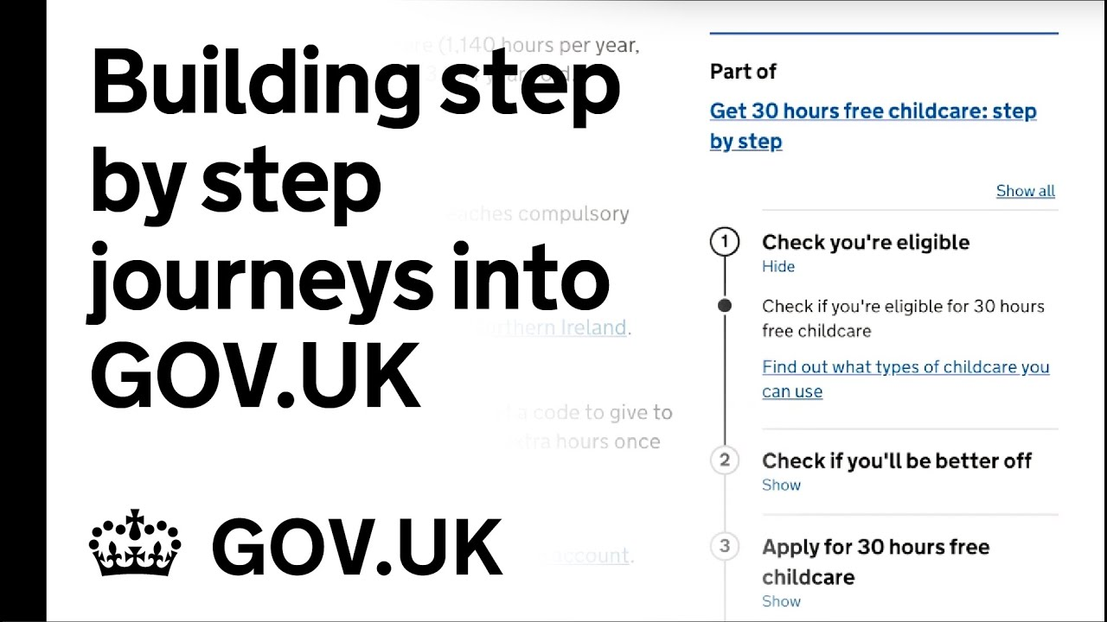

Slide 17
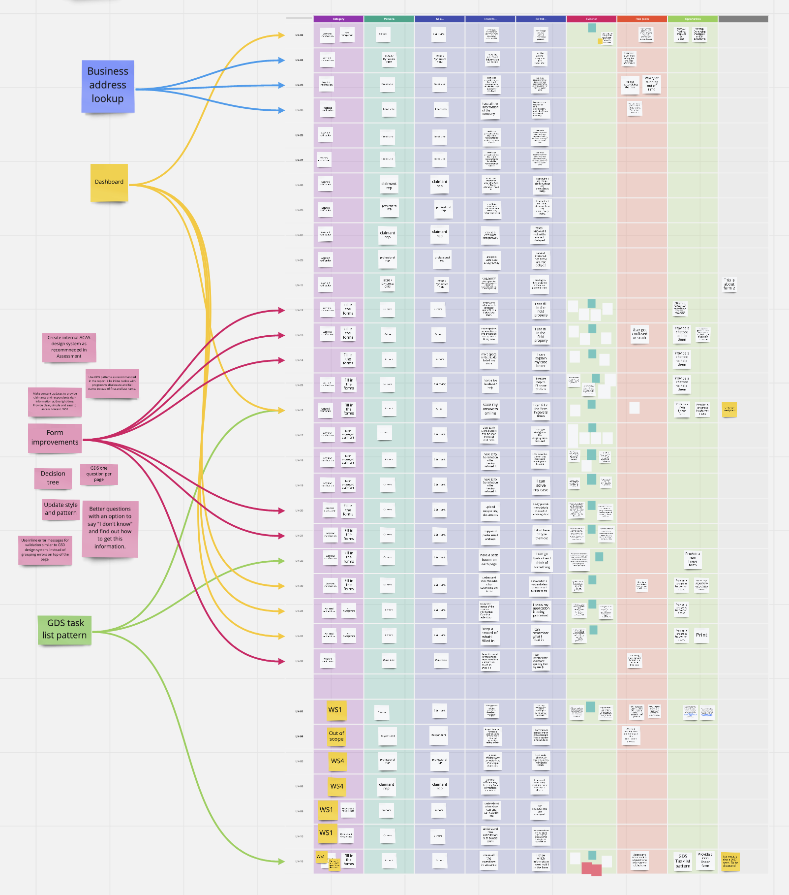
User needs, pain-points, evidence and opportunities
https://miro.com/app/board/o9J_lmKcXHc=/?invite_link_id=919763344598

