Slide 1
Ideas to prototype in Alpha
With rational on why to test these ideas

Slide 2
How can we offer our users the simplest and most accessible journey to help them resolve their employment dispute at the earliest point possible, and ensure that they experience a high-quality, value-added service that leads to an appropriate outcome for their case.
Problem to be solved

Slide 3
The alpha will explore targeted micro-guidance and other notification form interventions that will help users notify successfully, reduce invalid or out of time cases and improve the quality of the information provided to conciliators to help them resolve cases faster and more often.
What will we explore in Alpha

Slide 4
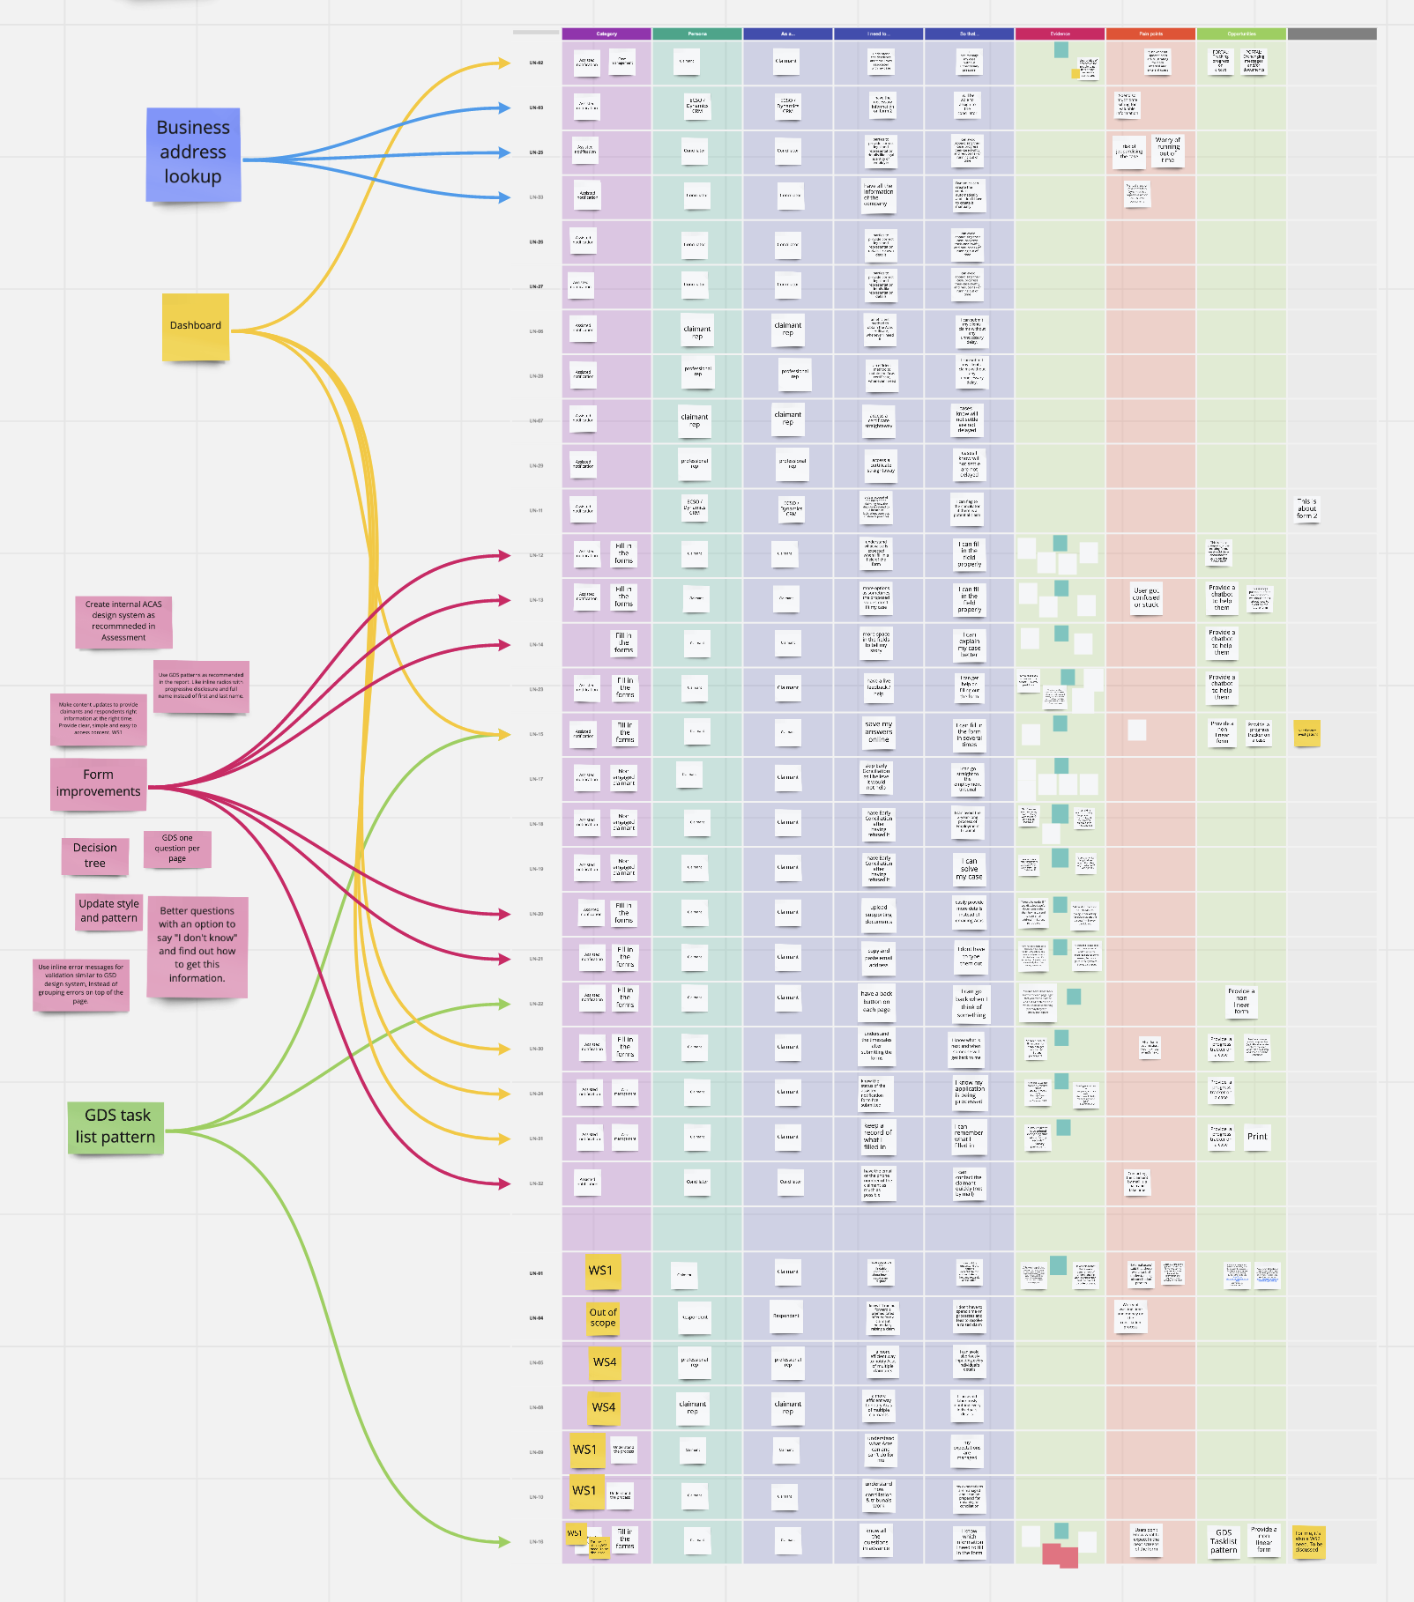
https://miro.com/app/board/o9J_lmKcXHc=/?invite_link_id=919763344598

Slide 5
Learn from the research and experience of other service teams and avoid repeating work that’s already been done.
Help users get a better user experience by using tired and tested GDS patterns

Slide 6
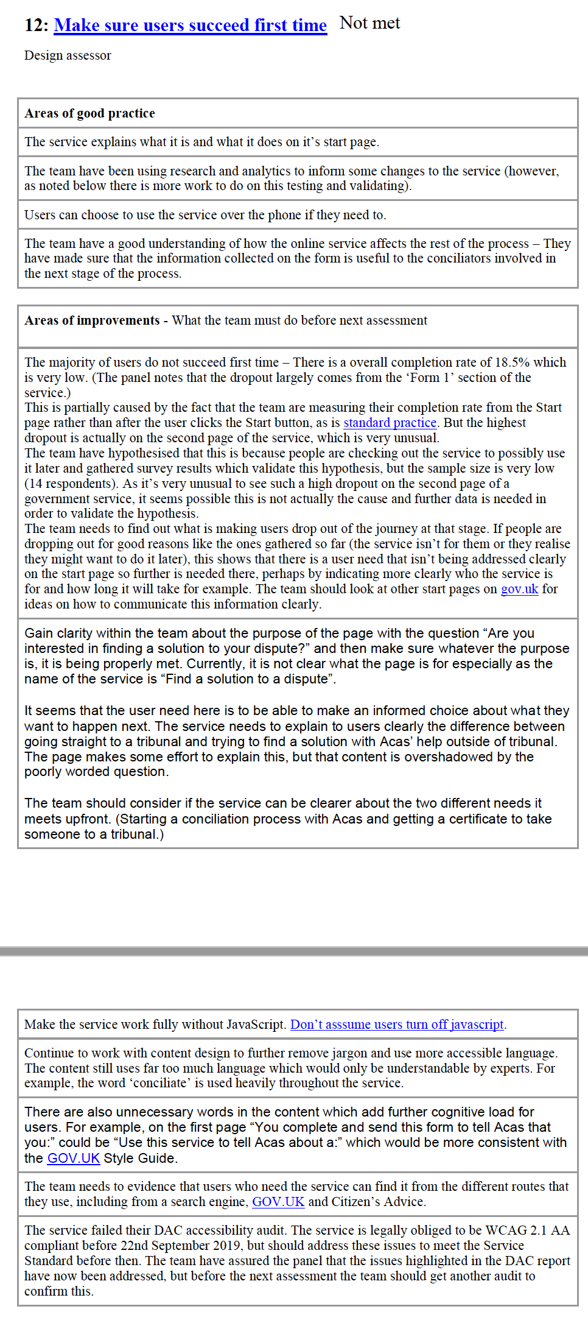
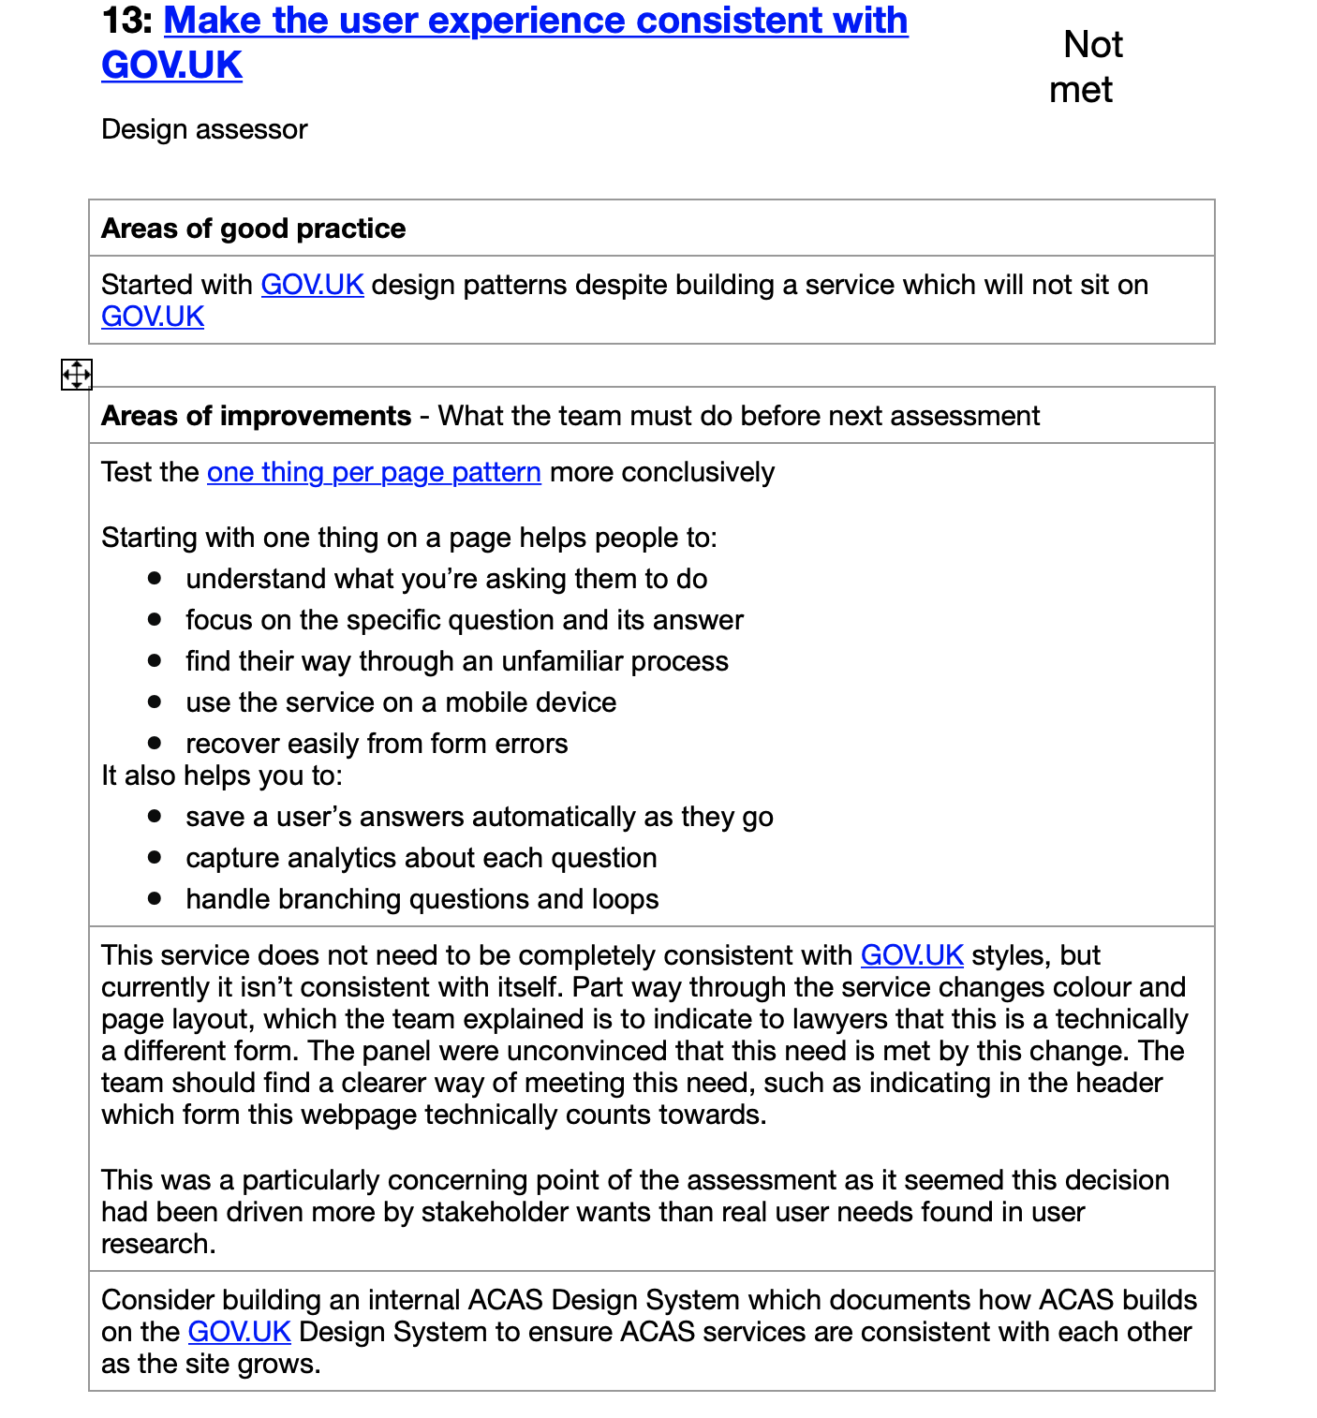

Slide 7
Interactive from, which uses decision tree, to channel users to right direction, by checking if they’re eligible to use your service resulting in reduced invalid or out of time cases.
Help users to check if this service is suitable

Slide 8
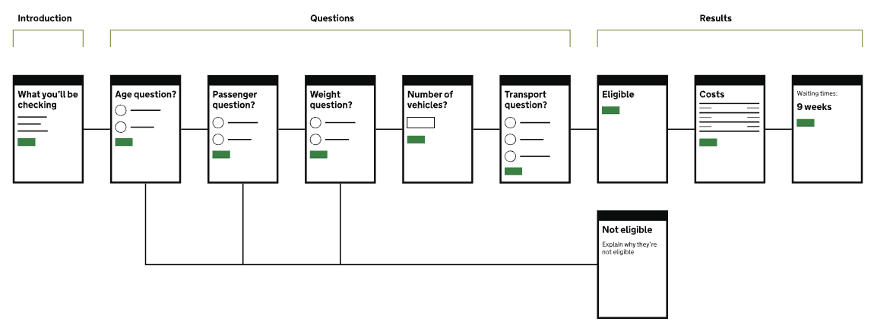

Slide 9
“We need to filter out frivolous vexatious or unreasonable claims at the outset.”
Source internal survey S4

Slide 10
GDS pattern lets users review and undo mistakes more efficiently. Better presentation and usability as users can make a change to answer without have to having go back through all the pages in the form.
Help users to check answers with better check my answers page

Slide 11
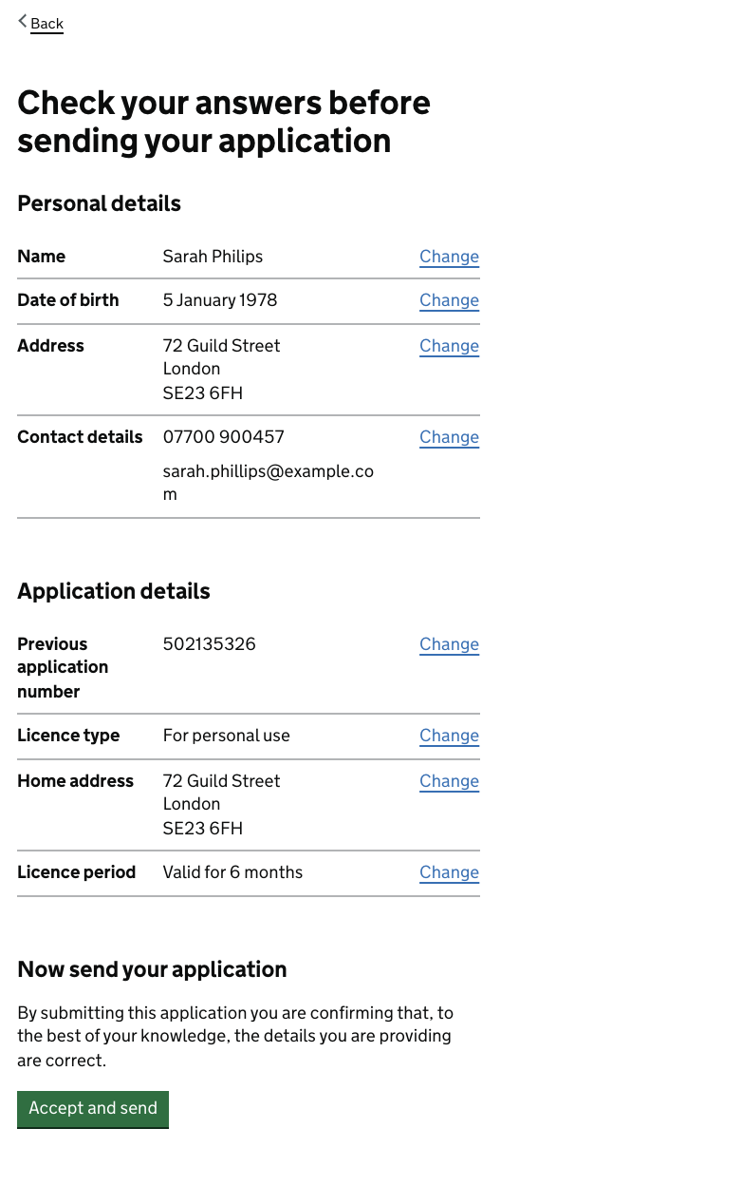

Slide 12
By using the GDS task list pattern we will using tried and pattern, which tells users which section in the form is completed, which is under progress and which section still needs to completed.
Help users to understand all the tasks they need to complete by using GDS task list pattern

Slide 13
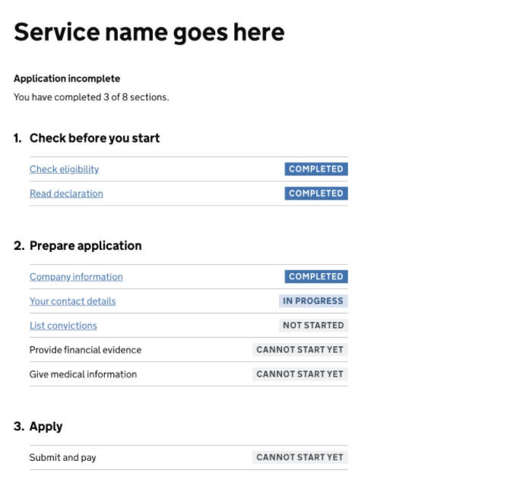

Slide 14
By using GDS patterns for error handling.e will using tried and pattern, which tells users which section in the form is completed, which is under progress and which section still needs to completed.
Help users to correct mistakes by using GDS patterns for error handling

Slide 15
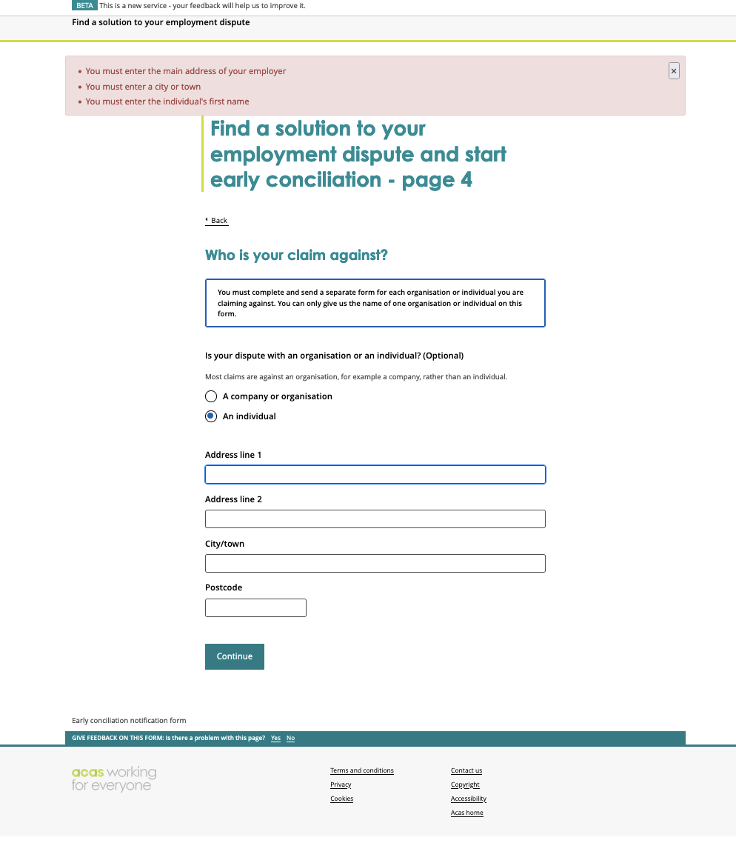
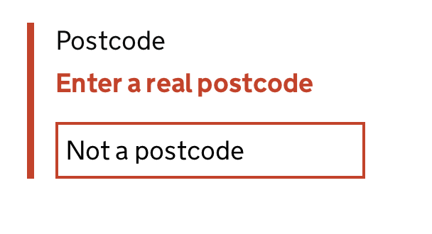


Slide 16
By using the business name and address lookup, we can save the time that users would need to find and enter employer’s correct legal name and address. We could also reduce potential errors that could happen when user enter employer name and address.
Help users save time and reduce mistakes by offering business name and address lookup

Slide 17

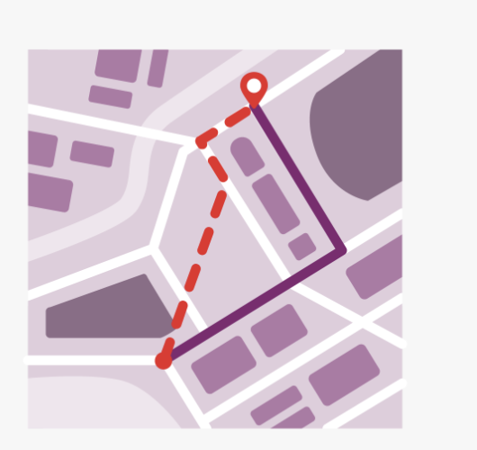

Slide 18
By using as dashboard we help users lets a user know where they are in the conciliation process and avoid too many phones calls from 'needy' (maybe unrepresented) customers that are anxious.
Help users to stay informed about the case status with a dashboard

Slide 19
