Slide 1


Agenda
Content Management Interoperability Services (CMIS) + Transact

Slide 2
Topics
CMIS
Transact Integration
Live Demo
Tools
Document reference
Troubleshooting areas

Slide 3



CMIS..??
ContentManagementServer
Web-Client-1
OASIS
CMIS
CMIS
Vendor specific
Standards
Vendor specific
Standards
Vendor specific
Standards
CMIS
CMIS
CMIS
CMS -1
CMS-2
CMS-3

Slide 4
CMIS Terminology….
Repository
Folder
Document
Content Model
Custom Property
Aspect

Slide 5
How to Connect with CMIS services..
AtomPub Binding
WebService
Browser
CMIS-1.0
CMIS-1.1
CMIS 1.0 AtomPub Service Document (http://localhost:8080/alfresco/api/-default-/public/cmis/versions/1.0/atom)
CMIS 1.0 Web Services WSDL Document(http://localhost:8080/alfresco/cmisws/cmis?wsdl)
CMIS 1.1 AtomPub Service Document(http://localhost:8080/alfresco/api/-default-/public/cmis/versions/1.1/atom)
CMIS 1.1 Browser Binding URL(http://localhost:8080/alfresco/api/-default-/public/cmis/versions/1.1/browser)

Slide 6
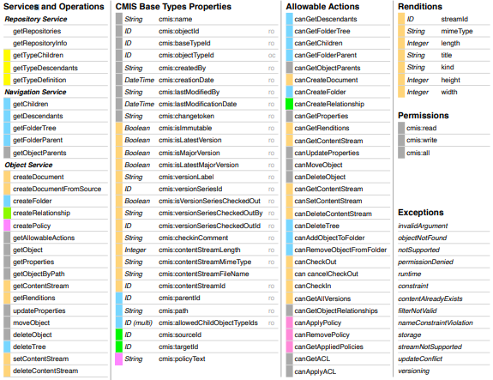
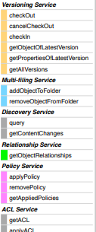
CMIS offered Services

Slide 7
CMIS integration with Transact

Slide 8
TRANSACT INTEGRATION ..
Transact Version : 2020.1.04
CMIS: Alfresco- 5.2
DCMA-CMIS (For CMIS export)
DCMA-CMIS-IMPORT (For CMIS import)
Apache-Chemistry : To connect with CMIS server(Alfresco CMIS Server)

Slide 9
Export CMIS plugin
Start
Prepare Meta-Data
Perform Authentication
Check Authentication-Mechanism
Terminate
Authenticated?
Oauth
NO
YES
YES
NO
YES
WS-Security
Prepare-Docs
NO
Terminate
Upload File to CMIS
Basic
Fail
YES
Success
Workflow Complete

Slide 10
CMIS EXPORT CONFIGURATION…..
Transact
CMIS-Server
Configuration File
Dcma-cmis.properties
Mapping Files
Aspect-mapping.properties
DLF-attribute-mapping.properties
Custom Model
Document properties
Aspect properties

Slide 11
Demo
Transact Version : 2020.1.04
CMIS: Alfresco- 5.2

Slide 12
Queries………..
Which binding should we use?
The Browser Binding is the fastest binding and is recommended for CMIS 1.1 repositories. Choose the AtomPub Binding for CMIS 1.0 repositories. The Web Services Binding is the last resort and should be avoided. It is the slowest binding and is the most complex to set up.

