Slide 1
Kubernetes

Slide 2
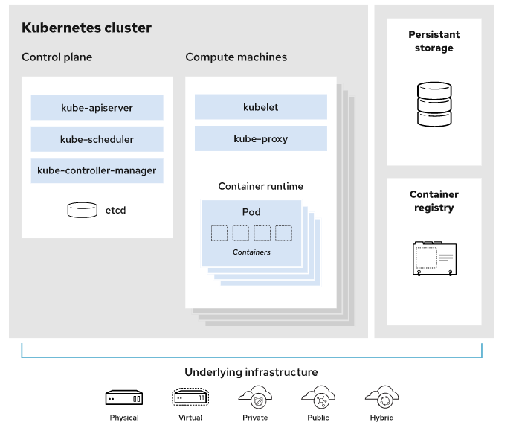
Kubernetes-Architecture

