Slide 1
Distributed Systems
The CAP Theorem is a fundamental theorem in distributed systems that states any distributed system can have at most two of the following three properties.
Consistency
Availability
Partition tolerance

Slide 2
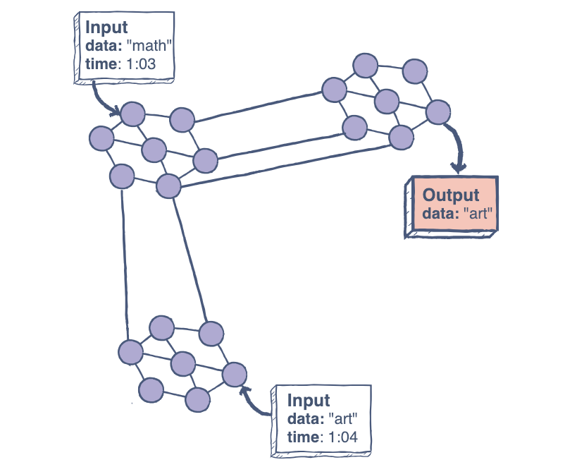
Distributed System
Consistency
A system is said to be consistent if all nodes see the same data at the same time.
Simply, if we perform a read operation on a consistent system, it should return the value of the most recent write operation. This means that, the read should cause all nodes to return the same data, i.e., the value of the most recent write.

Slide 3
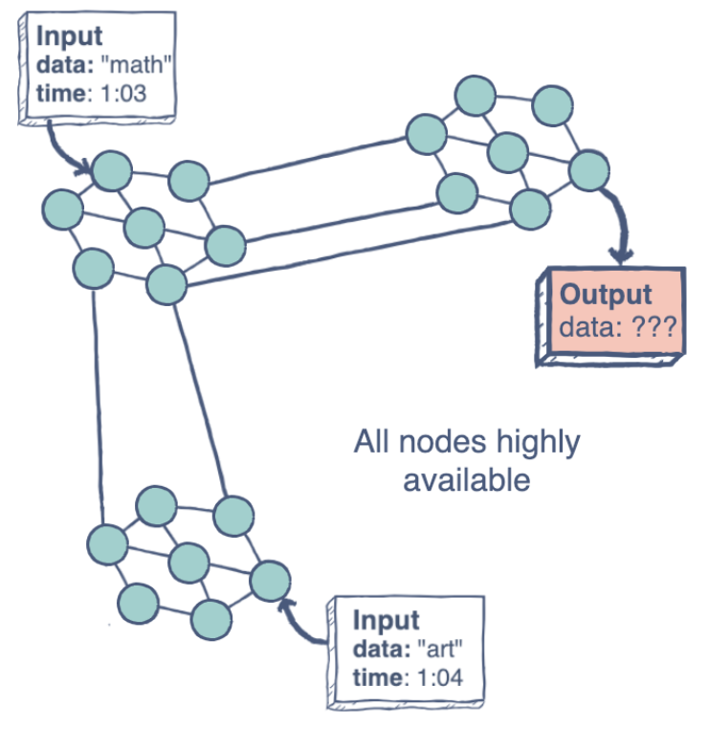
Distributed System
Availability
Availability in a distributed system ensures that the system remains operational 100% of the time. Every request gets a (non-error) response regardless of the individual state of a node.
Note: this does not guarantee that the response contains the most recent write.
The figure on the left illustrates an “unavailable” system.

Slide 4
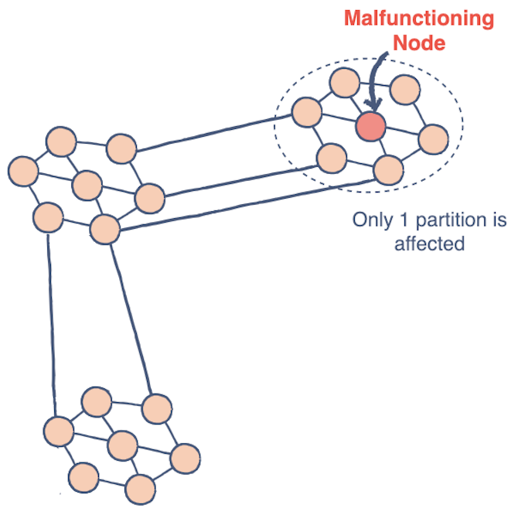
Distributed System
Partition Tolerance
This condition states that the system does not fail, regardless of if messages are dropped or delayed between nodes in a system.
Partition tolerance has become more of a necessity than an option in distributed systems. It is made possible by sufficiently replicating records across combinations of nodes and networks.

