Slide 1
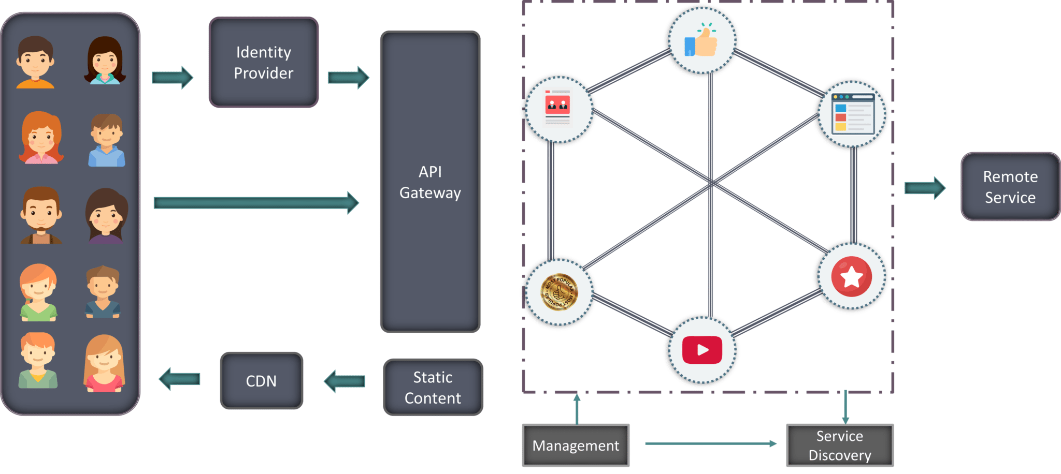
Microservices

Slide 2
Core Concepts
Service Discovery
Client Side discovery
Server side discovery
API Gateway
Load Balancing
Client Side load balancing
Server side load balancing
Circuit Breaker
Distributed Tracing

Slide 3
Service Discovery
Solutions
Netflix Eureka
Consul
Eureka
Zookeeper
Kubernetes

Slide 4
API Gateway
Solutions
Spring cloud gateway

Slide 5
Circuit breakers

Slide 6
Load Balancing for MicroServices
Software Load Balancing
Hardware load balancing

