Slide 1
Spring and Spring-Boot

Slide 2
Microservices
What are microservices?
Microservices are a modern approach to software whereby application code is delivered in small, manageable pieces, independent of others.
Why build microservices?
Their small scale and relative isolation can lead to many additional benefits, such as easier maintenance, improved productivity, greater fault tolerance, better business alignment, and more.

Slide 3

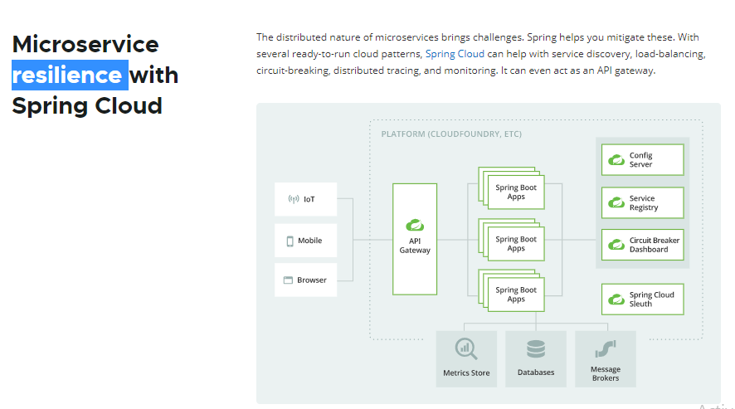

Slide 4
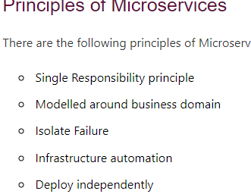

Slide 5
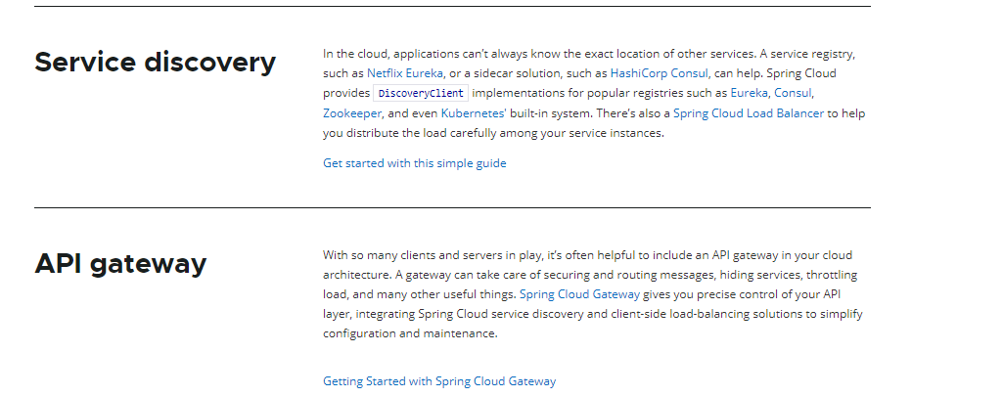

Slide 6
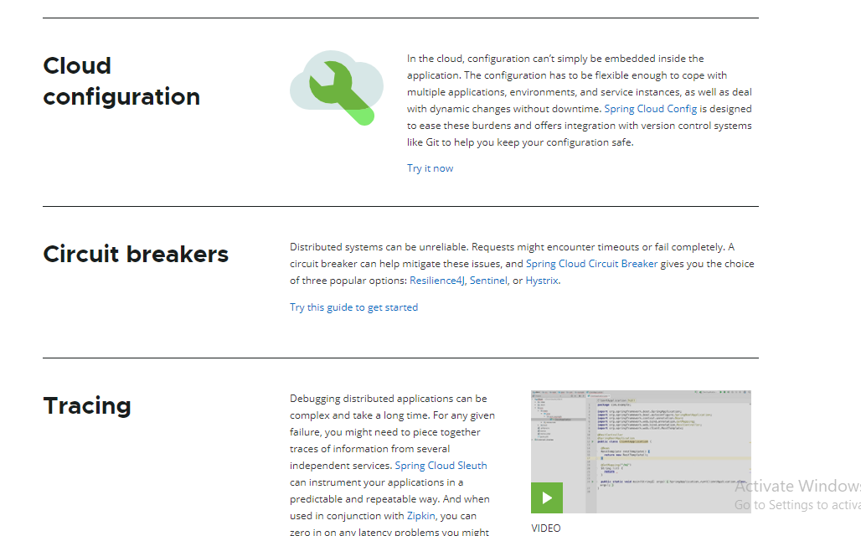

Slide 7
Springboot – components……
API Gateway—
Netflix zuul-Zuul is a library developed by Netflix that provides dynamic routing, monitoring, resiliency, security, and more amazing features
Service Discovery—Service Registry, The service discovery is implemented using Netflix OSS components. It provides Eureka, which is a Service Registry, and Ribbon, which is an HTTP client that queries Eureka in order to route HTTP requests to an available service instance.
Client side discovery
Server side discovery
Circuit Breaker

