Slide 1
DEV - OPS
Vikas
Notes:
https://github.com/yankils/hello-world
https://github.com/yankils/Simple-DevOps-Project

Slide 2
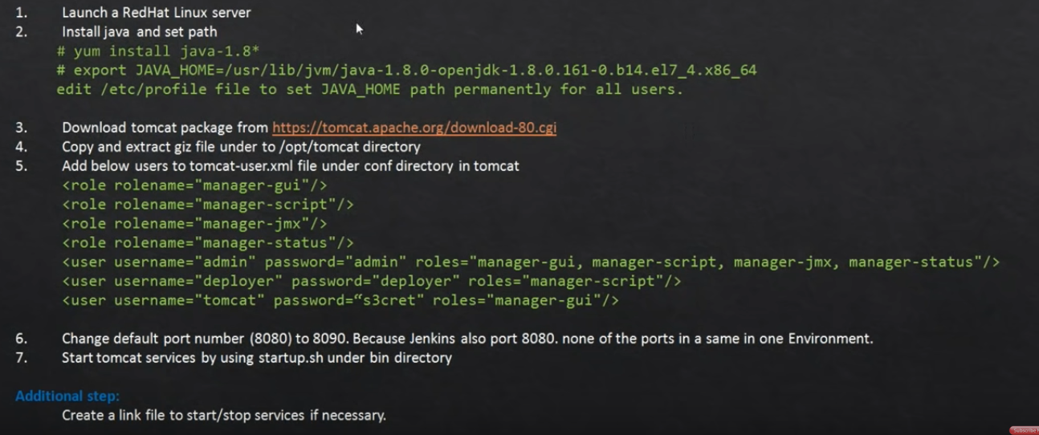
Tomcat EC2 instance | Tomcat server setup
Notes:
You can also use normal Amazon Linux Machine instead of RHL .
yum install java-1.8* wget
go to download tar.gz (pgp, sha512) from https://tomcat.apache.org/download-80.cgi
cd /opt
wget http://mirrors.estointernet.in/apache/tomcat/tomcat-8/v8.5.46/bin/apache-tomcat-8.5.46.tar.gz
tar -zvxf apache-tomcat-8.5.46.tar.gz
cd apache-tomcat-8.5.46/bin
start the services → ps –ef | grep tomcat
chmod +x shutdown.sh
chmod +x startup.sh
Then on /opt/apache-tomcat-8.5.45/bin say echo$PATH
ln -s /opt/apache-tomcat-8.5.46/bin/shutdown.sh /usr/bin/tomcatdown
ln -s /opt/apache-tomcat-8.5.46/bin/startup.sh /usr/bin/tomcatup
tomcatdown
tomcatup
ps –ef | grep tomcat
cd ..
cd conf
vi server.xml
tomcatdown
tomcatup
ps -ef | grep tomcat
find / -name context.xml
vi /opt/apache-tomcat-8.5.46/webapps/host-manager/META-INF/context.xml
vi /opt/apache-tomcat-8.5.46/webapps/manager/META-INF/context.xml
vi tomcat-users.xml
edit connector port to 8090 → save and come out → stop the service tomcatdown and then start it gain
Login works ➔ manage app
Read content → look for command → find / -name context.xml
Comment out valve class name by saying <!-- --> this is done at three files
Restart and try to connect again → Manager app → you should be prompted for user id → to get user id → vi tomcat-users.xml
<role rolename="manager-gui"/>
<role rolename="manager-script"/>
<role rolename="manager-jmx"/>
<role rolename="manager-status"/>
<user username="admin" password="admin" roles="manager-gui, manager-script, manager-jmx, manager-status"/>
<user username="deployer" password="deployer" roles="manager-script"/>
<user username="tomcat" password="s3cret" roles="manager-gui"/>
Install Deploy to container plugin in Jenkins
Draft credentials : Username with password : username and password is deployer .rest comment .
In post build action : Deploy war/ear to container : WAR/EAR File : **/*.war
Add container : Tomcat 8x :: use credentials[deployer/deployer] and the url from tomcat web :http://<>:8090/ ➔run the job in Jenkins → web app

Slide 3
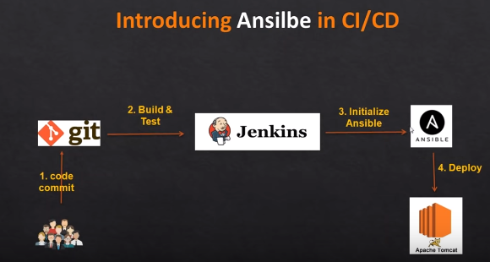
DevOps Project-2 | CI/CD pipeline using Ansible
Notes:
Login to previously configured Ansible server :
----------------------------------------------------
sudo su
Visudo
## Allow root to run any commands anywhere
root ALL=(ALL) ALL
ansadmin ALL=(ALL) NOPASSWD: ALL
useradd devopsusr
passwd devopsusr ===== change this on ansible as well as tomcat server .
su – ansadmin (In Ansible machine )
ssh-keygen -- > ssh-copy-id <target system ip/tom cat > -- > once copied try to ssh <ip of the prod machine >
[ To get target system IP go there and -- > ifconfig –a ]
As ansadmin -- > vi /etc/ansible/hosts → here add [webservers]
<ip of the prod machine> -- > :wq -- > ansible all –m ping -- > done
sudo chown -R ansadmin:ansadmin /opt/playbooks/
Now we go to home directory -- > cd /opt/playbooks/ -- > cat copyfile.yml
---
hosts: web-servers
become: true
tasks:
- name : copy war onto tom cat server
copy :
src : /opt/playbooks/webapp/target/webapp.war
dest: /opt/apache-tomcat-8.5.32/webapps
cat /etc/ansible/hosts
Install Jenkins Plugin : publish over SSH
Now in configure section : publish over ssh : SSH Server :: name = ansible_server :: hostname = <pvt ip of ansible server > :: username = ansadmin :: password based authentication and give the password :: save :: test connection ::
Now in post build step :: send files or execute command over SSH ::
Source files : webapp/target/*.war
Remote directory = //opt//playbooks
Exec-command = ansible-playbook /opt/playbooks/copyfile.yml [use another publisher over ssh]

Slide 4
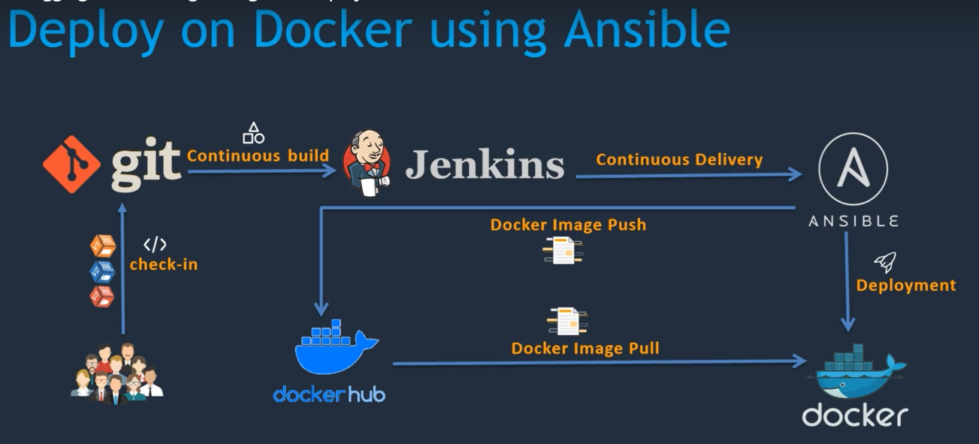
Notes:
Run Ansible playbooks from Jenkins:
========================
Clean any image or container existing from previous run in ansible machine .
Create a host file under opt/docker and put local host there
Run command in exec command section -- > ansible-playbook -i opt/docker/hosts opt/docker/simple-devops-image.yml ;
Docker tag simple-devops-image vikas99341/simple-devops-image
Docker login
Docker push vikas99341/simple-devops-image
Delete the existing image
Docker pull vikas99341/simple-devops-image
Login to docker putty now – switch to ansadmin – id – add him to docker group – try docker pull

Slide 5
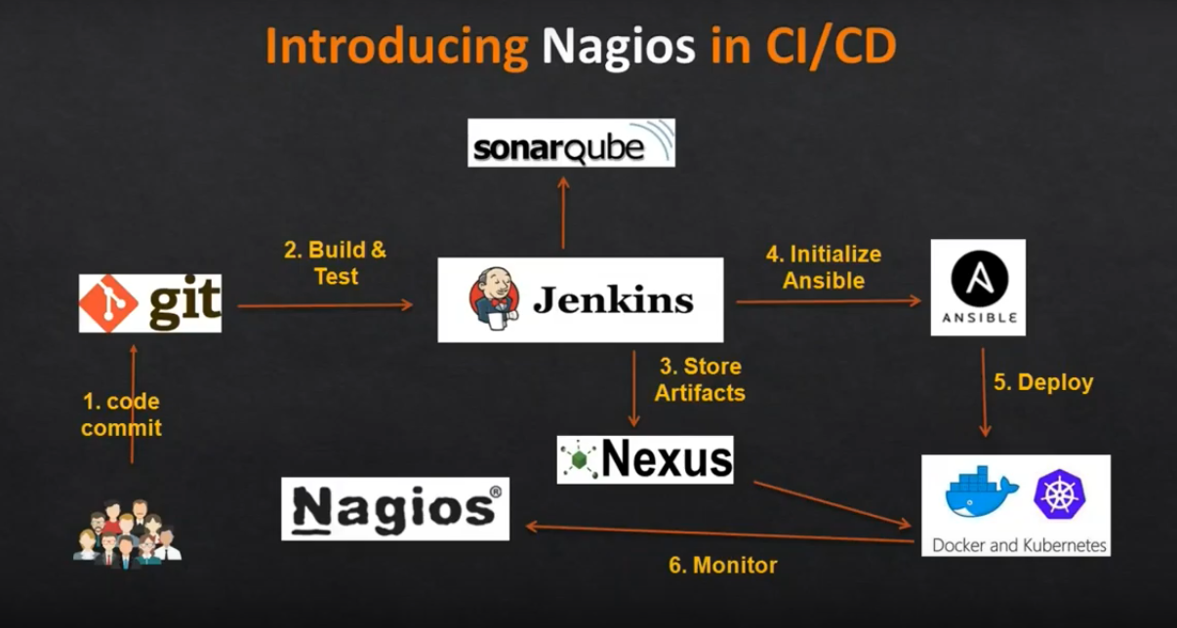

Slide 6
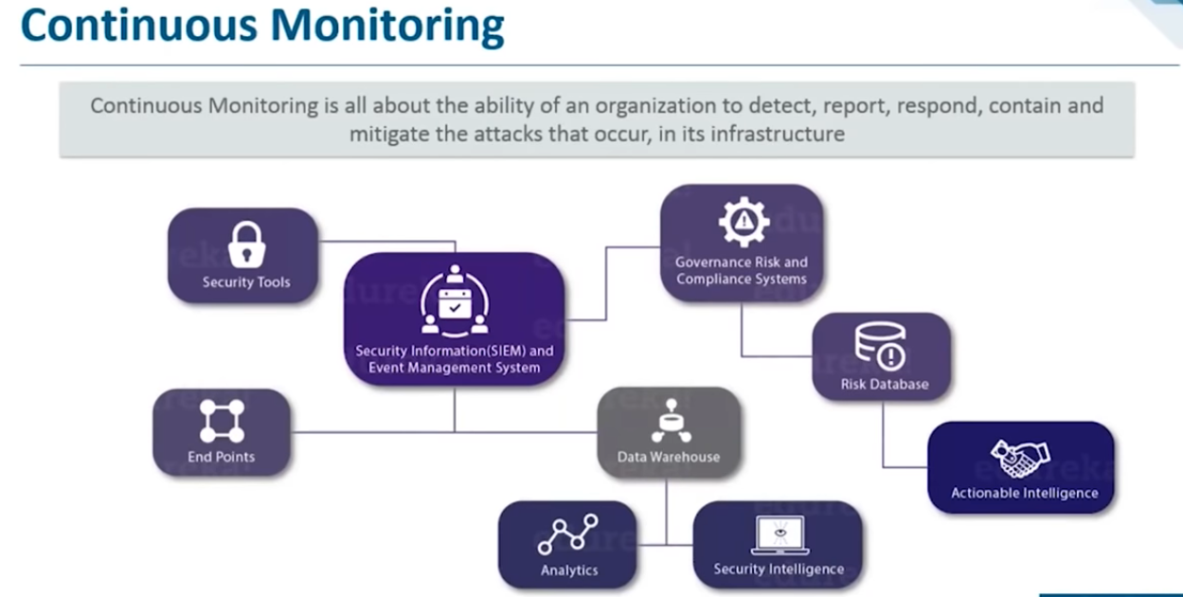
Notes:
This will resolve system errors :
System low memory
Unreachable server before they have negative impact
Detects network and server problems .
Determine root cause of any issue
Maintain security and availibity of the services .
Monitors and trouble shoot performance issue .
Plan infra updates before outdated systems cause business interruption .
Automatically fix issues when detected .
Infra outage will have minimum impact & can monitor entire business logs .

Slide 7
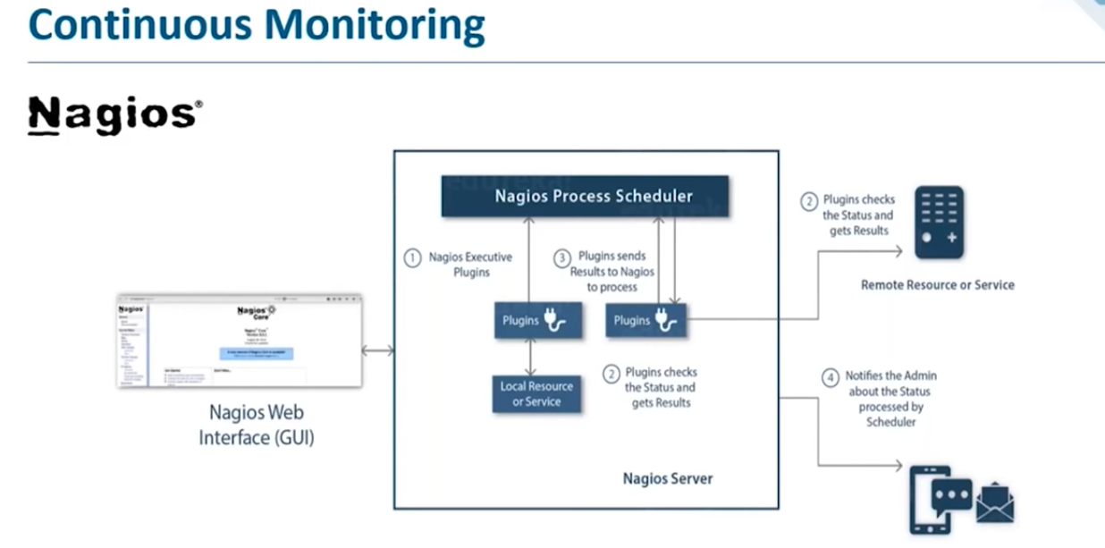
Notes:
Nagios is an open-source devops tool which is used for monitoring systems,networks and infrastructure.It also offers monitoring and alerting services for any configurable event .

Slide 8
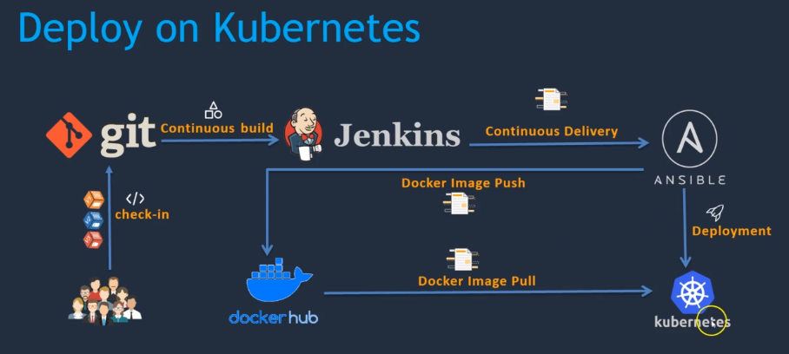
Notes:
Introduction to kubernetes
Setting up kubernetes environment .
Using kubectl command
Writing deployment and service file .
Creating ansible to deploy .
Integration with Jenkins .

Slide 9

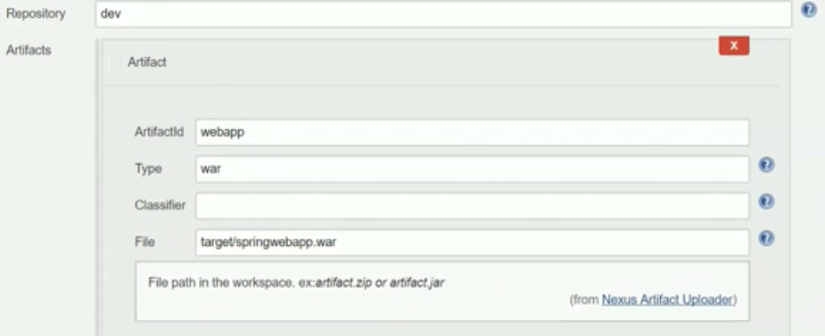
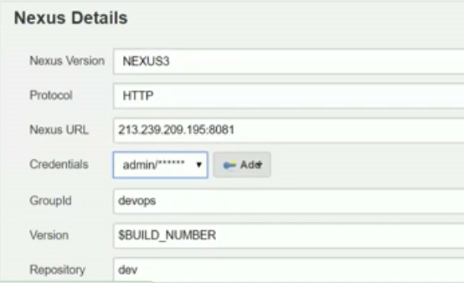
Notes:
docker way : docker run -d --restart=always -d -p 8081:8081 --name nexus -v nexus:/nexus-data sonatype/nexus3
docker logs -f nexus → wait till you get up and running message
login using admin and admin123
create Repository -- >maven2(hosted) -- > give a name -- > version Policy = Mixed -- > Layout policy =Permissive -- > deployment policy =Allow redeploy -- > Create
In Jenkins configure -- > add post build step -- > Nexus artifact uploader -- >

