Slide 1
NEXUS
VIKAS

Slide 2
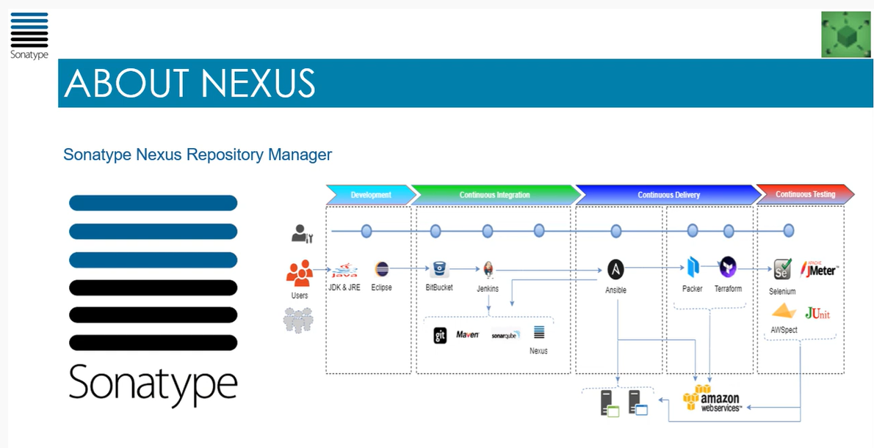
Notes:
Nexus Repository OSS is a universal repository manager with support for all major package formats and types .It’s a free solution for storing and sharing docker images and other companies like NuGet or NPM package .
docker run -d --restart=always -d -p 8081:8081 --name nexus -v nexus:/nexus-data sonatype/nexus3
docker logs –f nexus
admin/admin123
repositories – create repository – maven2(hosted)
dev – mixed – permissive –
In jenkins post step – nexus platform plugin

Slide 3
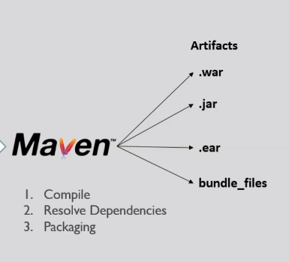
Notes:
amazon-linx-extras list
amazon-linux-extras install <java>
https://jfrog.com/open-source/
docker pull docker.bintray.io/jfrog/artifactory-oss:latest
docker run -d --restart=always -p 8082:8082 --name jfrog docker.bintray.io/jfrog/artifactory-oss
ipaddress:8082/artifactory
admin/password
http://3.236.28.97:8082/ui/repos/tree/General/artifactory-build-info

Slide 4
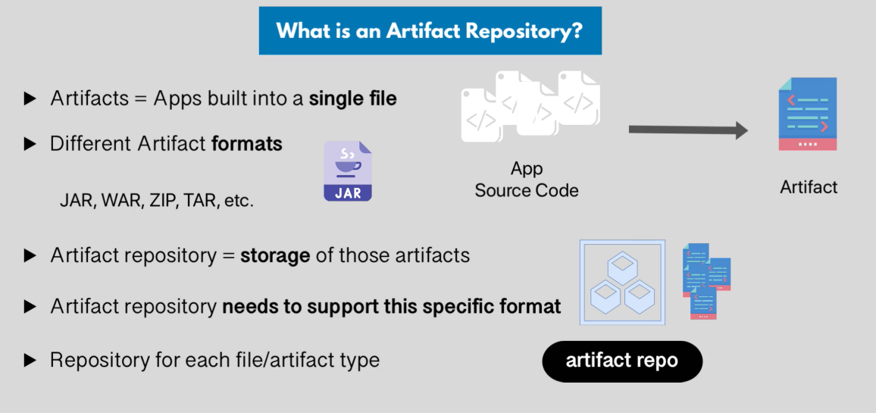

Slide 5
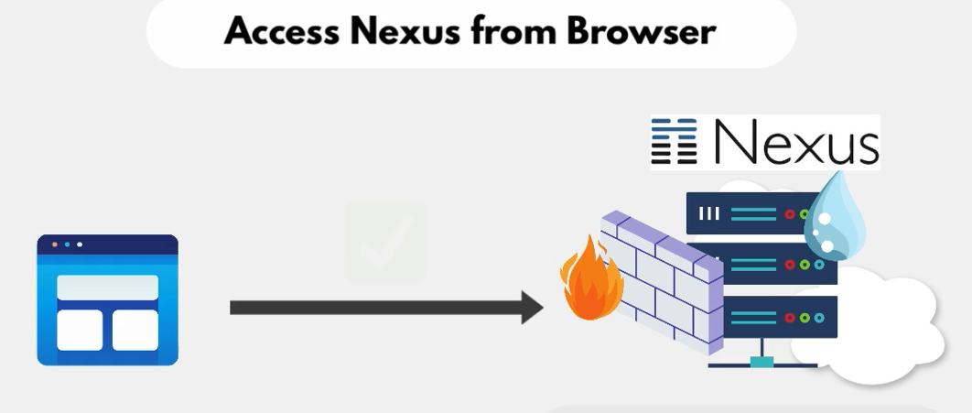

Slide 6
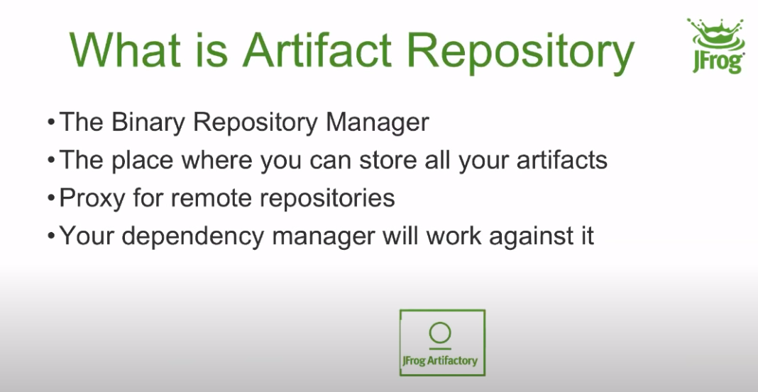
Notes:
https://repo.maven.apache.org/maven2/

Slide 7
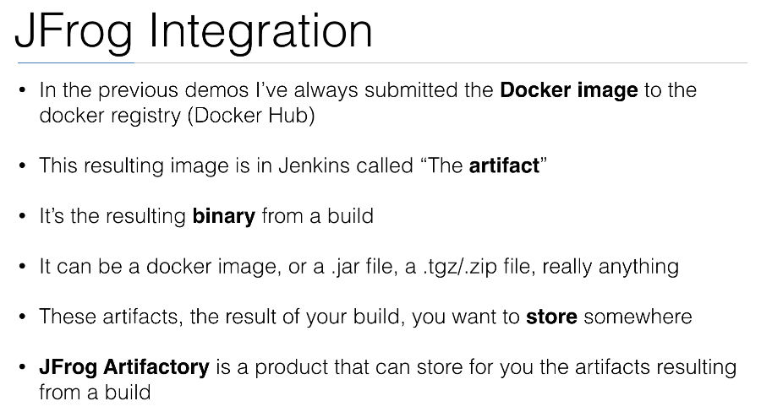

Slide 8
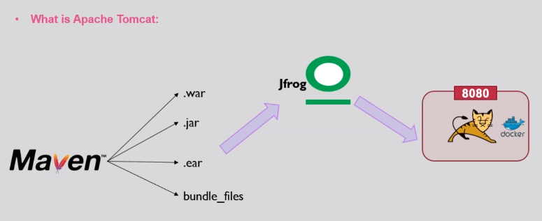
Notes:
Tom cat is open source web container .

