Slide 1
Selenium
Testing

Slide 2
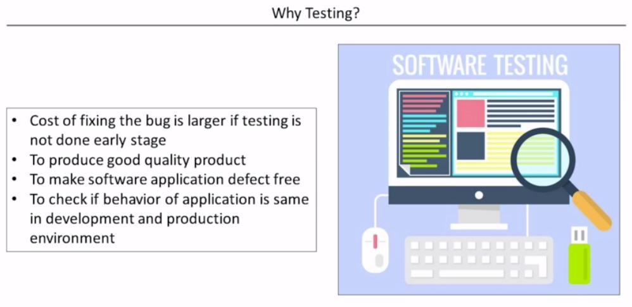

Slide 3
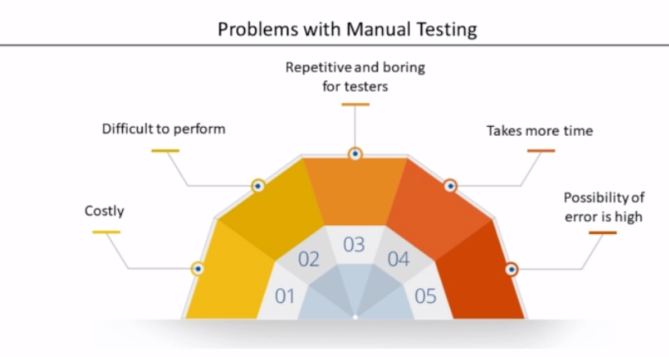

Slide 4
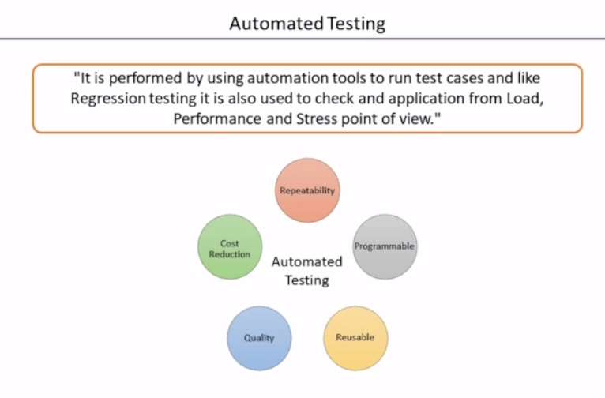

Slide 5
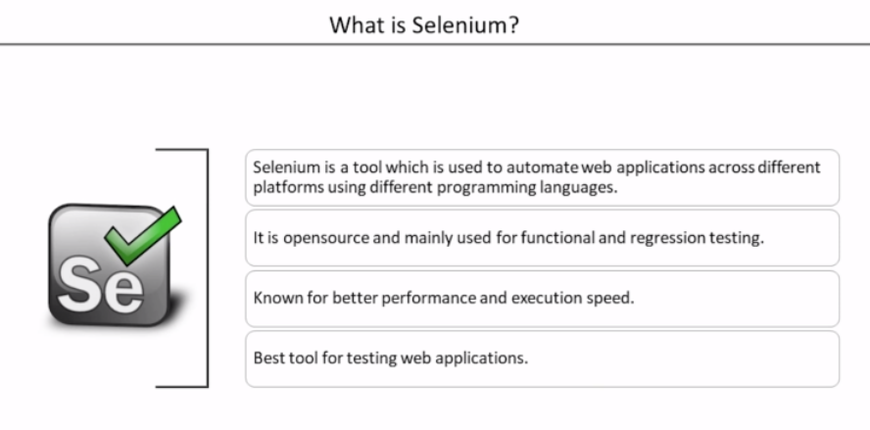
Notes:
https://github.com/devops-trainer?tab=repositories

Slide 6
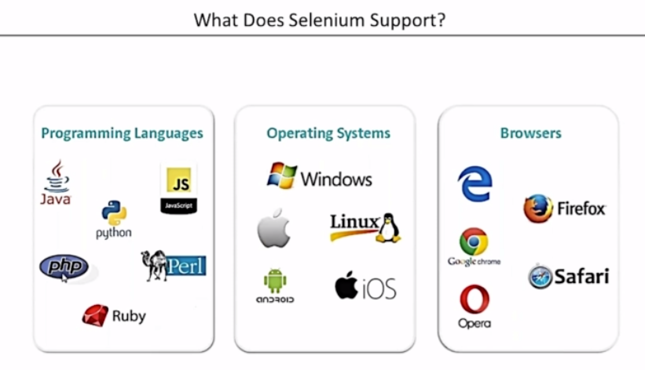

Slide 7
