Slide 1
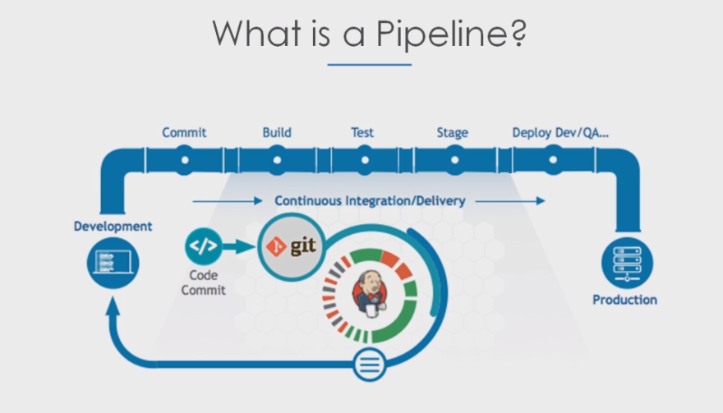
Notes:
Delivery Pipeline view plugin
Build Pipeline plugin to get build pipeline view
Jenkins pipeline

Slide 2
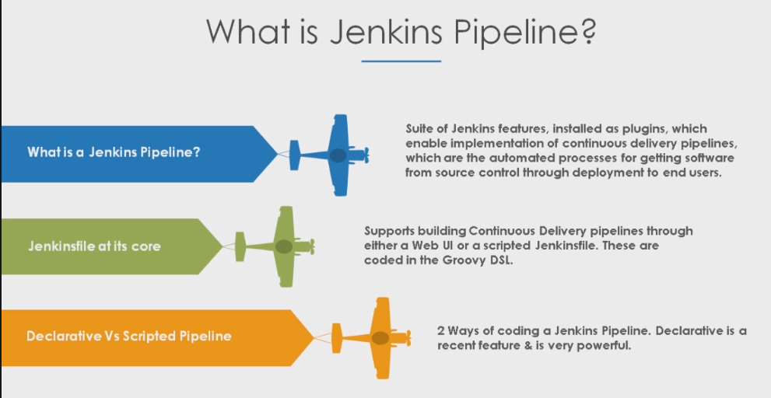
Notes:
Code your pipeline
Durability
Handles user input
Parallel job execution
Complex pipelines possible

Slide 3
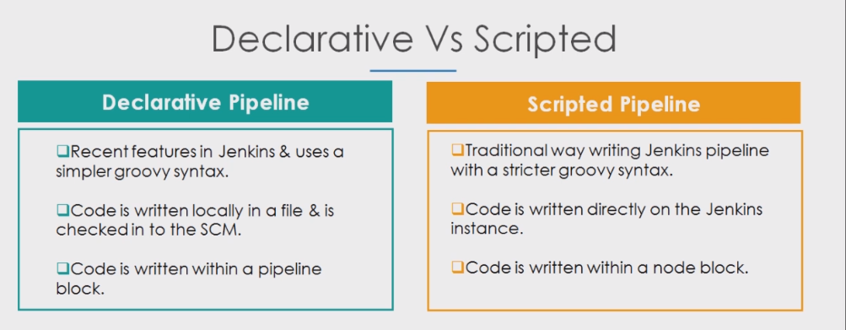
Notes:
Pipeline – user defined model of CD pipeline
Node – Machine which is part of the jenkins environment
Stage – conceptual distinct subset of a task
Step – single task that has been performed with in a stage ,.

Slide 4
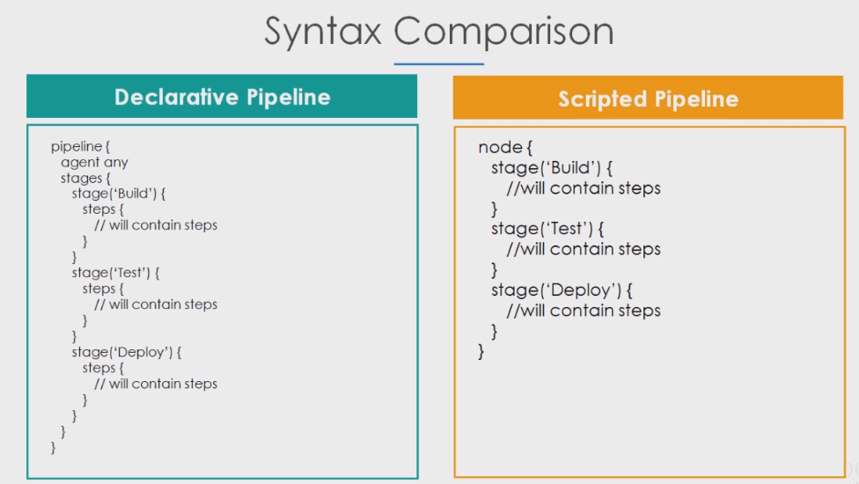

Slide 5
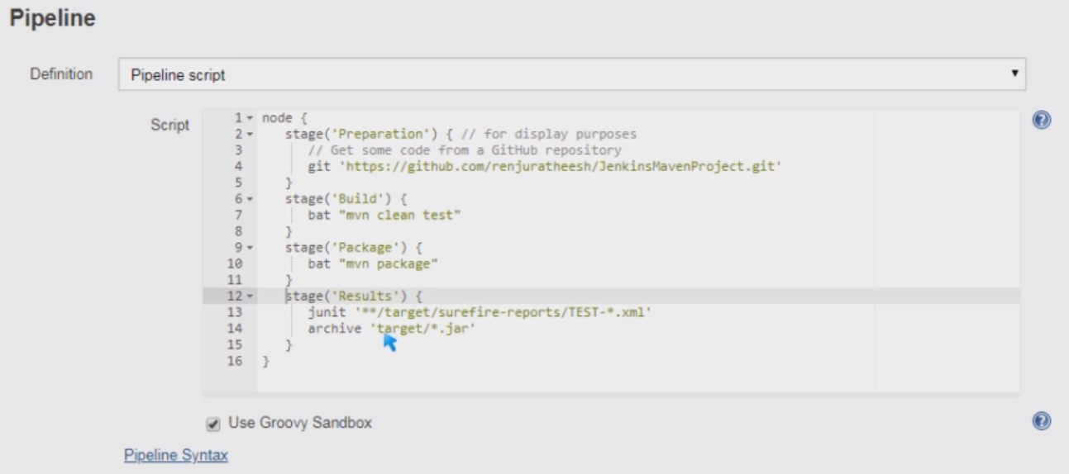
Scripted Pipeline
Notes:
New item <name it > -- pipeline – ok
Pipeline script : take it from jenkins.io save and build
node {
for(int i=0; i<5 ;i++)
{
stage(‘Stage ‘+i) {
echo “Inside Stage “+i
}
}
}
-------------------------------------------------------------------
Groovy String Interpolation : “ are mandatory
-------------------------------------------------------------------
node {
def name = “Vikas”
echo “Welcome to ${name}”
}
-------------------------------------------------------------------

Slide 6
Declarative Pipeline
Notes:
Pipe line from SCM : GIT

Slide 7
Notes:
For Slack Notification :
Install the plugin Slack Notification

