Slide 1
CONTINOUS Monitoring with Nagios
VIKAS
Notes:
https://www.itzgeek.com/how-tos/linux/ubuntu-how-tos/install-nagios-4-1-1-ubuntu-16-04.html
https://www.itzgeek.com/how-tos/linux/centos-how-tos/monitor-remote-linux-system-with-nagios-3.html
Launch RHL server with port 22 ,80, custom TCP Rule (5666) ,all ICMP –IPV4
Install and configure Nagios
Install dependencies :
Add Nagios user add him to Nagios group
Install Nagios (Create build resource + complie the resources + install the resources)
Install plugin

Slide 2
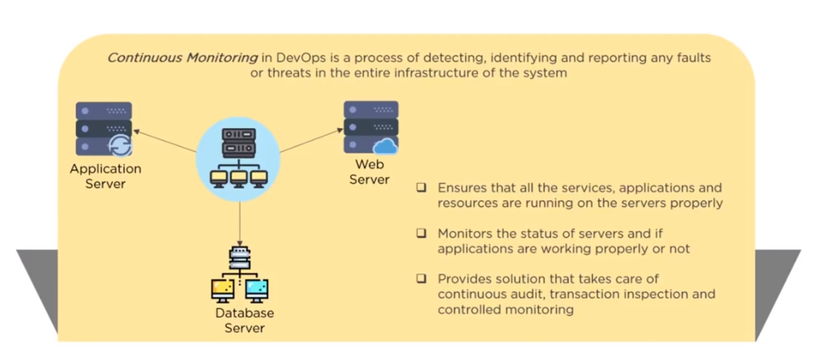

Slide 3
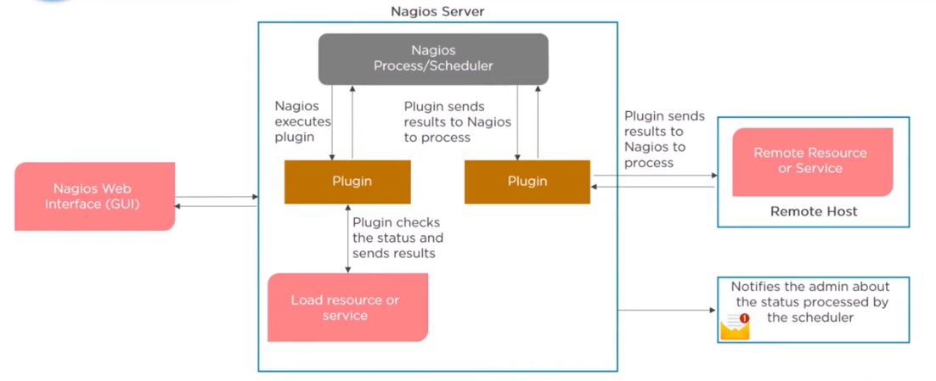

Slide 4
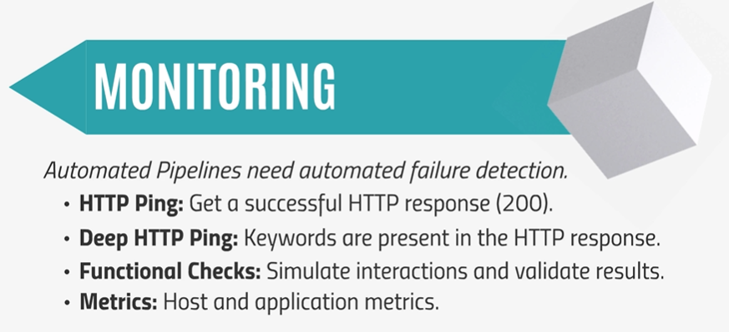

Slide 5
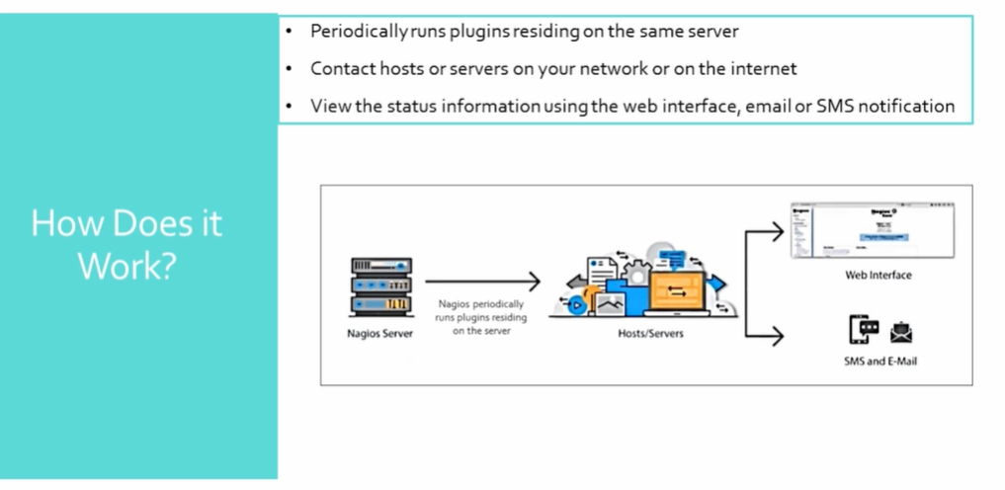

Slide 6
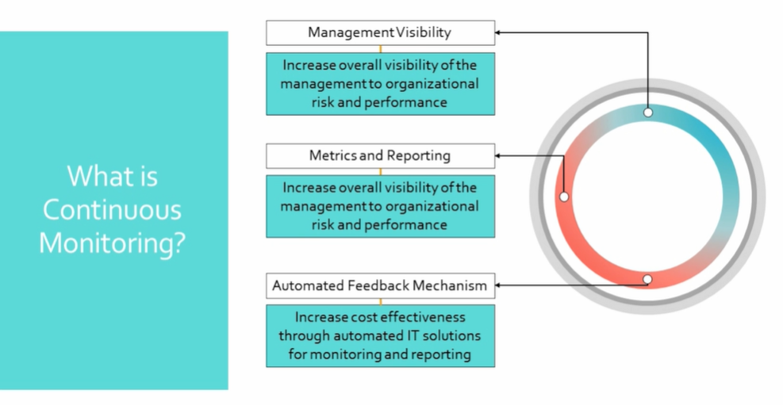

Slide 7
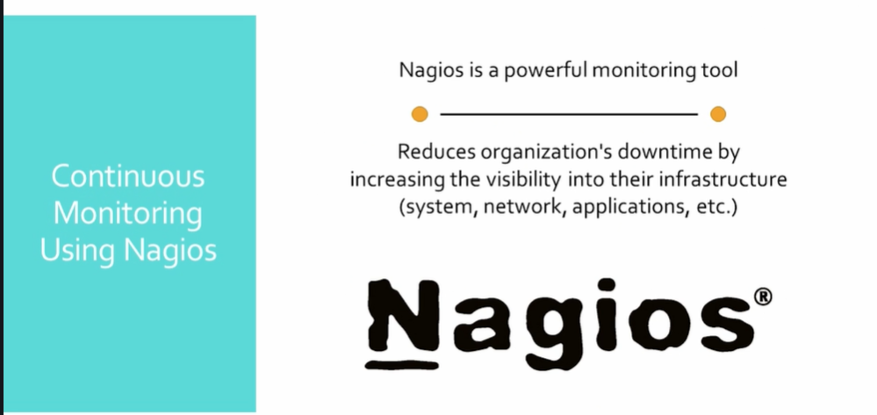

Slide 8
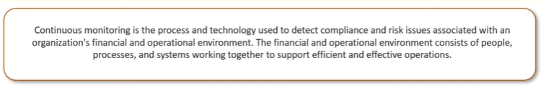
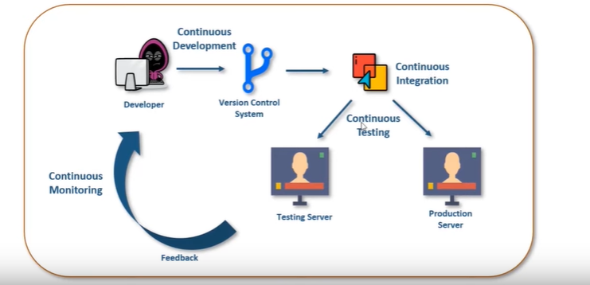
Notes:
It detects network and server issue .
Helps you to determine root cause of a issue .
Maintains security and availability of a service .
Monitors and trouble shoots server performance issue .
It can response to first sign in issues .
Monitors your entire infrastructure and business process.

Slide 9
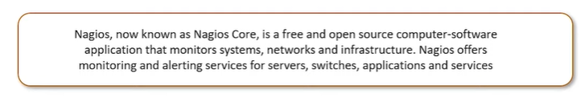
Notes:
Install required packages on server:
-----------------------------------------
https://dl.fedoraproject.org/pub/epel/6/
rpm -Uvh https://dl.fedoraproject.org/pub/epel/6/x86_64/epel-release-6-8.noarch.rpm
http://rpms.remirepo.net/enterprise/
rpm -Uvh http://rpms.remirepo.net/enterprise/remi-release-6.rpm
Install Nagios core ,Nagios plugins and NRPE :
---------------------------------------------------
yum install nagios nagios-plugins-all nagios-plugins-nrpe httpd php -y
chkconfig httpd on && chkconfig nagios on
service httpd start
service nagios start
dd if=/dev/zero of=/swap bs=1024 count=2097152
mkswap /swap && chown root. /swap && chmod 0600 /swap && swapon /swap
echo /swap swap swap default 0 0 >> /etc/fstab
echo vm.swappiness = 0 >> /etc/sysctl.conf && sysctl –p
Set Nagios password to access the web interface :
--------------------------------------------------------

Slide 10
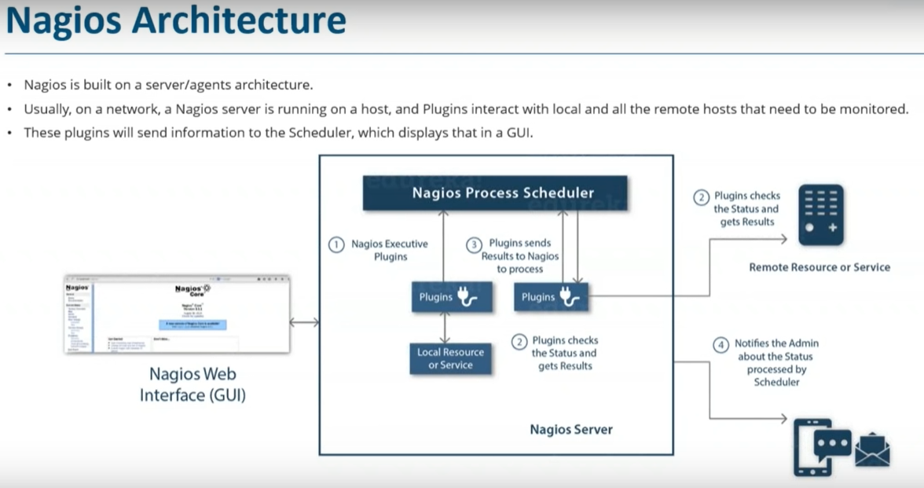
Notes:
ami-8642aafc
https://assets.nagios.com/downloads/nagioscore/docs/nagioscore/4/en/quickstart-ubuntu.html
http://xmodulo.com/monitor-common-services-nagios.html
Github.com/vikas99341/nagios_setup
https://www.youtube.com/watch?v=veL0W257gXI
Install 2 unbuntu servers with all channels open .

