Slide 1

TERRAFORM
One code syntax, One workflow ...any infrastructure
Notes:
Introduction:
My name is Vikas.
I am architect and have specialization on cloud and dev ops . I have been working with terraform for a long time now.
Run the command and relax
https://github.com/vikas99341/terraform-beginner-to-advanced-resource

Slide 2
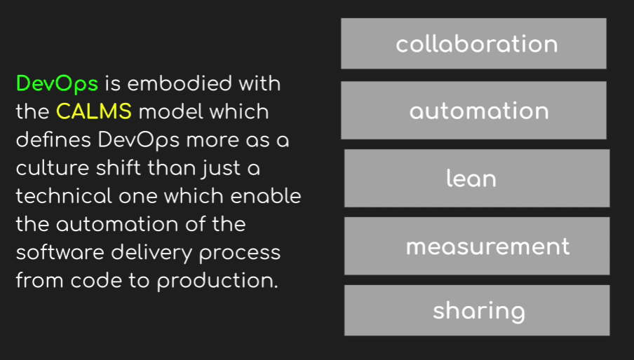
Notes:
Cloud offers infrastructure elements as software as service and is API driven.
IaC enables user to create ,provision , update and manage every aspect of their infrastructure using high level code.
Infrastructure as Code comes in many flavors:
Infrastructure provisioning tools: Terraform, CloudFormation, Azure Resource Manager, Heat
Configuration management tools: Ansible, Chef, Puppet...
Benefits:
1. Self service…no more dreaded IT tickets.
2. You can now see and read your infrastructure
3, It can be versioned like code using VCS and automated at the click of a button.
4. Its safe ,it can be validated and secured. It can be used for disaster recovery.
5. It will bring confidence!
Create alert in GCP:
-----------------------
Billing and alerts -- > select project -- >

Slide 3
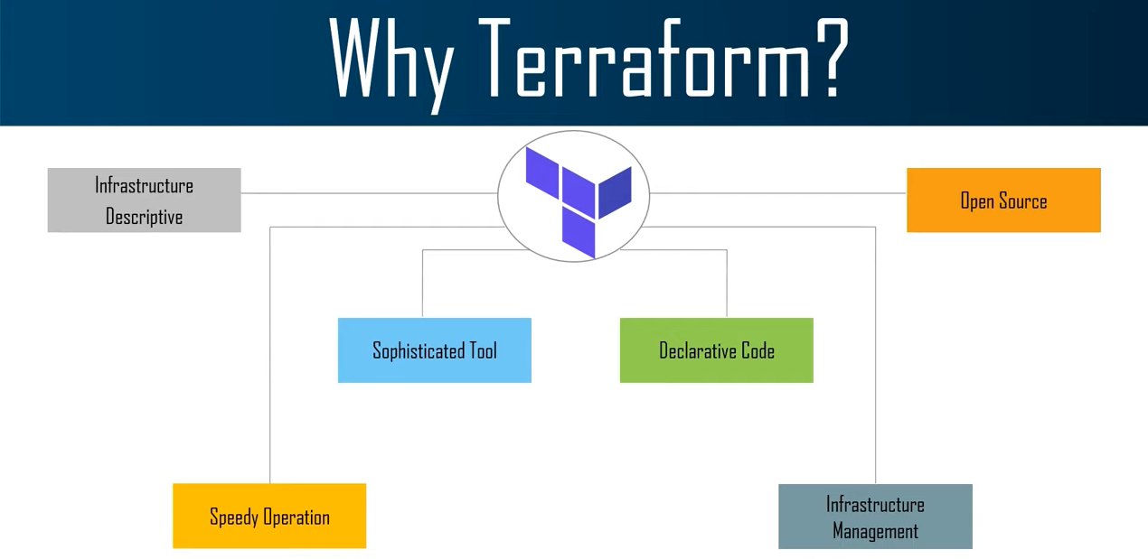
Notes:
Manage your Infrastructure with the Terraform
Link to download VS Code: https://code.visualstudio.com
Link for the plugin: https://marketplace.visualstudio.com/items?itemName=HashiCorp.terraform
https://www.howtoforge.com/how-to-install-terraform-on-ubuntu-1804/
https://github.com/vikas99341/Terraform-012.git
https://www.terraform.io/intro/index.html
https://www.terraform.io/downloads.html
terraform plan –out=plan1
terraform plan plan1
terraform plan destroy
https://terraform.io/docs/providers/docker/r/container.html

Slide 4
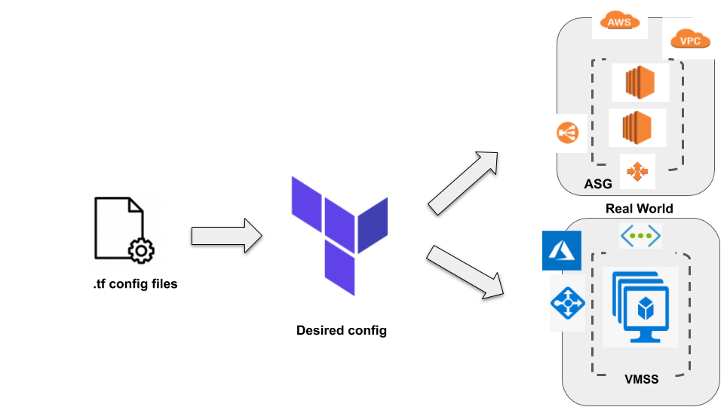
Notes:
Terraform is an Open-Source Infrastructure provisioning tool which has human readable, and machine editable code written in Hashicorp Configuration Language or HCL but can be expressed in JSON as well.
Platform agnostic , provision in any infrastructure provider ,no dependency on the Terraform software.
One Terraform workflow or execution plan is used to manage the execution of these configuration files in a provider. The reusable and repeatable nature of the Terraform workflow will give the operator or admin confidence in managing the infrastructure.
1. Declarative only defines the desired end state of a resource or service rather than having to define all the steps to achieve that desired state.
2. Terraform is immutable means reduce configuration drift , easier to test and qualify for deployment, easier to upgrade or roll back to a known working version without downtime. No need to keep tracking changes made to a build with complex deployments.
3. Terraform is idempotent means that desired end state is always what is provisioned in the real world , Compares the real world with the desired end state to decide what to add, delete or update without having to reprovision the whole infrastructure .Any manual changes will be destroyed.
Terraform is a reliable, reusable and predictable Infrastructure as Code tool.

Slide 5
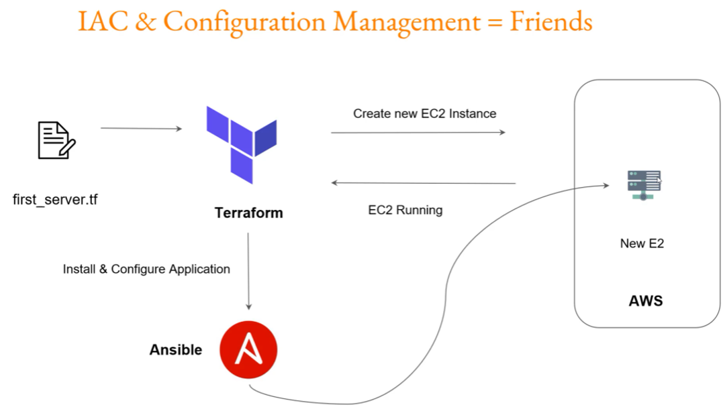
Notes:
wget https://releases.hashicorp.com/terraform/1.0.1/terraform_1.0.1_linux_amd64.zip
unzip <>
chmod +x <>
mv terraform /usr/local/bin
terraform version
https://registry.terraform.io/
first_ec2.tf :
provider "aws" {
region = "us-west-2"
access_key = "PUT-YOUR-ACCESS-KEY-HERE"
secret_key = "PUT-YOUR-SECRET-KEY-HERE"
}
resource "aws_instance" "myec2" {
ami = "ami-082b5a644766e0e6f"
instance_type = "t2.micro"
}
Iam & Admin -- > Service accounts -- > Create a service account -- > project (owner) -- > create JSON KP -- >
On cli : export GOOGLE_APPLICATION_CREDENTIALS=“<path of the file>”
provider “google" {
region = "us-east-4“
zone = “us-east4-a”
credentials = file("PUT-YOUR-ACCESS-KEY-HERE“)
project = "PUT-YOUR-SECRET-KEY-HERE"
}
Terraform {
required_version = “0.12.0”
}

Slide 6
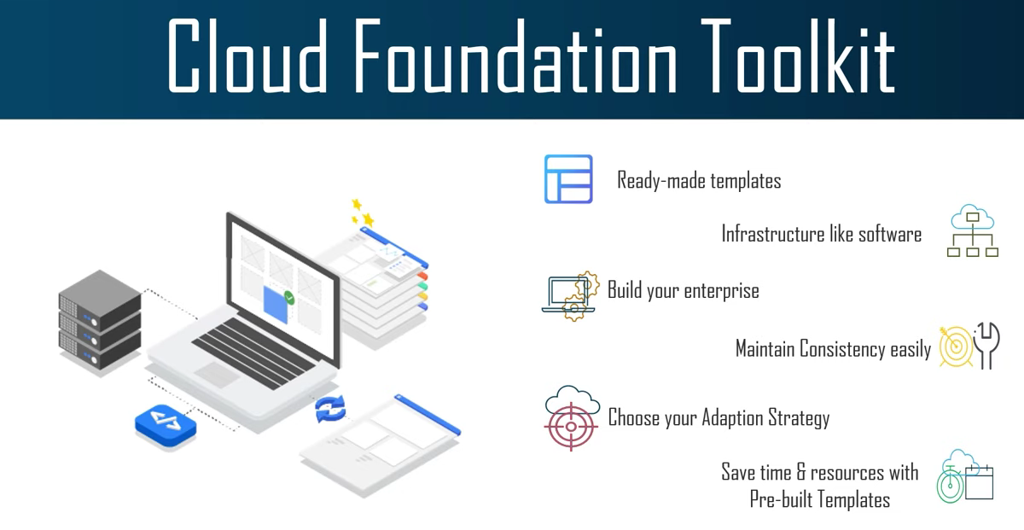

Slide 7
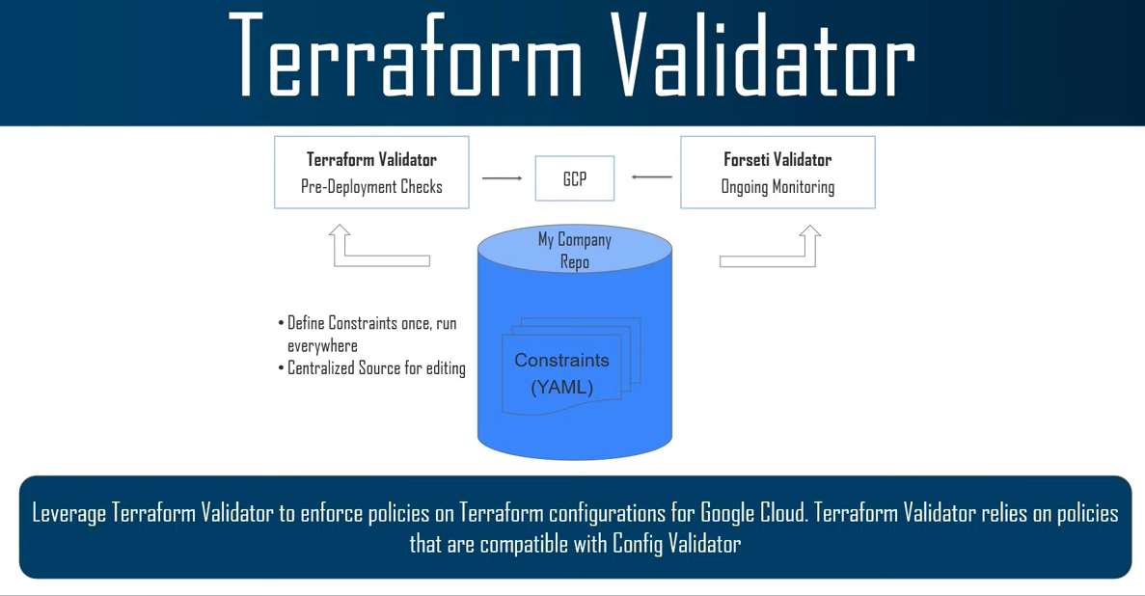

Slide 8
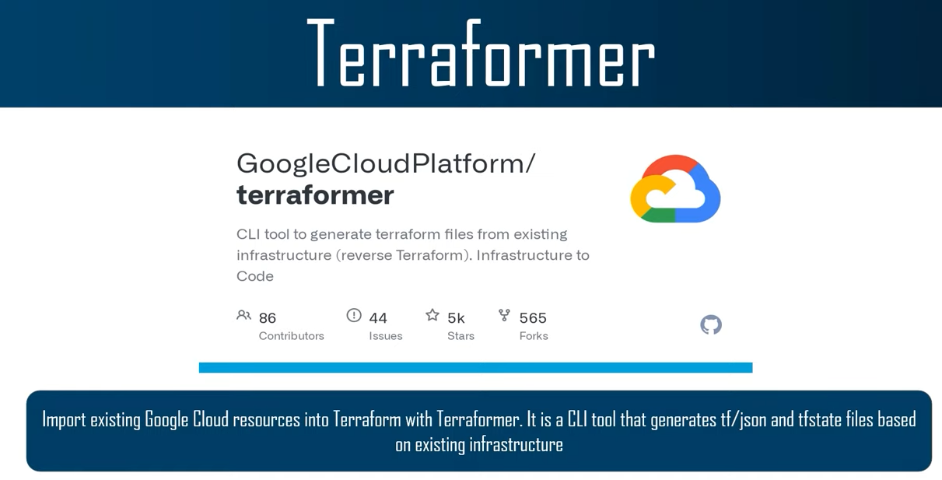

Slide 9
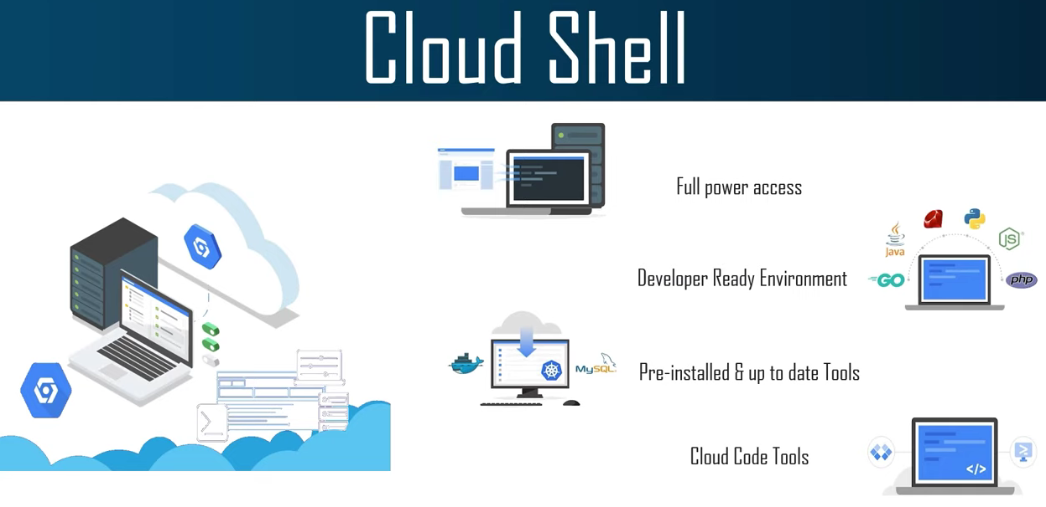

Slide 10
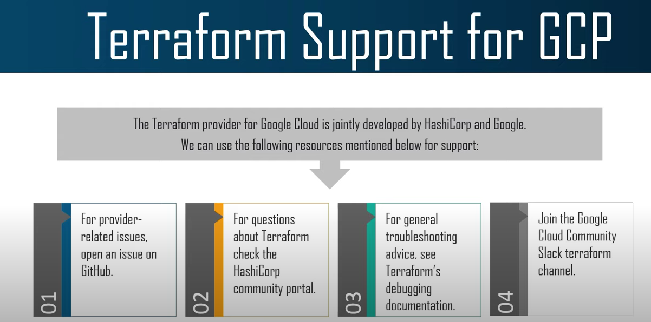
Notes:
https://cloud.google.com/sdk/docs/install
https://releases.hashicorp.com/terraform/0.12.29/ -- > terraform_0.12.29_windows_386.zip
https://learn.hashicorp.com/tutorials/terraform/google-cloud-platform-build
https://cloud.google.com/sdk/auth_success
Create a new project -- > Create a service account -- > Project owner -- > service account created -- > Manage Keys -- > add keys -- > json -- > download
save to a location -- > go to that location on cmf -- > gcloud auth revoke -- > gcloud config configurations list -- >
https://registry.terraform.io/providers/hashicorp/google/latest/docs/guides/getting_started

Slide 11

Infrastructure Automation With Terraform
Vikas

Slide 12
Notes:
Terraform vs ansible
Architecture
Configuration
Terraform state

Slide 13
Notes:
EC2:
===
https://registry.terraform.io/providers/hashicorp/aws/latest/docs/resources/instance

