Slide 1
Prometheus

Slide 2
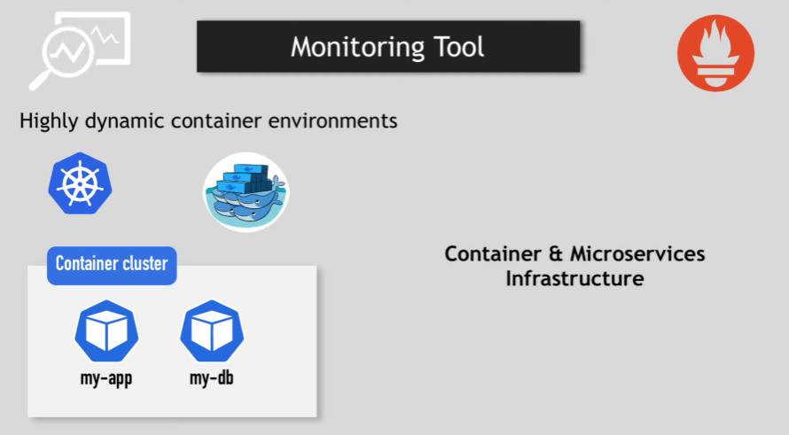
Notes:
Monitor complex infra with little knowledge on hardware and application where error , response latency ,overload or running out of resources can crash and fail the entire system .
Quick identification is needed to identify the cascading problem .
Identify the before it occurs and prevent system crash by sending regular alerts .

Slide 3
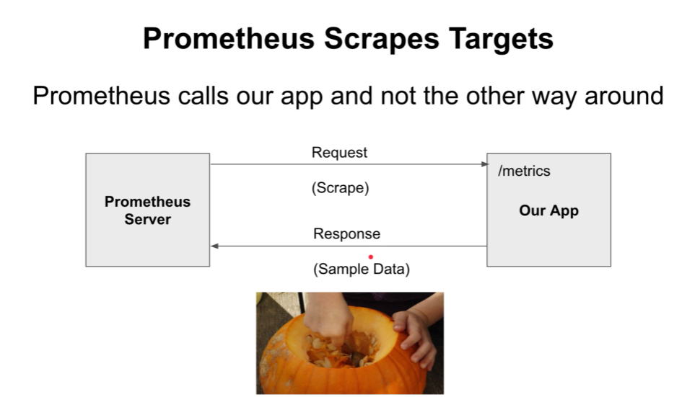
Notes:
Resource Usage – CPU , Memory, Disk space
Request rate
Error rate
Number of instances on our app
Sample – Temperature on a given date and time
List of samples ordered by time – Timeseries which can be stored TSDB .
Quantile and Percentile (.90 and 90%)
metric_name{label1=“value1”,label2=“value2”}
Temperature{city=”Bangalore”,”Chennai”}
Job and instance name ==
Instant Vector
Range Vector

Slide 4
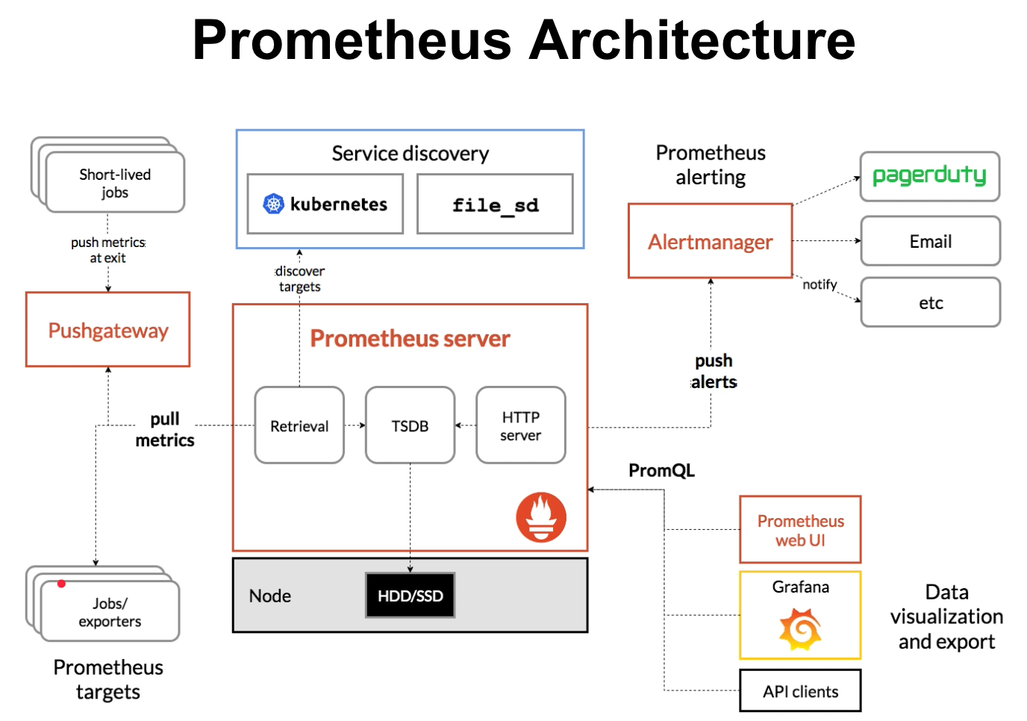
Notes:
PromQL – Language to query timeseries in Prometheus
Service Discovery – It can automatically find our job and monitor them .
Push gateway – for short running jobs metrics can be pushed (cron job)
Exporters - /metrics
AlertManager – send notification

Slide 5
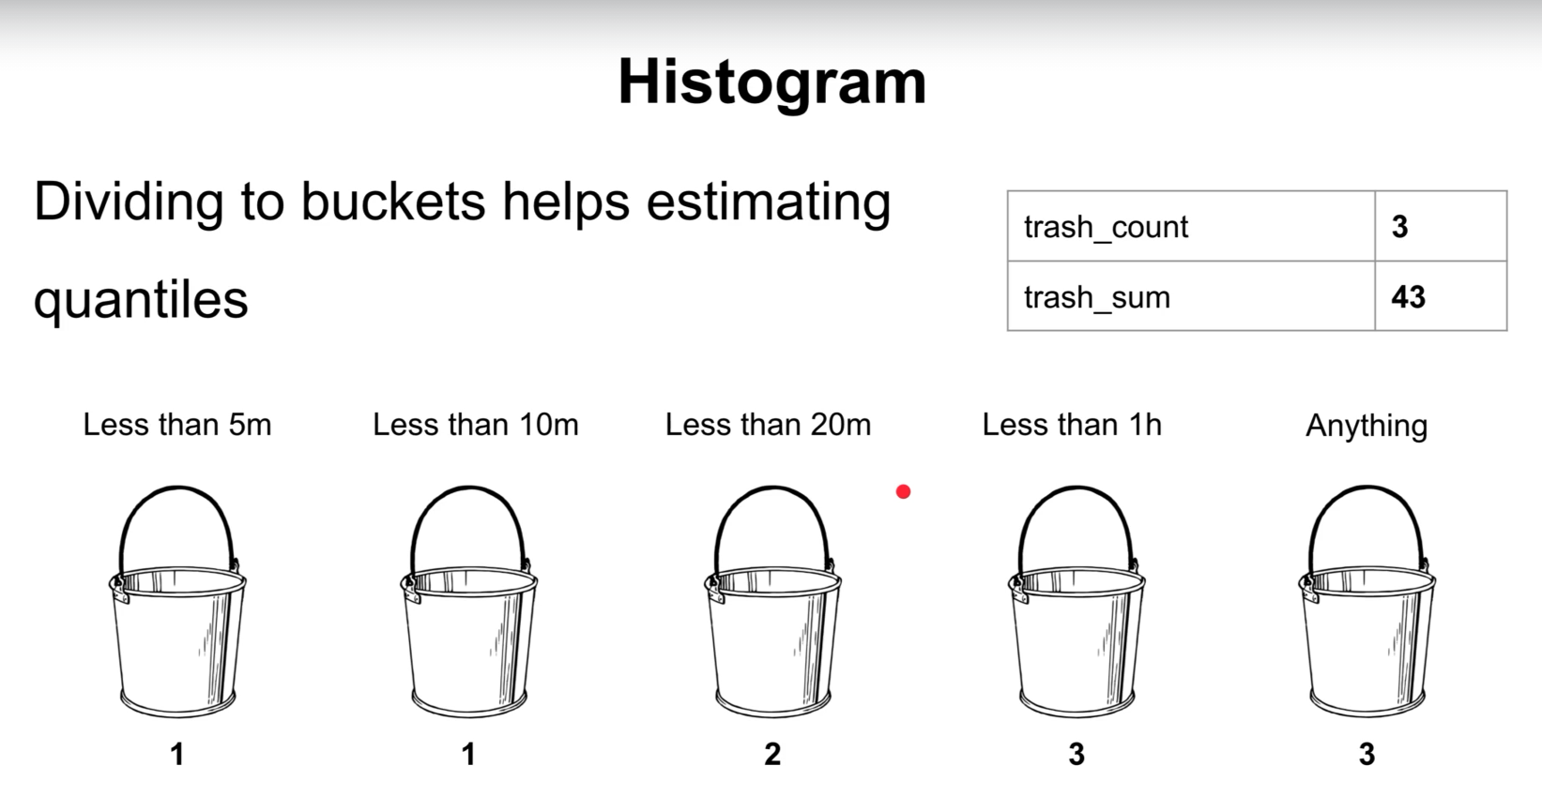
Notes:
Metric Types :
Counter – Always goes up (Request received by handler , number of errors) [How many times x happened]
Gauge – Goes up and down (Resource usage [cpu, disk, memory], number of elements in a queue) [Current value of x now ]
Histogram – Is to estimate quantiles to measure request latency . [how long or how big ]
Summary is similar to quantile but on client side but you cannot choose time window

Slide 6
Notes:
https://prometheus.io/download/
on ui : go_goroutines
rate(Prometheus_http_requests_total[5m])
check status
+ Add a new Panel
Metric : rate(Prometheus_http_requests_total[5m])
Legend : {{handler}}
Panel ttile : Requests Rate
New Panel:
(sum(rate(Prometheus_http_request_duration_seconds_bucket{le=“.2”}[5m])) + sum(rate(Prometheus_http_request_duration_seconds_bucket{le=“.4”}[5m])) / 2) / sum(rate(Prometheus_http_request_duration_seconds_bucket[5m]))
Put this on metrics
Visualization : stats
histogram_quantile(0.9,sum(rate(prometheus_http_request_duration_seconds_bucket[5m])) by (le))

Slide 7
Notes:
Helm is a Kubernetes package manager .
A package in Helm is called a chart and when we install a chart what we get is a set of k8s resources installed on our cluster .We get the chars from helm repo.

Slide 8
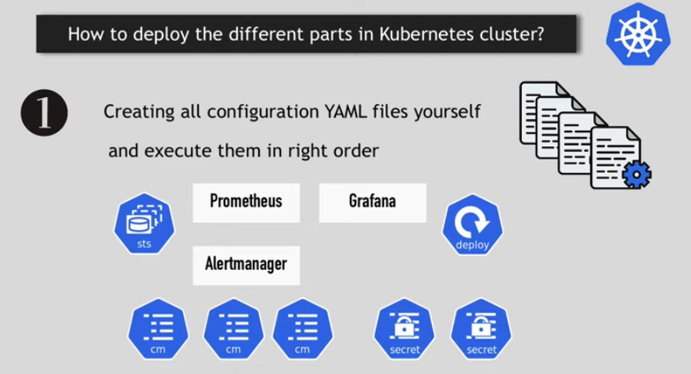
Notes:
Use helm chart used by helm community:

