Slide 1
JSONP
Security Consideration
Notes:
References
http://en.wikipedia.org/wiki/JSONP
http://quaxio.com/jsonp_handcrafted_flash_files/
https://miki.it/blog/2014/7/8/abusing-jsonp-with-rosetta-flash/
https://molnarg.github.io/ascii-flash/

Slide 2
@me
Malware Analyst
badboy16a@gmail.com
@_badbot

Slide 3
JSONp?
JSON-with-padding
JSON-P
JSON++
Notes:
Proposed in December 2005.

Slide 4
Web Page
HTML
CSS
Resources
Image
Audio
Video
Flash
…
JavaScript
Notes:
On Client/Browser
HTML : Content/Structure
CSS: Layout/Representation
JavaScript: Logic, Manipulation

Slide 5
SoP
Same-Origin-Policy
Protects against interference from other domains.
Not for JavaScript, Image,…
GET only

Slide 6
JSON
JavaScript Object Notation
Data-interchange format
For Human
For Machine
Restricted by SOP
{key1 : value, key2: [x,y,z], key3 : “String” }

Slide 7
JSONP
SOP workaround for JSON Data
Browsers not supporting CORS
JSON data wrapped in JavaScript

Slide 8
JSONP
Provider Domain
Owner of data
Consumer Domain
Owner of document

Slide 9
JSONP
<script type=“text/javascript” src=http://api.example.com/jsonp?callback=foo />
<script>
function foo(data){
Console.log(“value=“+data.key);
}
</script>
Notes:
As static tag on page.

Slide 10
JSONP
<script type=“text/javascript” src=http://api.example.com/jsonp?callback=foo />
<script>
function foo(data){
Console.log(“value=“+data.key);
}
</script>
HTTP/1.1 200 OK
Server: Apache/2.2
Content-Type: text/javascript
Content-Length: 16
foo({key: value});
GET jsonp?callback=foo HTTP/1.1
Host: api.example

Slide 11
Dynamic(ajax) JSONP
Create appropriate <script> elements
Add to body
Remove after processing
jQuery implements as helper function

Slide 12
JSONP
Only a convention
Not Standard
Padding can be anything
Convention: A function call
Limited to GET requests only
Control first few bytes of every response
Notes:
Padding: assignment, logic, …

Slide 13
JSONP::XSS
Also called Self-Inflicted XSS
Provider can provide anything
What about??
Ultimate trust on provider.
HTTP/1.1 200 OK
Server: Apache/2.2
Content-Type: text/javascript
Content-Length: 16
foo({key: value}); (function(){…evil code…})();

Slide 14
JSONP::Content Sniffing
HTTP/1.1 200 OK
Server: Apache/2.2
Content-Type: text/javascript
Content-Length: 100
<script>…evil javascript code…</script>
Notes:
Will this work?
Might with IE,Chrome

Slide 15
JSONP::Content Sniffing
HTTP/1.1 200 OK
Server: Apache/2.2
Content-Type: text/javascript
Content-Length: 100
<script>…evil javascript code…</script>
Browsers may ignore Content-Type
Specific Scenarios
Infer the content based on data
Use X-Content-Type: nosniff
Notes:
Will this work?
Might with IE,Chrome

Slide 16
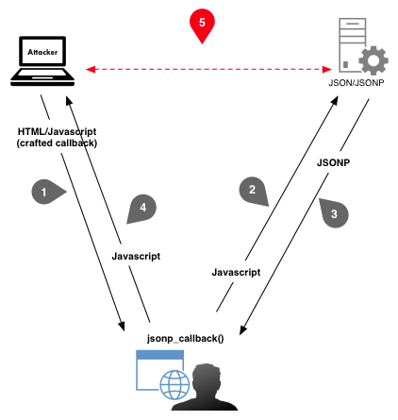
JSONP::CSRF
Easy target for CSRF
CSRF Token can be sniffed

Slide 17
JSONP::Flash Injection
Flash may ignore Content-Type if provided data is a valid flash file
Can bypass X-Content-Type
Can talk to originating domain
Validate callback name
Notes:
Validate for alpha, num, . & _
Flash contains other data.

Slide 18
JSONP::Rosseta Flash Exploit
Developed by Michele Spagnuoloy from Google
Converts any flash files to valid alphanumeric flash file.
Evades callback validation
Many high profile domain were vulnerable
accounts.google.com
maps.google.com
Youtube
Twitter
Flickr
…
More : https://miki.it/blog/2014/7/8/abusing-jsonp-with-rosetta-flash/
Notes:
Vulnerable as on July 2014

Slide 19
Conclusion
Hard to protect against CSRF
Hard to authenticate users
Mostly attacked in conjunction with Flash
Validate callback parameter
Create a sandbox domain for JSONP api
An empty javascript comment breaks Flash injection
/**/
Use CORS whenever possible.

Slide 20

Thank YOU

