Slide 1

Nullcon 2015
Reverse Engineering Malware
4th & 5th Feb 2015

Slide 2
Day 1.
Hash of a file, searching it with Virus Total.
Searching Strings in the file..
Little bit of a programming in ruby.
IDA PRO and Assembly language.
BSA – Buster Sandboxie Analyser

Slide 3

Memory Analysis
Volatility
Python based tool to analyze memory snapshots
Download from: code.google.com/p/volatility/downloads/list

Slide 4
When to use Memory Analysis ??
Case:
1.When Anti-Virus Fails.
2. Notice Suspicious activities and want to investigate further.

Slide 5
When to take Snapshot?
Can you take memory snapshot anytime??
Is it worth taking anytime ??
Take snapshot when you see suspicious activities.
Notes:
YES, YOU CAN TAKE ANY TIME BUT IT IS WORTH IT?

Slide 6
How to take snapshots.
In cuckoo ( Virtualization )
Utils/submit.py --package exe ~/zeus.exe –memory
Live Memory Acquisition
Taking memory image from live systems.
Memoryze: Taking memory image
Audit Viewer: For presenting and interacting with collected information.
Commandline: memoryze\MemoryDD.bat --output G:\images

Slide 7
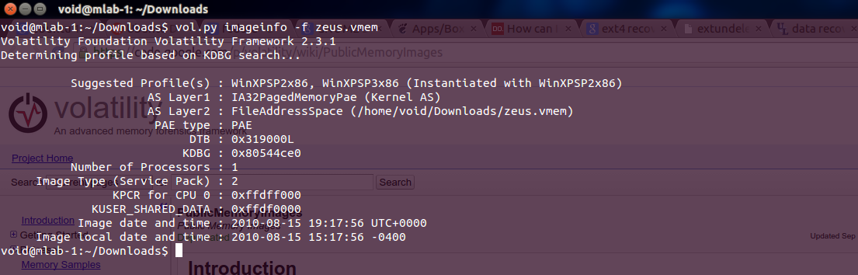
Lets analyze some Memory Dumps
Create a profile.. Why?
Vol.py imageinfo –f zeus.vmem
By default it is WinXPSP2x86
Notes:
Before analyzing a memory its very important to determine what is the base OS of the memory. – thus create a profile

Slide 8
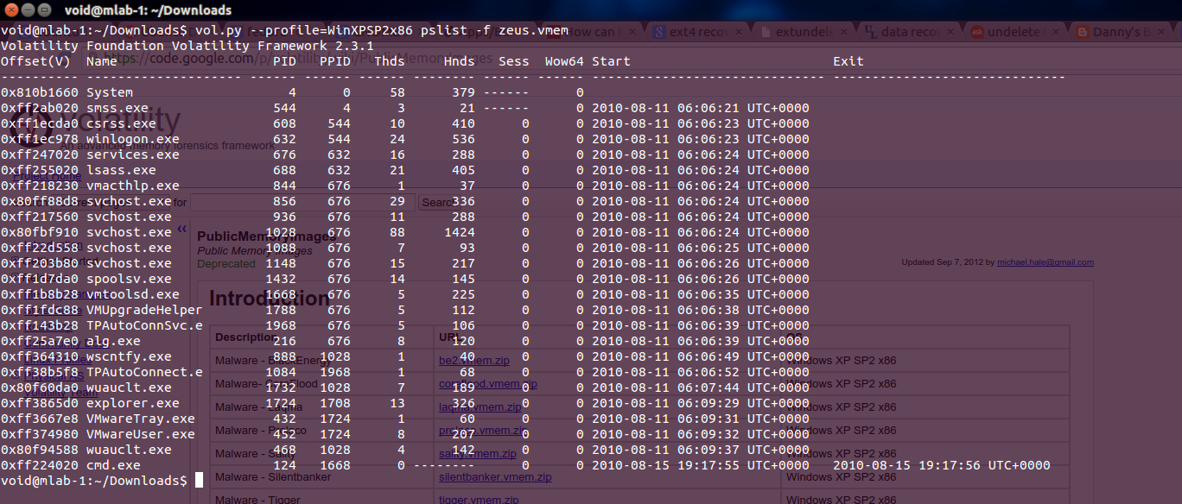
See Running Process
Vol.py –profile=WinXPSP2x86 pslist –f

Slide 9
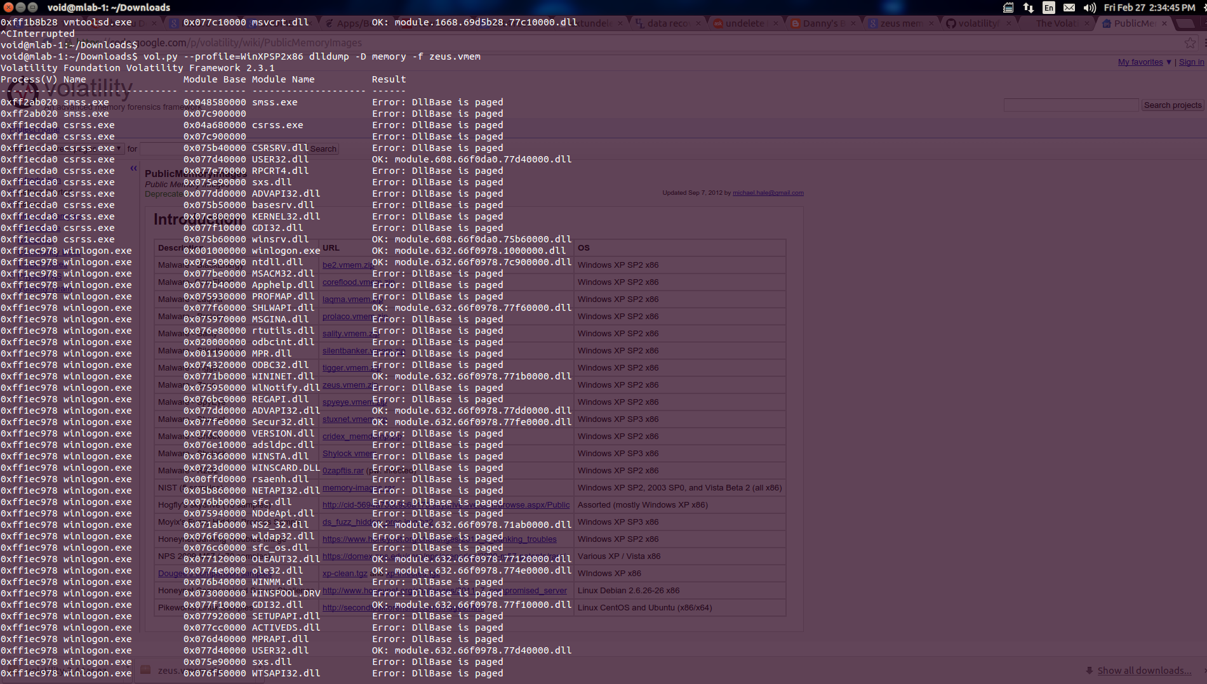
Dump all Dll
Vol.py –profile=WinXPSP2x86 dlldump –D ~/memory –f zeus.vmem

Slide 10
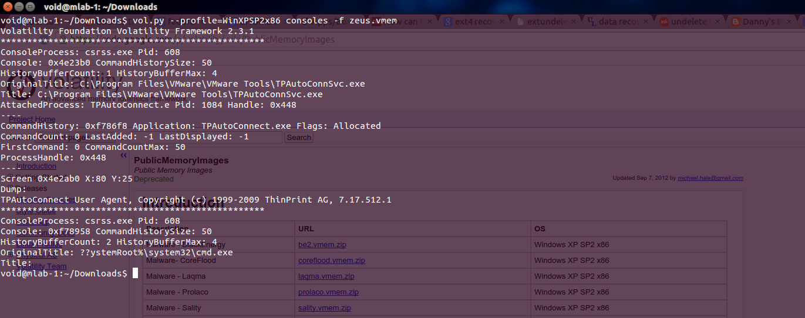
Find Commands Used..
Vol.py –profile=WinXPSP2x86 consoles -f zeus.vmem

Slide 11
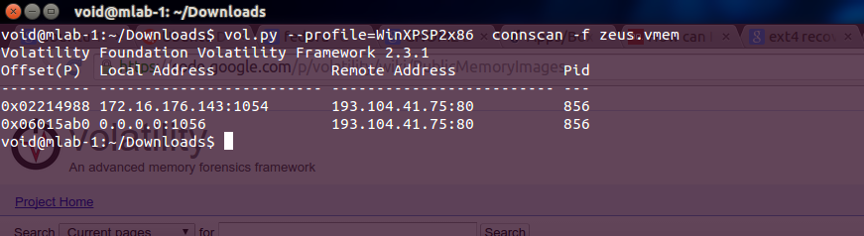
Connections it has made..
Vol.py –profile=WinXPSP2x86 connscan –f zeus.vmem

Slide 12
Apart from that what I learned…
You don’t always get the source code.
Tools:
IDA PRO, Decompiler
Understating low level language is Essential.
Experience.
Notes:
Tools we used here are the same, its just the experience that counts and with that you get how you can use the tool in diff scenarios.

Slide 13
Thank You

