Slide 1
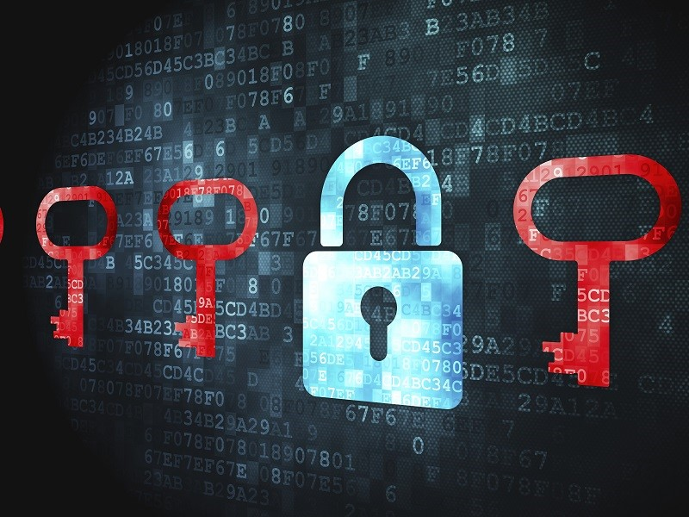
3Es of Ransomware
Economy ⬄ Evolution ⬄ Evaluation

Slide 2
Who am I?

Slide 3
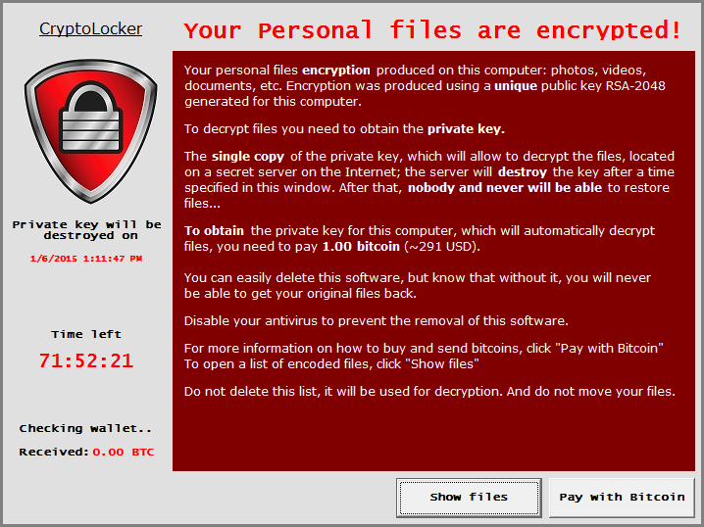
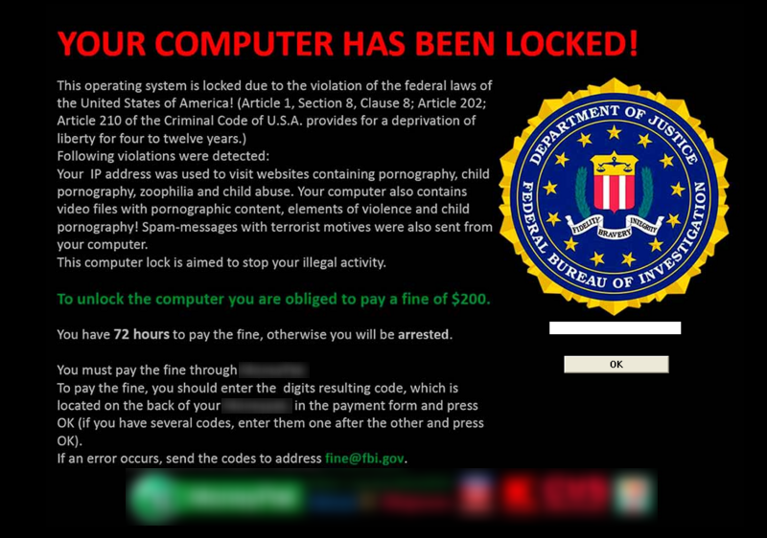
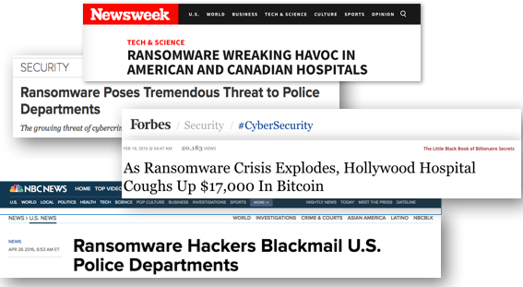
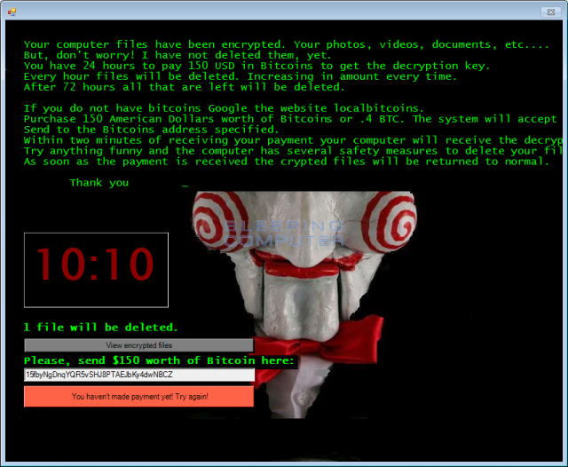
Ransomware
“Never before in the history of human kind have people across the world been subjected to extortion on a massive scale as they are today.”
Notes:
Symantec-08/2015
“Ransom”: A sum of money demanded or paid for the release of a captive.
Captive: Files/Systems
Ransomware is a tool to facilitate Ransom.
F-s0ciety
http://www.symantec.com/content/en/us/enterprise/media/security_response/whitepapers/the-evolution-of-ransomware.pdf

Slide 4
Why this?
$445 Billion
The amount cybercrime will cost the global economy in 2016. The primary driver of loss will be ransomware.
+300%
The increase in ransomware attacks from Q1 of 2016 compared to Q1 2015. That’s as many as 4,000 ransomware attacks per day.
60 Seconds
The time it takes a hacker to compromise a computer with ransomware.
Notes:
https://fightransomware.com/

Slide 5
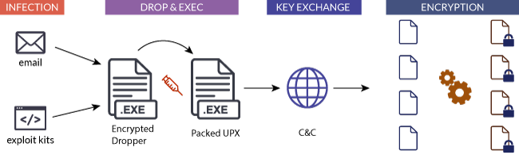
Components

Slide 6
Economy
About 1,425% ROI for 30 days campaign.
Investment : $5,900 USD
Delivery
Infection
C&C
Earnings: $90,000 USD
10% infection
0.5% payment
$300 Ransom
Profit: $84,100
Notes:
Return On Investment.
Stats by Trustwave, CTBLoker as example.
http://www.darkreading.com/analytics/cybercrime-can-give-attackers-1425--return-on-investment/d/d-id/1320756

Slide 7

Economy
About 39% of enterprises were attacked, ~40% paid to the attackers.
$209 million payments in the first three months of 2016.
Estimated to be a $1 billion a year
Notes:
*2 : byFBI, based on reported cases.
https://go.malwarebytes.com/OstermanRansomwareSurvey.html

Slide 8
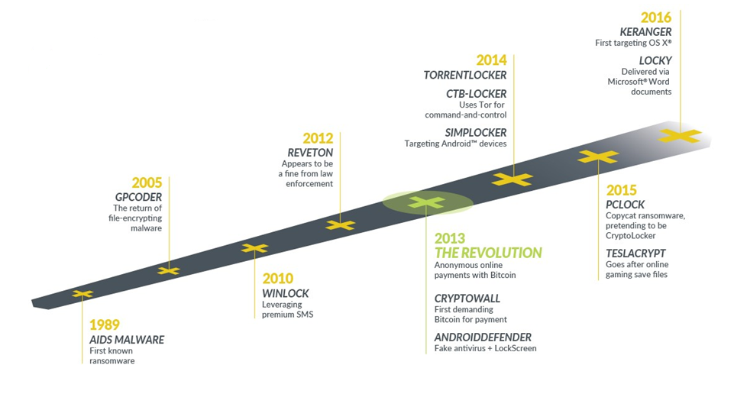
Evolution
Notes:
http://centracomm.net/wp-content/uploads/2016/06/the-rise-of-ransomware.png

Slide 9
Evolution
AIDS/PC Cyborg : 1989
Author: Joseph L. Popp
Delivery: 20,000 infected floppies.
Target: Attendees of WHO conference on AIDS.
Payout: $189 USD to PO Box in Panama.
Behavior: Encrypted file names and hide directories after 90 reboots.
Notes:
1. Harvard-trained evolutionary biologist Joseph L. Popp.
4. PO Box in name of PC Cyborg Corp.
5. Ransom was asked as license fee to use the software.

Slide 10
Evolution
GPCoder : 2005
Discovered and Researched by Kaspersky Lab.
First use of PKI.
RC4 + RSA.
Original file is Deleted.
Payout: $100-$200 in E-Gold/Liberty Reserve account.
StopGPCode was released to recover files.
Notes:
1st in 2004. Custom symmetric encryption, 1 byte key. Easily defeated.
GPCoder.ak proper 1024bit RSA+RC4.
Deleted, so undelete was possible.
RC4 => Easy cryptoanalysis.

Slide 11
Evolution
WinLock : 2010
System Locker.
Ransom: 1 premium SMS of ~$10.
Displaying porn.
Unnamed : 2011
System Locker.
Imitated Windows Activation Dialog.
Asked to call fake activation support phone.

Slide 12
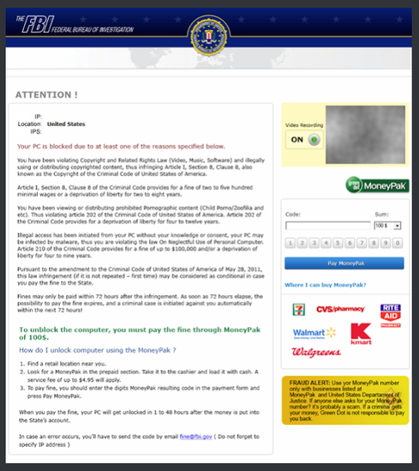
Evolution
Reveton: 2012
System Locker
Accused user’s of having illegal material.
Threatened action from FBI if “fine” is not paid.
Based on Zeus and Citadel.
Kotver : 2013
System Lokcer
Waits for certain actions.
Notes:
Police themed ransomware.
Ransomware for OSX. Used webpage and clickjacking.
Jay Matthew Riley, 21, of Woodbridge, Va, turned himself to police.

Slide 13
Evolution
CryptoLocker : 2013
Return of encryption.
Generated 2048 bit RSA key pair.
Uploaded private key to server.
Asked payment in Bitcoin.
Taken down by government in 2014.
At least $3 million extortion.
Notes:
Primarily distributed by the Gameover Zeus botnet
Operation Tovar

Slide 14
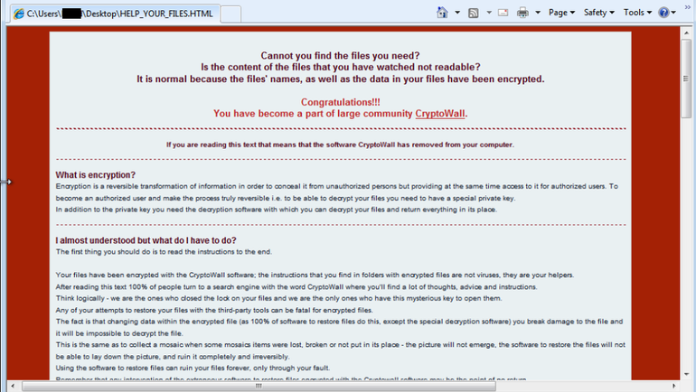
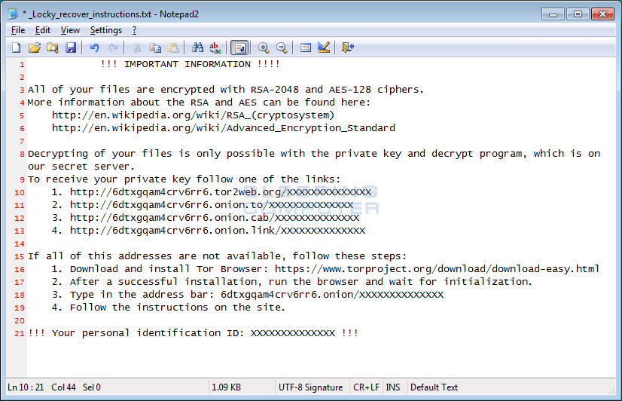
Evolution
CryptoWall: 2014
Used TOR from v1.0.
Distributed via malvertising.
Used digitally signed payload.
Estimated losses of $18 million by June 2015.
Locky: 2015
Ransomware for hire.
Adds .locky extension to encrypted files
Mostly distributed via spam emails.
Attachments with macros.
Notes:
These variants have evolved.
Clones/Mixed.
Random extensions.

Slide 15
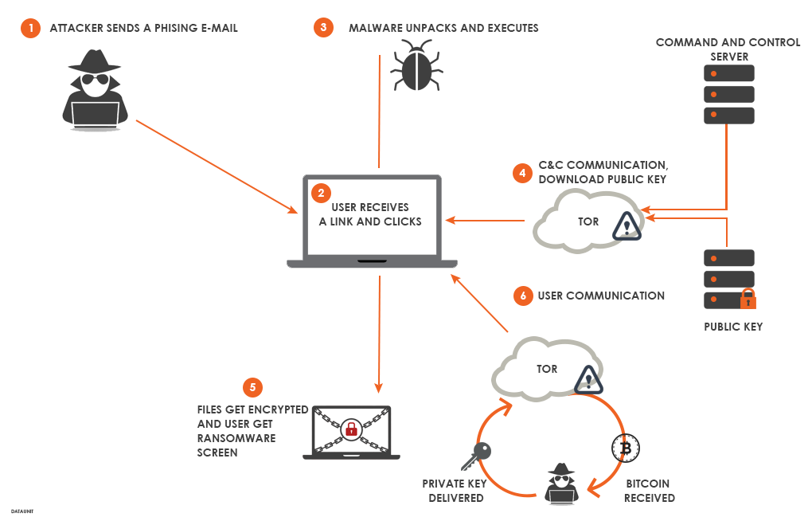
Evaluation
Notes:
Infection
Key-Setup
Encryption
Ransom Demand

Slide 16
Infection : Dropper
Attachment with macro
Macro activation.
Scripts
js/jse
vbs/vbe
wsf
HTML
HTA

Slide 17
Infection : Payload
EXE
Packing
Installer Package
DLL
PS script
JS

Slide 18
Setup
No Recovery
vssadmin delete shadows /for=d: /all
Registry Entries
Encryption Key

Slide 19
Encryption
Targets
File Types
Disks
Encryption
Encrypted Extensions

Slide 20
Ransom

Slide 21
Recovery

Slide 22
Extra
Trojan.Gpcoder.E (July 2007) boasted of using asymmetric RSA encryption with a 4096-bit key, but in reality, it only used custom symmetric encryption. It generated a four-byte long encryption key (32-bit) which was then stored in the registry of the compromised computer, meaning that it was possible for people to find the key on the computer.

