Slide 1
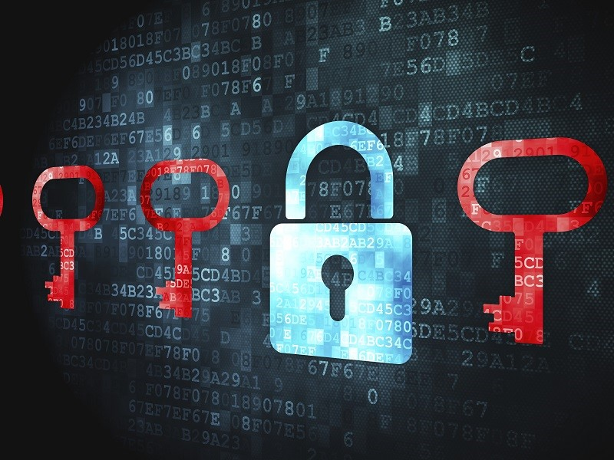
3Es of Ransomware
Economy ⬄ Evolution ⬄ Evaluation

Slide 2
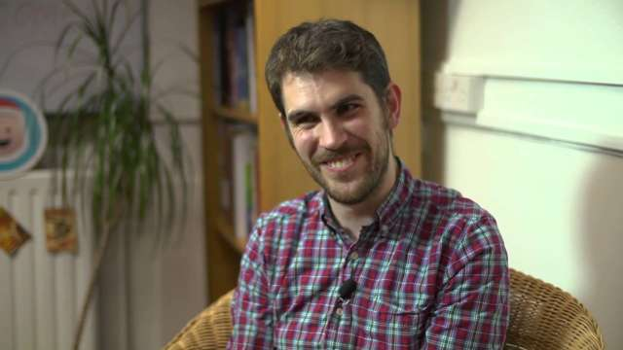
Who am I?
Threat Researcher for money.
Interested in
Things commonly considered criminal.
Reach me
@_badbot
badboy16a@gmail.com
Notes:
Sean Murray

Slide 3
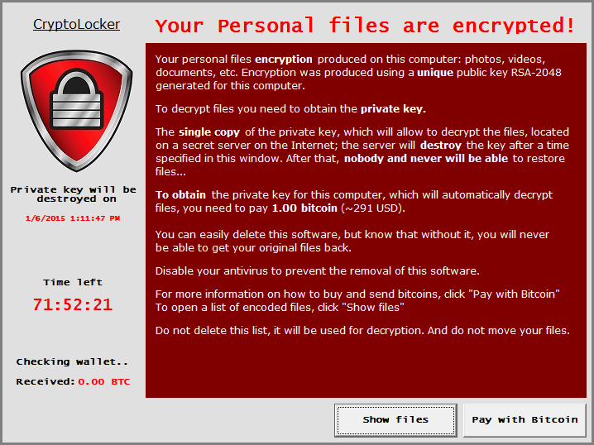
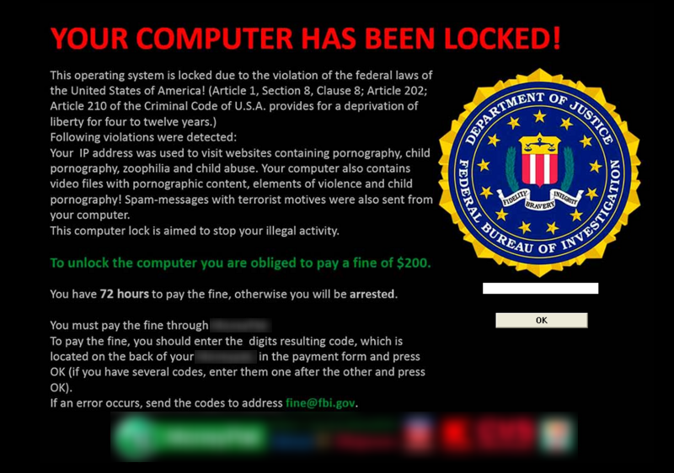
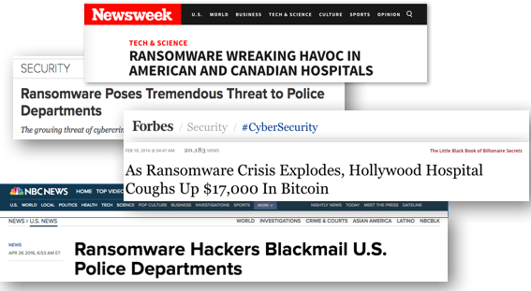
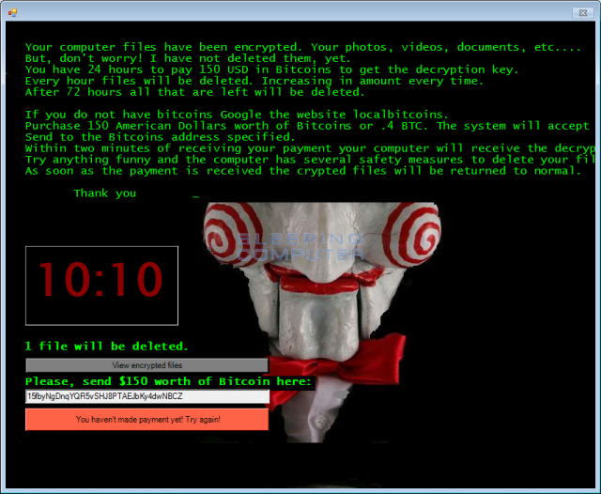
Ransomware
“Never before in the history of human kind have people across the world been subjected to extortion on a massive scale as they are today.”
Notes:
Symantec-08/2015
“Ransom”: A sum of money demanded or paid for the release of a captive.
Captive: Files/Systems
Ransomware is a tool to facilitate Ransom.
F-s0ciety
http://www.symantec.com/content/en/us/enterprise/media/security_response/whitepapers/the-evolution-of-ransomware.pdf

Slide 4
Why this?
$445 Billion
The amount cybercrime will cost the global economy in 2016. The primary driver of loss will be ransomware.
+300%
The increase in ransomware attacks from Q1 of 2016 compared to Q1 2015. That’s as many as 4,000 ransomware attacks per day.
60 Seconds
The time it takes a hacker to compromise a computer with ransomware.
Notes:
https://fightransomware.com/

Slide 5
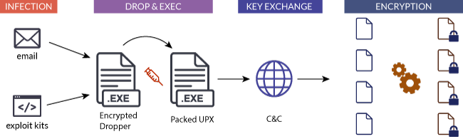
Components

Slide 6
Economy
About 1,425% ROI for 30 days campaign.
Investment : $5,900 USD
Delivery
Infection
C&C
Earnings: $90,000 USD
10% infection
0.5% payment
$300 Ransom
Profit: $84,100
Notes:
Return On Investment.
Stats by Trustwave, CTBLoker as example.
http://www.darkreading.com/analytics/cybercrime-can-give-attackers-1425--return-on-investment/d/d-id/1320756

Slide 7
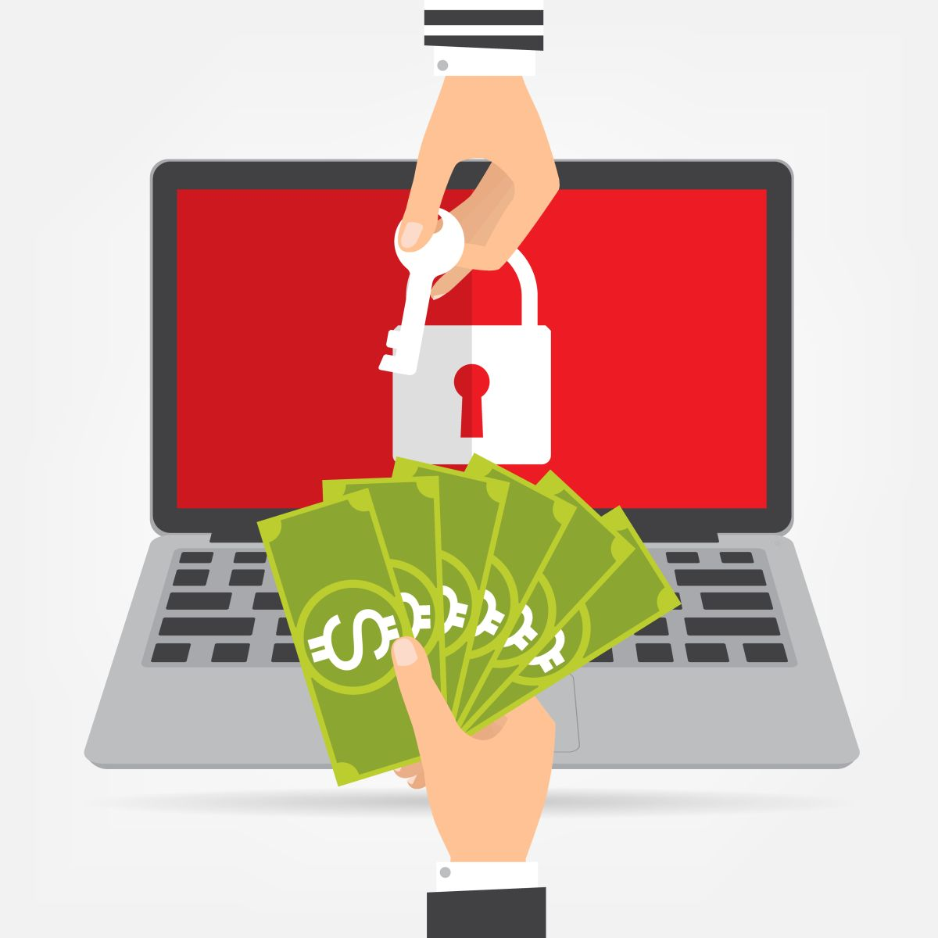
Economy
About 39% of enterprises were attacked, ~40% paid to the attackers.
$209 million payments in the first three months of 2016.
Estimated to be a $1 billion a year
Notes:
*2 : byFBI, based on reported cases.
https://go.malwarebytes.com/OstermanRansomwareSurvey.html

Slide 8
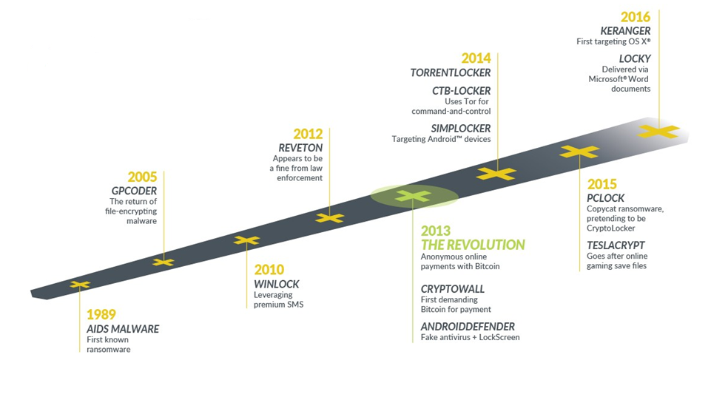
Evolution
Notes:
http://centracomm.net/wp-content/uploads/2016/06/the-rise-of-ransomware.png

Slide 9
Evolution
AIDS/PC Cyborg : 1989
Author: Joseph L. Popp
Delivery: 20,000 infected floppies.
Target: Attendees of WHO conference on AIDS.
Payout: $189 USD to PO Box in Panama.
Behavior: Encrypted file names and hide directories after 90 reboots.
Notes:
1. Harvard-trained evolutionary biologist Joseph L. Popp.
4. PO Box in name of PC Cyborg Corp.
5. Ransom was asked as license fee to use the software.

Slide 10
Evolution
GPCoder : 2005
Discovered and Researched by Kaspersky Lab.
First use of PKI.
RC4 + RSA.
Original file is Deleted.
Payout: $100-$200 in E-Gold/Liberty Reserve account.
StopGPCode was released to recover files.
Notes:
1st in 2004. Custom symmetric encryption, 1 byte key. Easily defeated.
GPCoder.ak proper 1024bit RSA+RC4.
Deleted, so undelete was possible.
RC4 => Easy cryptoanalysis.

Slide 11
Evolution
WinLock : 2010
System Locker.
Ransom: 1 premium SMS of ~$10.
Displaying porn.
Unnamed : 2011
System Locker.
Imitated Windows Activation Dialog.
Asked to call fake activation support phone.

Slide 12
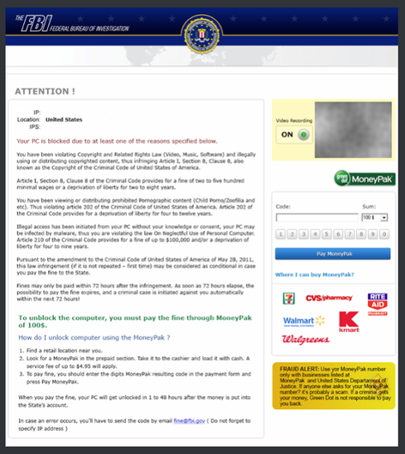
Evolution
Reveton: 2012
System Locker
Accused user’s of having illegal material.
Threatened action from FBI if “fine” is not paid.
Based on Zeus and Citadel.
Kotver : 2013
System Lokcer
Waits for certain actions.
Notes:
Police themed ransomware.
Ransomware for OSX. Used webpage and clickjacking.
Jay Matthew Riley, 21, of Woodbridge, Va, turned himself to police.

Slide 13
Evolution
CryptoLocker : 2013
Return of encryption.
Generated 2048 bit RSA key pair.
Uploaded private key to server.
Asked payment in Bitcoin.
Taken down by government in 2014.
At least $3 million extortion.
Notes:
Primarily distributed by the Gameover Zeus botnet
Operation Tovar

Slide 14
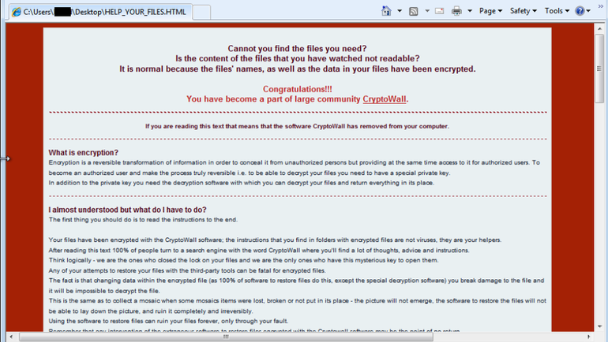
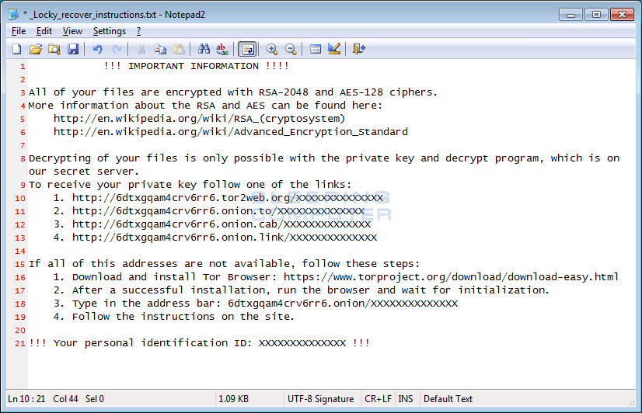
Evolution
CryptoWall: 2014
Used TOR from v1.0.
Distributed via malvertising.
Used digitally signed payload.
Estimated losses of $18 million by June 2015.
Locky: 2015
Ransomware for hire.
Adds .locky extension to encrypted files
Mostly distributed via spam emails.
Attachments with macros.
Notes:
Cryptowall started as clone of Cryptolocker
These variants have evolved.
Clones/Mixed.
Random extensions.

Slide 15
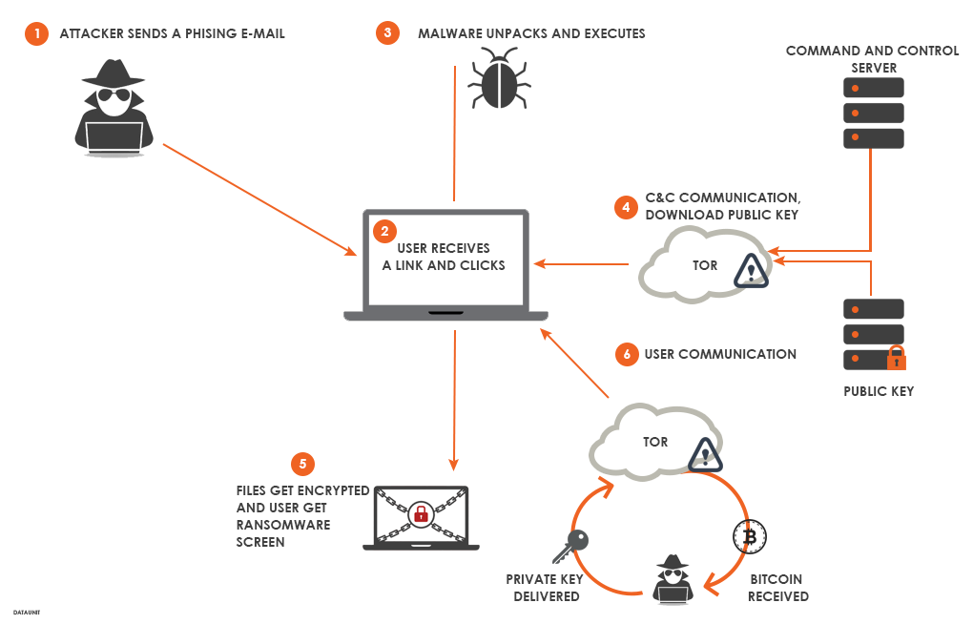
Evaluation
Notes:
Infection
Key-Setup
Encryption
Ransom Demand

Slide 16
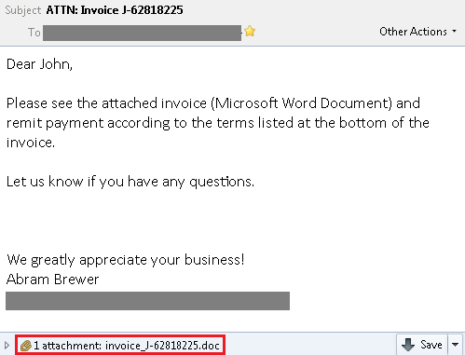
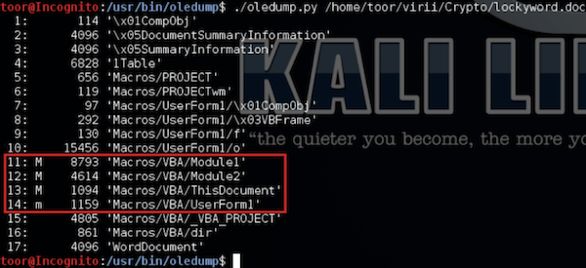
Infection : Dropper
Attachment with macro
Macro activation.
Scripts
js/jse
vbs/vbe
wsf
ps1
HTML
HTA

Slide 17

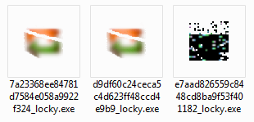
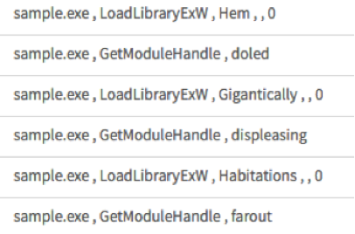
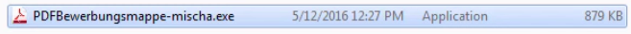
Infection : Payload
EXE
Custom Packers
Installer Package
DLL
Python
Fs0ciety
PS1
PowerWare
Cerber
Notes:
Custom packers: Locky, TeslaCrypt
DLL: Locky

Slide 18
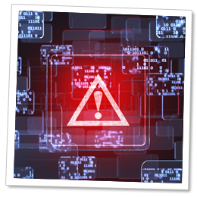
Setup
No Recovery
vssadmin delete shadows /for=d: /all
WMIC.exe "shadowcopy delete“
Bcdedit.exe "/set {default} recoveryenabled no“
Bcdedit.exe "/set {default} bootstatuspolicy ignoreallfailures
Registry Entries
Autorun
key+IV
TypeHandler
Encryption Key
UUID
SerialNumber
Notes:
Autorun: Locky
Key+iv: NoobLocker
PricessLocker adds ransom note as .locked type handler.

Slide 19
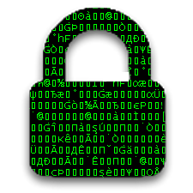
Encryption
Targets
File Types
doc, xls, ppt, jpg…
Disks
Extensions
locky, crypt, locked, [random]…
Exclusions
Program Files\
Windows\
.exe, .dll, .sys
Notes:
Cerber targets 294 different file extensions
HDDCryptor uses component of open source tool.

Slide 20
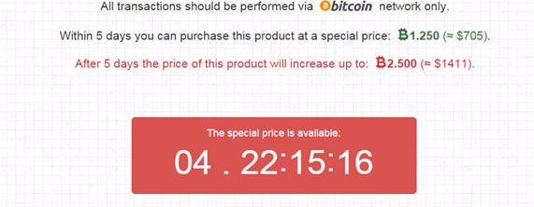
Ransom
Display Note
MessageBox
Window
Wallpaper
Image
HTML/TEXT/URL
Content
Encryption Algorithm
Amount
SystemID/UserID
URL for bitcoin transfer
Proof of decryption
Notes:
They usually display name of ransomware.

Slide 21

Recovery
Decryption/Eradication Tools
Kaspersky
WildFire, Shade, Rakhni, SMASH, CoinVault, XORIST…
TrendMicro
CryptXXX(1,2,3,4,5), Crysis, TeslaCrypt, Cerber V1, Nemucod…
https://www.nomoreransom.org/decryption-tools.html
Recovery tools
Photorec
Notes:
Almost all AV vendors have some ransomware recovery.
Not all versions are decryptable.
NoMoreRansom: Kaspersky, Intel, Law Enforcement
Recover Tools: TestDisk. Recuva

Slide 22

Education
Avoid ransomware
Don’t click
Unplug immediately
Don’t pay
Backup
Disconnected
Full Snapshots
Offline restoration
Update
Notes:
Don’t pay : don’t listen to FBI
Mount backups in ReadOnly mode while restoring.

Slide 23


Question?

