Slide 1


For the beginners, by a beginner

Slide 2

$whoami
Security Enthusiast
Broke lock of my own bag.
Start many things, finish nothing (mostly)
Threat Researcher @ Symantec
B&B
Talking at badboy16a@gmail.com
Broadcasting @_badbot

Slide 3

FUS Triangle
Systems
Security
Usability
Functionality

Slide 4

A few words
Encoding
Encryption
Obfuscation
Cryptography
Cryptanalysis
Steganography

Slide 5
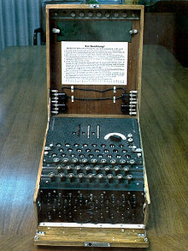
To name a few
Transposition
scytale
Substitution
Caesar cipher
Enigma
Shannon’s law of secrecy
PGP
Notes:
PGP Later

Slide 6

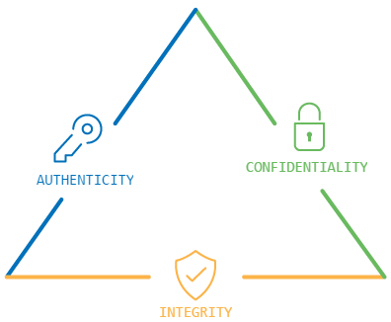
CIA Triangle
Notes:
https://www.digicert.com/images/iot/IoTSecuritySolutionGraphic_400x400.png

Slide 7
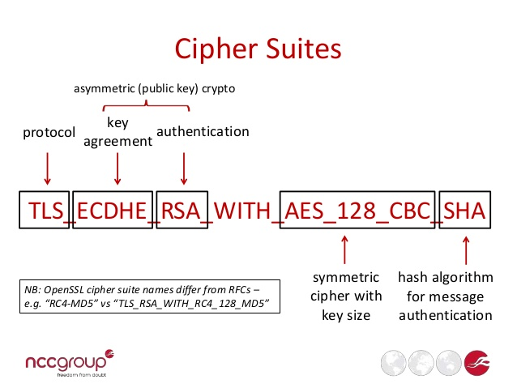
Cipher Suite

Slide 8
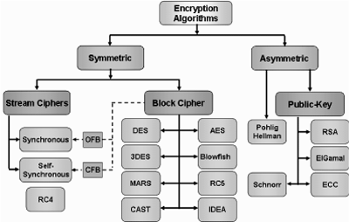
Encryption Algorithms
Notes:
DES:
by IBM, Lucifer, NSA?
Why not 2DES? Meet-in-the-middle

Slide 9
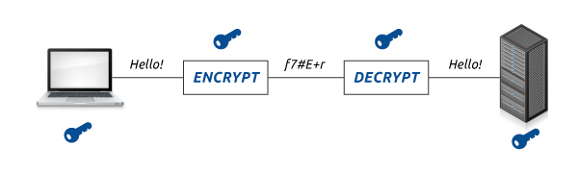
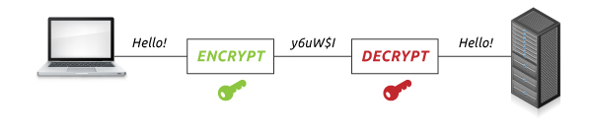
Symmetric vs Asymmetric
Notes:
Symmetric key must be shared before use.

Slide 10
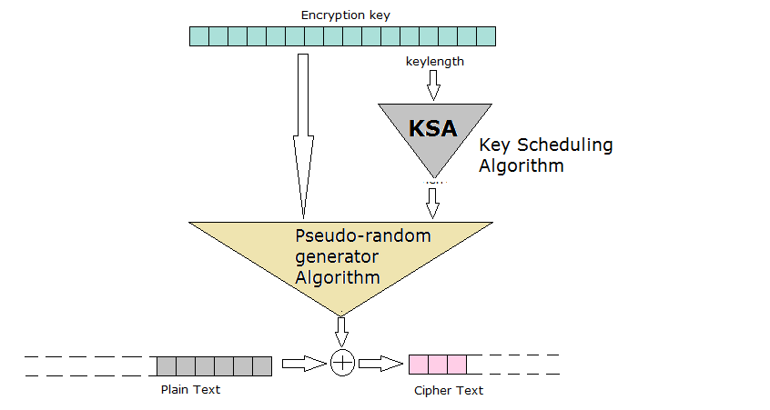
Stream Cipher
Notes:
Encrypts one bit/byte.
Perfect: One Time Pad

Slide 11
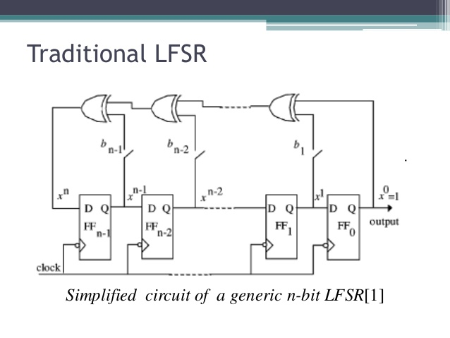
LFSR
Notes:
Linear Feedback Shift Register
Designed to be implemented in H/W (A5/1), CSS
Initial State, Key, Tap Points

Slide 12
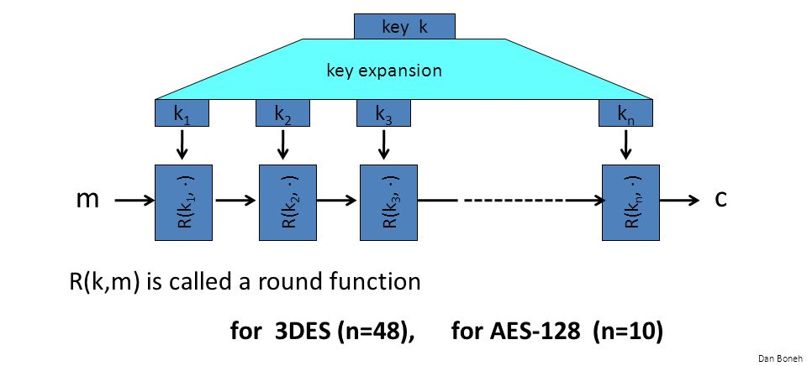
Block Cipher
Messages is split in to fixed size blocks.
Notes:
DES Block size: 64 bits, Keysize: 56b (+8b parity)
AES Block Size: 64 bits, Key size: 64, 128, 256

Slide 13


Block Encryption
Block Encryption

Slide 14

Encryption Modes
Electronic CodeBook (ECB)
Cipher Block Chaining (CBC)
Cipher FeedBack(CFB)
Output Feedback(OFB)
Counter (CTR)
Galois Counter Mode (GCM)
Notes:
GCM provides authentication also.

Slide 15
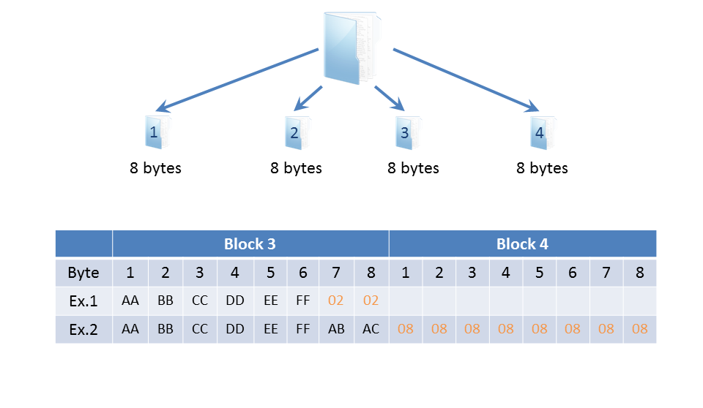
Padding
Required to align data to Block length.
Bit Padding
Byte Padding
Zero Padding
ANSIx.923
ISO-10126
PKCS#7
ISO/IEC 7816-4
Notes:
Must be identifiable after decryption
Ciphertext Stealing

Slide 16
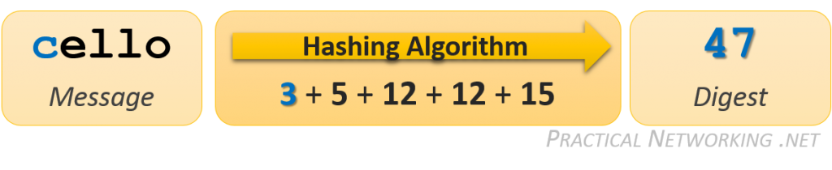
Hashing
One way function.
Arbitrary length input, fixed length output.
Examples:
CRC(16/32)
MD(4/5)
SHA(1/2/3/4)
Notes:
SHAttered
Fuzzy hashing.

Slide 17
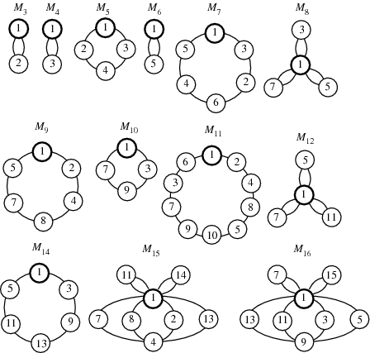
Bit of Number theory
Integers
Prime
Co-prime
Modulus
Congruence
Group
Modulus (M)
Operation
Identity
Inverse
Generator
Ring
Order (M-1) iff M is prime.
Notes:
Primality Test
Multiplicative Group

Slide 18
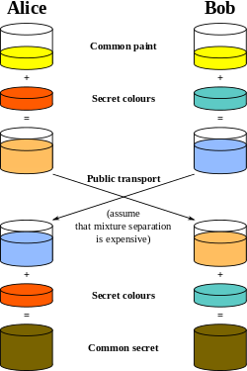
Key Exchange
Diffie-Hellman Key Exchange
Alice and Bob agree to use a modulus p = 23 and generator g = 5.
Alice chooses a secret integer a = 6, then sends Bob A = gª mod p
A = 5⁶ mod 23 = 8
Bob chooses a secret integer b = 15, then sends Alice B = g^{b} mod p
B = 5¹⁵ mod 23 = 19
Alice computes s = Bª mod p
s = 19⁶ mod 23 = 2
Bob computes s = A^{b} mod p
s = 8¹⁵ mod 23 = 2
Alice and Bob now share a secret (the number 2).

Slide 19
Asymmetric Encryption
Based on intractability principle
Multiplying two large integers is easy
Finding prime factors of large integers is an intractable problem.
Computations are performed in “Group” modulo M.
M being a very large prime.
2 keys are generated simultaneously.
Inverse of each other (modulo M).
One encrypts (Public Key)
Other decrypts (Private Key)
Notes:
Multiplicative group

Slide 20
RSA
Key Generation
Select 2 primes: p,q | p = 11, q = 3
Calculate: n = p*q | n = 33
Calculate: Φ(n) = (p-1)*(q-1) | Φ(n) = 20
Choose e : gcd(e, Φ(n)) = 1, (e,n) is public key | e = 3; K_{pub} = (3,33)
Find d : e*d = 1 mod Φ(n), (d,n) is private key | d = 7, K_{priv} = (7,33)
Encryption (P=5)
C = P^{e} mod n | 5³ % 33 = 125 % 3 = 26
Decryption
P = C^{d} mod n | 26⁷ % 33 = 8031810176 % 33 = 5 OR 26⁷ % 33 = 26 ⁽³⁺³⁺¹⁾ % 33 = (26³%33)* (26³%33)* (26%33) = 5
Notes:
RSA??
Extended Euclid,s Algorithm
e is small, usually 65537.

Slide 21
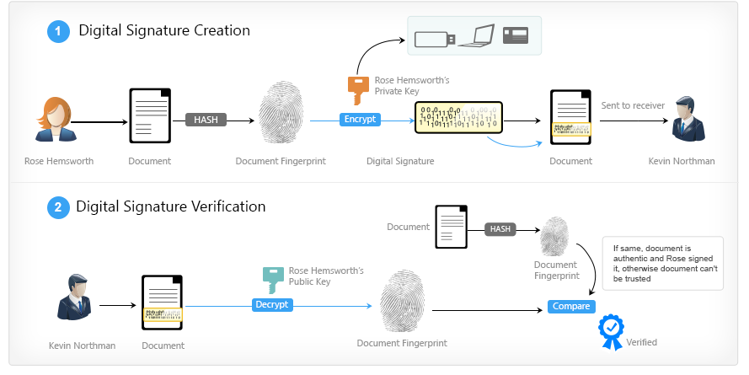
Digital Signature

Slide 22
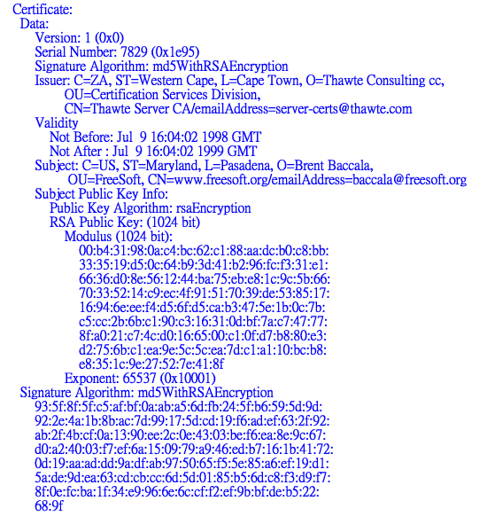
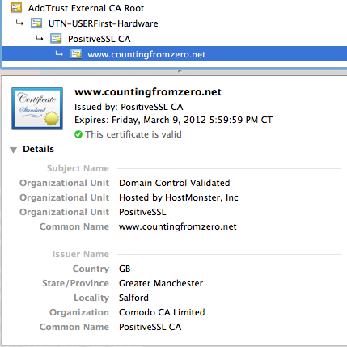
Public Key Infrastructure

Slide 23
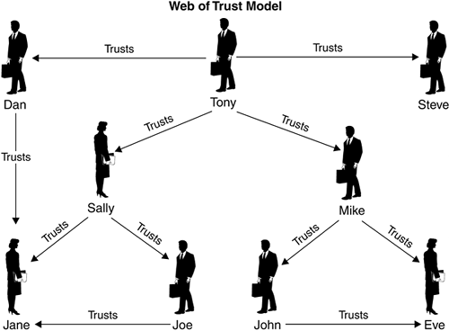
Web of Trust
Notes:
Trust = Sign their public key.

Slide 24
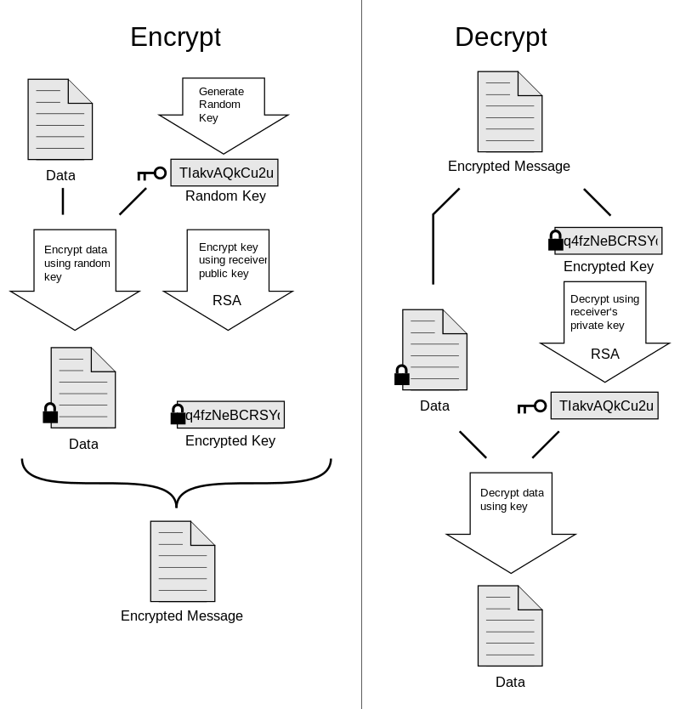
PGP

Slide 25

Thank You
Notes:
The Irony

