Slide 1
Racemi Dynacenter
Agenda
Supported region in AWS
Platforms Support
Supported instance type.
Creating Dynacenter AMI
Port number open
Dynacenter Console
Agent installation in source server
Creating template for target server

Slide 2
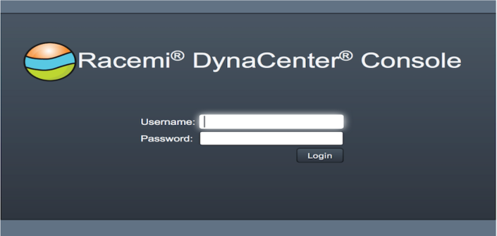
Dynacenter Console
Take note of DynaCenter instance's IP address. The IP address referring as the Console URL.
(Go to AWS console→ select Services→ Ec2→Instances→ Select the Dynacenter instance→In instance description copy the Elastic IP of Dynacenter server.)
Type the DynaCenter Username and Password

Slide 3
Supported region in AWS
US East (N.Virginia) Region
US West (N. California) Region
US West (Oregon) Region
GovCloud (US) Region
Ireland (EU) Region
Frankfurt (EU) Region
São Paulo Region
Singapore Region
Sydney Region
Tokyo Region

Slide 4
Platforms Support
On premises to AWS
AWS to AWS
Region to Region

Slide 5
Supported instance type
Instance type
C1.medium.magnetic/ssd(2cpu,1.7GB) |  | M2.4xlarge.magnetic/ssd(8cpus,68.4gb)
C1.xlarge.magnetic/ssd(8cpu,7GB) |  | M2.xlarge.magnetic/ssd(2cpus,17.1gb)
C3.2xlarge.magnetic/ssd(8cpu,15GB) |  | M3.2XLlarge.magnetic/ssd(8CPUs,30GB)
C3.large.magnetic/ssd(2CPU,3.75GB) |  | M3.large.magnetic/ssd(2cpus,7.5gb)
C3.xlarge.magnetic/ssd(4CPUs,7.5GB), |  | M3.medium.magnetic/ssd(1cpu,3.75GB)
C4.2xlarge.magnetic/ssd(8CPUs,15GB) |  | M3.xlarge.magnetic/ssd(4cpus,15gb)
c4.4xlarge.magnetic/ssd(16cpus,30gb), |  | M4.2xlarge,magnetic/ssd(8cpus,32GB)
c4.8xlarge.magnetic/ssd(36cpus,60gb), |  | M4.4xlarge.magnetic/ssd(16cpus,64gb)
C4.large.magnetic/ssd(2CPUs,3.75GB) |  | M4.large.magnetic/ssd(2cpus,8gb)
C4.xlarge.magnetic/ssd(4cpus,7.5GB) |  | M4.xlarge.magnetic/ssd(4cpus,16gb)
M1.large.magnetic/ssd(2cpu,7.5GB) |  | R3.2xlarge.magnetic/ssd(8cpus,61gb)
M1.medium.magnetic/ssd(1cpus,3.7GB) |  | R3.large.magnetic/ssd(2cpus,15gb)
M1.small.magnetic/ssd(1cpu,1.7gb) |  | R3.xlarge.magnetic/ssd(4cpus,30.5gb)
M1.xlarge.magnetic/ssd(4cpu,15gb) |  | T2.medium.magnetic/ssd(2cpus,4gb)
M2.2xlarge.magnetic/ssd(4cpu,34.3gb) |  | T2.small.magnetic/ssd(1cpus,2gb)

Slide 6
Creating Dynacenter AMI
Launching Dynacenter server using cloudformation template:
Get the required data for dynacenter. Ex: Instance type, storage size, Network configuration details, etc...
Enclosed cloudformation template to create dynacenter.
Login into the AWS console.
Go to services→Select cloudformation, Home page of cloudformation window will be displayed.

Slide 7
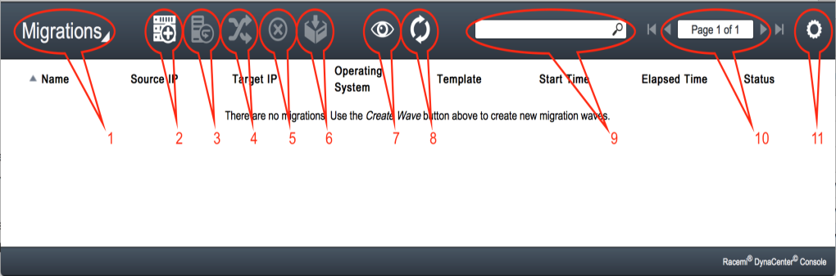
Console toolbar
After you log in, the DynaCenter Console main screen appears and there's a row of icons at the top of the console page
Console screen. Choose between "Migrations", "Servers", and "Templates".
New wave: Create a new migration wave
Retry wave: Retry the wave migration after a failure
Sync servers: Bring data changes from the source server to the target server after migration
Cancel: Stop the current operation for the selected wave
Archive wave: Move the wave to the "archive". This takes the wave out of view. You can still see the wave if you click the "View all" button

Slide 8
View all: Show all waves, including archived ones
Refresh screen: Update the list of waves displayed
Search: Show all waves and servers matching the string you type in this box
Page navigation: Navigate between pages listing waves and servers
Menu and Settings: Log out of the console, download agent or show console version

Slide 9
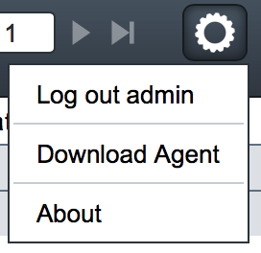
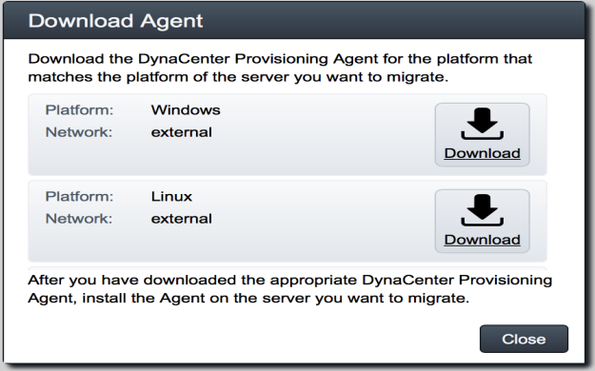
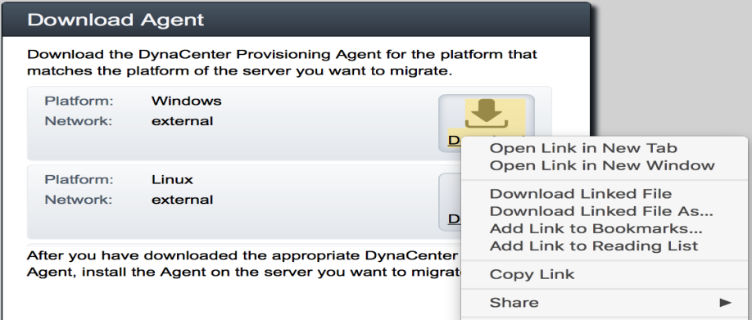
Install the DynaCenter Agent
To download the Windows and Linux agents, click on the Menu and Settings button on the upper right corner.
Select Download Agent.
On the Download Agent window, click on each button to download the agents.

Slide 10
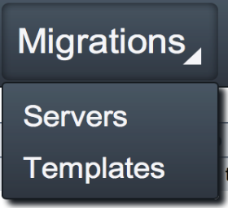
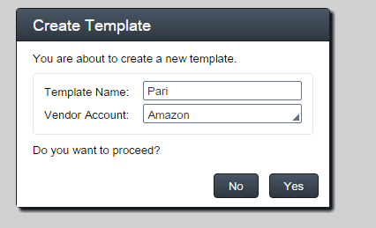
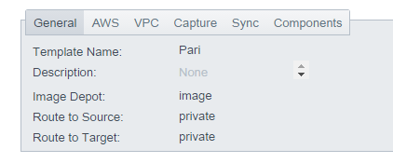
Create a migration template
Migration templates are defined in the "Template" page in the Console. To access the "Templates" page, click on the button located in the upper left corner of the Console page.
On the Templates page, select the "New template" button to create a new template

Slide 11
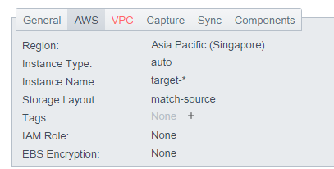
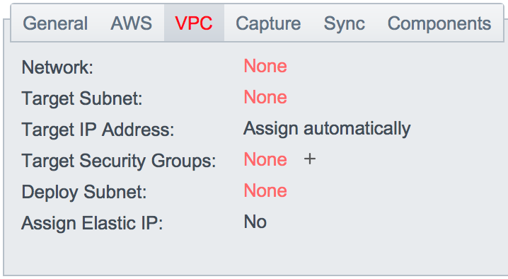
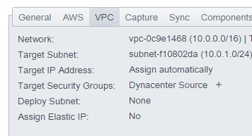
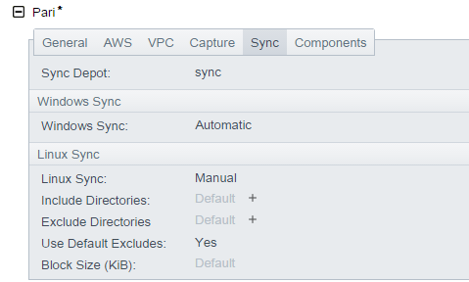

Slide 12

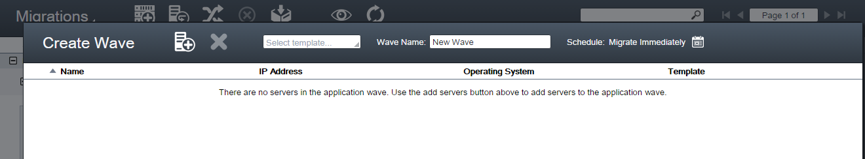

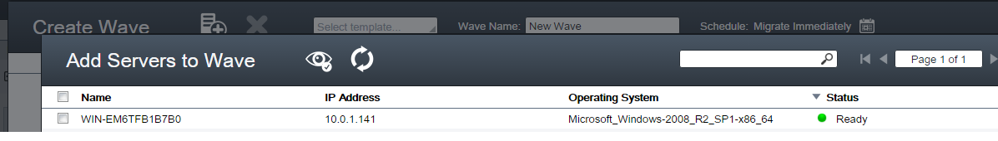
Migrate Servers
In the DynaCenter Console, click the Create Migration Wave button .
In the Create Wave view, click the Add Server to Wave button .

Slide 13
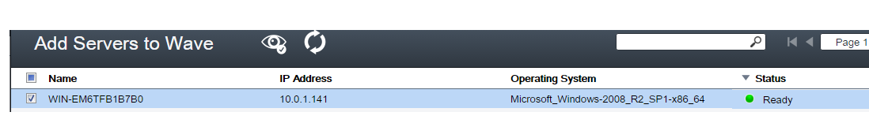


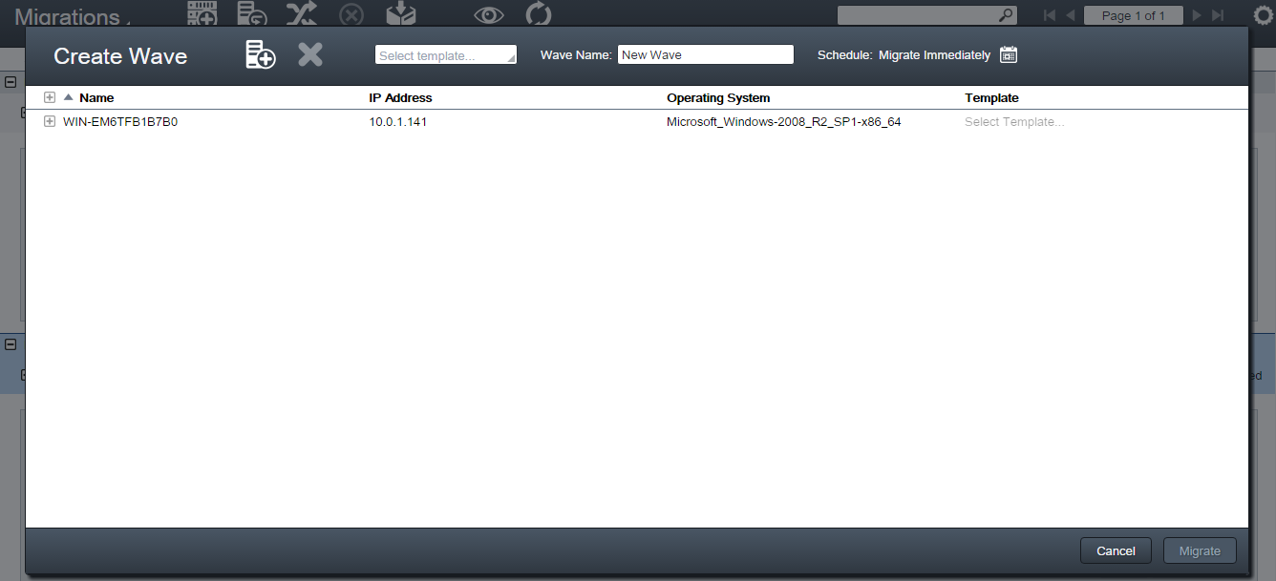
In the Add Servers to Wave view, select the servers you want to migrate as part of this wave.
Click the Refresh button to refresh the list of servers
Type a search term that applies to the server
Click the Show All Servers button to list all servers that are available for migration
Click Add Servers.

Slide 14
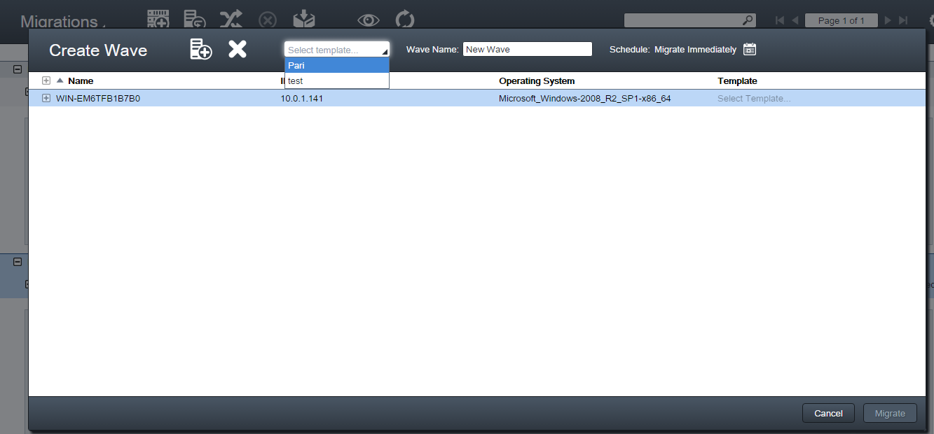
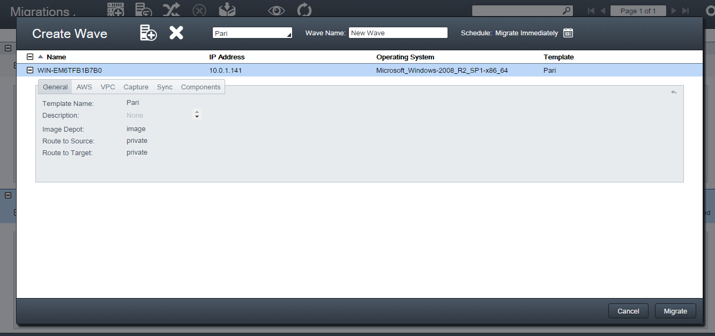
In the Create Wave view, select a server or a group of servers and apply the appropriate template to the selected servers.
Type a Wave Name for this migration wave

Slide 15
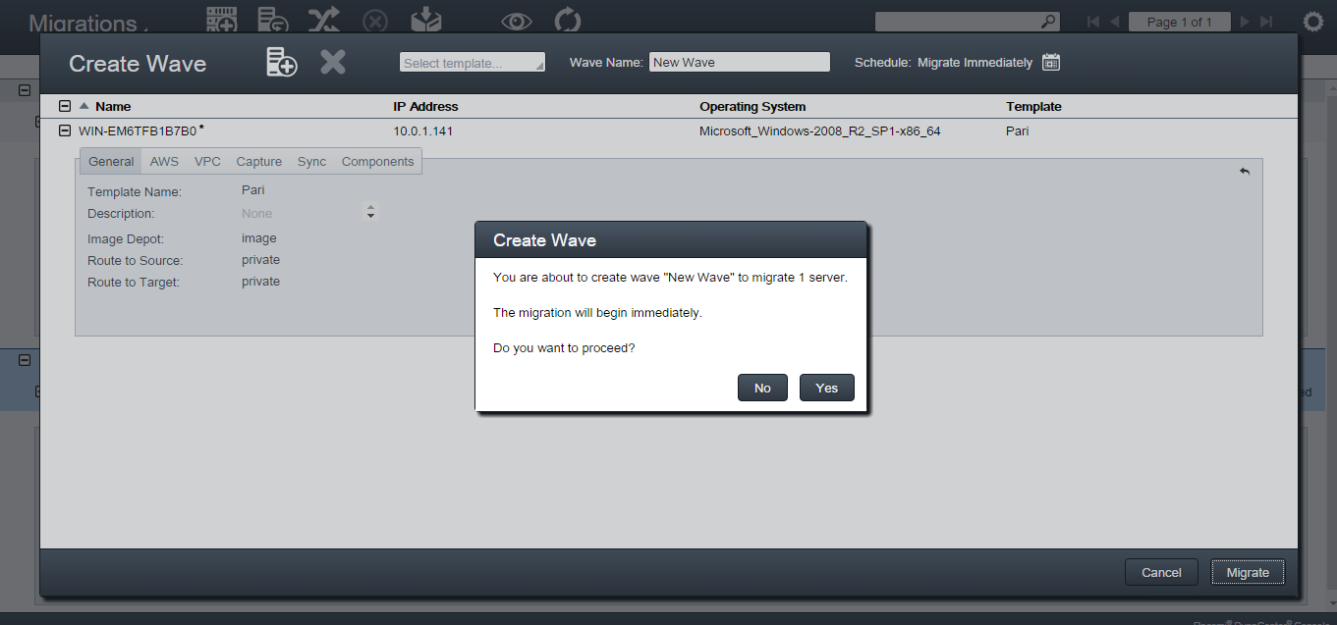
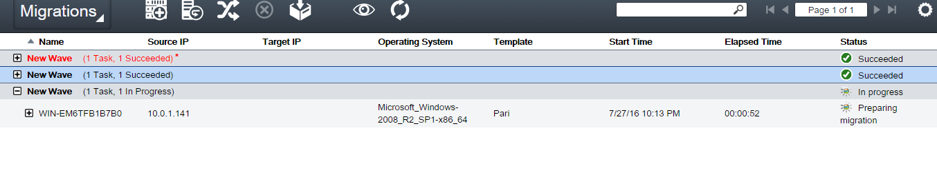
Verify the information in the Create Wave summary view
After you accept the wave configuration, the newly configured wave appears in the Migrations view.

Slide 16
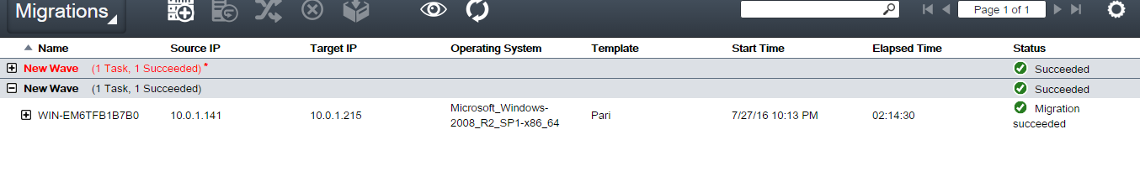
The status column will display "Migration Succeeded" when the migration completes.

Slide 17
DynaCenter Synchronization
Intermediate sync - DynaCenter quiesces services on the target server only. This option is usually selected when the goal of the sync operation is to reduce the data change set between the source and target servers in preparation for a final sync. By reducing the data change set before the final sync operation, you help to ensure that the final sync operation can be completed within a scheduled maintenance window.
Final sync - DynaCenter quiesces services on both the source and the target servers. This option is usually selected when the goal of the sync operation is to make the final cutover from the source server to the target server. By quiescing both the source and target servers before the sync operation, you help to ensure that the synchronized data on the target server is consistent with the source server before a production cutover.

Slide 18
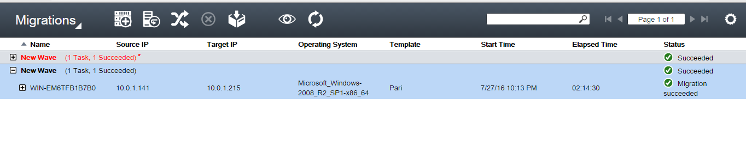

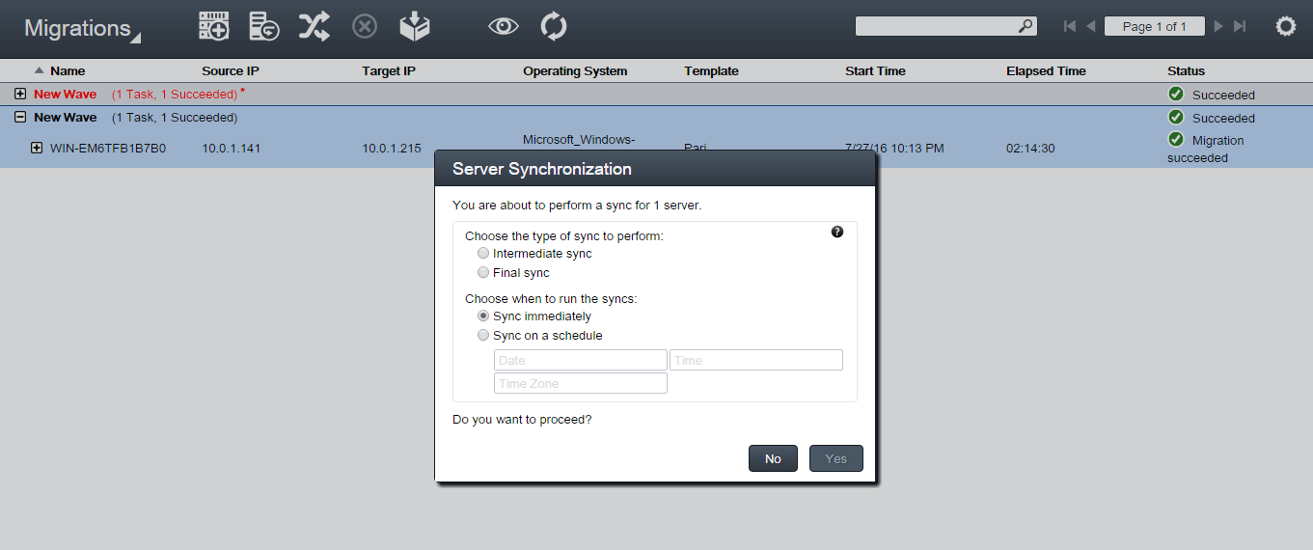
Synchronize servers
Click the Sync Servers button

