Slide 1
SDLC
Software Development Life Cycle (SDLC) is a process used by the software industry to design, develop and test high quality softwares. The SDLC aims to produce a high-quality software that meets customer expectations, reaches completion within times and cost estimates.

Slide 2
SDLC
Waterfall Model
Iterative Model
Spiral Model
V-Model
Big Bang Model
Other related models are Agile Model, RAD Model, Rapid Application Development and Prototyping Models.

Slide 3
WaterFall model
In a waterfall model, each phase must be completed before the next phase can begin and there is no overlapping in the phases.
The Waterfall model is the earliest SDLC approach that was used for software development.
The waterfall Model illustrates the software development process in a linear sequential flow. This means that any phase in the development process begins only if the previous phase is complete. In this waterfall model, the phases do not overlap.

Slide 4
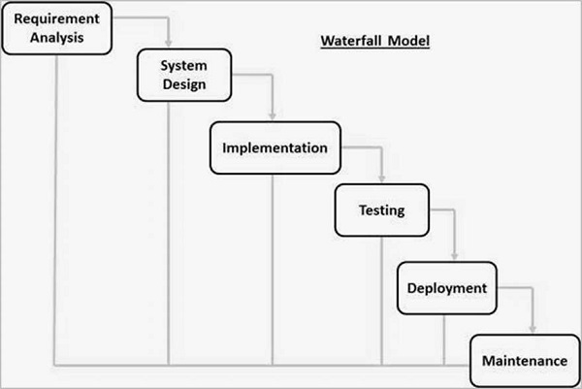
Notes:
The sequential phases in Waterfall model are −
Requirement Gathering and analysis − All possible requirements of the system to be developed are captured in this phase and documented in a requirement specification document.
System Design − The requirement specifications from first phase are studied in this phase and the system design is prepared. This system design helps in specifying hardware and system requirements and helps in defining the overall system architecture.
Implementation − With inputs from the system design, the system is first developed in small programs called units, which are integrated in the next phase. Each unit is developed and tested for its functionality, which is referred to as Unit Testing.
Integration and Testing − All the units developed in the implementation phase are integrated into a system after testing of each unit. Post integration the entire system is tested for any faults and failures.
Deployment of system − Once the functional and non-functional testing is done; the product is deployed in the customer environment or released into the market.
Maintenance − There are some issues which come up in the client environment. To fix those issues, patches are released. Also to enhance the product some better versions are released. Maintenance is done to deliver these changes in the customer environment.

Slide 5
Note:-
For Example In a waterfall model during performance testing of the application, If it is fails due to an architecture / design issue then will not have been having enough time to accommodate changes.
But in agile model this kind of problems are not coming.
Because in Agile Parallel development and testing will be happens.
Agile is nothing but small waterfall models.

Slide 6
AGILE Model is a practice that promotes continuous iteration of development and testing throughout the software development lifecycle of the project.
Both development and testing activities are concurrent unlike the Waterfall model.
→Reducing the Documentation.
→Reducing the Development time and Cost.
→Modifications are easy in the middle if
Customer not satisfied (OR) Product is not good.(OR) if new requirements are coming.

Slide 7
In Agile :
The customer has early and frequent opportunities to look at the product and make decision and changes to the project
In Waterfall model:
The customer can only see the product at the end of the project

