Slide 1
Fraudulent Insurance Claim Detection

Slide 2
Problem Statement
Problem Statement
Problem Statement
Global Insure, a leading insurance company, processes thousands of claims annually. However, a significant percentage of these claims turn out to be fraudulent, resulting in considerable financial losses. The company’s current process for identifying fraudulent claims involves manual inspections, which is time-consuming and inefficient. Fraudulent claims are often detected too late in the process, after the company has already paid out significant amounts. Global Insure wants to improve its fraud detection process using data-driven insights to classify claims as fraudulent or legitimate early in the approval process. This would minimise financial losses and optimise the overall claims handling process.

Slide 3
Problem Statement
Problem Statement
Dataset & Assumptions
1000 records, multiple categorical & numerical features
Cleaned invalid entries like '?'
Dropped irrelevant columns (policy_number, incident_location, etc.)
Assumption: fraud_reported is the target (binary classification)

Slide 4
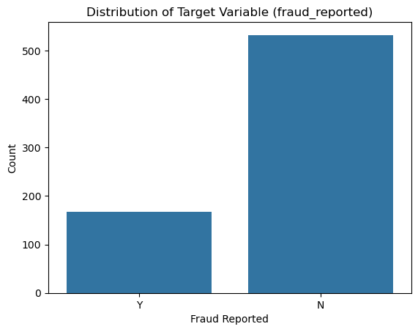
Problem Statement
Problem Statement
Exploratory Data Analysis (EDA)
Observed Class imbalance in the target variable

Slide 5
Problem Statement
Problem Statement
Methodology
Preprocessing: scaling, encoding, feature engineering
Models: Logistic Regression, Random Forest
Feature Selection:
Logistic: RFECV
Random Forest: Feature importance
Tuning: GridSearchCV (Random Forest)

Slide 6
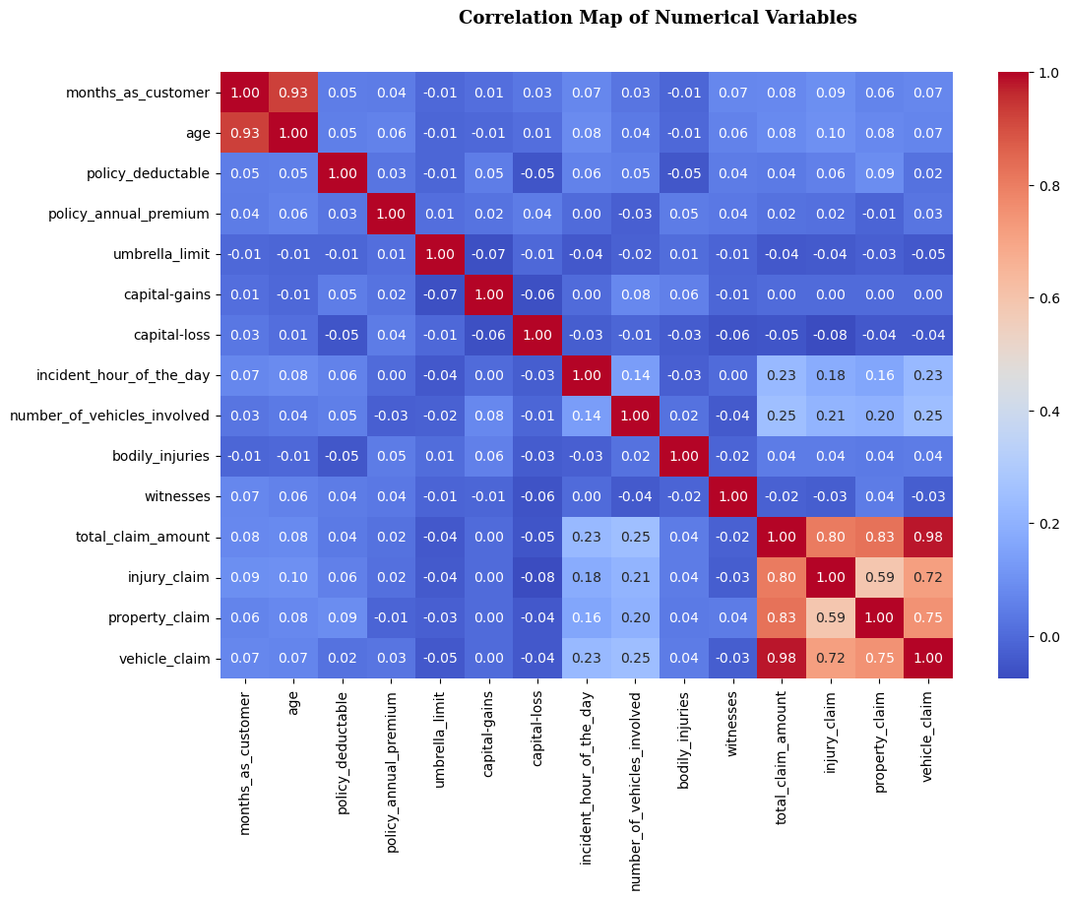

Slide 7
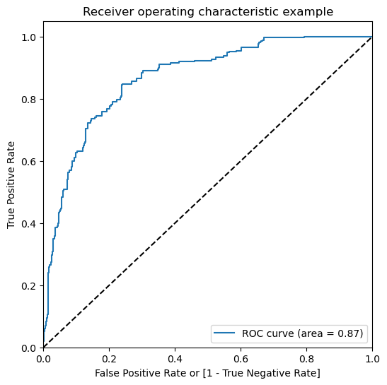
Problem Statement
Problem Statement
Model Performance
Metric | Logistic Regression | Random Forest
Train Accuracy | 78% | 93%
Test Accuracy | 73% | 77%

Slide 8
Problem Statement
Problem Statement
Key Insights
Fraud cases are associated with higher claim amounts
incident_type, insured_relationship, and authorities_contacted are important predictors
Random Forest handles non-linear relationships better than Logistic Regression

Slide 9
Problem Statement
Problem Statement
Recommendation
Use Random Forest model in production
Monitor performance over time (data drift, fraud strategy changes)
Business impact: reduce false positives and detect more genuine frauds

Slide 10
Problem Statement
Problem Statement
Business Implications
Reduced fraud losses = increased profits
Faster, automated claim approval for genuine users
Data-driven fraud detection strategy enhances credibility

Slide 11
Q&A
Q1: How can we analyse historical claim data to detect patterns that indicate fraudulent claims?
Answer:
By performing Exploratory Data Analysis (EDA) on historical claims, we identified suspicious trends
Visual tools like boxplots, likelihood analysis, and correlation heatmaps help in spotting anomalies.
Using machine learning, we trained models on past data to learn patterns associated with fraud.

Slide 12
Q&A
Q2: Which features are most predictive of fraudulent behaviour?
Answer:
Random Forest:
incident_severity_Minor Damage
property_claim, vehicle_claim, injury_claim
months_as_customer, umbrella_limit
incident_day, capital-gains, capital-loss
incident_week_of_year, witnesses
Logistic Regression:
incident_month, incident_week_of_year
vehicle_claim, injury_claim
incident_severity_Trivial Damage, property_damage_Unknown/YES
incident_severity_Minor Damage, Total Loss
insured_education_level_High School, umbrella_limit

Slide 13
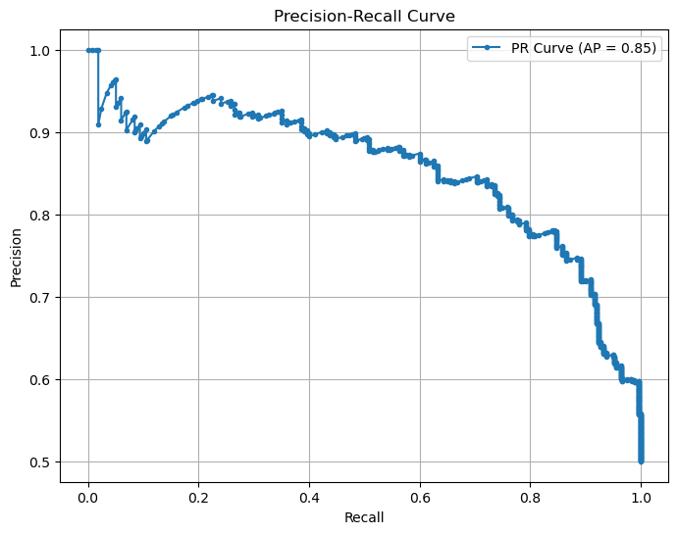
Q&A
Q3: Can we predict the likelihood of fraud for an incoming claim, based on past data?
Answer:
Yes, Our trained models can predict the probability of fraud for a new claim
The Random Forest model, tuned using GridSearchCV, achieved:
Train Accuracy: 93%
Test Accuracy: 77%
Logistic Regression also showed decent predictive performance.

Slide 14
Q&A
Q4: What insights can be drawn from the model that can help in improving the fraud detection process?
Answer:
Certain patterns like high claim amount + single-vehicle accident + police involvement → higher fraud likelihood
Models can be integrated into the claim processing pipeline to flag suspicious claims in real time
Helps prioritize manual review for only high-risk claims → improves operational efficiency

