Slide 1
Domain: Deep Learning
Technology: Python
SMART VOTING SYSTEM USING DL & COMPUTER VISION

Slide 2
INDEX
Abstract
Introduction
Literature review
Existing Method
Drawbacks
Proposed method
Advantages
Implementation
Algorithms
Hardware and Software Requirements
Architecture
UML diagrams
Results
Conclusion
References

Slide 3
ABSTRACT
An online voting system for Indian election is proposed for the first time in this application. The proposed model has a greater security in the sense that voter high security password is confirmed before the vote is accepted in the main database of Election Commission of India.
The additional feature of the model is that the voter can confirm if his/her vote has gone to correct candidate party.
In this model a person can also vote from outside of his/her allotted constituency or from his/her preferred location.
In the proposed system the tallying of the votes will be done automatically, thus saving a huge time and enabling Election Commissioner of India to announce the result within a very short period.

Slide 4
INTRODUCTION
Online voting system is a way that helps public to select their representatives and express their preferences for how they will be governed.
The belief of the election process is utmost important.
Election process is secure if anything goes wrong in Elections the system will increase the security levels.
But there is a chance for Maoist attacks and rigging problems in some areas, there is a chance to lost their vote and life.
So public needs a more secure way of casting their vote.

Slide 5
LITERATURE REVIEW
S. NO | Journal Type with year | Authors | Title | Outcomes
1 | ICIIECS 2017 | Z. A. Usmani, K. Patanwala, M. Panigrahi and A. Nair | Multi-purpose platform independent online voting system | Fundamentals of an online voting system
2 | IRJET 2016 | Ajay Nair and Gulabchand K. Gupta | MULTI PURPOSE ONLINE VOTING SYSTEM USING SMARTPHONE | Implementation of a voting system

Slide 6
LITERATURE REVIEW
S. NO | Journal Type with year | Authors | Title | Outcomes
3 | IST-Africa 2020 | M. M. THIGA | Increasing Participation and Security in Student Elections through Online Voting: The Case of Kabarak University. | Working and inner implementations for an online voting system
4 | ENC 2005 | C. Garcia-Zamora, F. Rodriguez-Henriquez and D. Ortiz-Arroyo | SELES: an e-voting system for medium scale online election. | E-Voting system applications.

Slide 7
EXISTING SYSTEM
In existing systems, voters go to the voting centers and they use their votes manually.
It is time consuming and there is chance of gambling the votes.
These system relies on huge number of skilled people to work at polling booths and hence is difficult to scale up.

Slide 8
DISADVANTAGES
Chance of frauds.
Time consuming.
Difficult to handle
Expensive
Difficult to scale.

Slide 9
PROPOSED SYSTEM
In the proposed system, we have tried to build a secure online voting system that is free from unauthorized access while casting votes by the voters.
The server aspects of the proposed system have such distribution of authority that server does not enable to manipulate the votes.
It is expected that the proposed online voting system will increase the transparency and reliability of the existing electoral system.
It includes OTP verification for the user as well.
The facial recognition system is built using Haarcascading techniques.

Slide 10
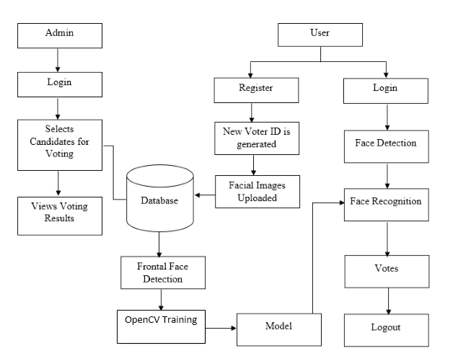
BLOCK DIAGRAM

Slide 11
ADVANTAGES
Time consumption is reduced.
Fraud/gambling’s can be reduced.
Privacy and secure.
Highly convenient.
Easy to scale up.

Slide 12
IMPLEMENTATION
Admin:
Login
Select Candidates
Model Training
View Results
User:
User Register
User Login
Voting
Logouts

Slide 13
HARDWARE AND SOFTWARE REQUIREMENTS
HARDWARE REQUIREMENTS
• Processor - I3/Intel Processor
• RAM - 4GB (min)
• Hard Disk - 128 GB
• Key Board - Standard Windows Keyboard
• Mouse - Two or Three Button Mouse

Slide 14
SOFTWARE REQUIREMENS
• Operating System : Windows 7+
• GUI : Falsk
• IDE : PyCharm
• Libraries Used : Pandas, os, Pillow, pymysql, numpy.

Slide 15
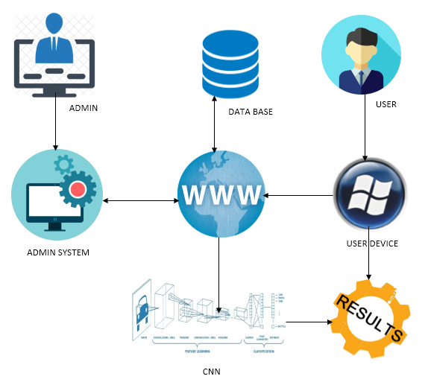
ARCHITECTURE

Slide 16
USE CASE DIAGRAM
A use case diagram in the Unified Modeling Language (UML) is a type of behavioral diagram defined by and created from a Use-case analysis.
Its purpose is to present a graphical overview of the functionality provided by a system in terms of actors, their goals (represented as use cases), and any dependencies between those use cases.
The main purpose of a use case diagram is to show what system functions are performed for which actor. Roles of the actors in the system can be depicted.

Slide 18
CLASS DIAGRAM
In software engineering, a class diagram in the Unified Modeling Language (UML) is a type of static structure diagram that describes the structure of a system by showing the system's classes, their attributes, operations (or methods), and the relationships among the classes. It explains which class contains information.

Slide 19
SEQUENCE DIAGRAM
A sequence diagram in Unified Modeling Language (UML) is a kind of interaction diagram that shows how processes operate with one another and in what order.
It is a construct of a Message Sequence Chart.
Sequence diagrams are sometimes called event diagrams, event scenarios, and timing diagrams.

Slide 21
COLLABORATION DIAGRAM
In collaboration diagram the method call sequence is indicated by some numbering technique as shown below.
The number indicates how the methods are called one after another.
We have taken the same order management system to describe the collaboration diagram.
The method calls are similar to that of a sequence diagram.
But the difference is that the sequence diagram does not describe the object organization where as the collaboration diagram shows the object organization.

Slide 23
DEPLOYMENT DIAGRAM
Deployment diagram represents the deployment view of a system. It is related to the component diagram. Because the components are deployed using the deployment diagrams. A deployment diagram consists of nodes. Nodes are nothing but physical hardware used to deploy the application.

Slide 24
ACTIVITY DIAGRAM
Activity diagrams are graphical representations of workflows of stepwise activities and actions with support for choice, iteration and concurrency.
In the Unified Modeling Language, activity diagrams can be used to describe the business and operational step-by-step workflows of components in a system.
An activity diagram shows the overall flow of control.

Slide 26
COMPONENT DIAGRAM
A component diagram, also known as a UML component diagram, describes the organization and wiring of the physical components in a system.
Component diagrams are often drawn to help model implementation details and double-check that every aspect of the system's required functions is covered by planned development.

Slide 27
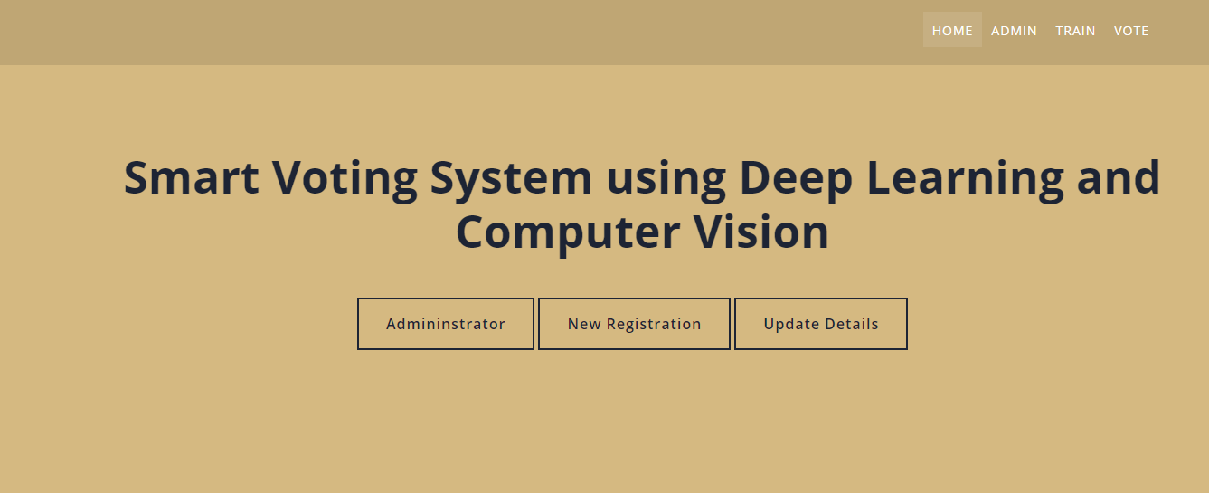
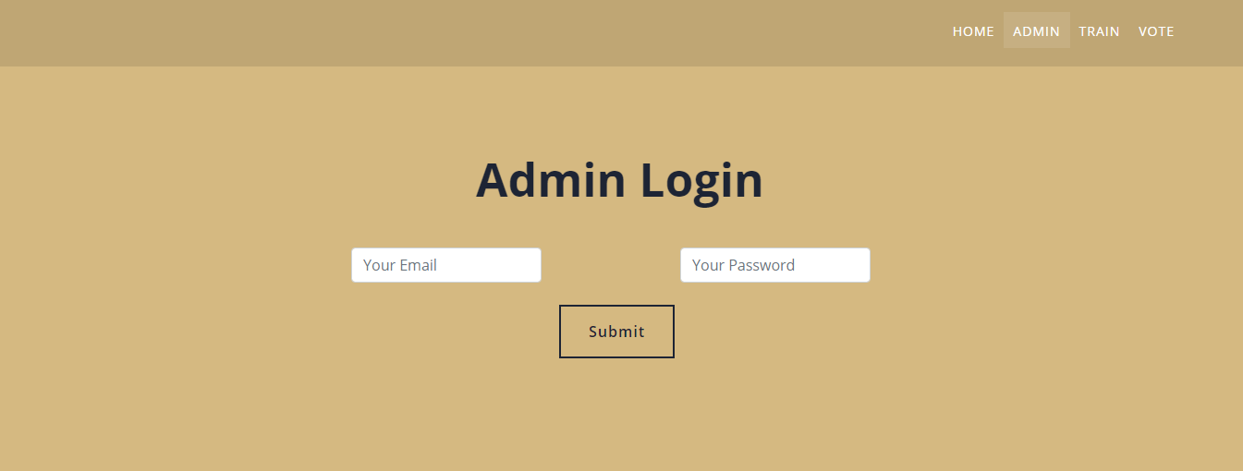
RESULTS

Slide 28

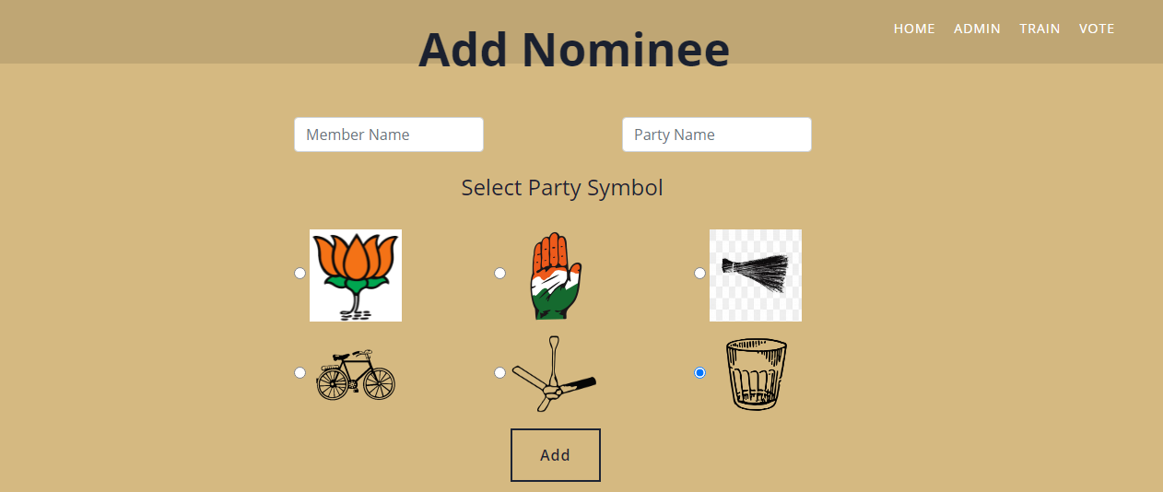

Slide 29
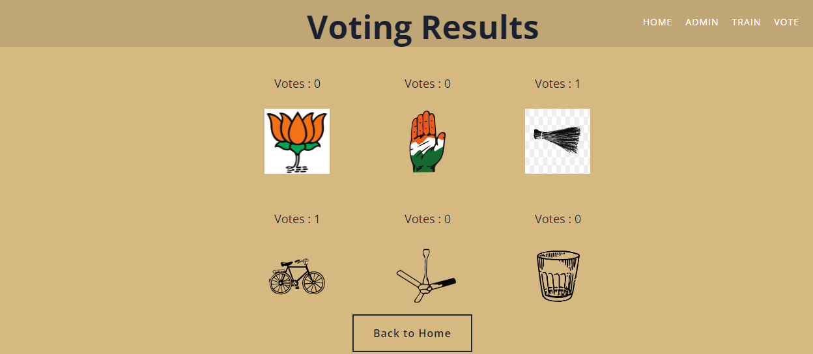
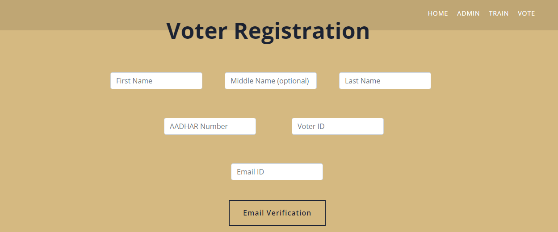

Slide 30
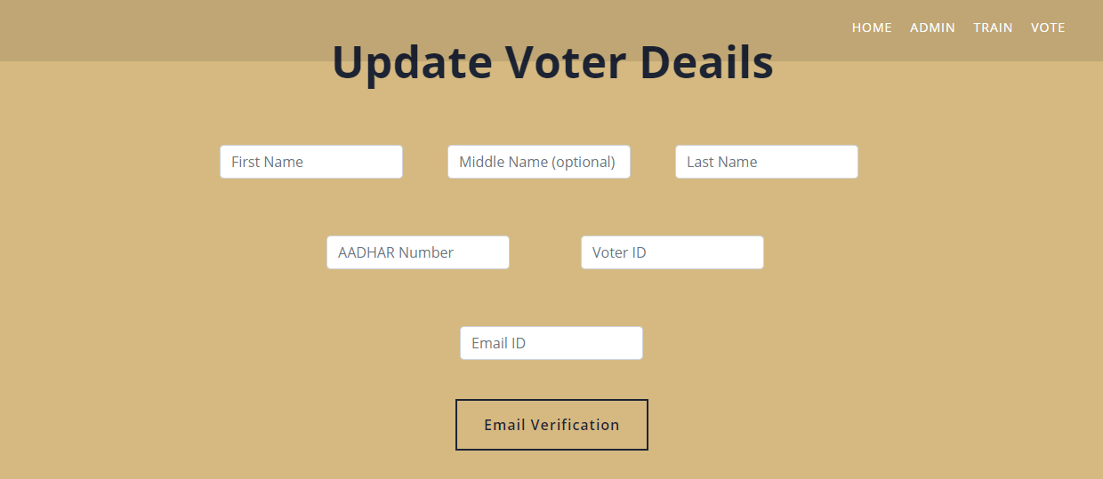
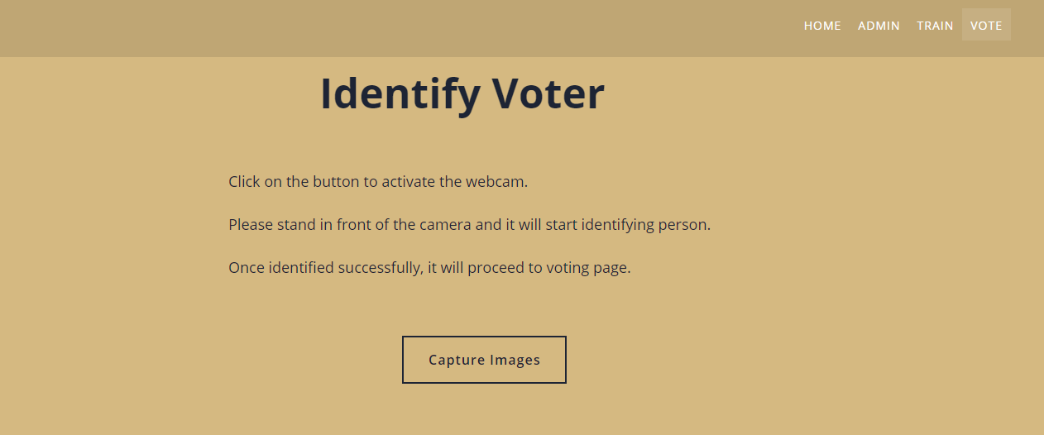

Slide 31
CONCLUSION
We have successfully developed an online voting system. The system has a new registration feature which takes in frontal facial images of the person registering.
Once someone is registered, the models has to be trained again by the admin in order to detect and recognize the new person.
A registered user is identified by their face and then allowed to vote unless they have already voted as no one can vote more than once.
Frontal Face Haarcascading is used for facial embedding generation.
Computer Vision is employed for image preprocessing and video streaming. PySimpleGUI is used for the User Interface via Python.

Slide 32
REFERENCES
[1] Kohno, T., Stubblefield, A., Rubin, A. D., & Wallach, D. S. (n.d.). Analysis of an electronic voting system. IEEE Symposium on Security and Privacy, 2004. Proceedings. 2004. doi:10.1109/secpri.2004.1301313
[2] D. Chaum, "Secret-ballot receipts: True voter-verifiable elections," in IEEE Security & Privacy, vol. 2, no. 1, pp. 38-47, Jan.-Feb. 2004, doi: 10.1109/MSECP.2004.1264852.
[3] Evans, D., & Paul, N. (2004). Election security: perception and reality. IEEE Security & Privacy Magazine, 2(1), 24–31. doi:10.1109/msecp.2004.1264850

Slide 33
[4] Jefferson, D., Rubin, A. D., Simons, B., & Wagner, D. (2004). Analyzing internet voting security. Communications of the ACM, 47(10), 59. doi:10.1145/1022594.1022624
[5] Evans, D., & Paul, N. (2004). Election security: perception and reality. IEEE Security & Privacy Magazine, 2(1), 24–31. doi:10.1109/msecp.2004.1264850

Slide 34
Thank You

